Slide 1
My revelations & „found-out”s of the week
…in Programming language C

Slide 2
Switch statement can evaluate boolean expression too!
switch (num1 > num2) {
case 0:
printf("Num1 is less than num2.\n");
break;
case 1:
printf("Num1 is greater than num2.\n");
break;
}

Slide 3
Char variable works just like as an integer
A [char] variable can be represented by…
its ASCII character with %c
an integer number with %d (ASCII char code)
char c = 'v';
printf("Char: %c %d", c, c);

Slide 4
How to make an integer number from float?
By defining a temp integer value:
float a; (3.14)
int a_int = a; (3)
By applying a prefix (not need extra var.):
float a;
… (int)a …

Slide 5
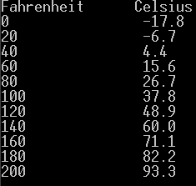
Can use tab character for pretty-printing (make columns)

Slide 6
Beware of pow() results
Power of 10s can be inaccurate:
At Armstrong number task I :
I got pow(10, 2) = 99!
I learned: do not load results from pow to integer. Use ceil() instead!

Slide 7
Finding prime numbers
I would like to find out if „x” is a prime number or not.
If not x = a x b, where (for ex.) a > b.
Square root of x is c, so -> x = c x c.
Obvious: a > c > b
Meaning: a divider must be found till the value of sqrt!

