Slide 1
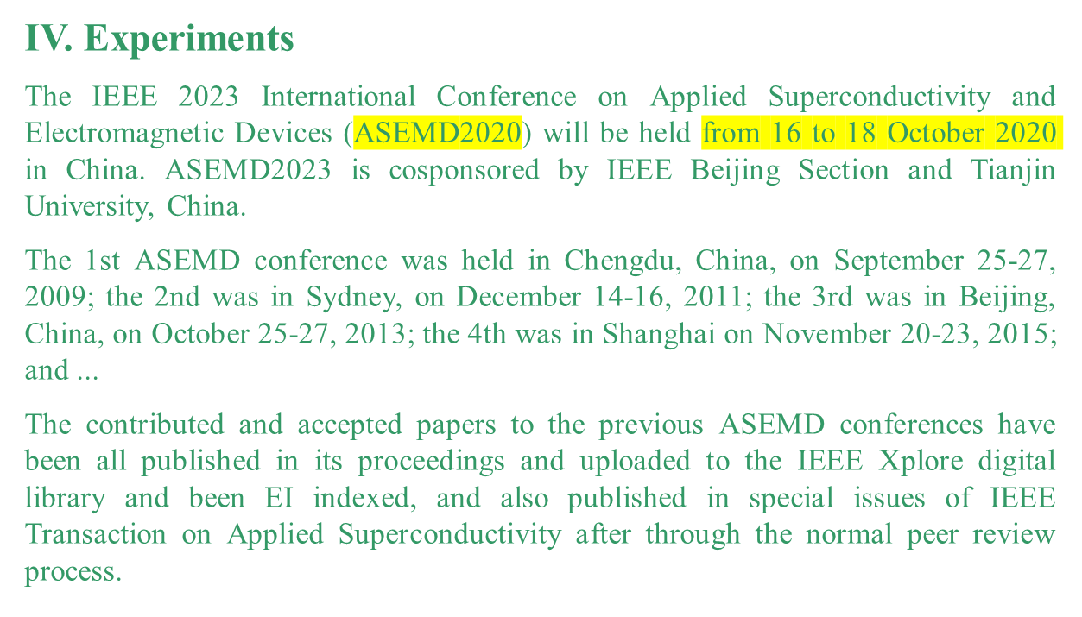
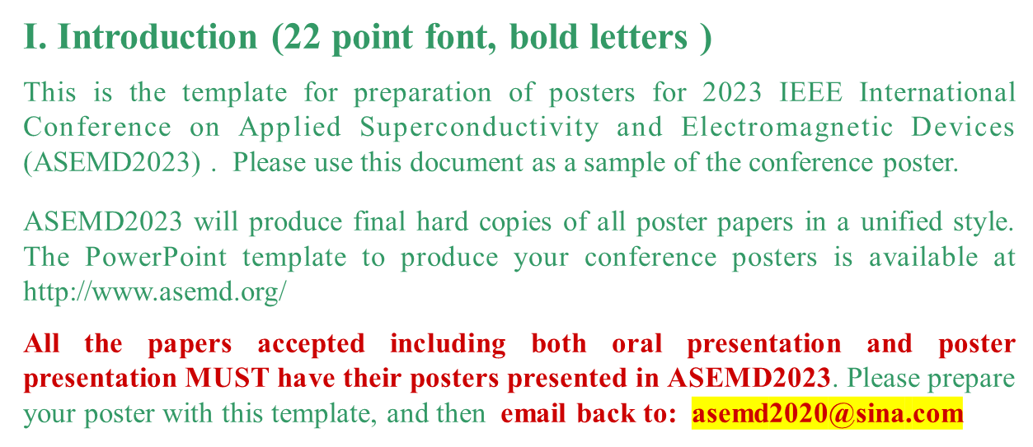
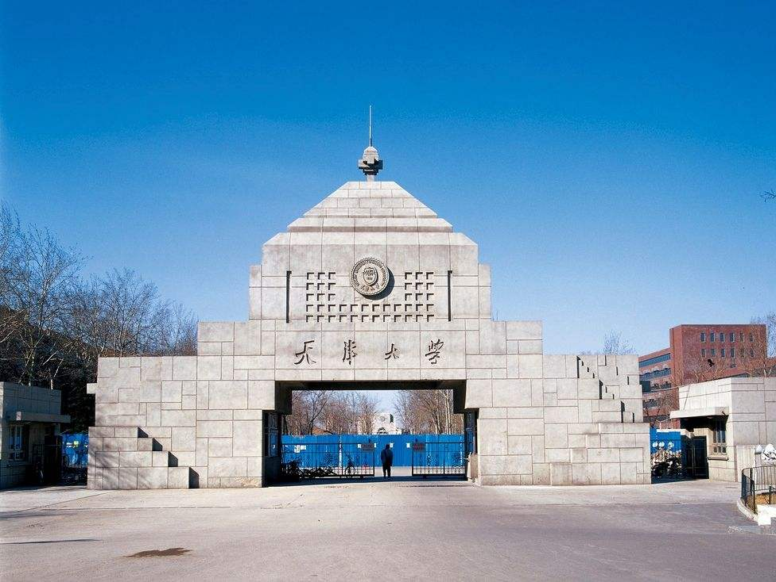
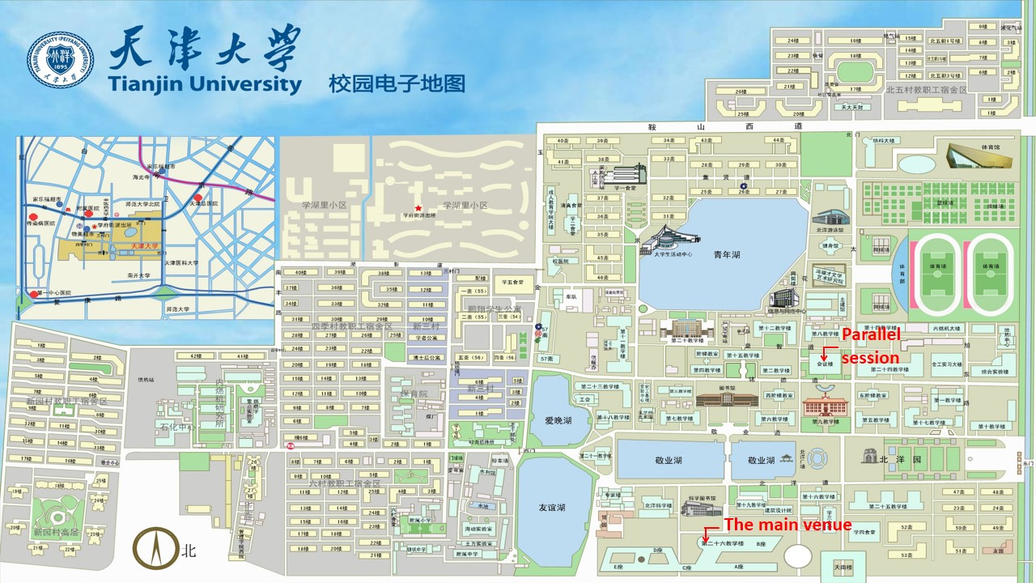
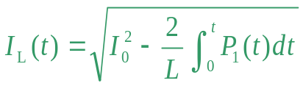
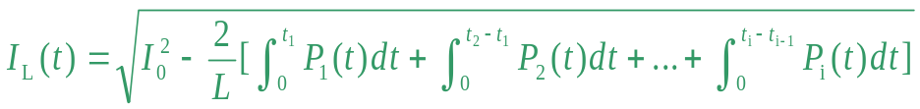
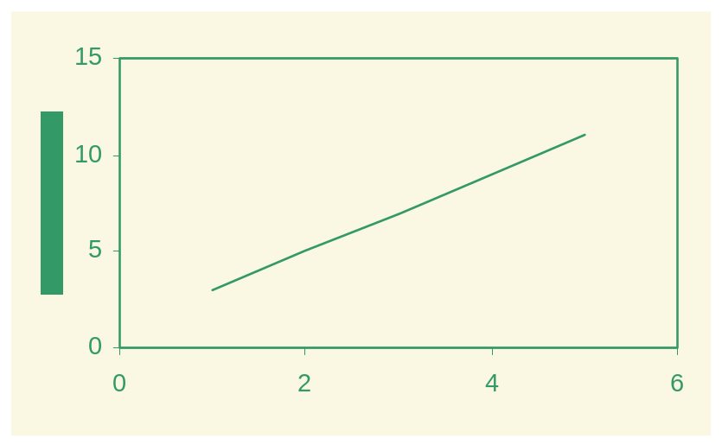
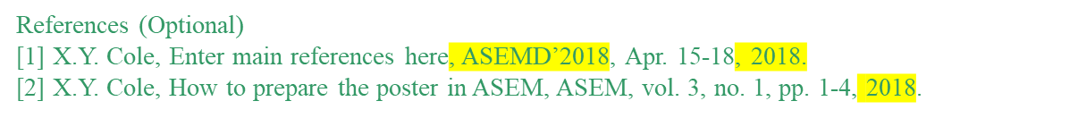

The Title of the Paper in IEEE International Conference on Applied Superconductivity and Electromagnetic Devices (30 point font, bold letters)
ID: 2XXX
Names of the Authors (24 point font, bold letters, one line only)
Authors’ Affiliation(s) (20 point font, one line only)
Abstract (22 point font, bold letters)
All papers submitted to the ASEMD2023 are also required to be displayed as posters even the papers have been assigned as oral presentation. Please use this document as a template to form the poster in which you can type your own text. (17
point font, single-spaced) and paste figures.
Keywords (22 point font, bold letters)
IEEE; ASEMD’18; Magnet. (one line if possible)
II. Principle (22 point font, bold letters )
Describe the basic principle of your research works here.
The scope of the conference includes principally the following topics:
1. Strong Current and Large Scale
2. Applied Superconductivity
3. Superconducting Electronics
4. Superconducting Materials
5. Electromagnetic Materials
6. Electromagnetic Devices
7. Electric Power Devices
8. Electrical Machines
9. Energy Efficiency Devices
10. Power Electronic Devices and Circuits
11. Mechatronics
12. Control and Measurement
13. Computing and Informatics
Fig. 3. Tianjin University, China.
III. Theoretical Modelling
This is the template for preparation of posters for ASEMD2023. Please use this
document as a sample of the conference poster.
V. Results and Analyses
There are many hotels surrounding the Tianjin University
Tianjin University, No.92 Weijin Road, Nankai District, Tianjin, 300072, China
ASEMD2023 will not make contract-hotels for participants. However if you need ASEMD2023 help to book hotel, please inform us through Email
A. Template of Font (20 point font)
All the items in your poster should be presented as an uniform layout. Do NOT
change the font sizes and font colors in the template.
Move the mouse to the beginning of the last column of each paragraph, press the key of “Enter” to interrupt the last column, and then make it LEFT align.
Other columns in each paragraph are recommended to be JUSTIFY align.
B. Template of Figures and Tables
More Figures and Tables are preferred for your poster to present your
outstanding works in ASEMD2023.
Try to make your Figures are transparent to suit the light-yellow
background of the poster. In addition, all the items in the Figures and Tables such as lines, words, symbols are recommended to be identical to the colour of the
TEXT in the template (dark green)
(1)
(2)
Fig. 4. Title of the Figure. (16 point font)
VI. Conclusion
1. Technical Tours
2. Post Conference Tours
(Detailed information will be updated later)
Fig. 1. Title of the Figure. (16 point font)
Fig. 2. Title of the Figure. (16 point font)
Table I. Heading of the Table. (16 point font)
Model | Feature extraction | Reprocessing | Classification
KNN | >200,000 flops | ~10 flops | ~200 flops
NN |  |  | ~10,000 flops
• Enter your acknowledgements or sponsors here. (Optional) (14 point font)
Author email: XXX@XX.XX
2023 IEEE International Conference on Applied Superconductivity and Electromagnetic Devices, Tianjin, China, 27-29 October 2023

