Slide 1
Numerical Simulations on Lattice
Liuming Liu, Yi-Bo Yang
Jan.11-13, 2019
SJTU, Shanghai

Slide 2
Outline
Path intergral revisit
Monte Carlo simulation
Impotance sampling
Markov chains
Metropolis algorithm
An example: 1D harmonic oscillator
Generating configurations using Metropolis algorithm
Perform measurements
Data analysis

Slide 3
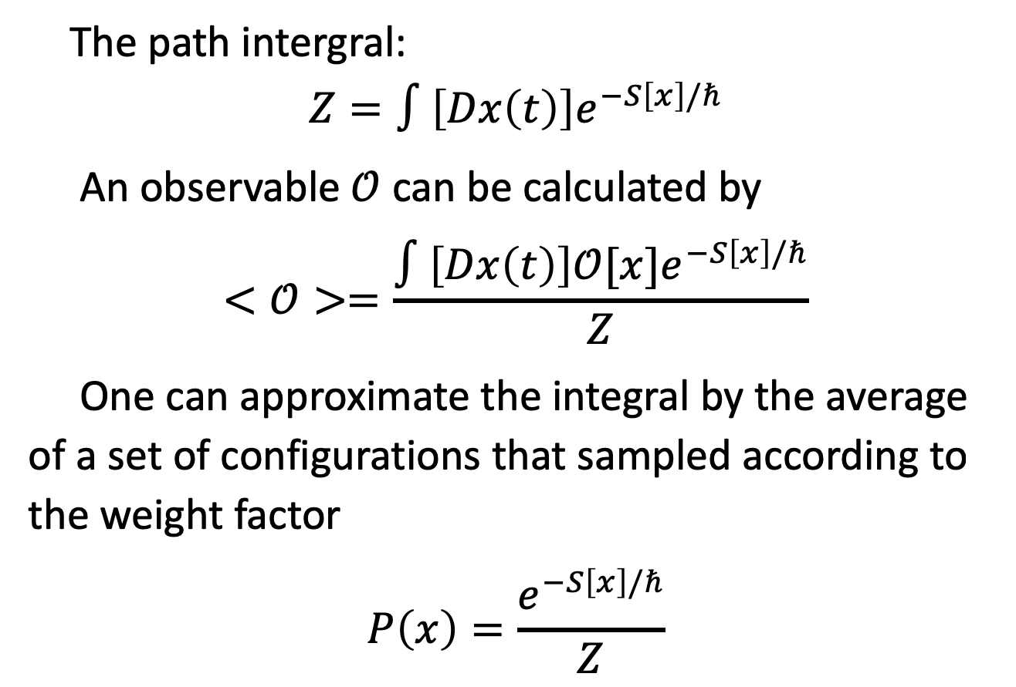
Path integral revisit
The path intergral:
$$Z=∫\left[Dx\left(t\right)\right]e^{−S\left[x\right]/ℏ}$$
An observable $𝒪$ can be calculated by
$$<𝒪>=\frac{∫\left[Dx\left(t\right)\right]{𝒪[x]e}^{−S\left[x\right]/ℏ}}{Z}$$
One can approximate the integral by the average of a set of configurations that sampled according to the weight factor
$$P\left(x\right)=\frac{e^{−S\left[x\right]/ℏ}}{Z}$$

Slide 4
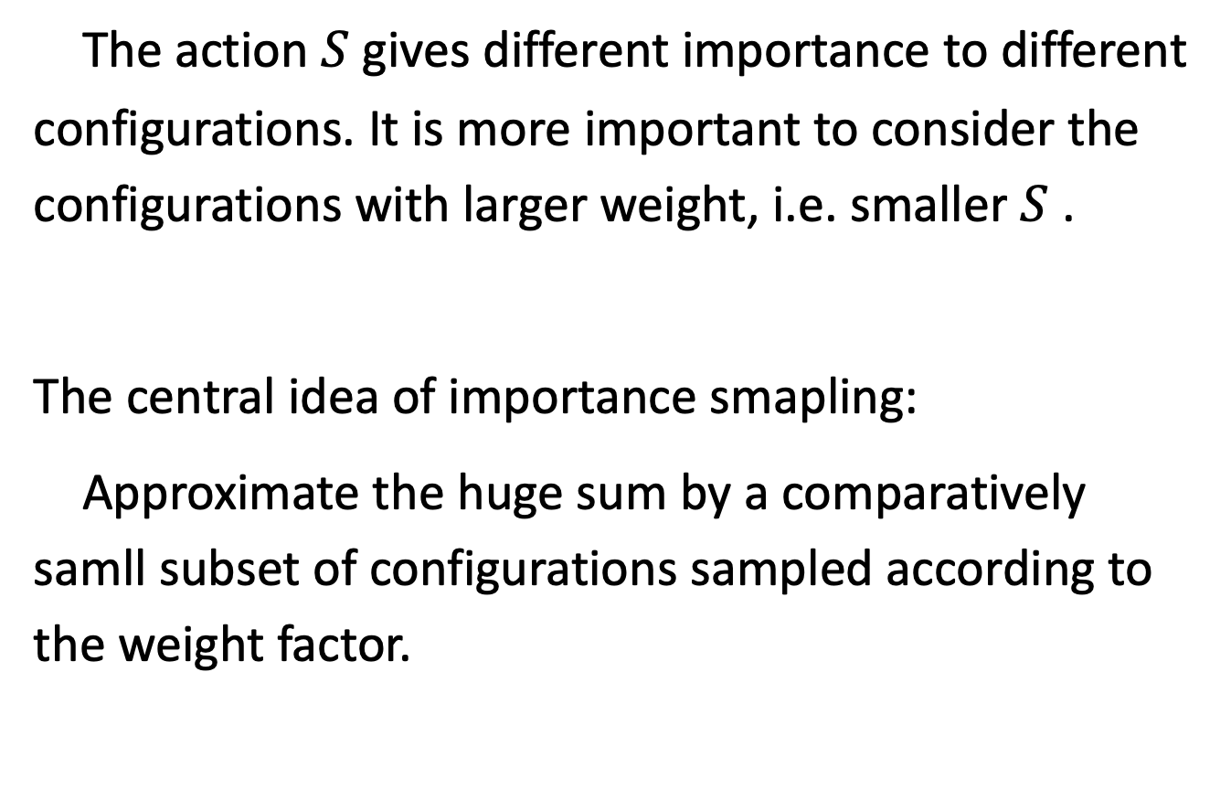
Impotance sampling
The action $S$ gives different importance to different configurations. It is more important to consider the configurations with larger weight, i.e. smaller $S$ .
The central idea of importance smapling:
Approximate the huge sum by a comparatively samll subset of configurations sampled according to the weight factor.

Slide 5
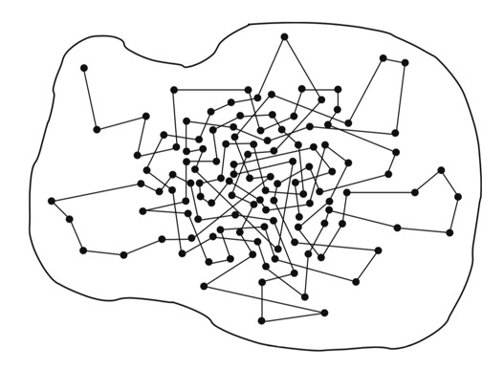

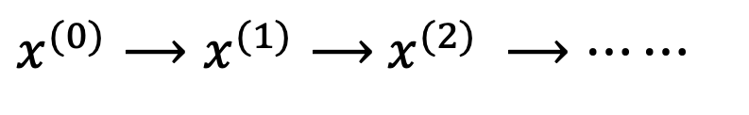
Markov chains
How do we find the configurations following the desired distribution $P\left(x\right)$ ?
Markov chains
$x^{(0)}⟶x^{(1)}⟶$ $x^{(2)} ⟶⋯⋯$

Slide 6
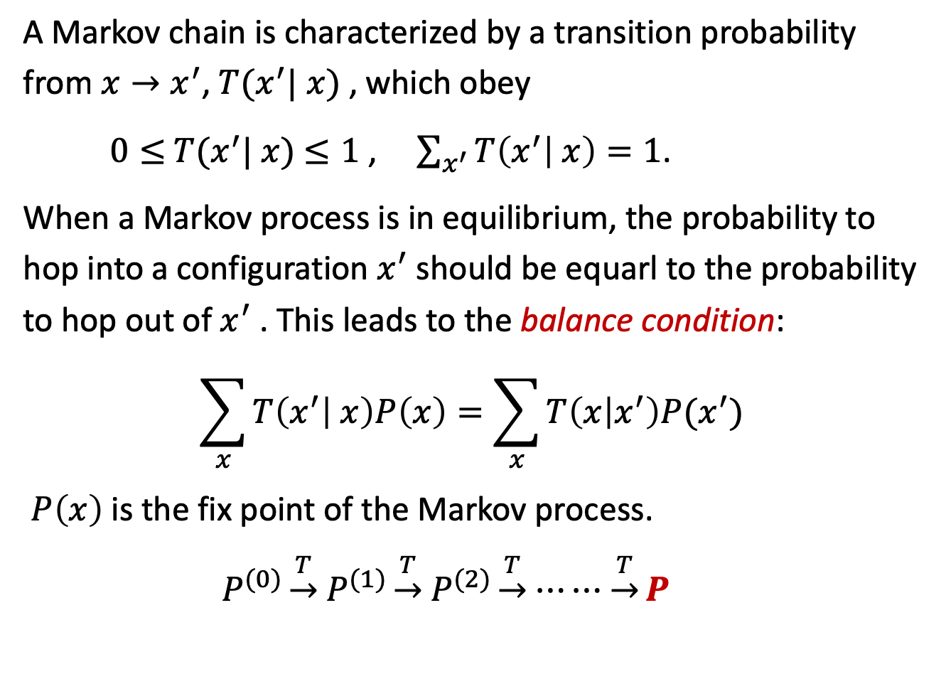
Markov chains
A Markov chain is characterized by a transition probability from $x→x^{′}$, $T(x^{′}|$ $x)$ , which obey
$0≤$ $T(x^{′}|$ $x)$ $≤1$ , $\sum_{x^{′}}{T\left(x^{′} | x\right)=1}$.
When a Markov process is in equilibrium, the probability to hop into a configuration $x^{′}$ should be equarl to the probability to hop out of $x^{′}$ . This leads to the balance condition:
$$\sum_{x}{T\left(x^{′} | x\right)P\left(x\right)=\sum_{x}{T\left(x | x^{′}\right)P(x^{′})}}$$
$P\left(x\right)$ is the fix point of the Markov process.
$P^{(0)}\underset{→}{T}$ $P^{(1)}\underset{→}{T}$ $P^{(2)}\underset{→}{T}$ $⋯⋯$ $\underset{→}{T}P$

Slide 7

Markov chain
A solution of the balance condition can be obtained by requiring the equality holds term-wise, this is so-called detailed balance condition:
$T\left(x^{′} | x\right)P\left(x\right)=$ $T\left(x | x^{′}\right)P\left(x^{′}\right)$
Most Monte Carlo algorithms use detailed balance condition, which is sufficient but not necessary.
Metropolis algorithm
“The mother of all Monte Carlo algorithms”

Slide 8
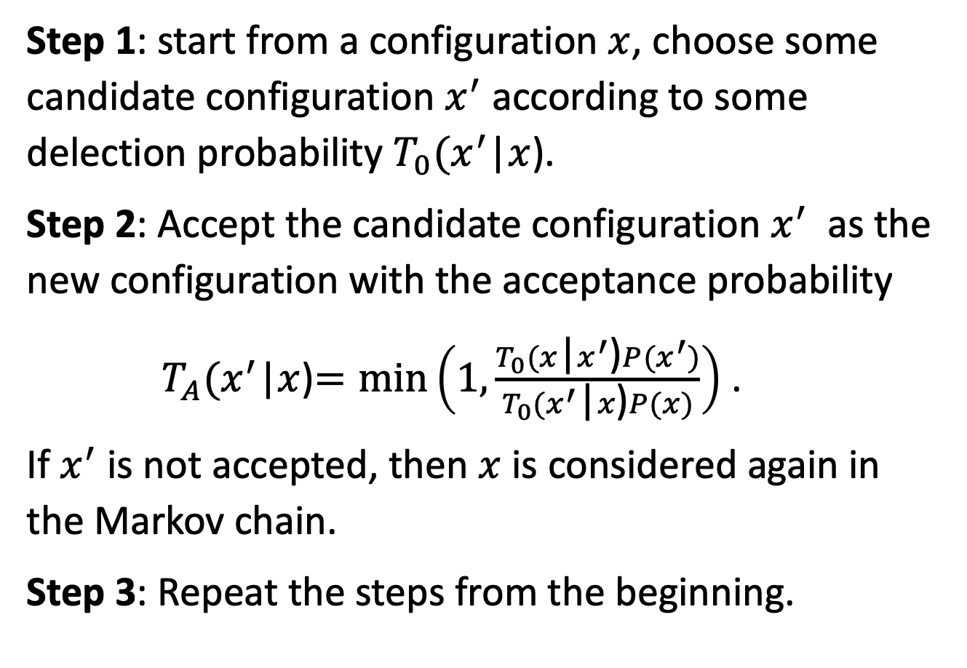
Metropolis algorithm
Step 1: start from a configuration $x$, choose some candidate configuration $x^{′}$ according to some delection probability $T_{0}(x^{′}$|$x$).
Step 2: Accept the candidate configuration $x^{′}$ as the new configuration with the acceptance probability
$T_{A}(x^{′}$|$x$)$=\min\left(1,\frac{T_{0}(x\text{|}x^{′}\text{)}P(x^{′})}{T_{0}(x^{′}\text{|}x\text{)}P(x)}\right)$ .
If $x^{′}$ is not accepted, then $x$ is considered again in the Markov chain.
Step 3: Repeat the steps from the beginning.

Slide 9
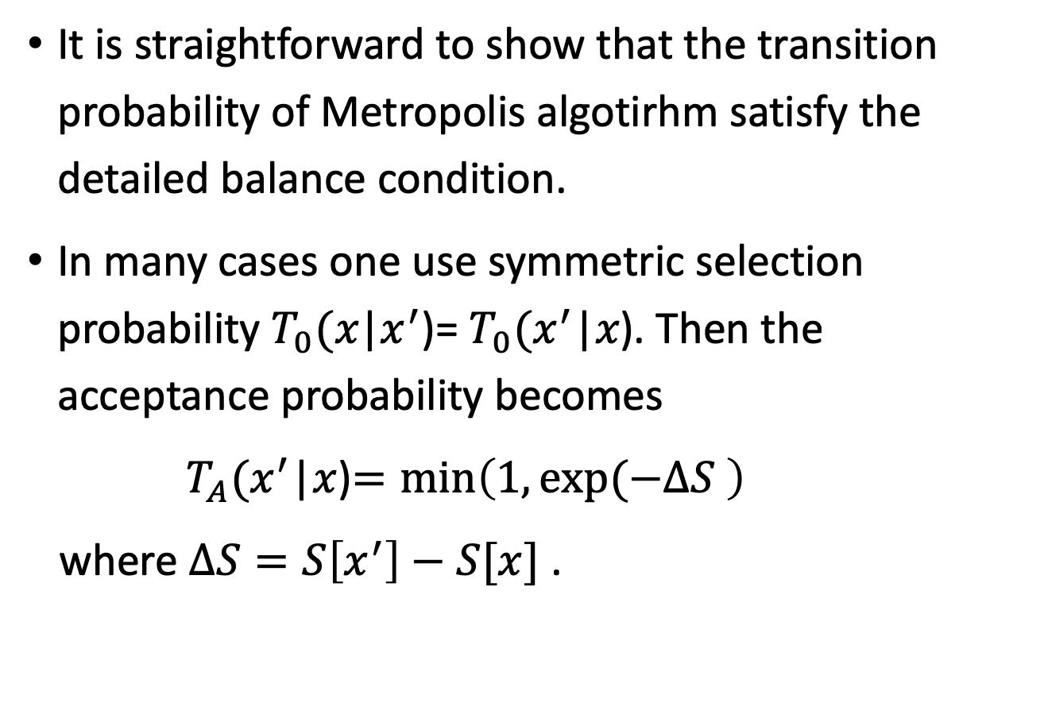
Metropolis algorithm
It is straightforward to show that the transition probability of Metropolis algotirhm satisfy the detailed balance condition.
In many cases one use symmetric selection probability $T_{0}(x\text{|}x^{′}\text{)}$= $T_{0}(x^{′}\text{|}x\text{)}$. Then the acceptance probability becomes
$T_{A}(x^{′}$|$x$)$=\min\left(1,exp⁡(−∆S \right)$
where $∆S=S\left[x^{′}\right]−S[x]$ .

Slide 10
1D harmonic oscillator Monte Carlo Simulation

Slide 11







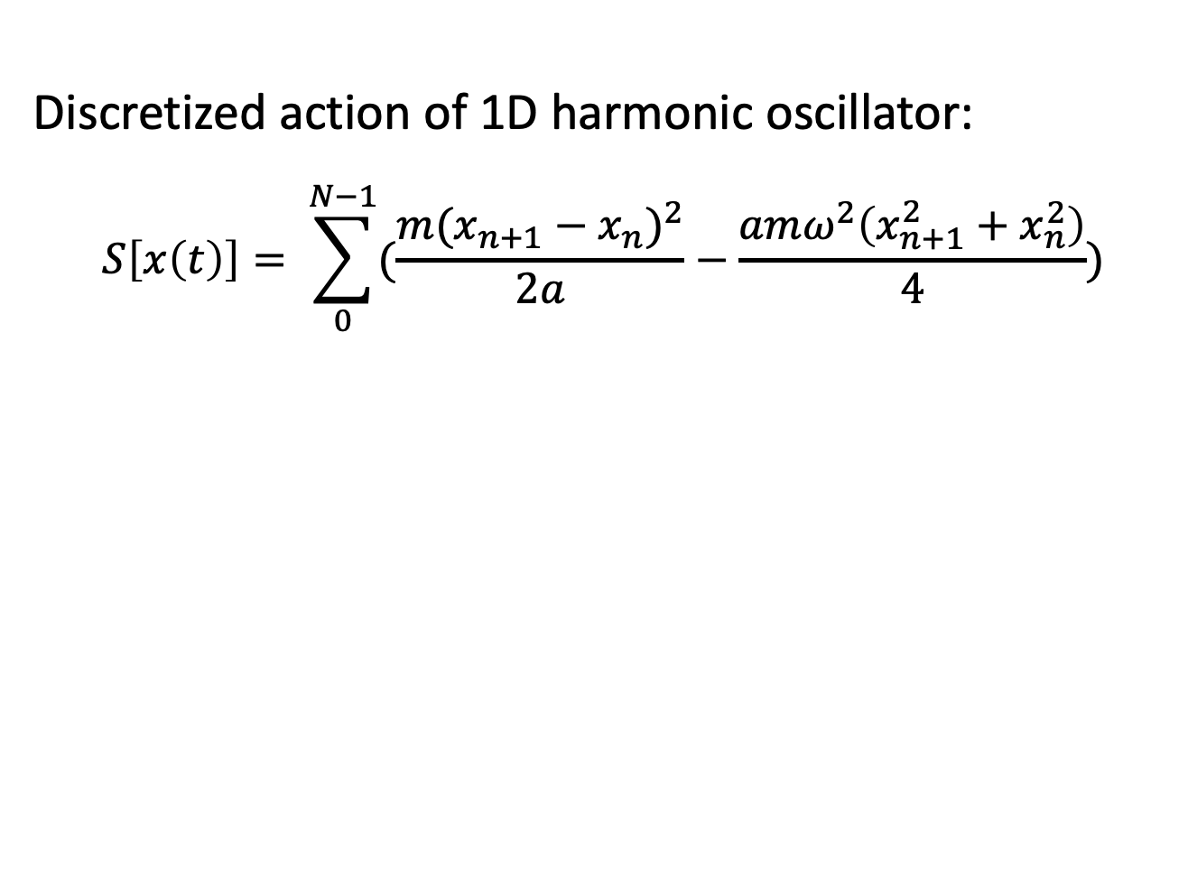









Generate the configurations
Discretized action of 1D harmonic oscillator:
$$S\left[x\left(t\right)\right]= \sum_{0}^{N−1}{(\frac{m(x_{n+1}−x_{n})^{2}}{2a}}−\frac{amω^{2}\left(x_{n+1}^{2}+x_{n}^{2}\right)}{4})$$
$$x$$
$$a$$
$$x_{0}$$
$$x_{1}$$
$$x_{2}$$
$$x_{3}$$
$$x_{4}$$
$$x_{5}$$
$$x_{6}$$
$$x_{7}$$
$$x_{8}$$
$$x_{9}$$
$$⋯⋯$$
$$x_{N}$$
$$t$$
$$aN=T$$

Slide 12
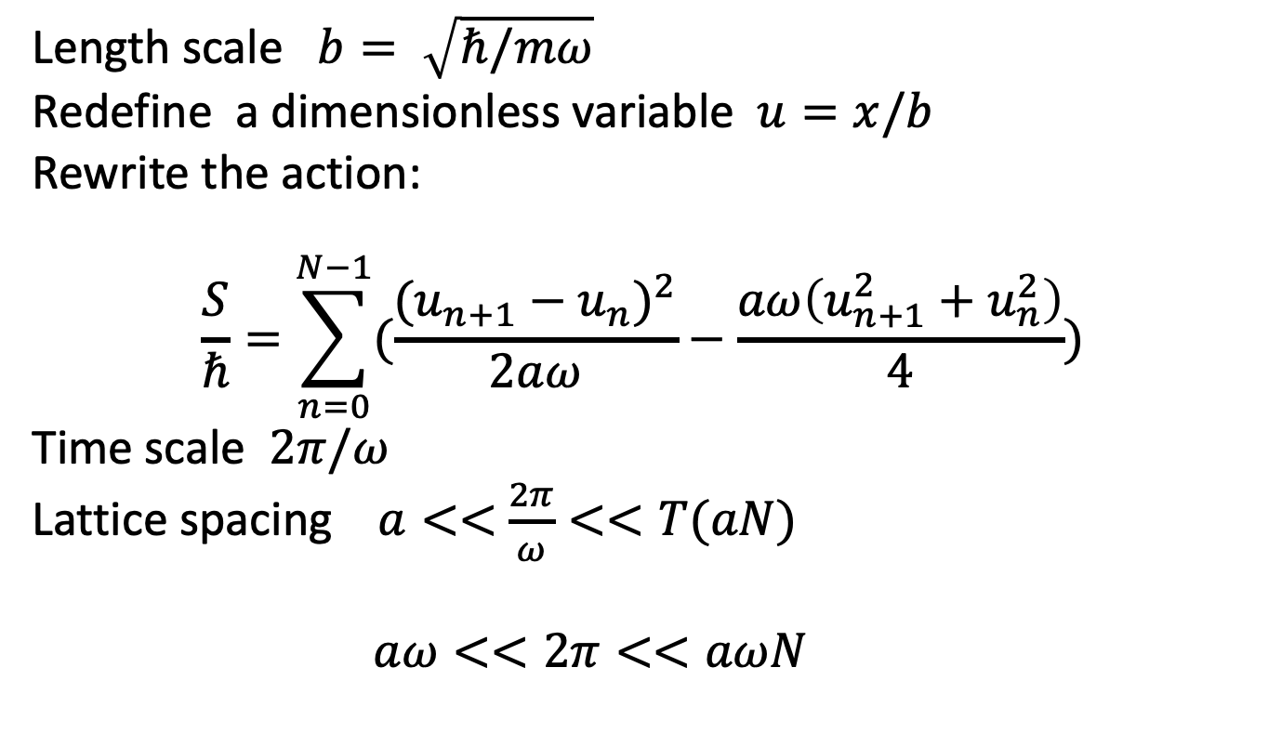
Generate the configurations
Length scale $b= \sqrt{ℏ/mω}$
Redefine a dimensionless variable $u=x/b$
Rewrite the action:
$$\frac{S}{ℏ}=\sum_{n=0}^{N−1}{(\frac{(u_{n+1}−u_{n})^{2}}{2aω}}−\frac{aω\left(u_{n+1}^{2}+u_{n}^{2}\right)}{4})$$
Time scale $2π/ω$
Lattice spacing $a<<$ $\frac{2π}{ω}<<T(aN)$
$aω<<2π<<aωN$

Slide 13
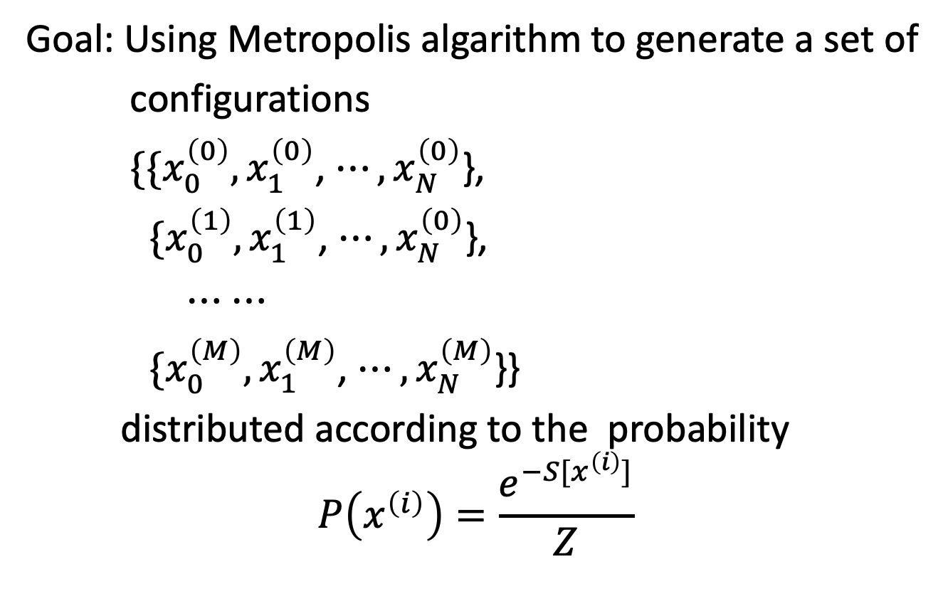
Generate the configurations
Goal: Using Metropolis algarithm to generate a set of
configurations
$\{\{x_{0}^{\left(0\right)},x_{1}^{\left(0\right)}$, $⋯,x_{N}^{\left(0\right)}$},
$\{x_{0}^{\left(1\right)},x_{1}^{\left(1\right)}$, $⋯,x_{N}^{\left(0\right)}$},
$⋯$ $⋯$
$\{x_{0}^{\left(M\right)},x_{1}^{\left(M\right)}$, $⋯,x_{N}^{\left(M\right)}$}}
distributed according to the probability
$$P\left(x^{\left(i\right)}\right)=\frac{e^{−S[x^{\left(i\right)}]}}{Z}$$

Slide 14
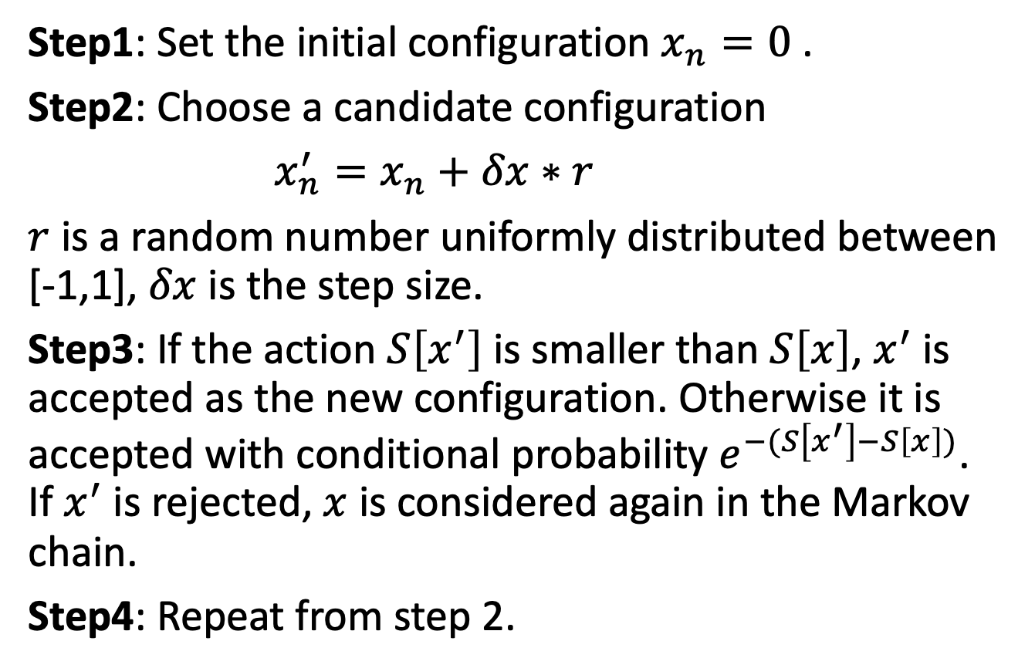
Generate the configurations
Step1: Set the initial configuration $x_{n}=0$ .
Step2: Choose a candidate configuration
$x_{n}^{′}=x_{n}+δx∗r$
$r$ is a random number uniformly distributed between [-1,1], $δx$ is the step size.
Step3: If the action $S\left[x^{′}\right]$ is smaller than $S\left[x\right]$, $x^{′}$is accepted as the new configuration. Otherwise it is accepted with conditional probability $e^{−(S\left[x^{′}\right]−S\left[x\right])}$. If $x^{′}$is rejected, $x$ is considered again in the Markov chain.
Step4: Repeat from step 2.

Slide 15
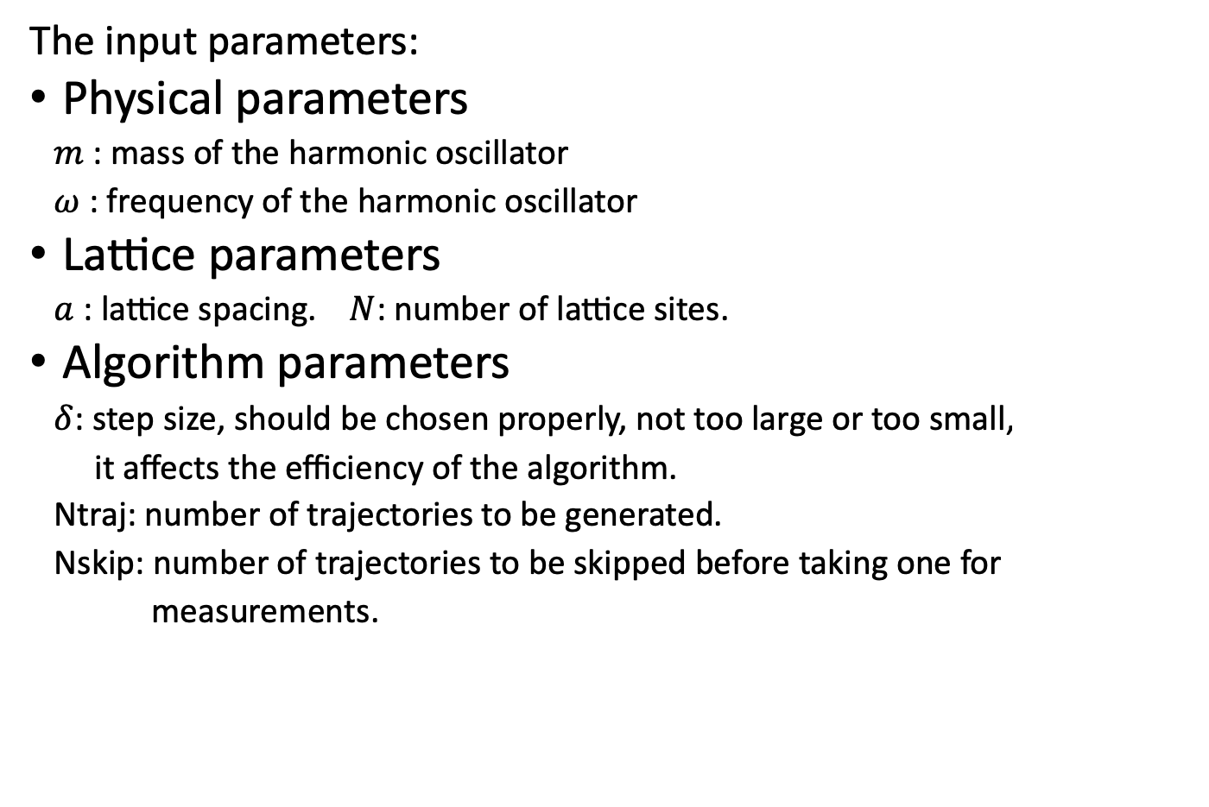
Generate the configurations
The input parameters:
Physical parameters
$m$ : mass of the harmonic oscillator
$ω$ : frequency of the harmonic oscillator
Lattice parameters
$a$ : lattice spacing. $N$: number of lattice sites.
Algorithm parameters
$δ$: step size, should be chosen properly, not too large or too small,
it affects the efficiency of the algorithm.
Ntraj: number of trajectories to be generated.
Nskip: number of trajectories to be skipped before taking one for
measurements.

Slide 16
Generate the configurations
Exercise: (30 minutes)
Following the above instructions, write the code to generate the configurations.

Slide 17

Measurements
Compute the expectation value of $x^{2}$ and the ground state energy $E_{0}$ .
$$E_{0}=mω^{2}<x^{2}>$$
Recall $E_{0}=ℏω/2$，$x=u\sqrt{ℏ/mω}$
We should have $<u^{2}> =0.5$

Slide 20
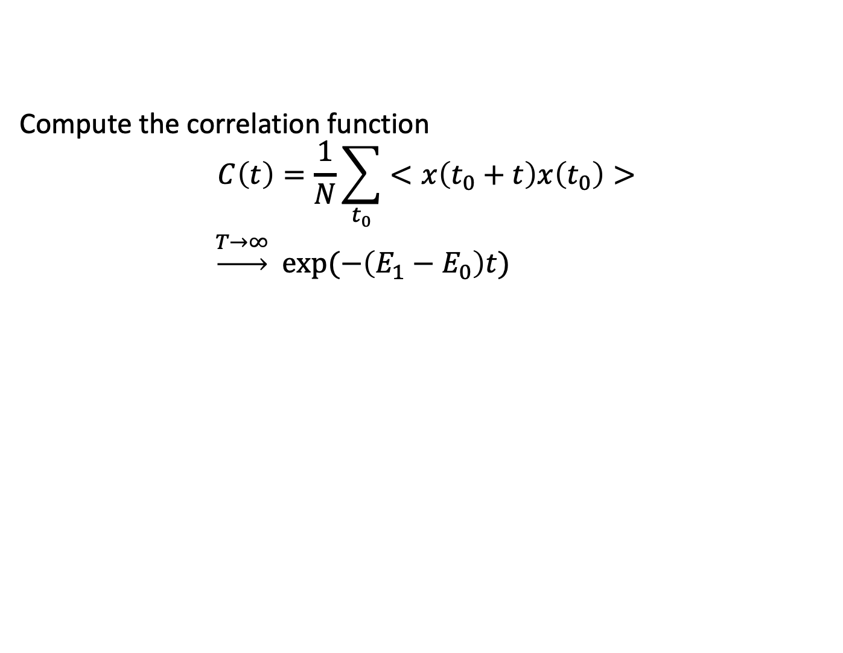
Measurements
Compute the correlation function
$$C\left(t\right)=\frac{1}{N}\sum_{t_{0}}{<x\left(t_{0}+t\right)x\left(t_{0}\right)>}$$
$\underset{→}{T→∞}$ $exp⁡(−\left(E_{1}−E_{0}\right)t)$

Slide 22
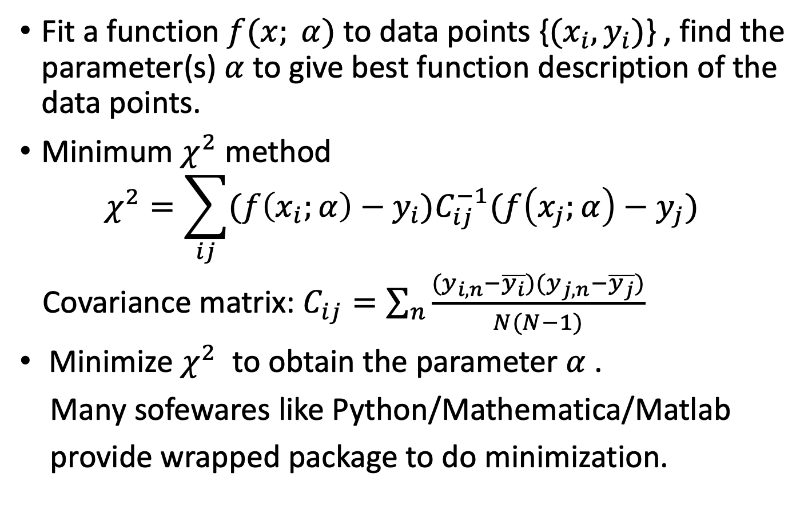
Data analysis
Fit a function $f(x; α)$ to data points {${(x}_{i},y_{i})$} , find the parameter(s) $α$ to give best function description of the data points.
Minimum $χ^{2}$ method
$$χ^{2}=\sum_{ij}{(f\left(x_{i};α\right)−y_{i})C_{ij}^{−1}(f\left(x_{j};α\right)−y_{j}) }$$
Covariance matrix: $C_{ij}=\sum_{n}{\frac{(y_{i,n}−\overline{y_{i}})(y_{j,n}−\overline{y_{j}})}{N(N−1)}}$
Minimize $χ^{2}$ to obtain the parameter $α$ .
Many sofewares like Python/Mathematica/Matlab
provide wrapped package to do minimization.

Slide 23


Data analysis
Fit the correlation function $C\left(t\right)$ to an exponential function to obtain the value of $E_{1}−E_{0}$.
$$E_{1}−E_{0}=0.995(9)$$

