Slide 1
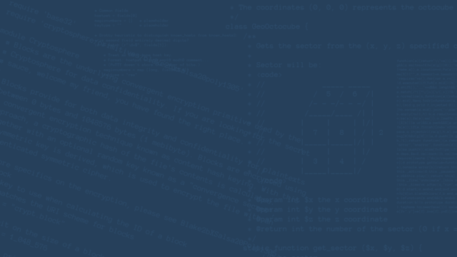
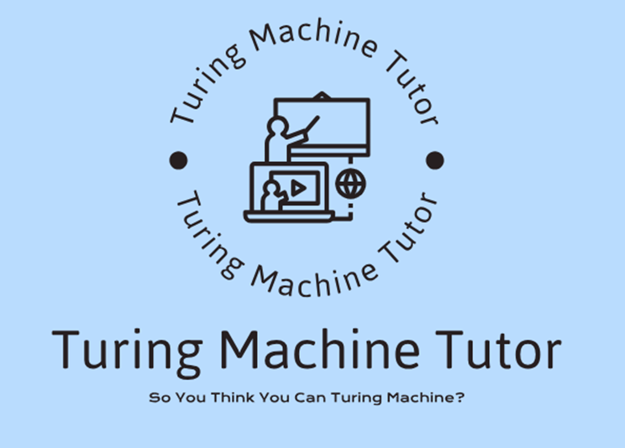
turing machine tutor
bayan kassem
radwan ganem
yuval dolev
meitar daddon

Slide 2
Proof of concept

Slide 3
risk: misunderstanding / changes in requirements
solution:schedule meeting with client.
Notes:
we are planning to make schedule meeting with our client to show progress that has been made and to emphasize the requirements and to minimize misunderstanding of requirements.

Slide 4
risk: poor design decisions , that lead to bad user experience
solution:schedule meetings with advisor for consultation .
Notes:
we are planning to make meeting with our academic advisor for consultation to our design of the system , if we face any dilemmas and struggles.

Slide 5
risk: Incompatibility with Chosen Technologies.
solution:do a research in advance.
Notes:
we are planning to dedicate time for searching for new technologies and to study them in order to be able to choose which platform suits us the most, and we are going to watch videos from youtube to see some examples of implementations of similar systems and web apps

Slide 6
risk:Performance Bottlenecks.
solution:analyze and predict problematic scenarios and design properly
Notes:
the risk is some sections that are common that will be called more often and will have a lot of requests and users using it in parallel, so the solution is analyzing and predicting possible sections in the system where is high likely going to be some stress and pressure , then choosing a design to overcome this obstacle and making it concurrency friendly

Slide 7
risk:forgotten some details and definitions from the course “computational models” material.
solution:preview the material from model or ask our client.
Notes:
we did this course at least 1 year ago, so maybe some of us has forgotten some details and how things work, solution for that is to review the material and help each other , in worst case scenario ask dana.

Slide 8
risk: data loss as a result of server crash.
solution:do a backup for the system every some defined time.
Notes:
the server might crash , we prepare for that by backing up our system frequently and make an ability to load data, we can use mySQLdump or MongoDBdump ,so we won’t lose data

Slide 9
gantt

Slide 10
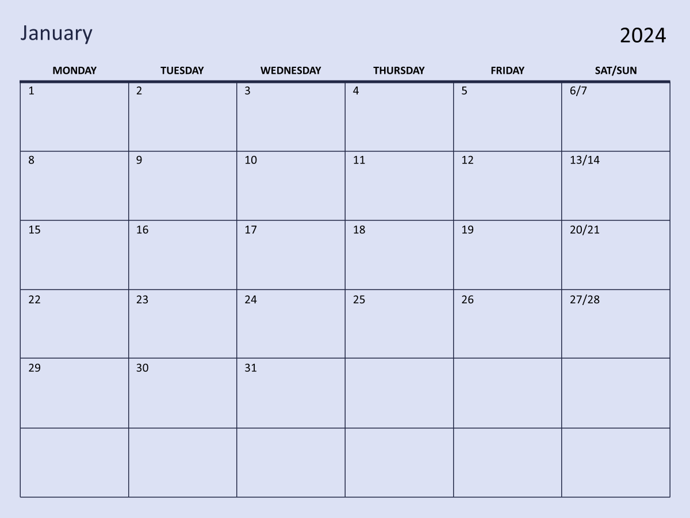
deciding about the technology
working on ADD + group meetings
schedule private meeting with advisor
schedule meeting with client

Slide 11
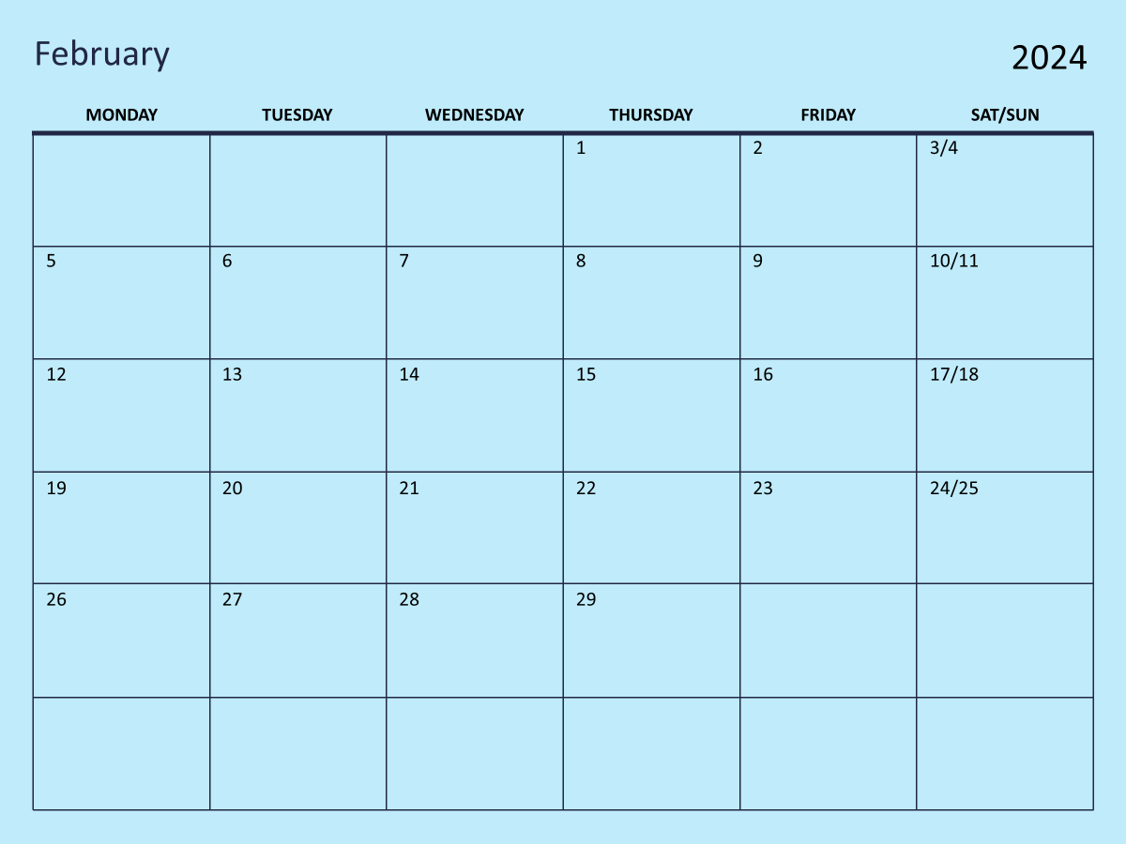
working on ADD+ group meetings
schedule private meeting with advisor
schedule meeting with client
presenting ADD to advisor
working on first iteration - possible meetings with client and advisor
meetings with group
marathon in campus

