Slide 1
Autonomous Robots
Sensors

Slide 2
Sensors
Kinematics, Dynamics, Control all describe the state of the robot system and provided means of influencing it
Path Planning provides a means of determining the path/actions the system will be taking to reach a goal without collisions
All of these made the assumption that we knew the state of the system (position, velocity, etc.)
To determine the state, we need sensors
Notes:
Active sensors transmit their own signal and can thus be engineered in such a way that it is easy to detect and extract the information (e.g. transmission in a frequency band or with a modulation that occurs rarely (or never) in nature).
Extracting the information is then independent of what is actually in the environment (objects, etc.). All that has to be done is looking for the special signal and compute either time of flight or to triangulate the (known) signal.
But there are drawbacks. Active transmission can interfere both with other sensors and with objects or entities in the environment. E.g. sonar and dogs sometimes do not go together that well.

Slide 3
Internal vs External Sensors
Sensors can be used to measure something internal to the robot or external with respect to the world
Internal sensors do not require any information from outside the system to measure aspects of the state of the system, e.g.
Rotation sensors to measure motor angles
Inertial measurement units to measure acceleration and rotation
Battery state sensors
Notes:
Active sensors transmit their own signal and can thus be engineered in such a way that it is easy to detect and extract the information (e.g. transmission in a frequency band or with a modulation that occurs rarely (or never) in nature).
Extracting the information is then independent of what is actually in the environment (objects, etc.). All that has to be done is looking for the special signal and compute either time of flight or to triangulate the (known) signal.
But there are drawbacks. Active transmission can interfere both with other sensors and with objects or entities in the environment. E.g. sonar and dogs sometimes do not go together that well.

Slide 4
Rotation Sensors
Measures angle using a resistor/voltage divider
Has a gap, i.e. can not measure full 360 degrees
Resistor is temperature sensitive, i.e. heating changes readings
Friction causes wear
Need to keep track of the number of rotations
Rotation sensors are important to measure the state of the motors and thus the joint angles
Simplest rotation sensor is using a potentiometer
Notes:
Active sensors transmit their own signal and can thus be engineered in such a way that it is easy to detect and extract the information (e.g. transmission in a frequency band or with a modulation that occurs rarely (or never) in nature).
Extracting the information is then independent of what is actually in the environment (objects, etc.). All that has to be done is looking for the special signal and compute either time of flight or to triangulate the (known) signal.
But there are drawbacks. Active transmission can interfere both with other sensors and with objects or entities in the environment. E.g. sonar and dogs sometimes do not go together that well.

Slide 5
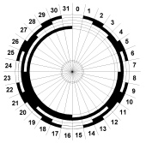
Rotation Sensors - Encoders
Absolute encoders use multiple rings to identify an absolute orientation
Need to keep track of full rotations
Range is limited by the number of rings (and thus detectors)
Encoders use either optical detectors or magnetic switches to produce a digital signal corresponding to rotation
Notes:
Active sensors transmit their own signal and can thus be engineered in such a way that it is easy to detect and extract the information (e.g. transmission in a frequency band or with a modulation that occurs rarely (or never) in nature).
Extracting the information is then independent of what is actually in the environment (objects, etc.). All that has to be done is looking for the special signal and compute either time of flight or to triangulate the (known) signal.
But there are drawbacks. Active transmission can interfere both with other sensors and with objects or entities in the environment. E.g. sonar and dogs sometimes do not go together that well.

Slide 6

Rotation Sensors - Encoders
Incremental encoders use only one rings to count the incremental change in orientation
Need to calibrate/zero the state before counting
Need to read it fast enough to not miss any counts
Require a way to identify the direction of rotation
Direction can be determined by using two detectors offset by half the width of a segment
Quadrature encoder
Notes:
Active sensors transmit their own signal and can thus be engineered in such a way that it is easy to detect and extract the information (e.g. transmission in a frequency band or with a modulation that occurs rarely (or never) in nature).
Extracting the information is then independent of what is actually in the environment (objects, etc.). All that has to be done is looking for the special signal and compute either time of flight or to triangulate the (known) signal.
But there are drawbacks. Active transmission can interfere both with other sensors and with objects or entities in the environment. E.g. sonar and dogs sometimes do not go together that well.

Slide 7
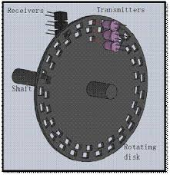
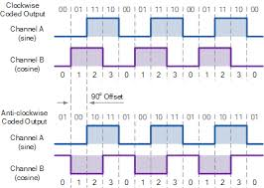
Rotation Sensors - Encoders
Optical encoders are most common in robot systems
Optical encoders can have finer gradations for sectors than magnetic encoders
Optical encoders are less influenced by magnetic fields from motors or temperature changes

Slide 8
Rotation Sensors - Resolvers
Magnetic field induces an oscillating field
Can measure the angle without discretization
Resolvers can measure angle using magnetic fields
Can be used to measure velocity more directly
But is significantly effected by additional magnetic fields produced by the motors

Slide 9
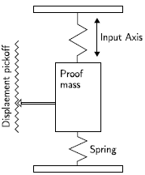
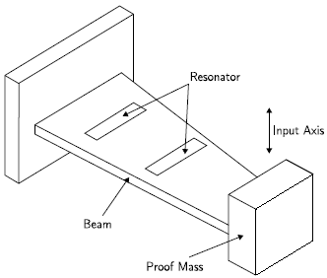
Inertial Measurements
Other things about the state of the system that can be measured purely internally are dynamic forces and with them accelerations and orientations
Accelerometers can measure the
effect of accelerations on a mass
Displacement of the mass is
proportional to acceleration
MEMS accelerometers sensors to
measure tension in a beam on the chip

Slide 10
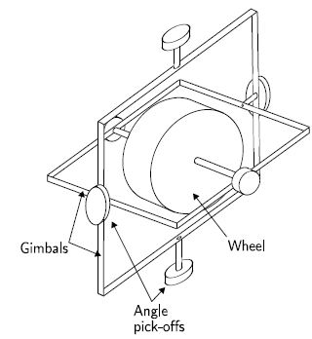
Inertial Measurements
Gyroscopes can measure the gyroscopic effect or the effects of centrifugal and coriolis forces effect of accelerations on a mass
Mechanical gyroscopes use the fact
that rotating masses stabilize the
rotation axis to measure orientation
MEMS gyroscopes measure centrifugal or coriolis forces cause by the
rotation of a mass on the chip
Measure rotational velocity (not
orientation (rate gyros)

Slide 11
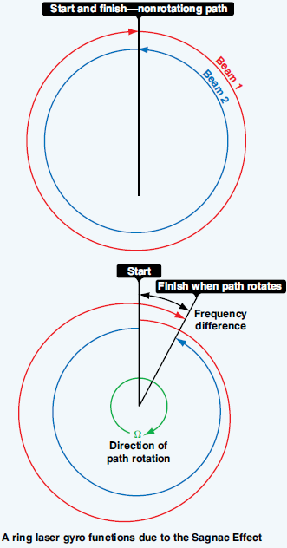
Inertial Measurements
Optical Gyroscopes use the time difference caused by the rotation on the light traveling through a curled fiber
Measure the phase shift between
split beams traveling two different
routes
Require no moving parts
Can be very precise but need to be
careful to avoid phase-locking

Slide 12
Internal vs. External Sensors
Internal sensors can measure the orientation of joints and accelerations and rotational velocities
Odometry will drift over time when errors in these measurements accumulate
Errors in position estimates from internal sensors only tend to accumulate over time
The system will eventually get lost
External sensors measure properties of objects in the environment
Errors in their measurements do not accumulate

Slide 13
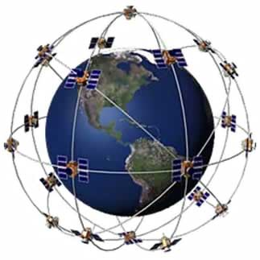
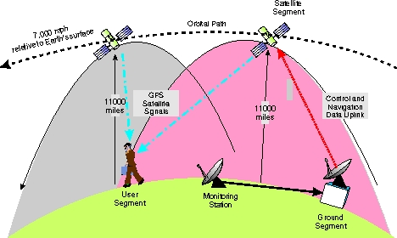
Global Positioning System (GPS)
Consists of a satellite-based navigation system made up of a network of 24 satellites.
GPS positioning information can be improved by obtaining additional information from fixed ground facilities. These enhancement strategies are referred to as Differential GPS and commonly uses the WAAS (Wide Area Augmentation System)
http://www.pocketgpsworld.com/howgpsworks.php
http://plane.ardupilot.com/wiki/
common-gps-how-it-works/

Slide 14
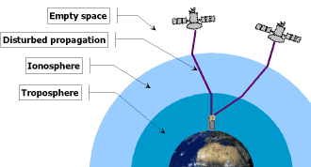
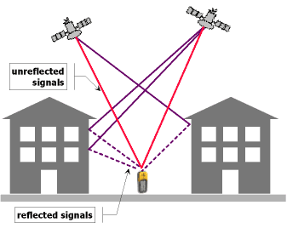
Limitations of GPS
Ionospheric perturbations and magnetic storms (solar activity) can cause signal delays. This can be partially compensated using SBAS and L1 / L2 decoding.
Multipathing is causing GPS position errors that are difficult to detect and compensate for. Multiple GNSS receivers are better suited to filter out multipathing thanks to a higher number of visible satellites at the same time.
http://plane.ardupilot.com/wiki/
common-gps-how-it-works/

Slide 15
Proximity Sensors
Proximity sensors measure the distance to objects in the environment
Laser range finding (LADAR)
Radar
Machine Vision
Ultrasonic
Infrared
Tactile sensor

Slide 16

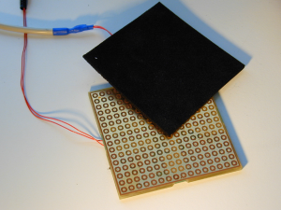
Tactile sensors
Tactile sensors are basically bump sensors. They are mechanical devices that close an electromechanical switch.
The switch closure acts as a binary input to the control system.
Typically used in small low-cost system. Requires low vehicle speeds and mass. Used frequently in biologically inspired behavior-based systems.
http://www.wireless-earth.de/private/mindstorms_eng.html
http://ni.www.techfak.uni-bielefeld.de/robotics

Slide 17
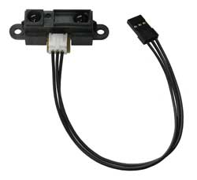
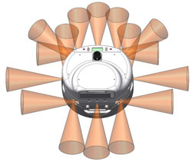
Infrared Sensors
IR rangers use triangulation and a small linear CCD array to compute the distance and/or presence of objects in the field of view.
The basic idea is this: a pulse of IR light is emitted by the emitter. This light travels out in the field of view and either hits an object or just keeps on going.
In the case of no object, the light is never reflected and the reading shows no object. If the light reflects off an object, it returns to the detector and creates a triangle between the point of reflection, the emitter, and the detector.
Low-cost, simple to implement, relatively short range. Work best in controlled lighting. Requires the linearization of the sensor output.
http://www.active-robots.com/products/
robonova/robonova-sensors.shtml
www.wanyrobotics.com/.../infrared-range.jpg
http://www.acroname.com/robotics/info/articles/sharp/sharp.html#e2

Slide 18
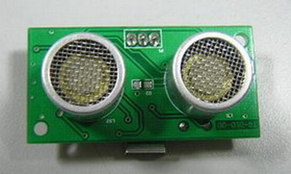
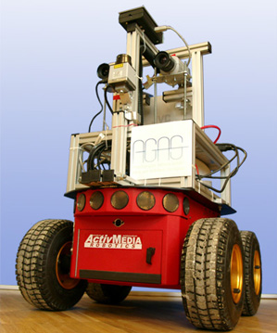
Ultrasonic Sensors
Ultrasonic sensors generate high frequency sound waves and evaluate the echo which is received back by the sensor. Sensors calculate the time interval between sending the signal and receiving the echo to determine the distance to an object.
Relatively inexpensive, simple to implement, good for short distance ranging.
Subject to cross-talk between multiple transmitter / receiver pairs
img.alibaba.com/photo/209455902/TS601dt_ultra...
www.uni-koblenz-landau.de/.../images/robbie6

Slide 19
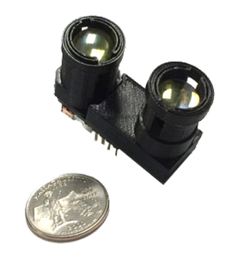
Laser range finder
Uses a laser beam to determine the distance to a reflective object.
Detects the time of flight of a laser pulse sent in a narrow beam towards an object and measures the time taken for the light to be reflected back to the sensor.
Sensor resolution is determined by the brevity of the pulse and the speed of the light detector.
Doppler effect techniques can be used to determine the relative motion and velocity of the target.
Opti-Logic RS100 unit

Slide 20
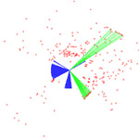
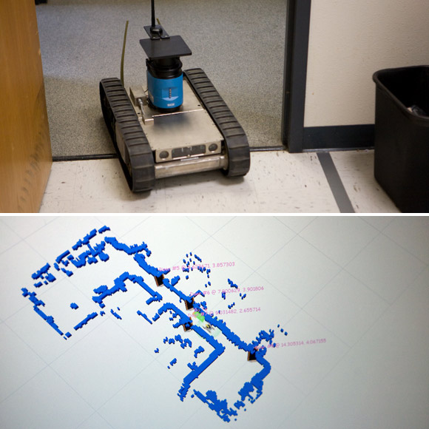
Laser Detection and Ranging (LADAR)
Also know as LIDAR (Light Detection and Ranging)
These systems use the same basic technology as laser range finders with the exception that the laser beam is steered in one or two axes.
LADAR can be used to create two and three dimensional maps of the physical environment.
The system’s laser, scanner & optics, and photodetector & receiver electronics all influence the range, speed, and resolution of the LADAR system.
users.soe.ucsc.edu/~manduchi/Media/Ladar.jpg
www.wired.com/.../2008/01/spawar/10_mapper.jpg

Slide 21

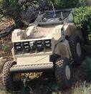
Laser Detection and Ranging (LADAR)
Negative Obstacles create a challenge for all sensing techniques.
Sensors tend to be placed to the front and as high as possible on the vehicle.
The CMU Crusher system uses multiple LADAR sensors to create a dynamic 3-D map of its environment

Slide 22

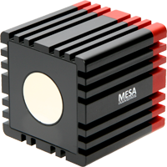
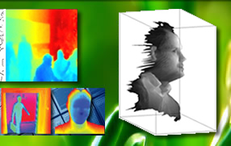
2D LIDAR / ToF Depth Cameras
Time-of-flight cameras compute the distance of a part of the object by measuring the time it takes for light to travel from a light source to the individual pixel
Emit modulated light near lens
Modulation changes intensity at a rate of around 15-30 MHZ
Compute time-of-flight based on phase shift in modulation
Eliminates the need to measure at 1/100
Objects
TOF
Camera
Modulated
Illuminator
Phase Shift
Calculation

Slide 23
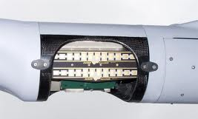
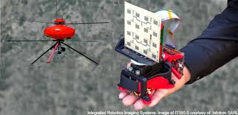
Radar
An object detection system that uses electromagnetic waves to identify the range, altitude, direction of both moving and fixed objects.
The term RADAR was coined in 1941 and stands for radio detection and ranging.
Used primarily in larger UAV and USV systems
http://gcn.com/blogs/emerging-tech/2014/06/uav-radar-sense-and-avoid.aspx

Slide 24
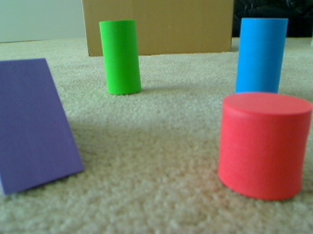
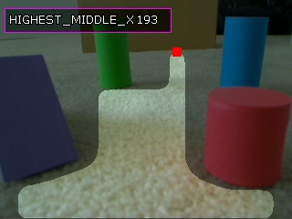
Machine Vision
Machine vision systems process images acquired with cameras in order to produce a representation of objects in the world.
Computer algorithms are used to analyze patterns of pixels values provide by the image sensor.
By identifying and classifying groups of pixels as an obstacle, machine vision can be used to generate information that supports path planning or opportunistic motion behaviors.
www.roborealm.com/.../obstacle_scene_1.jpg

