Slide 1
Welcome
Cloud Computing Project Presentation

Slide 2

Nopa Islam
ID: 011 151 062
Sukannya Saha
ID: 011 151 079
Nasir Uddin Ahmed
ID: 011 151 086

Slide 3
Index
Project Features
Scope Of The Project
Requirements Specifications
Stake Holders
Context Diagram
Activity Diagram
DFD Diagram
Use Case Diagram
ER Diagram
Challenges
UI Of The Project

Slide 4
Project Title: Online Shopping
Project Features
User account
User log in
User sign up
Product category
Wish-list
Merchant commission
Online integration
User cart
Shipping
Payments
Search

Slide 5
Scope Of The Project
Electronic data interchange
Product sales and services on cloud platform
Scalability

Slide 6

Cloud Service Model
IAAS

Slide 7
Requirements Specifications
System properties
a. Runs linux server
b. HTML/CSS, Java Script based UI design
c. Php based functioning system
d. Mysql database
e. Platform : Microsoft Azure Student Portal
f. Authentication type : SSH

Slide 8
Requirements Specifications
Storage requirements
a. Subscription : Student account
b. RAM : 8 GB
c. Virtual core : 2
d. Temporary storage : 16 GB

Slide 9
Requirements Specifications
Technical process
a. Back end programming language : Php
b. Scripting language : HTML, Java script
c. Virtual machine : Ubuntu 18.04 LTS
d. IDE : Brackets, Notepad++

Slide 10
Stake Holders
Suppliers
User
Shipping Agent
Stake Holder
Buyer
Merchant
Payment Providers
Figure : Stake holders diagram for the project

Slide 11
Context Diagram of Project
USER
Order Acceptance/ Rejection
SHIPPING
View Order product
ONLINE SHOPPING
Update Database
Shipping Request
Credit card status
ADMIN
PAYMENT
Customer billing details
Credit card details

Slide 12
ACTIVITY Diagram of Project
Start
USER
Registration
Login
Category of Product
Add Product
Cart
Delete Product
Product Details
Product Search
Checkout
Update Product
Payment
By Name
By Price
By Filter
Shipment
Mobile Banking
Bkash
Cards
Logout
End

Slide 13
DATA FLOW DIAGRAM(DFD)
USER
1.0
Registration
USER DATABASE
2.0
Login
PRODUCT DATABASE
3.0
Product Category
4.0
Product Search
4.2
Search By Price
4.3
Search By Filter
4.1
Search By Name
5.0
Product Details
6.0
Cart
ADMIN
6.1
Add to Cart
6.2
Update Cart
6.2
Delete Cart
7.0
Payment
8.0
Shipment

Slide 14

Use Case Diagram(01)
E-Commerce System
User Authentication
<<include>>
Log In
<<include>>
Register
Category
USERS
ADMINS
Details
Update/
Remove
Product
<<include>>
CART
Add
Product
<<include>>

Slide 15
USE CASE DIAGRAM(02)
Searching
<<extend>>
Name and
Price
<<extend>>
Different Filters
Payment
USERS
ADMINS
Shipment

Slide 16
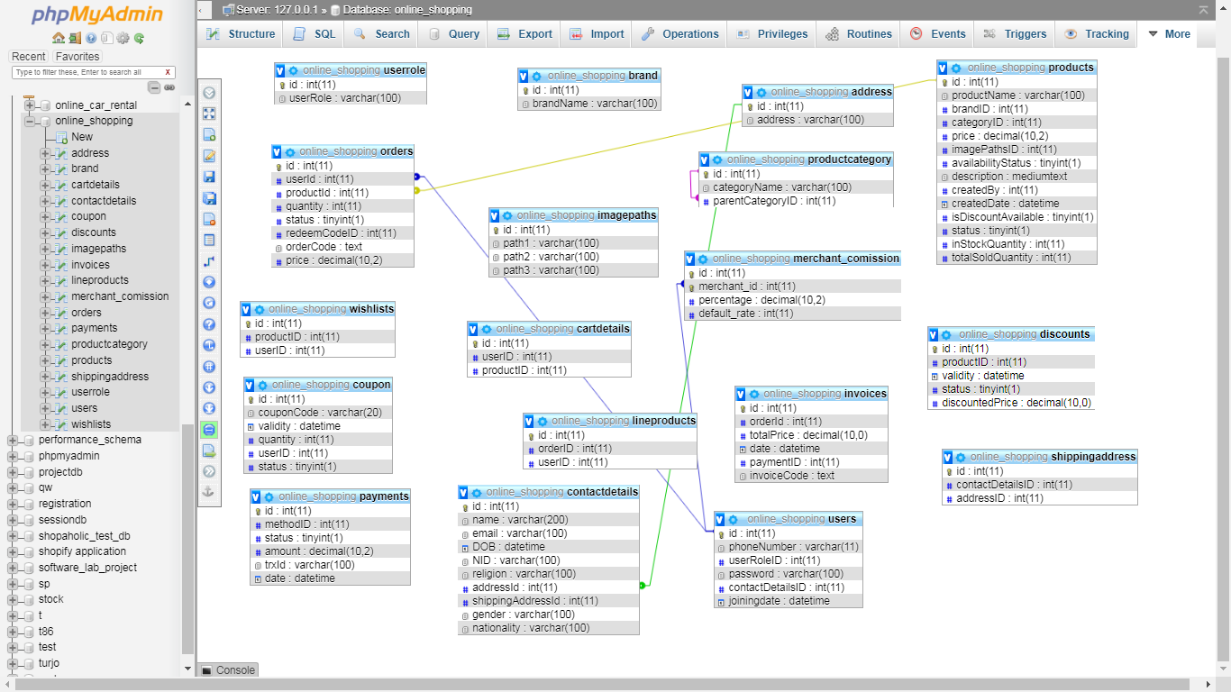
ER Diagram
Figure : ER diagram

Slide 17
CATEGORY AND SUB CATEGORY (ADMIN PANEL AND USER AUTHENTICATION)
ADMIN PANEL
USER AUTHENTICATION
ADMIN
ADD PRODUCT
UPDATE PRODUCT
DELETE PRODUCT
ADD CATEGORY
DELETE CATEGORY
Customer Authentication
User Sign Up
User Log in
Update User Information

Slide 18
CATEGORY AND SUB CATEGORY (Searching And Details Of Product)
SEARCHING
DETAILS OF PRODUCT
SERACHING
Search By Product Name
Search by Filter
Search By category
Search By product type
Details
Description Of The Product
Name
Price
Adding Product To Cart
Quantity
Description

Slide 19
CART (Menu And Submenu)
Cart
Adding Product To Cart
Update Product
Delete Product
Don’t Add same product

Slide 20
Challenges
Student portal $100 dollar limitation
LAMP server compatibility
Using other programming language

Slide 21
UI Of The Project

