Slide 1
CSE 6091: Cryptography Introduction Salekul Islam United International University

Slide 2
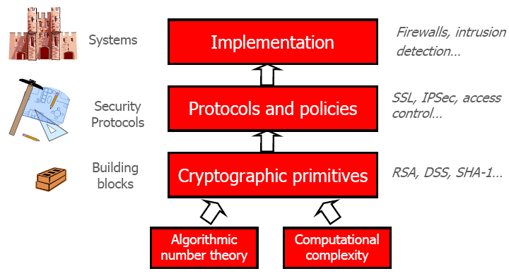
Target of this course

Slide 3
Computer Security Concept
COMPUTER SECURITY
The protection afforded to an automated information system in order to attain the applicable objectives of preserving the
integrity,
availability, and
confidentiality of
information system resources (includes hardware, software, firmware, information/ data, and telecommunications).

Slide 4
Three Key Objectives
Confidentiality
Data confidentiality: confidential information
Privacy: individuals control what information related to them may be collected/stored and by who can access that
Integrity:
Data integrity: information and programs are changed only in a specified and authorized manner.
System integrity: a system performs its intended function in an unimpaired manner, free from unauthorized manipulation of the system.
Availability: Assures that systems work promptly and service is not denied to authorized users.

Slide 5
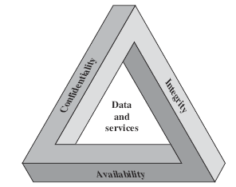
CIA triad
Security requirements

Slide 6
Two more objectives
Authenticity
The property of being genuine and being able to be verified and trusted;
confidence in the validity of a message originator.
verifying that users are who they say they are
Accountability
The security goal that generates the requirement for actions of an entity to be traced uniquely to that entity.
This supports nonrepudiation, deterrence, fault isolation, intrusion detection and prevention, and after-action recovery and legal action.

Slide 7
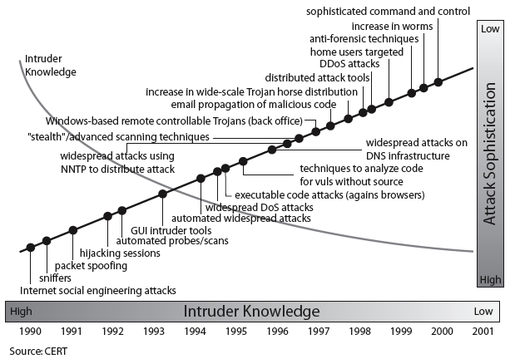
Security Trends
Notes:
Discuss observed security trends (Stallings section 1.1 & Figure 1.2 above), noting growth in sophistication of attacks contrasting with decrease in skill & knowledge needed to mount an attack.

Slide 8
OSI Security Architecture
ITU-T X.800 “Security Architecture for OSI”
defines a systematic way of defining and providing security requirements
for us it provides a useful, if abstract, overview of concepts we will study
Notes:
To assess effectively the security needs of an organization and to evaluate and choose various security products and policies, the manager responsible for security needs some systematic way of defining the requirements for security and characterizing the approaches to satisfying those requirements. This is difficult enough in a centralized data processing environment; with the use of local and wide area networks,the problems are compounded. ITU-T Recommendation X.800, Security Architecture for OSI, defines such a systematic approach. The OSI security architecture is useful to managers as a way of organizing the task of providing security.

Slide 9
Aspects of Security
Consider 3 aspects of information security
Security attack
Any action that compromises the security of information owned by an organization.
Security mechanism
A process that is designed to detect, prevent, or recover from a security attack.
Security service
A service that enhances the security of the data processing systems of an organization.
Intended to counter security attacks, and make use of one or more security mechanisms to provide the service.
Notes:
The OSI security architecture focuses on security attacks,mechanisms,and services. These can be defined briefly as follows:
• Security attack: Any action that compromises the security of information owned by an organization.
• Security mechanism: A process (or a device incorporating such a process) that is designed to detect, prevent,or recover from a security attack.
• Security service: A processing or communication service that enhances the security of the data processing systems and the information transfers of an organization.The services are intended to counter security attacks, and they make use of one or more security mechanisms to provide the service.

Slide 10
Threats and Attacks (RFC 2828)
Often threat & attack used to mean same thing
Threat
A potential for violation of security, which exists when there is a circumstance, capability, action, or event that could breach security and cause harm. That is, a threat is a possible danger that might exploit a vulnerability.
Attack
An assault on system security that derives from an intelligent threat; that is, an intelligent act that is a deliberate attempt (especially in the sense of a method or technique) to evade security services and violate the security policy of a system.

Slide 11
Security Attacks
Have a wide range of attacks, we can focus of generic types of attacks
Passive Attack
nature of eavesdropping on, or monitoring of, transmissions.
The goal of the opponent is to obtain information that is being transmitted.
Active Attack
involve some modification of the data stream
or the creation of a false stream
Notes:
Expand on definition and use of “security attack”, as detailed above.
See Stallings Table 1.1 for definitions of threat and attack.

Slide 12
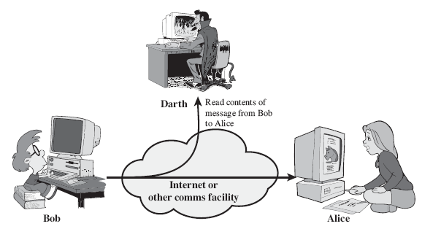
Passive Attacks: Release of message contents
Notes:
Have “passive attacks” which attempt to learn or make use of information from the system but does not affect system resources.
By eavesdropping on, or monitoring of, transmissions to:
+ obtain message contents (as shown above in Stallings Figure 1.3a), or
+ monitor traffic flows
Are difficult to detect because they do not involve any alteration of the data.

Slide 13
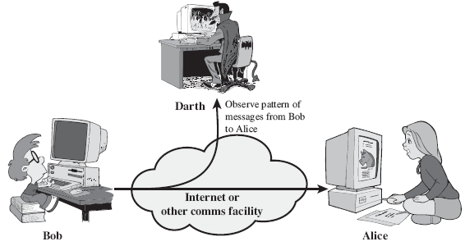
Passive Attacks: Traffic analysis

Slide 14
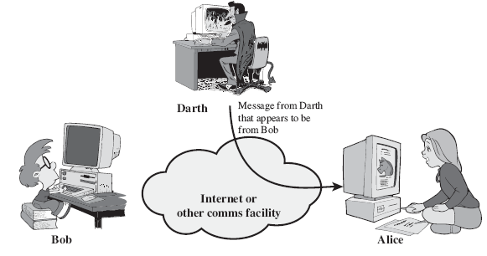
Active Attacks: Masquerade

Slide 15
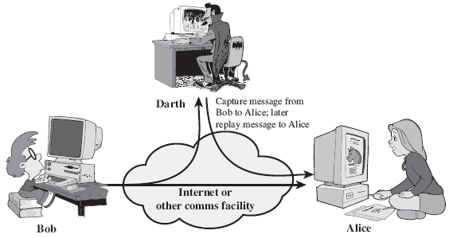
Active Attacks: Replay
Notes:
Also have “active attacks” which attempt to alter system resources or affect their operation.
By modification of data stream to:
+ masquerade of one entity as some other
+ replay previous messages (as shown above in Stallings Figure 1.4b)
+ modify messages in transit
+ denial of service
Active attacks present the opposite characteristics of passive attacks. Whereas passive attacks are difficult to detect, measures are available to prevent their success. On the other hand, it is quite difficult to prevent active attacks absolutely, because of the wide variety of potential physical,software,and network vulnerabilities. Instead, the goal is to detect active attacks and to recover from any disruption or delays caused by them.

Slide 16
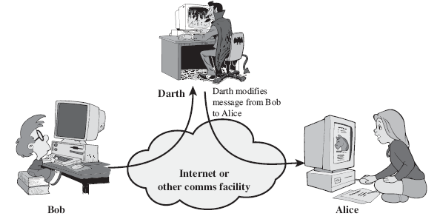
Active Attacks: Modification of messages

Slide 17
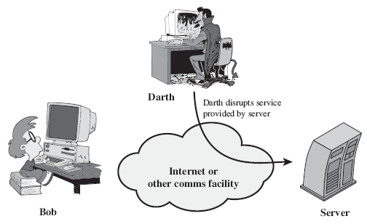
Active Attacks: Denial of Service (DoS)

Slide 18
Security Service
X.800 defines
a security service as a service that is provided by a protocol layer of communicating open systems and that ensures adequate security of the systems or of data transfers.
RFC 2828 defines
a processing or communication service that is provided by a system to give a specific kind of protection to system resources; security services implement security policies and are implemented by security mechanisms
Notes:
Consider the role of a security service, and what may be required.
Note both similarities and differences with traditional paper documents, which for example:
have signatures & dates;
need protection from disclosure, tampering, or destruction;
may be notarized or witnessed;
may be recorded or licensed

Slide 19
Security Services (X.800)
Authentication - assurance that the communicating entity is the one claimed
Access Control - prevention of the unauthorized use of a resource
Data Confidentiality –protection of data from unauthorized disclosure
Data Integrity - assurance that data received is as sent by an authorized entity
Non-Repudiation - protection against denial by one of the parties in a communication
Notes:
This list includes the various "classic" security services which are traditionally discussed.
Note there is a degree of ambiguity as to the meaning of these terms, and overlap in their use.
See Stallings Table 1.2 for details of the 5 Security Service categories and the 14 specific services given in X.800.

Slide 20
Security Mechanism
feature designed to detect, prevent, or recover from a security attack
no single mechanism that will support all services required
however one particular element underlies many of the security mechanisms in use:
cryptographic techniques
hence our focus on this topic
Notes:
Now introduce “Security Mechanism” which are the specific means of implementing one or more security services.
Note these mechanisms span a wide range of technical components, but one aspect seen in many is the use of cryptographic techniques.

Slide 21
Security Mechanisms (X.800)
Specific security mechanisms: incorporated into the appropriate protocol layer in order to provide some of the OSI security services
Encipherment
digital signatures
access controls
data integrity
authentication exchange
traffic padding
routing control
notarization
Notes:
Some examples of mechanisms from X.800. Note that the “specific security mechanisms” are protocol layer specific, whilst the “pervasive security mechanisms” are not. We will meet some of these mechanisms in much greater detail later.
See Stallings Table 1.3 for details of these mechanisms in X.800, and Table 1.4 for the relationship between services and mechanisms.

Slide 22
Security Mechanisms (X.800)
Pervasive security mechanisms: Mechanisms that are not specific to any particular OSI security service or protocol layer.
trusted functionality
security labels
event detection
security audit trails
security recovery

Slide 23
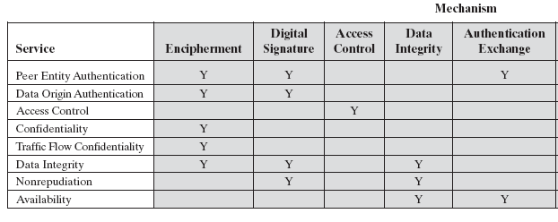
Relationship Between Security Services and Mechanisms

Slide 24
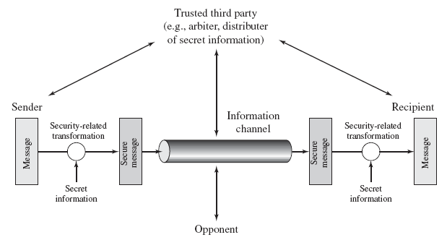
Model for Network Security
Notes:
In considering the place of encryption, its useful to use the following two models from Stallings section 1.6.
The first, illustrated in Figure 1.5, models information flowing over an insecure communications channel, in the presence of possible opponents. Hence an appropriate security transform (encryption algorithm) can be used, with suitable keys, possibly negotiated using the presence of a trusted third party.

Slide 25
Model for Network Security
Using this model requires us to:
design a suitable algorithm for the security transformation
generate the secret information (keys) used by the algorithm
develop methods to distribute and share the secret information
specify a protocol enabling the principals to use the transformation and secret information for a security service
Notes:
This general model shows that there are four basic tasks in designing a particular security service, as listed.

Slide 26
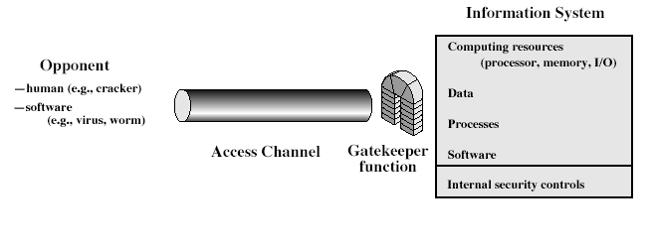
Model for Network Access Security
Notes:
The second, illustrated in Figure 1.6, model is concerned with controlled access to information or resources on a computer system, in the presence of possible opponents. Here appropriate controls are needed on the access and within the system, to provide suitable security. Some cryptographic techniques are useful here also.

Slide 27
Model for Network Access Security
Using this model requires us to:
select appropriate gatekeeper functions to identify users
implement security controls to ensure only authorised users access designated information or resources
trusted computer systems may be useful to help implement this model
Notes:
Detail here the tasks needed to use this model.
Note that trusted computer systems (discussed in Ch 20 can be useful here).

