Slide 1
WQD7004
Programming for Data Science
Chapter 1
Getting to know R

Slide 2
Contents
Introduction
Introduction to R
Setup
Running R
R Markdown and RPubs
R Basic

Slide 3
Introduction
Data science is the study of data. It involves developing methods of recording, storing, and analyzing data to
effectively extract useful information.
Data science turn raw data into understanding, insight, and knowledge. The goal is to gain insights and knowledge from any type of data, both structured and unstructured.

Slide 4
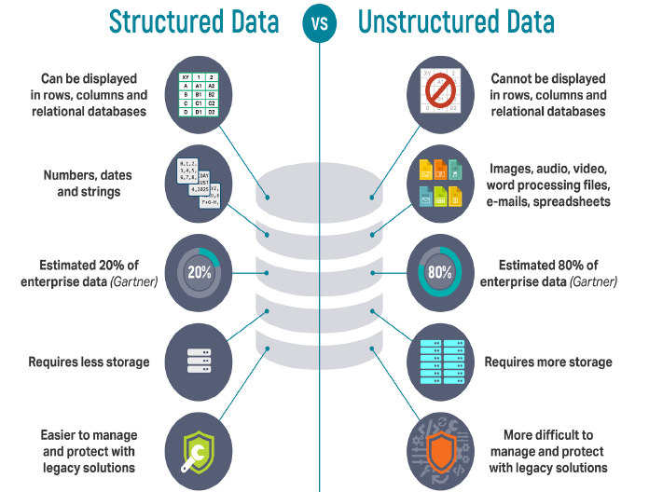
Introduction

Slide 5
Introduction
Knowing customer precise requirements from the existing data like the customer's past browsing history, purchase history, age and income.
With the vast amount and variety of data, you can train models more effectively and recommend the product to your customers with more precision.
The self-driving cars collect live data from sensors, including radars, cameras and lasers to create a map of its surroundings. Based on this data, it takes decisions like when to speed up, when to speed down, when to overtake, where to take a turn.

Slide 6
Introduction
Data from ships, aircrafts, radars, satellites can be collected and analyzed to build weather forecast models. These models will not only forecast the weather but also help in predicting the occurrence of any natural calamities.
Data analytical systems, such as Google Analytics, deliver you accurate data about who visited your website or e-commerce, when, from where what was he or she interested in, and many more.

Slide 7
Introduction to R
R is a programming language and free software environment for statistical analysis, graphics representation and reporting.
R was initially written by Ross Ihaka and Robert Gentleman at the Department of Statistics of the University of Auckland in Auckland, New Zealand.
R provides a wide variety of statistical (linear and nonlinear modelling, classical statistical tests, time-series analysis, classification, clustering, …) and graphical techniques, and is highly extensible.
R allows integration with the procedures written in the C, C++, .Net, Python or Java.

Slide 8
Introduction to R
R is an integrated suite of software facilities for data manipulation, calculation and graphical display.
  an effective data handling and storage facility,
  a suite of operators for calculations on arrays, in particular matrices,
  a large, coherent, integrated collection of intermediate tools for data analysis,
  graphical facilities for data analysis and display either on-screen or on hardcopy, and
  a well-developed, simple and effective programming language which includes conditionals, loops, user-defined functions and input and output facilities.

Slide 9
Introduction to R
R is an interpreted language meaning that all commands typed on the keyboard are directly executed without requiring to build a complete program.
Interpretation
  Translate the source program each time it has to be run; as it interprets the code every time it is intended to be executed;
  The interpreter checks if all subsequent lines are correct. If error found, it finishes its work immediately. (error message)
  Languages designed to be utilized in the interpretation manner are often called scripting languages, while the source programs encoded using them are called scripts.

Slide 10
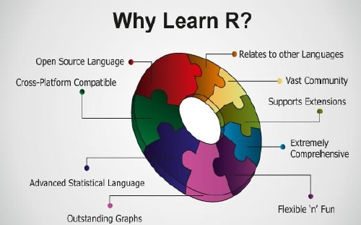
Introduction to R

Slide 11
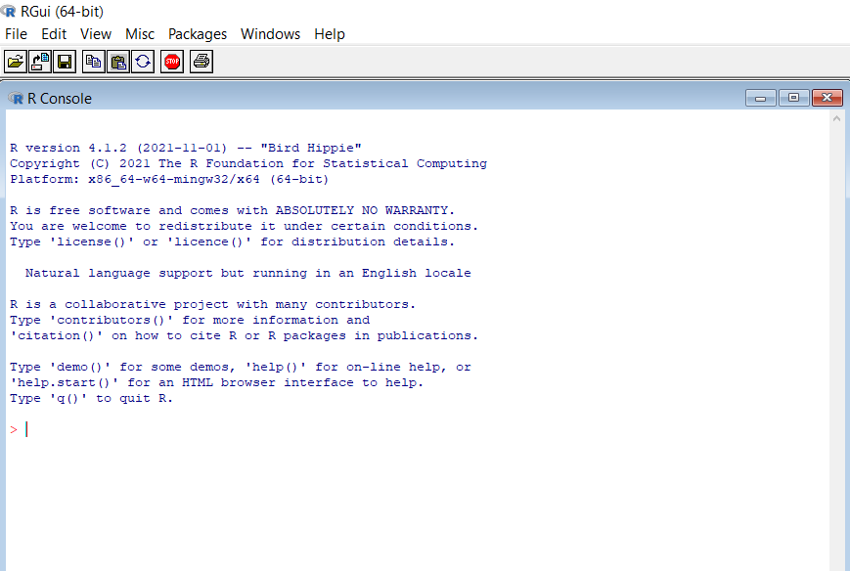
Setup
Download the installer from https://cran.rstudio.com/
Then, select the installer based on your OS type (windows, linux, macos)
You can run R by locating the installation folder locate at C:\Program Files\R\R-4.2.0\bin\x64 (64 bits) - and execute the Rgui application.

Slide 12
Setup
RStudio is an integrated development environment (IDE) for R. It is available in open source.
It includes a console, syntax-highlighting editor that supports direct code execution, as well as tools for plotting, history, debugging and workspace management.
RStudio provides the best tools that allow the data scientists to ingest, organize, and analyze data to find important insights.
You can install RStudio after R installation.

Slide 13
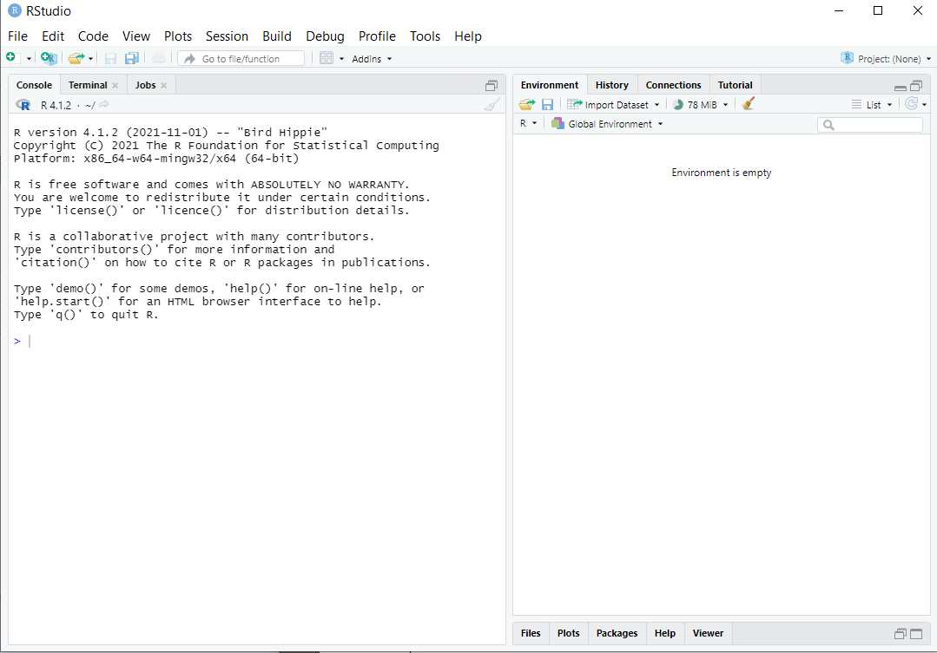
Setup

Slide 14
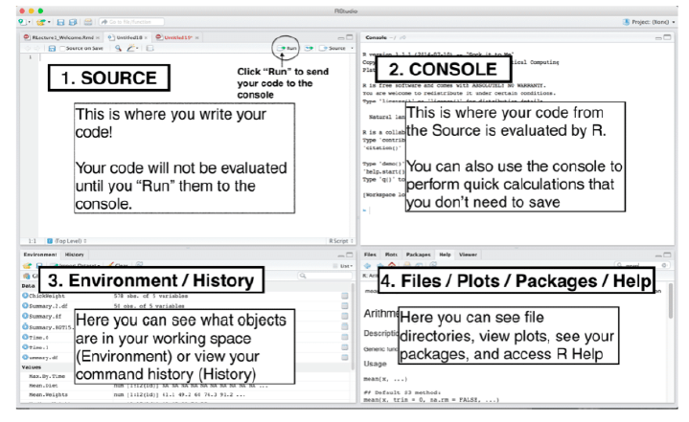
Setup

Slide 15
Setup
Source
  Where you create and edit R Scripts. R scripts are just text files with the .R extension.
Console
  The heart of R. It is also called a command window. Here is where R actually evaluates code. You can type code directly into the console after the prompt and get an immediate response.
  You can press Ctrl-L to clear the console command
  q() is used to quit R.

Slide 16
Setup
Environment
  It shows the names of all the data objects (like vectors, matrices, and dataframes) that you have defined in your current R session.
History
  This window shows all commands that were executed in the console.
Files
  The files panel gives you access to the file directory on your hard drive.

Slide 17
Setup
Plots
  This panel shows all your plots. There are buttons for opening the plot in a separate window and exporting the plot as a pdf or jpeg.
Packages
  Shows a list of all the R packages installed on your hard drive and indicates whether or not they are currently loaded.
  Packages can also be installed using the command:
    install.packages(packagename)
Help
  Help menu for R functions.

Slide 18

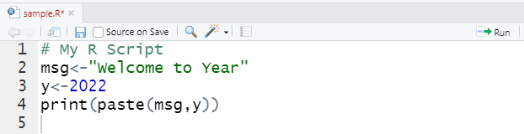
Running R
You can run statements using R interpreter
You can create R file using RStudio (new file → R Script). Just highlight the script you would like to run in the R file and press the run button.

Slide 19
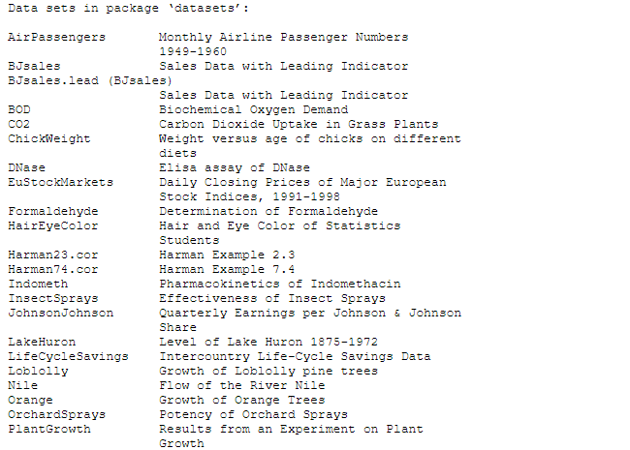
Running R
The data() command display all the datasets in the package

Slide 20
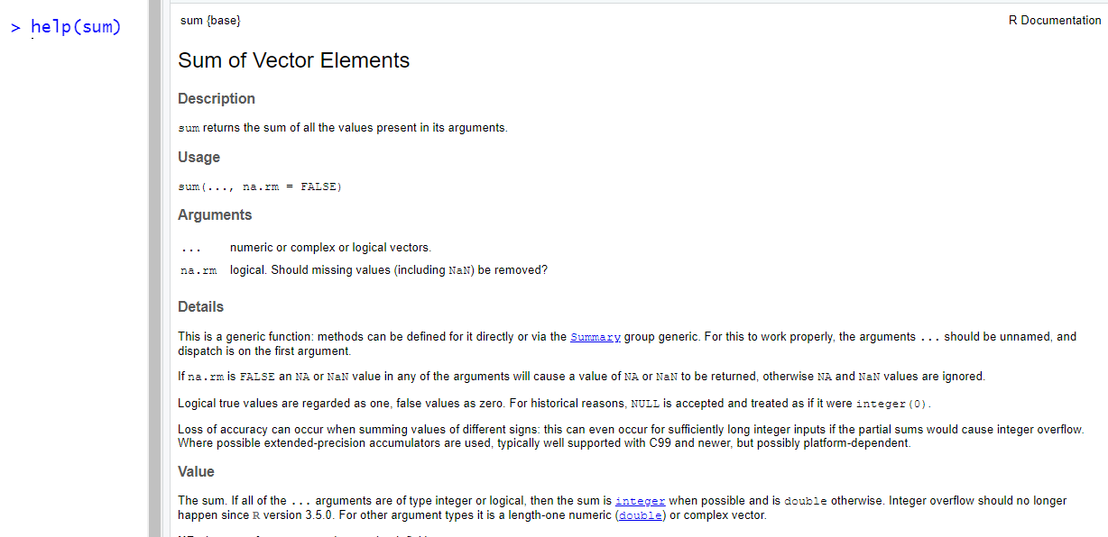
Running R
To learn more about the function of R, you can use help().

Slide 21
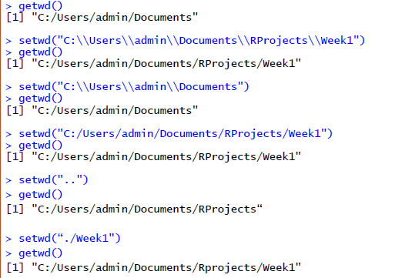
Running R
R Working Directory
  The folder to store the processing data files.
  getwd() is used to get the working directory.
  setwd() is used to set the working directory.
  list.files() is used to list all files in working directory.

Slide 22
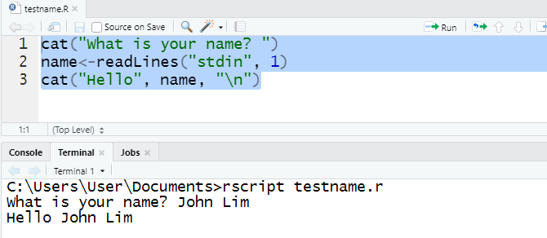
Running R
Running R File using Terminal
  The RStudio terminal provides access to the system shell from within the RStudio IDE.

Slide 23
R Markdown and RPubs
R Markdown is a special file type with the .Rmd suffix.
It is combination of text, Markdown, and R code.
Once you’ve written an R Markdown document, you can “knit” the document to construct all kinds of nicely formatted documents, from reports in PDF, to Web pages in HTML, or Word documents.
  install.packages("rmarkdown")
  https://rpubs.com/YaRrr/markdownbasics

Slide 24
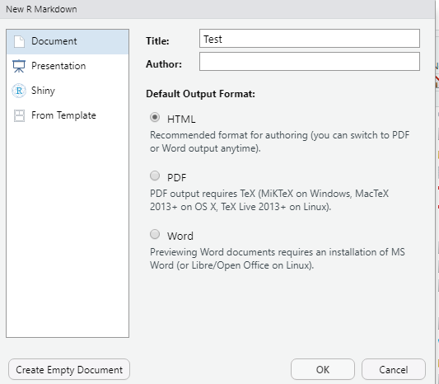
R Markdown and RPubs

Slide 25
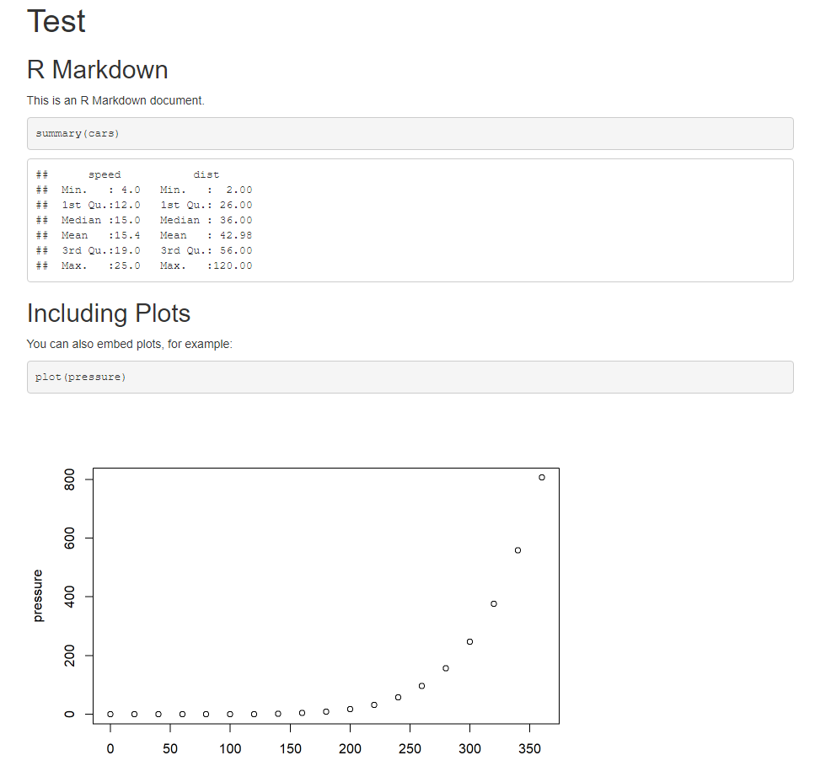
R Markdown and RPubs

Slide 26
R Markdown and RPubs
RPubs allow you to publish the R Markdown documents on the web.
You need to register an account at https://rpubs.com/
Then, press the publish button after you knit the R Markdown documents.

Slide 27
R Basic
R is case sensitive. A and a is different.
Comments can be used to explain R code, and to make it more readable. It can also be used to prevent execution when testing alternative code.
Comments starts with a # . When executing the R-code, R will ignore anything that starts with # .
However, R does not support multi-line comments or comment blocks.

Slide 28
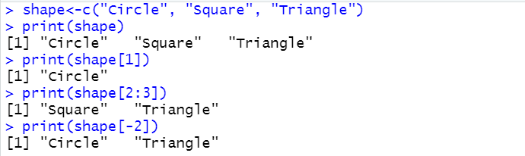
R Basic
Most basic type of R object is a vector.
A vector is a sequence of data elements of the same basic type. The c() function is used to create vector with multiple elements.
the vector element is printed in square brackets [], vector index start from 1.

Slide 29


