Slide 1
WQD7004
Programming for Data Science
Chapter 7
Data Cleaning

Slide 2
Contents
Introduction
Data Cleaning
Data Preparation
Data Conversion
Missing Value

Slide 3
Introduction
Data Science is all about a systematic process used by data scientists to analyze, visualize and model large amounts of data.
A data science process helps data scientists use the tools to find unseen patterns, extract data, and convert information to something meaningful.
However, we always face data quality problems due to manual data entry errors, duplicate data, missing values, data transformation errors etc.
Data quality problems are expensive and pervasive. It can lead to inaccurate analysis and poor business decisions.

Slide 4
Introduction
There are errors in data collection
  Corrupt records
  Missing values
    NA, ""
  Structural errors
    Data type errors (integer become character)
    Columns swap position
    Currency format change (USD → RM)
  Duplicate records
  Unwanted outliers

Slide 5
Introduction
Data Cleaning is the process of identifying the incorrect, incomplete, inaccurate, irrelevant or missing part of the data and then modifying, replacing or deleting them according to the necessity.
80% of a typical data science project is sourcing cleaning and preparing the data, while the remaining 20% is actual data analysis.
Mostly has to be performed almost manually with the help of tools such as R.
Data cleaning is considered a foundational element of the basic data science. The package used for cleaning data includes dplyr, tidyr, lubridate and stringr.

Slide 6
Data Cleaning
complete.cases() returns a data frame with no missing values.
any(is.na(dataframe)) is used to check any NAs value in the dataframe.
nrow(na.omit(dataframe)) is used to count the total rows with no NA values in any column of data frame.
Exclude missing value from analyses
  mean(x, na.rm=TRUE)
sum() function can be used to display the total rows with empty value and which() functions can be used to return the row number with empty value.

Slide 7
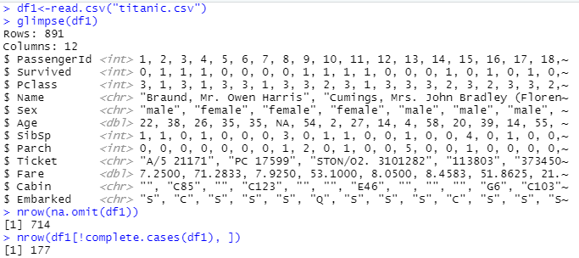

Data Cleaning
Exploring Raw Data

Slide 8
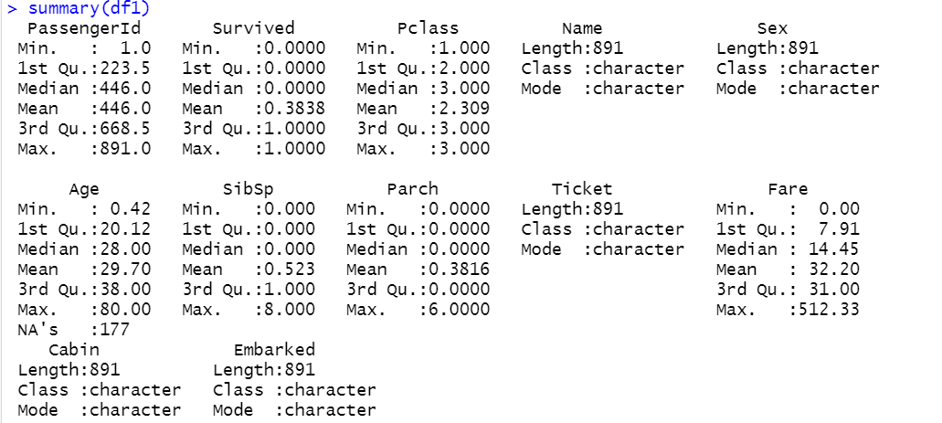
Data Cleaning

Slide 9
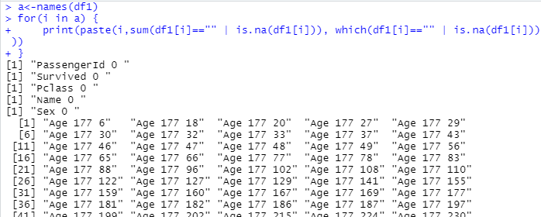
Data Cleaning

Slide 10
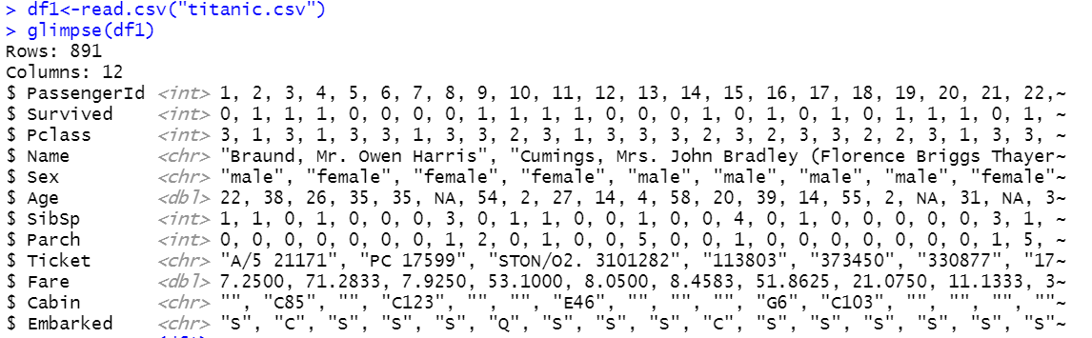
Missing Value
Replace all missing value, "" with NA.

Slide 11
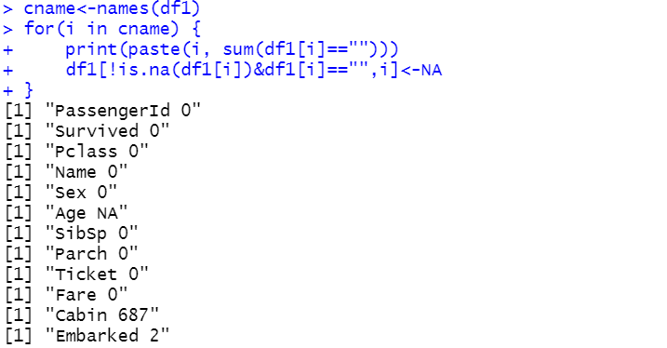
Missing Value

Slide 12
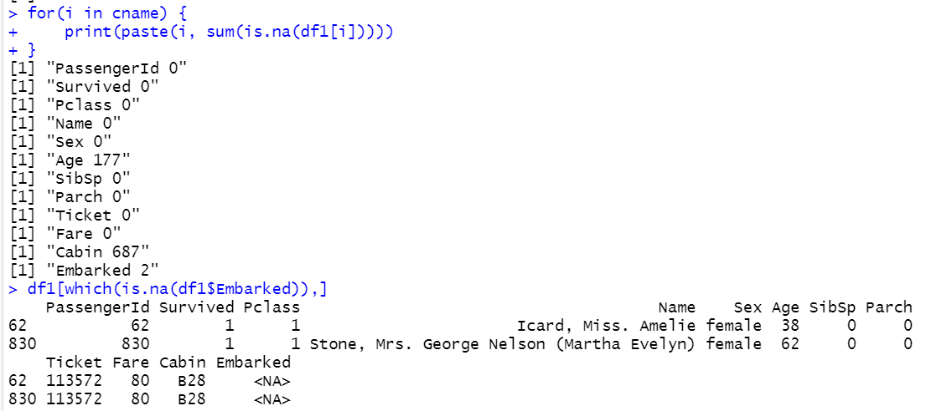
Missing Value

Slide 13
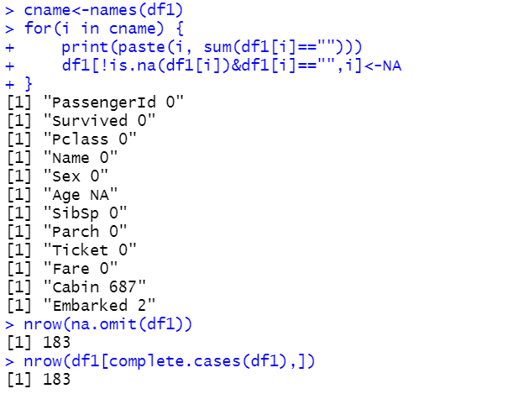
Missing Value
Before cleaning, the total rows with no NA values is 714. After cleaning, the total rows with no NA values is 183. This is due to a lot of missing value in Age and Cabin columns.

Slide 14
Data Preparation
Tidy data is data that’s easy to work with: it’s easy to manipulate (dplyr), visualise (ggplot2) and model.
The two most important properties of tidy data are:
  Each column is a variable
  Each row is an observation
tidyr is a package that reshapes the layout of the tables.
  install.packages("tidyverse")
  library(tidyverse)

Slide 15
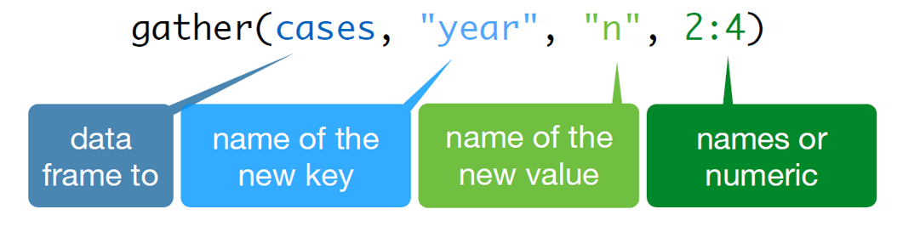
Data Preparation
gather() function
  It takes multiple columns and gathers them into key-value pairs, duplicating all other columns as needed.

Slide 16
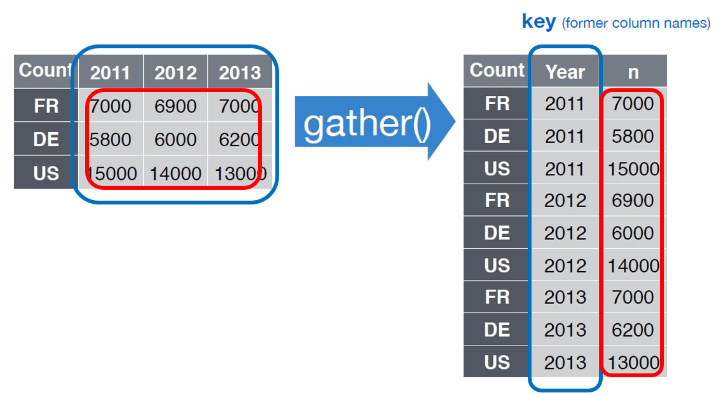
Data Preparation

Slide 17
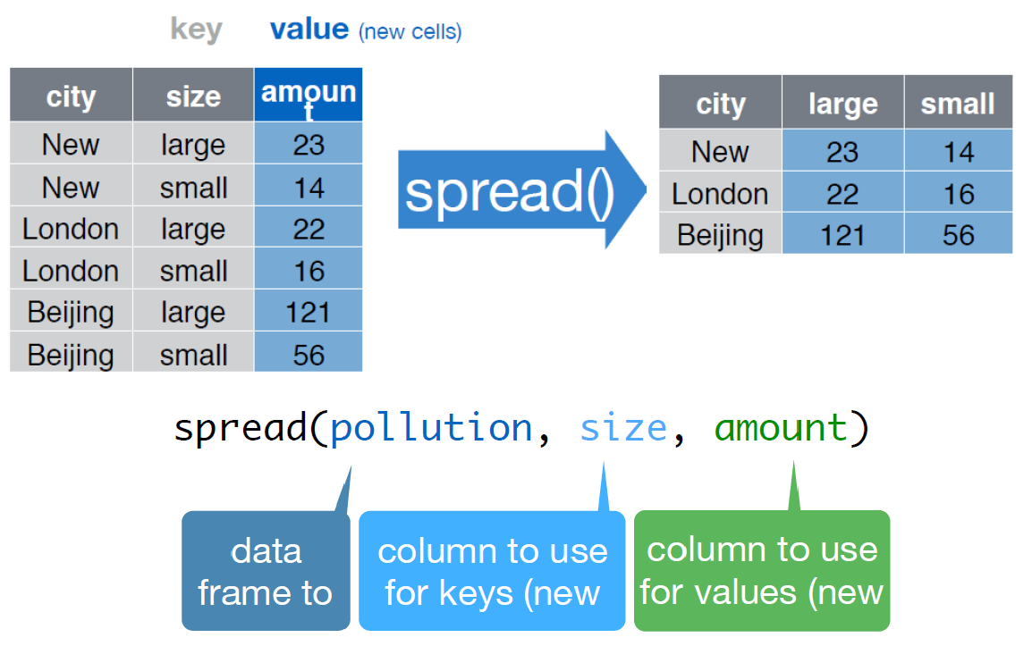
Data Preparation
spread() function
  It spreads a key-value pair across multiple columns

Slide 18
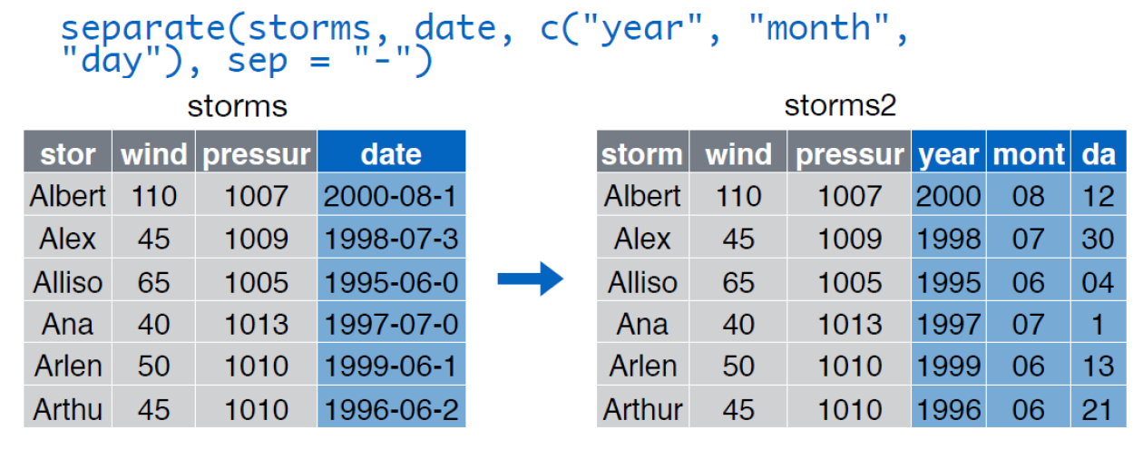
Data Preparation
separate() function
  Turns a single character column into multiple columns.

Slide 19
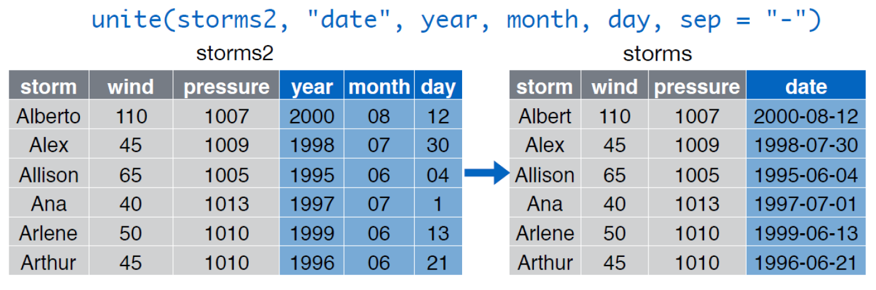
Data Preparation
unite() function
  It merges few columns into one column.
  It combines few variables of a single observation into one variable.

Slide 20
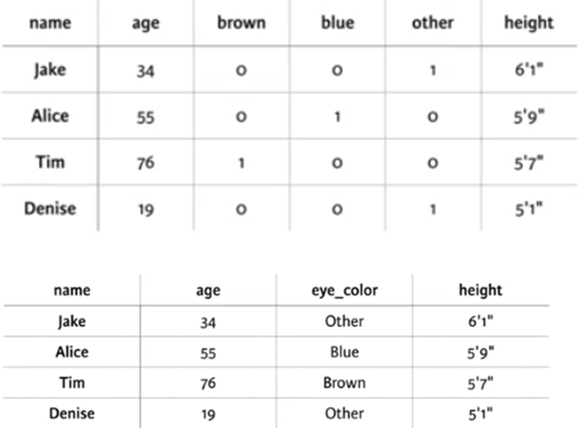
Data Preparation
Case Study 1

Slide 21
Data Preparation
Step 1 : Gather
  gather(df1, eye_color, color_value, 3:5)
Step 2 : Filter
  filter(df1, color_value==1)
Step 3 : Select
  select(df1, c("name", "age", "eye_color", "height"))
df1<-df1 %>% gather(eye_color, color_value, 3:5) %>% filter(color_value==1) %>% select(c("name", "age", "eye_color", "height"))

Slide 22
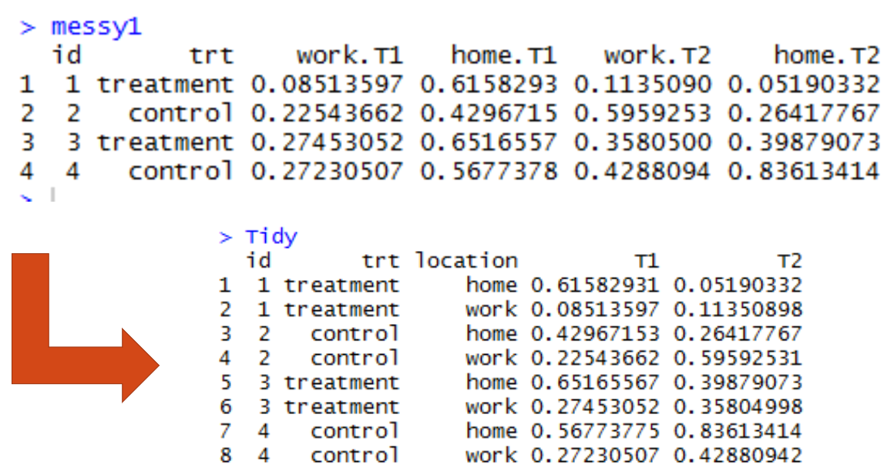
Data Preparation
Case Study 2

Slide 23
Data Preparation
Step 1 : Gather Key and Time
  gather(messy1, key, time, 3:6)
Step 2 : Separate key into two columns
  separate(messy1, key, c("Location", "Slot"), sep="\\.")
Step 3: Spread the Slot (value) into columns name
  spread(messy1, Slot, time)
tidy<-messy1 %>% gather(key, time, 3:6) %>% separate(key, c("Location", "Slot"), sep="\\.") %>% spread(Slot, time)

Slide 24
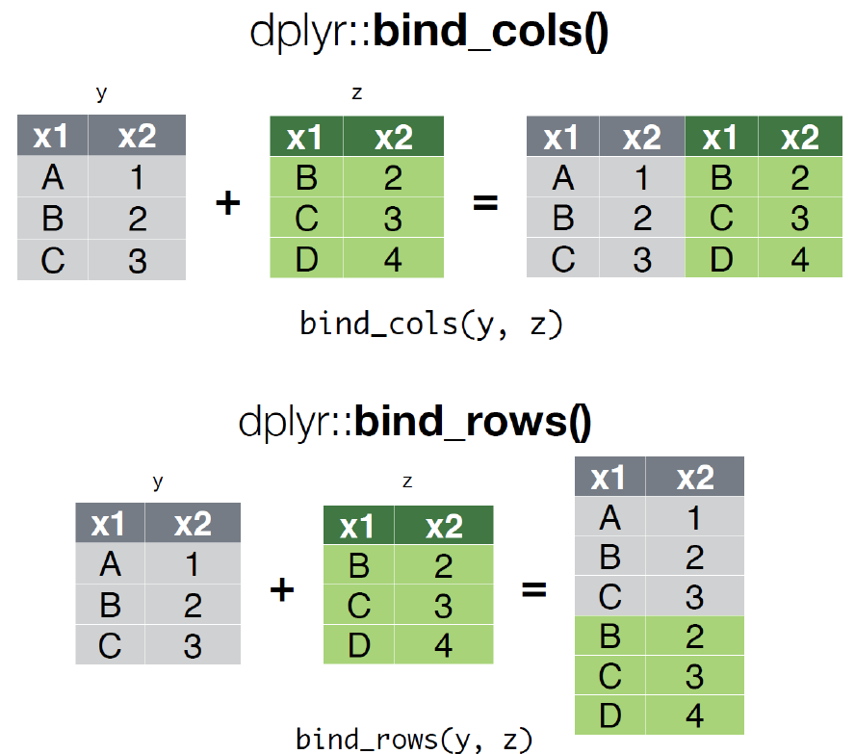
Data Preparation

Slide 25
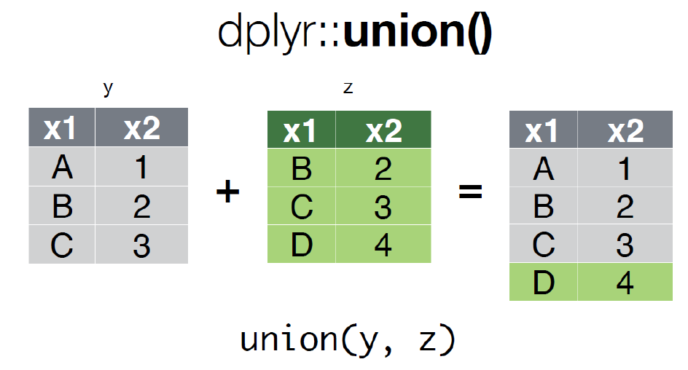
Data Preparation

Slide 26
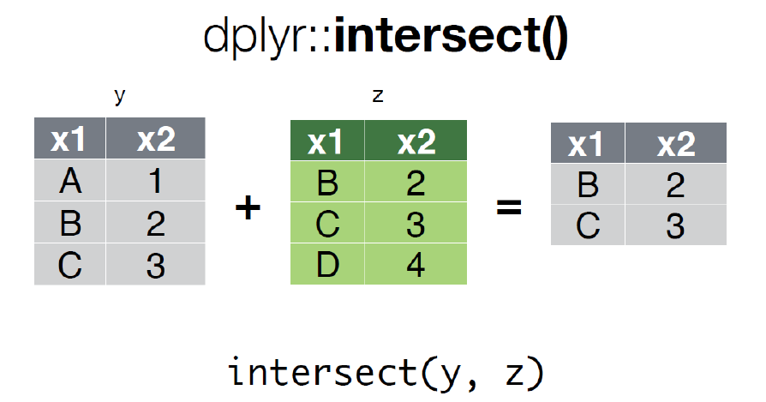
Data Preparation

Slide 27
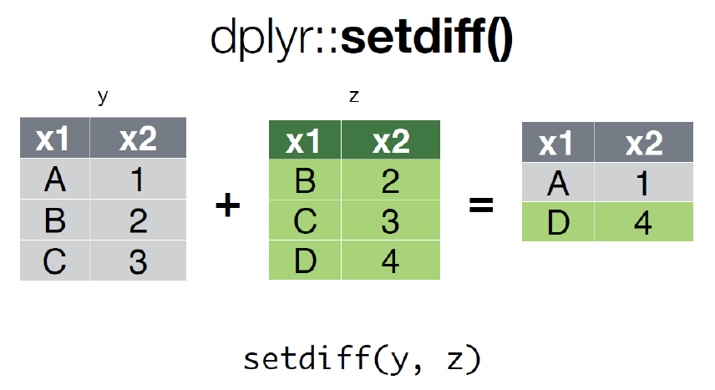
Data Preparation

Slide 28
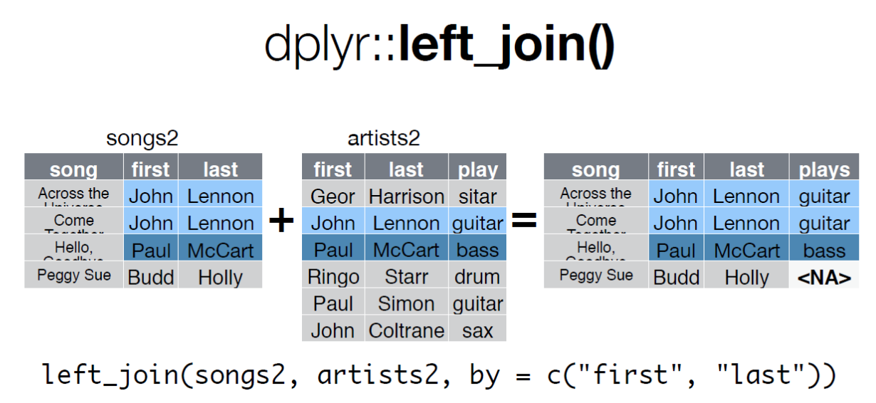
Data Preparation

Slide 29
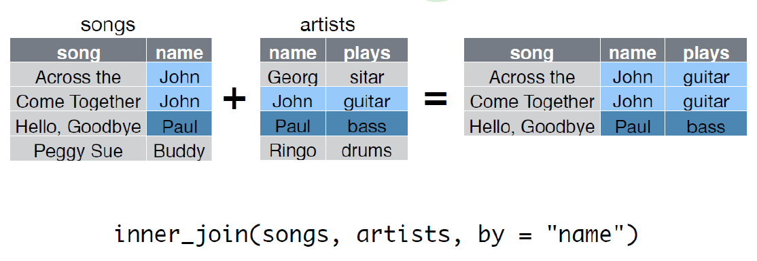
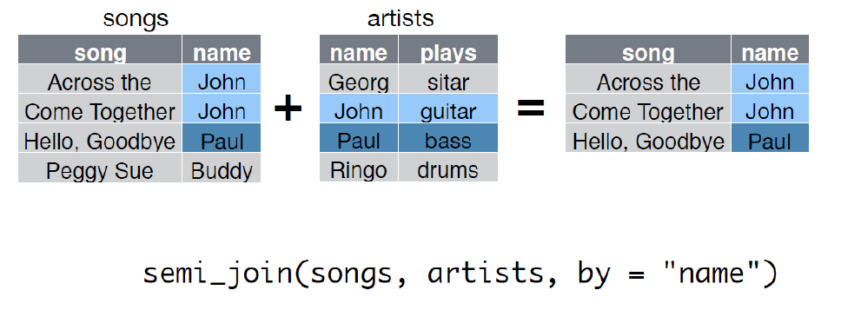
Data Preparation

Slide 30
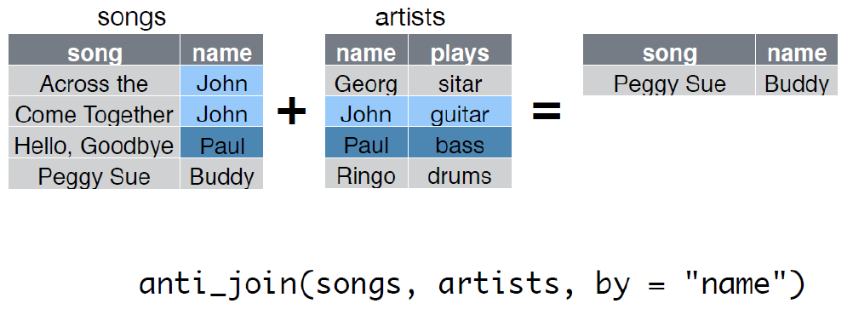
Data Preparation

Slide 31
Data Conversion
Date-time data can be frustrating to work with in R.
R commands for date-times are generally unintuitive and change depending on the type of date-time object being used.
Lubridate makes it easier with date-times.
  install.packages("lubridate")
  library(lubridate)
Common functions
  ymd(), ymd_hms(), dmy(), dmy_hms(), mdy()

Slide 32
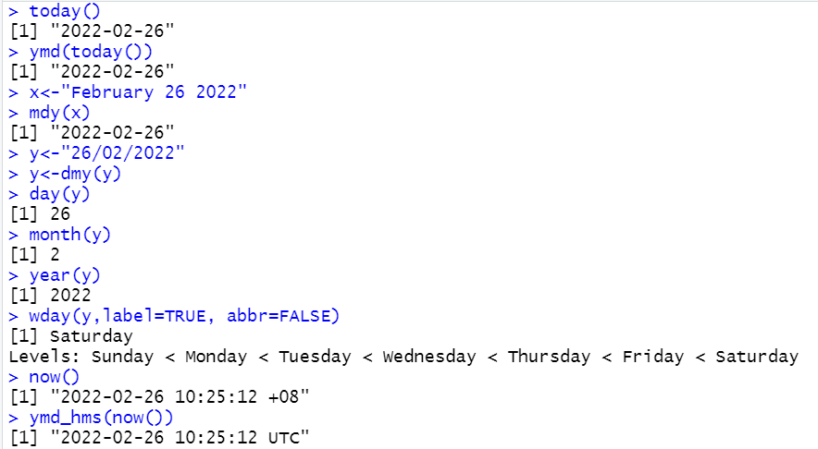
Data Conversion
today() and Sys.Date() function return today's date.
now() and Sys.time() function return current date and time.

Slide 33
Data Conversion
String plays a big role in many data cleaning and preparation tasks.
The stringr package provide a cohesive set of functions designed to make working with strings as easy as possible.
  install.packages("stringr")
  library(stringr)
Common functions
  str_trim(), str_pad(), str_detect(), str_replace(), toupper(), tolower()

Slide 34
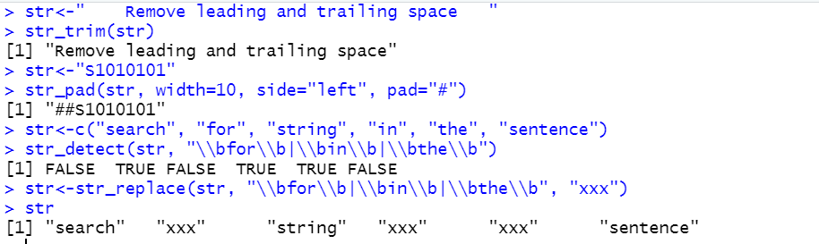
Data Conversion

Slide 35


