Slide 1
WQD7004
Programming for Data Science
Chapter 11
Shiny

Slide 2
Contents
Introduction
Build a User Interface
Reactive Output
Loading Data
Reactive Expressions
Share your Apps

Slide 3
Introduction
Shiny is an R package that makes it easy to build interactive web applications.
Shiny apps are contained in a single script called app.R. The script app.R located in a directory and can be run with runApp("directoryname").
  install.packages("shiny")
  library(shiny)

Slide 4
Introduction
app.R has three components:
  a user interface object controls the layout and appearance of your app.
  a server function contains the instructions that your computer needs to build your app.
    a call to the shiny App function creates Shiny app objects from an explicit UI/server pair.
      shinyApp(ui = ui, server = server)
  runApp("sample") if your Shiny app is in a directory called sample.

Slide 5
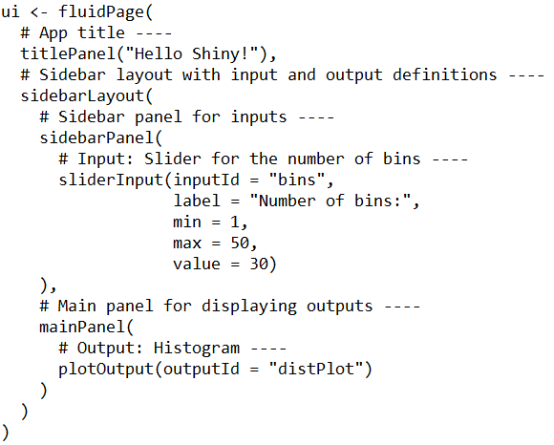
Introduction

Slide 6
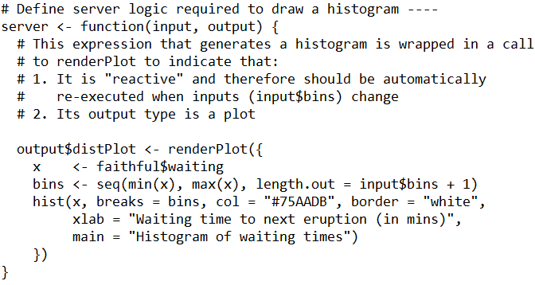
Introduction

Slide 7
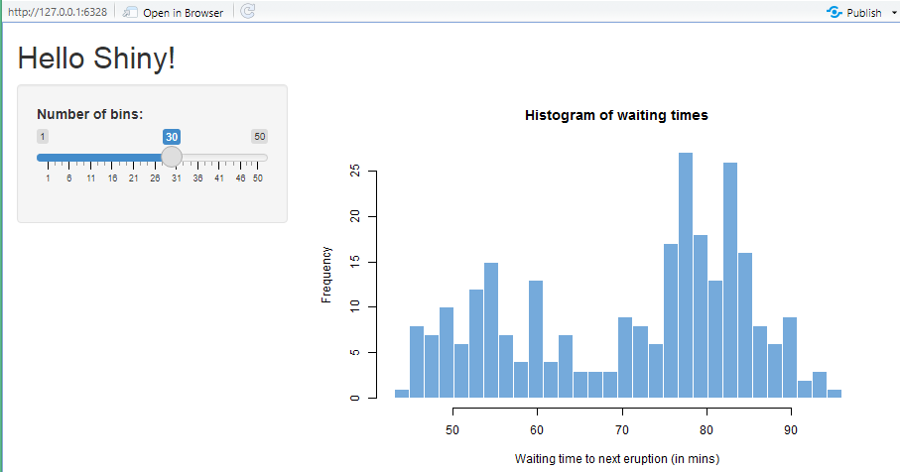
Introduction

Slide 8
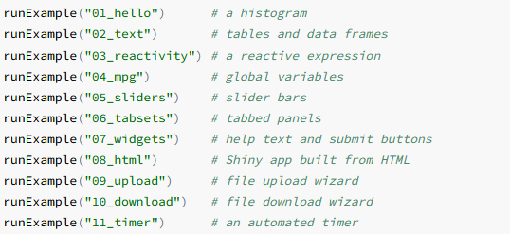
Introduction
You can create Shiny apps by copying and modifying existing Shiny apps. The Shiny gallery provides some good examples.

Slide 9
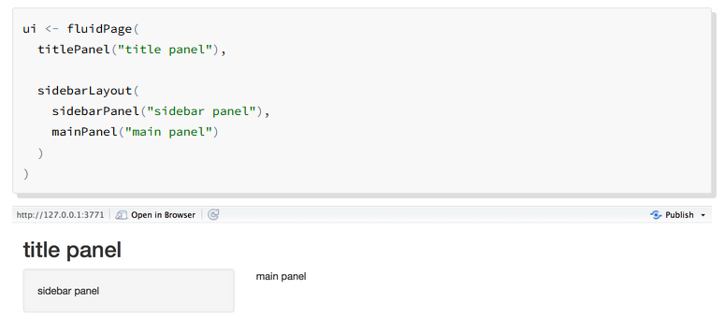
Build a User Interface
Shiny uses the function fluidPage to create a display that automatically adjusts to the dimensions of your user’s browser window.

Slide 10
Build a User Interface
You can add content to your Shiny app by placing it inside the panel function.
Images can enhance the appearance of your app and help your users understand the content. Shiny looks for the img function to place image files in your app.
The img function looks for your image file in a specific place. Your file must be in a folder named www in the same directory as the app.R script.
  img(src="imagefilename")
We can design custom layouts using grid layout system
  fluidRow() & column()

Slide 11
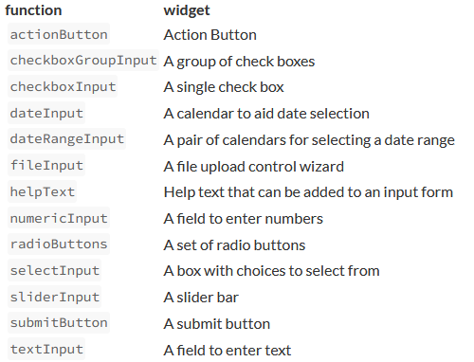
Build a User Interface
Widgets provide a way for your users to send messages to the Shiny app.
Shiny comes with a family of pre-built widgets, each created with a transparently named R function.

Slide 12
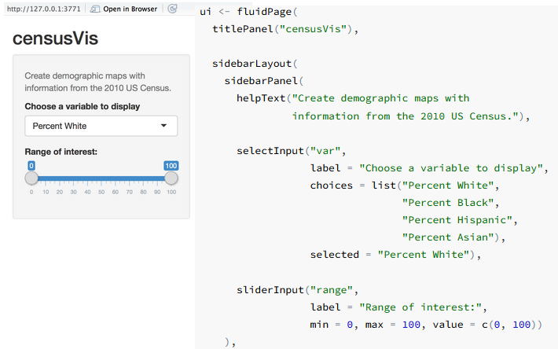
Build a User Interface
Each widget function requires several arguments. The first two arguments for each widget are a name for the widget and a label.

Slide 13
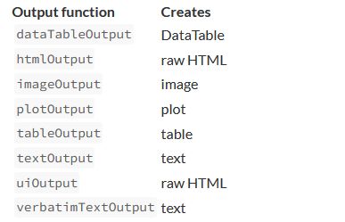
Reactive Output
Shiny provides a family of functions that turn R objects into output for your user interface. Each function creates a specific type of output.

Slide 14

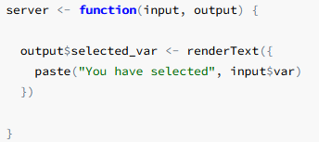
Reactive Output
The textOutput takes an argument, the character string "selected_var“
The server function plays a special role in the Shiny process; it builds a list-like object named output that contains all the code needed to update the R objects in your app.
In the server function below, output$selected_var matches textOutput("selected_var") in your ui.

Slide 15
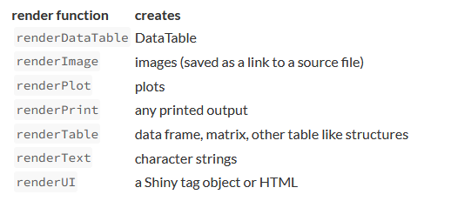
Reactive Output
Each entry to output should contain the output of one of Shiny’s render* functions. These functions capture an R expression and do some light pre-processing on the expression. Each render* function takes a single argument: an R expression surrounded by braces, {}

Slide 16
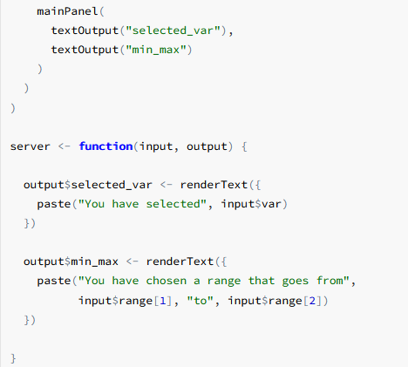
Reactive Output
Shiny will automatically make an object reactive if the object uses an input value.
Shiny tracks which outputs depend on which widgets. When a user changes a widget, Shiny will rebuild all the outputs that depend on the widget, using the new value of the widget as it goes. As a result, the rebuilt objects will be completely up-to-date.

Slide 17
Loading Data
A choropleth map is a map that uses color to display the regional variation of a variable. The maps and mapproj packages are required for a choropleth map.
  install.packages("maps")
  install.packages("mapproj")
The dataset file is usually stored in the data folder in your Shiny apps.
helpers.R is an R script that can help you make choropleth maps.
The first three arguments, var, color, and legend.title, depend on the value of the select box widget.
The last two arguments, max and min, should be the max and min values of the slider bar widget.

Slide 18
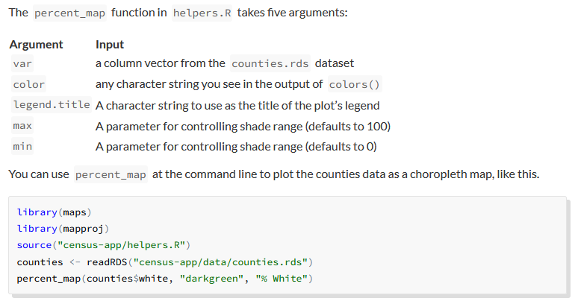
Loading Data

Slide 19
Reactive Expressions
Reactive expressions let you control which parts of your app update, which prevents unnecessary computation that can slow down your app.
A reactive expression is an R expression that uses widget input and returns a value. The reactive expression will update this value whenever the original widget changes.
To create a reactive expression, use the reactive function, which takes an R expression surrounded by braces {}

Slide 20
Reactive Expressions
Reactive expressions are a bit smarter than regular R functions. They cache their values and know when their values have become outdated.
The first time that you run a reactive expression, the expression will save its result in your computer’s memory.
The next time you call the reactive expression, it can return this saved result without doing any computation (which will make your app faster).

Slide 21
Reactive Expressions
The reactive expression will only return the saved result if it knows that the result is up-to-date. If the reactive expression has learned that the result is obsolete (because a widget has changed), the expression will recalculate the result. It then returns the new result and saves a new copy. The reactive expression will use this new copy until it too becomes out of date.
You can use this behavior to prevent Shiny from re-running code unnecessarily.

Slide 22
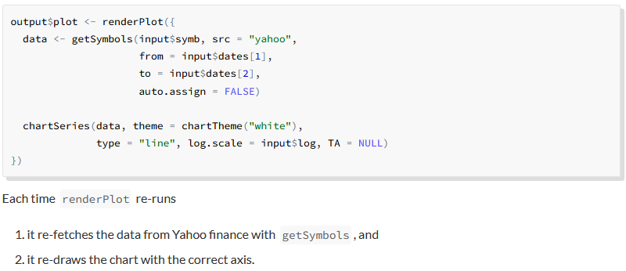
Reactive Expressions

Slide 23
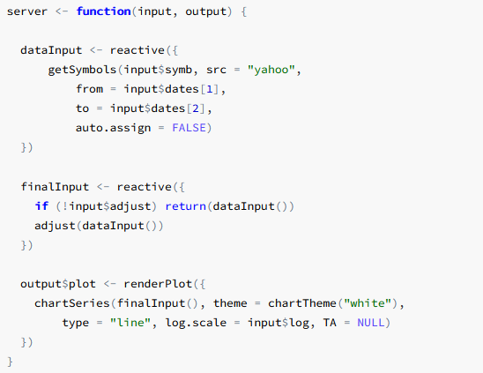
Reactive Expressions

Slide 24
Share your Apps
After building the useful Shiny app, it can be shared with others.
Share your Shiny app as R scripts. Users can use these scripts to launch the app from their own R session.
Share your Shiny app as a web page. This is the most user-friendly way to share a Shiny app. Your users can navigate to your app through the internet with a web browser. They will find your app fully rendered, up to date, and ready to go.
Shiny has three built in commands that make it easy to use files that are hosted online: runUrl, runGitHub, and runGist.

Slide 25
Share your Apps
runUrl will download and launch a Shiny app straight from a weblink.
To use runURL:
  Save your Shiny app’s directory as a zip file
  Host that zip file at its own link on a web page. Anyone with access to the link can launch the app from inside R by running:
  library(shiny)
  runUrl( "<the weblink>")

Slide 26
Share your Apps
runGitHub
  To share an app through GitHub, create a project repository on GitHub. Then store your app.R file in the repository, along with any supplementary files that the app uses.
  runGitHub( "<your repository name>", "<your user name>")

Slide 27
Share your Apps
runGist
  If you want an anonymous way to post files online, GitHub offers a pasteboard service for sharing files at gist.github.com.
  To share your app as a gist:
    Copy and paste your app.R files to the gist web page.
Once you’ve made a gist, your users can launch the app with runGist("<gist number>") where "<gist number>" is the number that appears at the end of your Gist’s web address.

Slide 28
Share your Apps
RStudio offers three ways to host your Shiny app as a web page:
  shinyapps.io - upload your app straight from your R session to a server hosted by RStudio.
  Shiny Server
  RStudio Connect

Slide 29


