Slide 1

COM692 Coursework 2 Presentation Football Data Analytics: Insights from the English Premier League
Rahmatul Ektidar Aziz
10280470

Slide 2
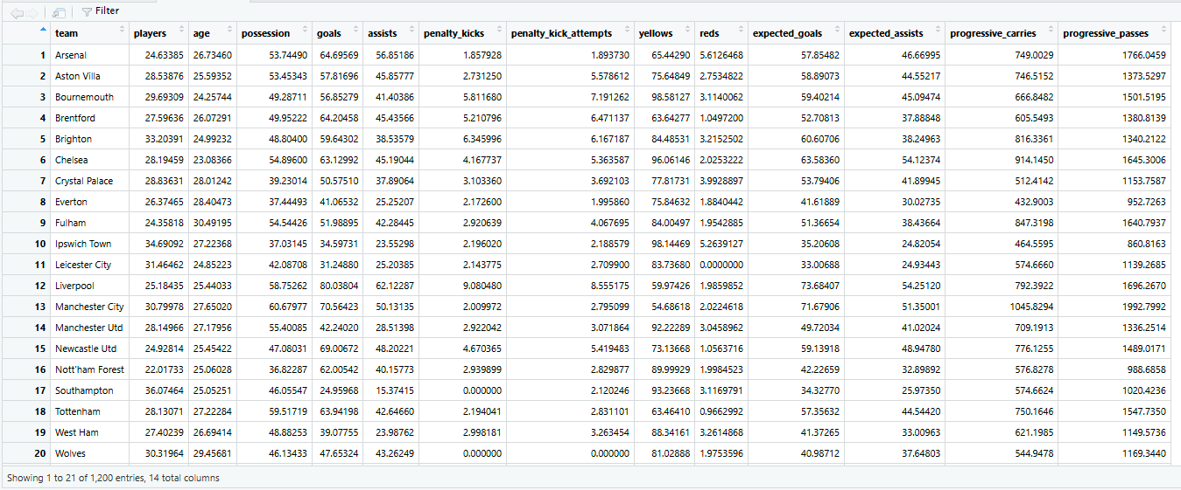
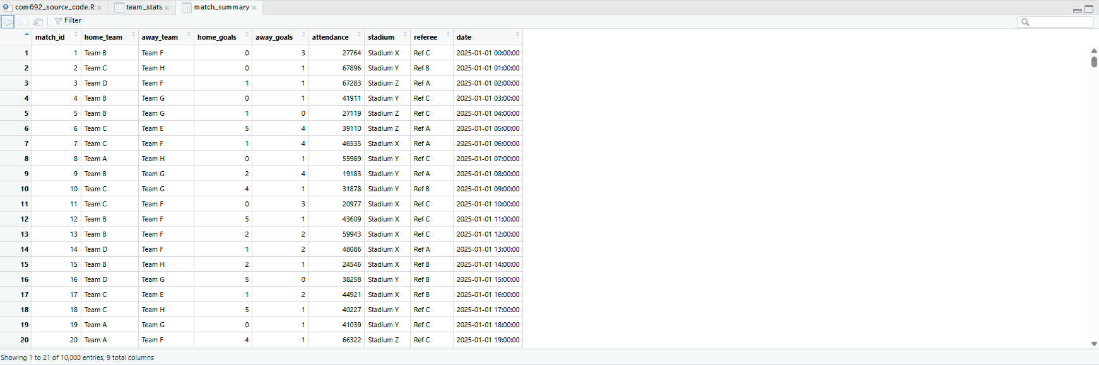
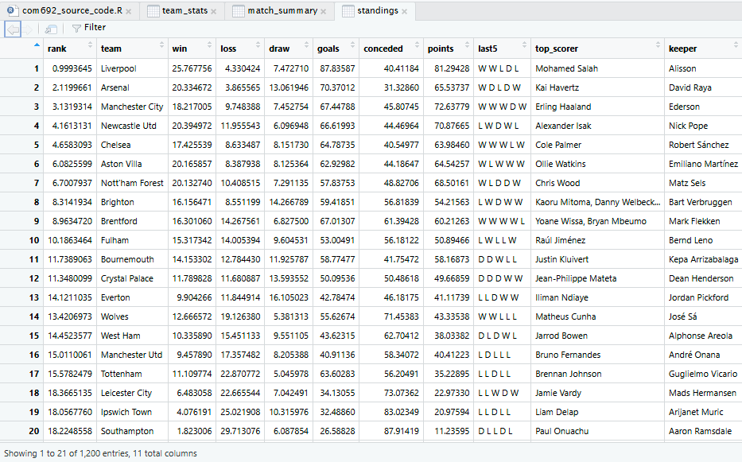
Introduction
Domain - English Premier League (EPL)
Dataset – Public CSVs (Team stats, match summaries, standings)
Fig1: Team stats Fig2: Match Summaries Fig3: Standings
Objective - Explore patterns and build a model to predict match outcomes

Slide 3


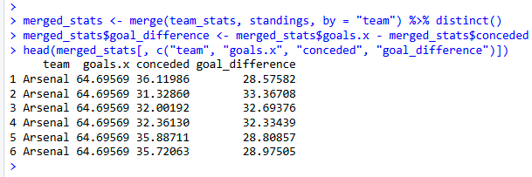
Data Processing
Removed duplicates from match summary
This confirms all duplicate rows have been removed
Formatted Data Column
The date column is now in proper POSIXct format
Removed Missing Values
Confirms no NA values remain in the dataset
Merged team stats with standings
New column goal_differemce added and correct (goals – co nceded)

Slide 4
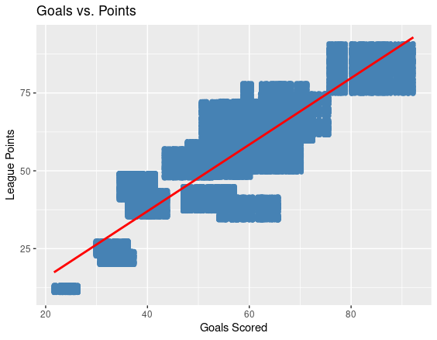

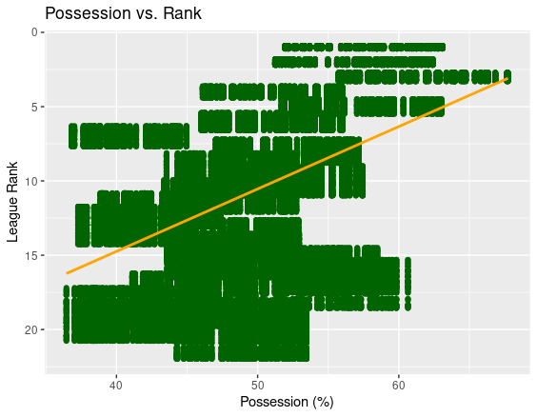
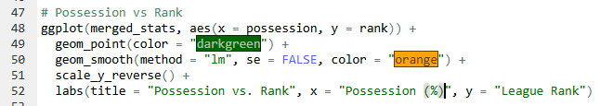
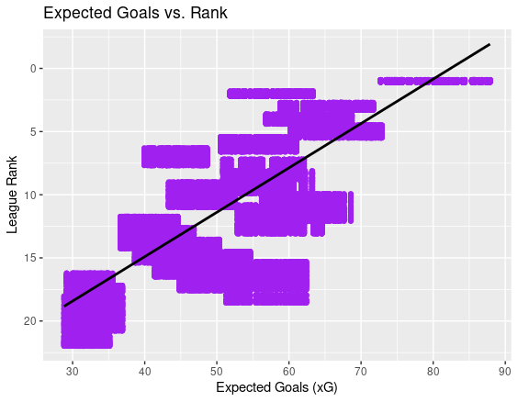
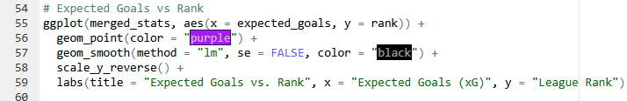
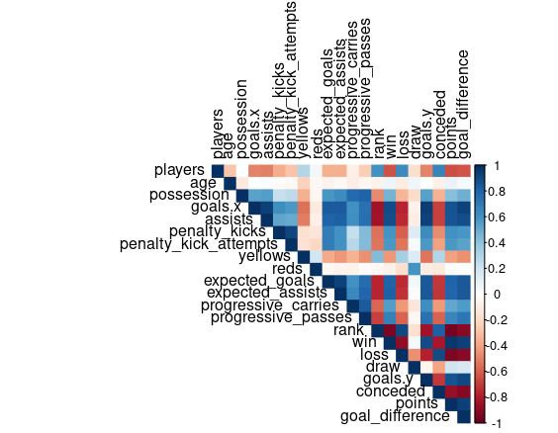

Exploratory Data analysis

Slide 5
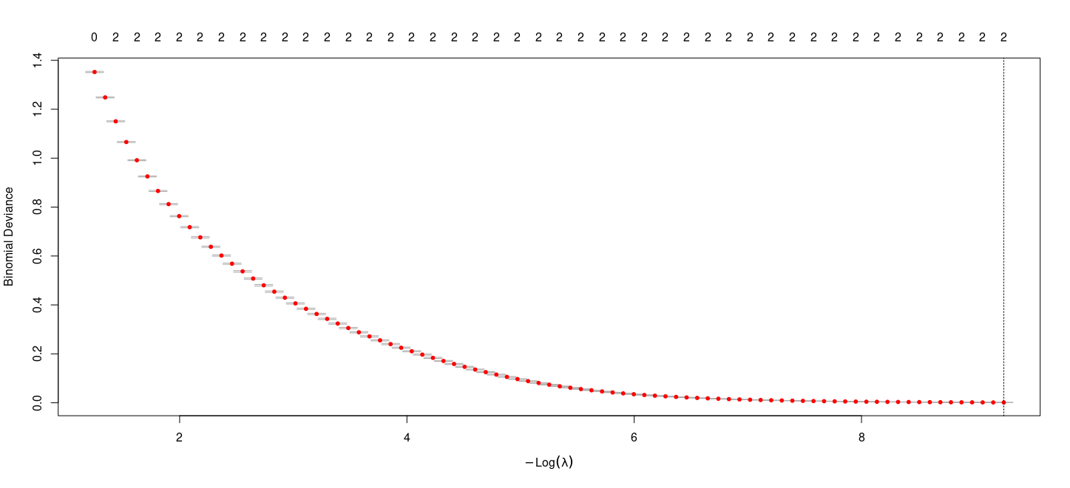
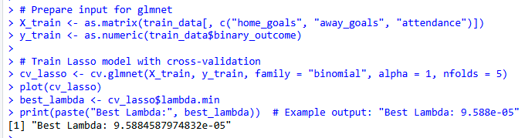
Predictive Modeling
Binary outcome defined : HomeWin =1, Else = 0
Used Lasso Logistic Regression : (cv.glmnet)
Train-test split : (80/20)
Results : Accuracy : 100%, AUC : 1.0
I used a Lasso Logistic Regression model with an 80/20 train-test split. The model achieved 100% accuracy and AUC of 1.0 on the test set, but this result likely indicates overfitting. In future iterations, I would explore adding more predictors or regularisation tuning.

Slide 6
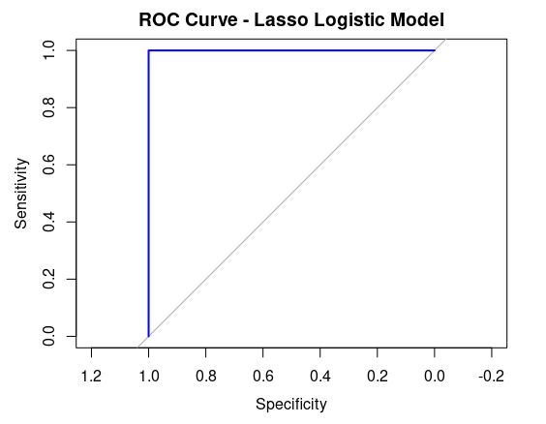
EVALUATION AND INSIGHTS
✅ ROC curve indicates strong separation (AUC = 1.0); may require further validation
⚡ Possession, xG, and goal count strongly correlate with better league rank
📈 Home goals and attendance are predictive of home wins (via Lasso logistic regression)

Slide 7
Conclusion
🧹 Thorough data cleaning (e.g., duplicates, NAs, date parsing) and correlation analysis identified key predictors
🛡️ Lasso regularisation improved model generalisation — but perfect accuracy suggests further validation is needed
✅ All project objectives were addressed with meaningful analytical results
✅ Project goals were met; future work will explore more robust evaluation methods

Slide 8
references
📦 R packages: ggplot2, dplyr, corrplot, glmnet, pROC
📊 Dataset: Custom-created CSVs from Kaggle ( https://www.kaggle.com/datasets/flynn28/2025-premier-league-stats-matches-salaries)
📚 Course Material: Lecture material from COM692
📖 Documentation: CRAN documentation for glmnet & pROC

