Slide 1
MyStudies: Smart Academic Organizer
Graduation Project – Final Presentation
Jubail Industrial College - COIT - Semester #471 - 12/2025
Supervisor: Dr. Mohamed Yassine El Amrani
Section: 3
Team Members:
Asim Alzahrani (421900453)
Mustafa Al Qattan (441101247)
Majed Almutairi (431900118)
Abdulaziz Alghamdi (421901508)
Turki Alshaikh (422100018)

Slide 2
Introduction & Problem Statement
Students often struggle with academic responsibilities due to fragmented information and inefficient processes.
Problems
Impact
Static PDF schedules
Poor organization
Deadlines scattered across Blackboard announcement
Missed deadlines
Scattered academic resources
Increased student workload
These challenges highlight the need for an automated, centralized academic management system designed specifically for students.

Slide 3
Solution: MyStudies
MyStudies is a mobile application that helps students manage classes, deadlines, and announcements in one place.
Purpose
Target Users
Automatically convert schedules and announcements
into calendar events
College and university students
Enhance organization & time management
MyStudies helps students stay organized and avoid missing important academic deadlines.

Slide 4
Main Features
MyStudies offers a comprehensive suite of features to address core academic organization challenges.
Automatic Import
OCR Scanning
Unified Calendar
Automatically import class schedules from PDFs, eliminating manual data entry.
Scan Blackboard announcements via OCR to capture deadlines and key information, with integrated reminders.
Centralized calendar view for all academic events, consolidating schedules and deadlines.
GPA Tracking
Calendar Export
Calculate current and predict target GPA to monitor academic progress effectively.
Export academic events seamlessly to Google/Apple Calendar.

Slide 5




System Architecture Overview
Our modular and maintainable architecture ensures a stable and scalable application.
Flutter UI Layer
Business Logic (BLoC/Cubit)
Provides an intuitive, responsive user interface for seamless interaction.
1
Manages state for predictive and consistent application behavior.
2
Cloud PDF Parsing Service (Python)
4
Local SQLite Database
3
Ensures secure and efficient storage of academic data.
backend for processing static PDF schedules.
Design Goal: Achieve clear separation of concerns and stable state management.

Slide 6
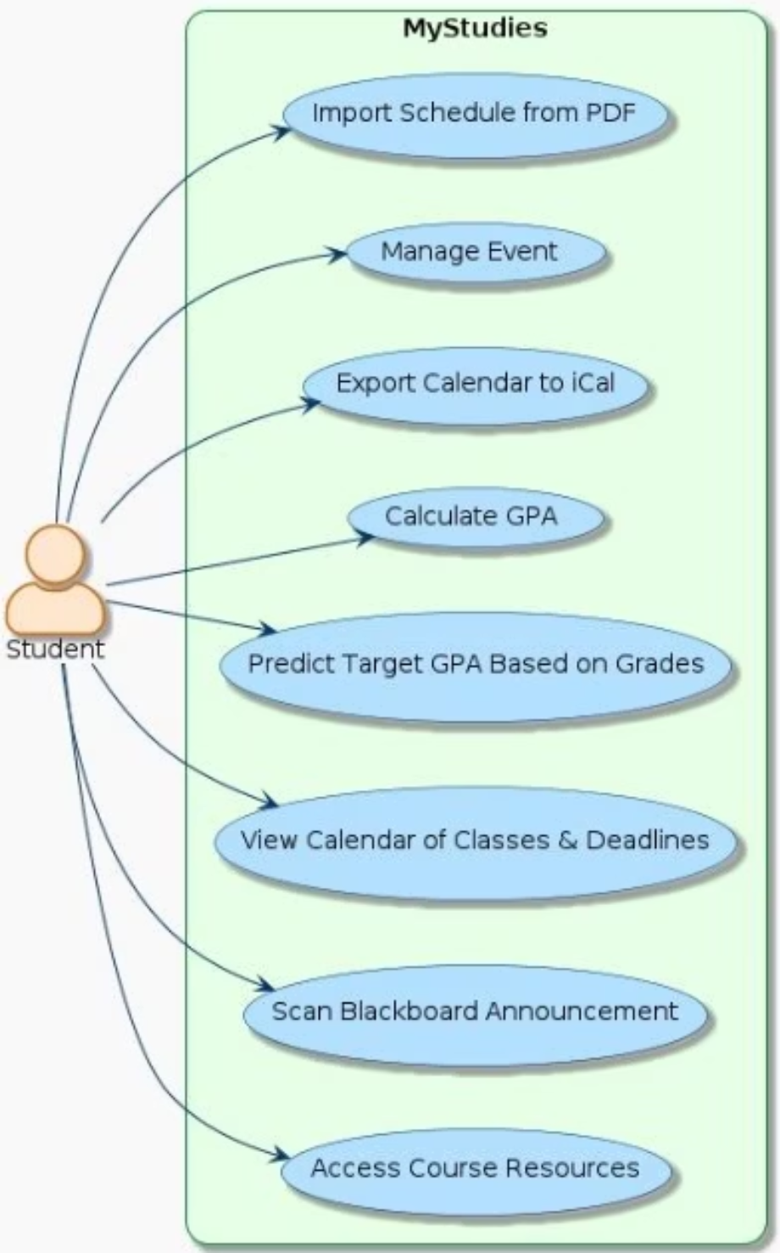
Use Case Diagram
This diagram illustrates the interactions between the student user and the MyStudies application, highlighting all primary functionalities.

Slide 7
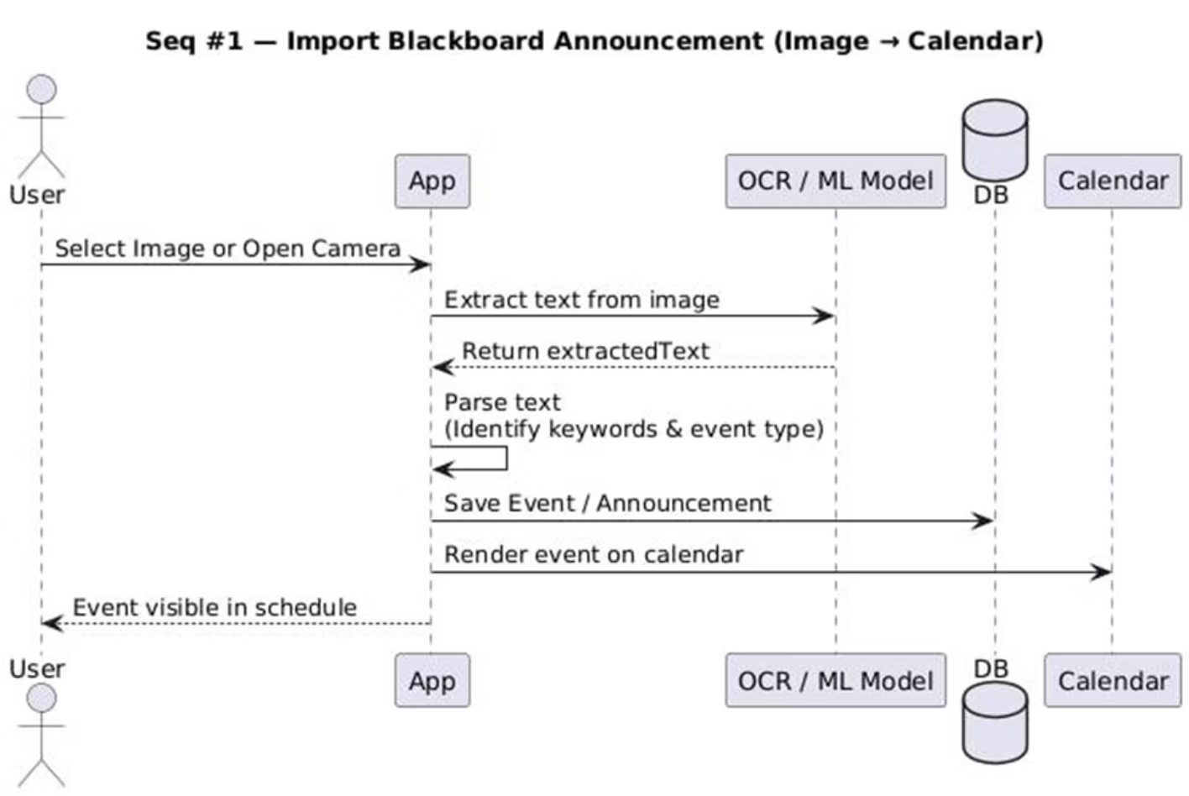
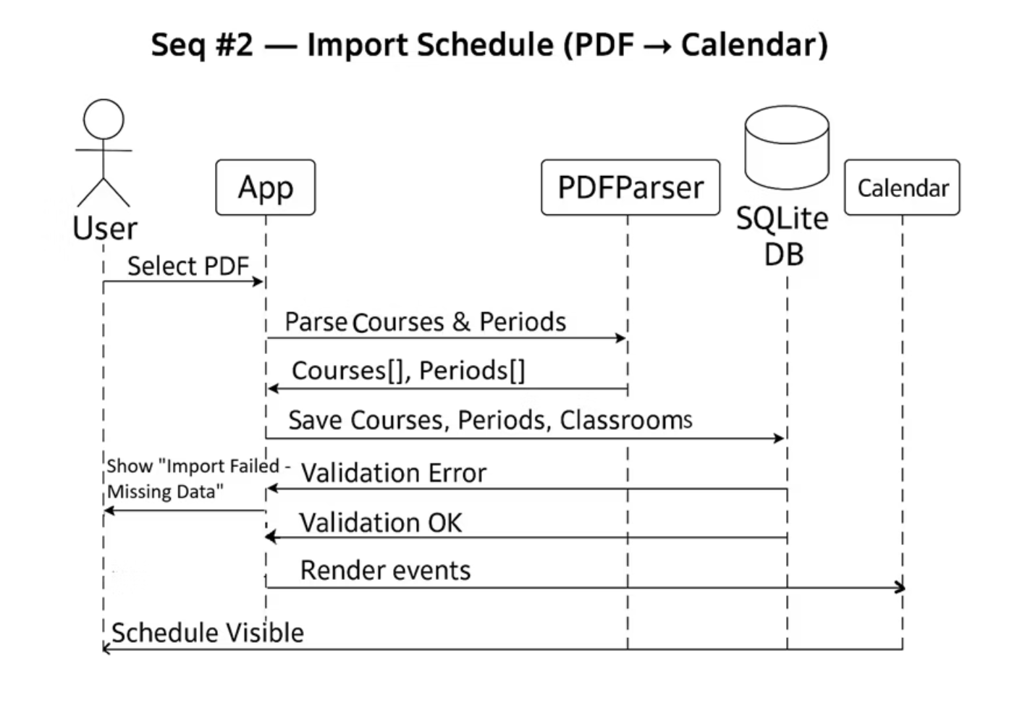
Sequence Diagrams​
Announcement Import (OCR) Sequence Diagram
Schedule Import Sequence Diagram

Slide 8
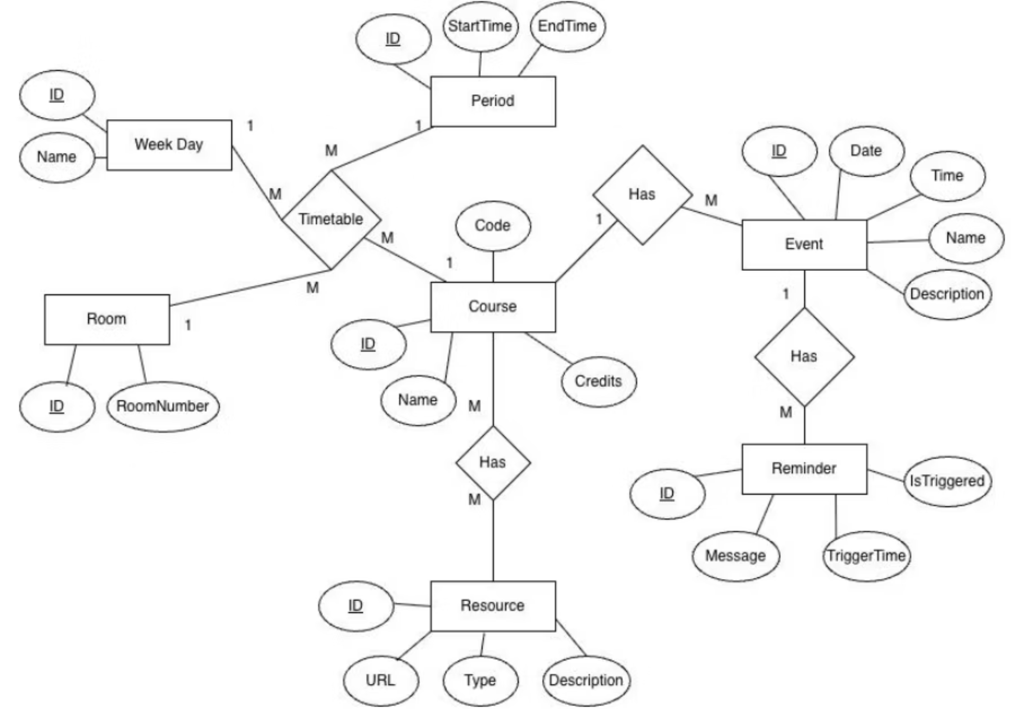
Entity Relationship Diagram (ERD)

Slide 9
Professional Development & Lessons Learned
Technical Skills Acquired
Advanced Flutter & Dart (BLoC/Cubit)
Cloud API Development: Python & RESTful APIs
AI/ML Integration: Google ML Kit for OCR
Version Control: Git & GitHub for collaborative development
Obstacles & Solutions
Obstacle
Description
Solution
PDF Layout Inconsistency
Dart package limitations in table detection
Implemented Python backend (pdfplumber)
OCR Accuracy
Inaccurate OCR reads from low-quality images
Integrated human-in-the-loop verification

Slide 10
Conclusion & Future Work
Key Achievements
Delivered a production-ready mobile application.
Demonstrated advanced technical integration (Flutter, Python, ML Kit, SQLite).
Overcame significant technical challenges with innovative solutions.
Impact
Simplifies academic management
Reduces manual work and errors
Boosts student productivity
Future Enhancements
Cloud Sync for Multi-Device Access
Peer Academic Resource Sharing
Major-Specific Study Plans

