Slide 1
WEB SCRAPING AND LINEAR REGRESSION
By Turki & Ahmed

Slide 2
Goal
our goal is to build a regression model for car prices based on the data collected from carvago. com. We had 5959 rows and 11 columns.

Slide 3
Plan
Web Scraping
Exploratory Data Analysis
Modeling
Communicate Findings and Results.

Slide 4
Tools Used
Python
Pandas
NumPy
BeautifulSoup
Matplot
Seaborn
Sklearn
Patsy
request

Slide 5
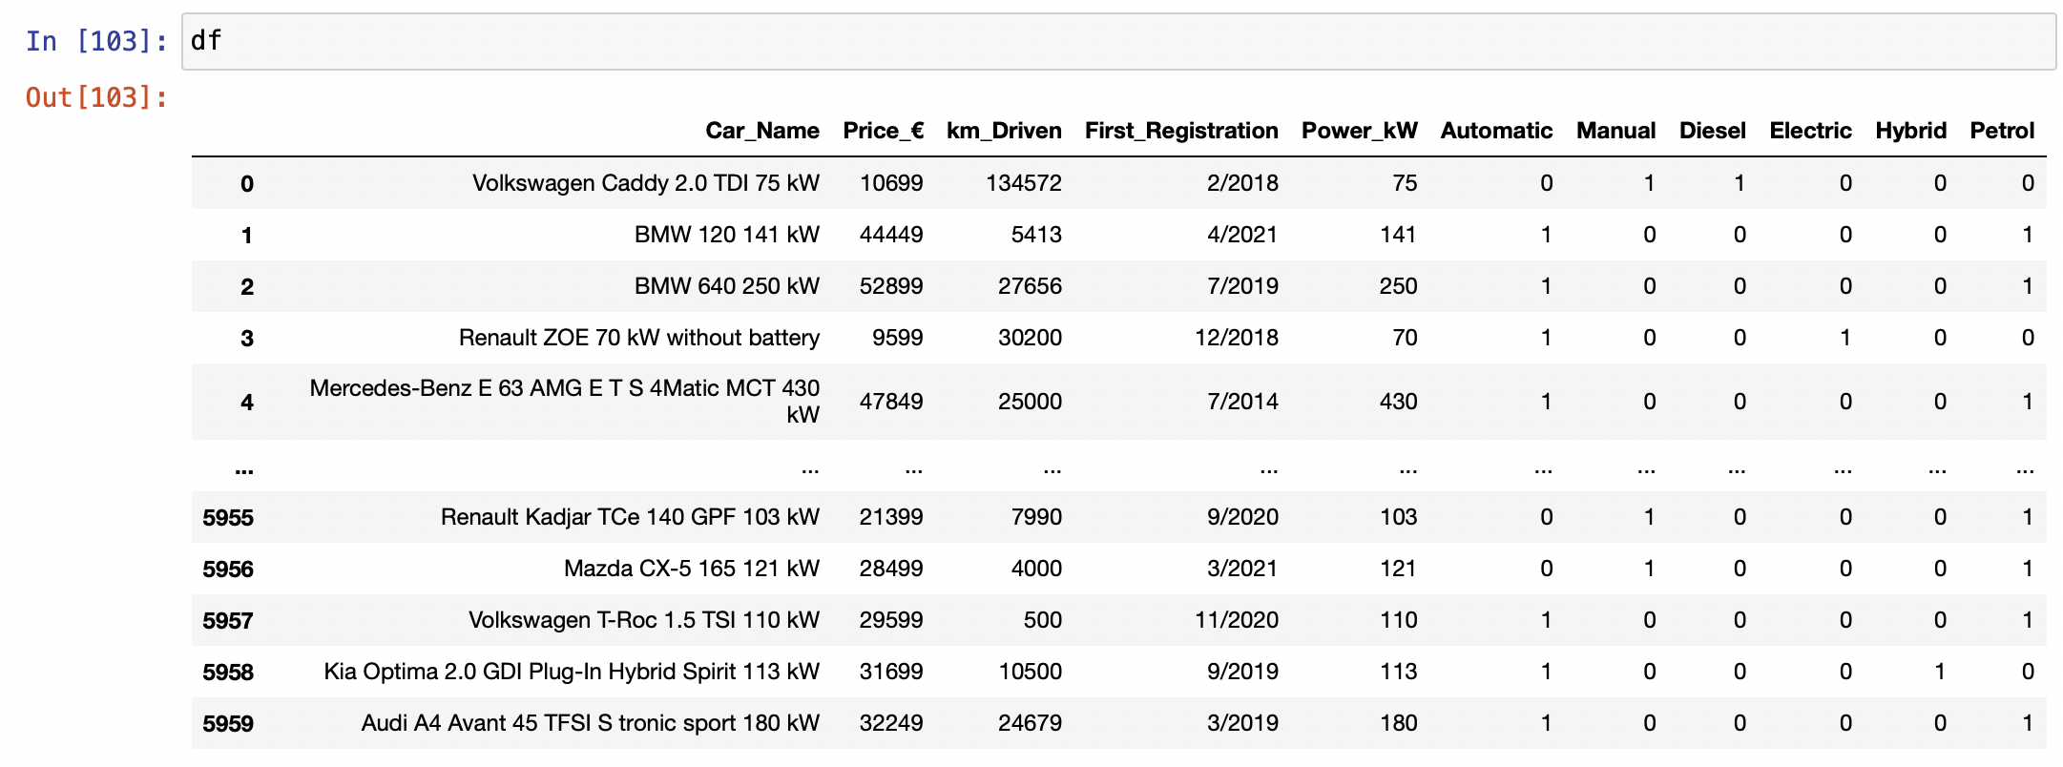
Our dataset with Transmission and fuel converted to dummy variables

Slide 6
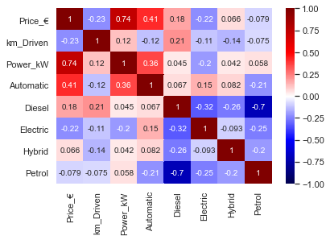
Correlation

Slide 7
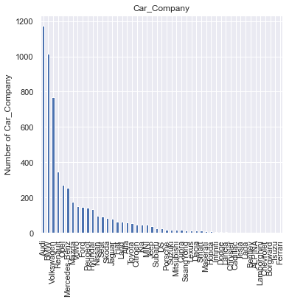
Car companies vs numbers

Slide 8
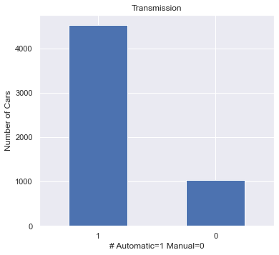
Transmission numbers in our dataframe

Slide 9
Regression & findings
Linear Regression train R^2: 0.699
Ridge Regression train R^2: 0.699
Degree 2 polynomial regression train R^2: 0.699
Degree 2 polynomial regression test R^2: 0.705

Slide 10
Thank you for listening

