Slide 1

Workshop 1
Software engineering 2

Slide 2
BANK APPLICATION REPORT​
In this workshop, we are going to inspect and analyze an android bank application. We are going to take a deep dive into multiple aspects of this bank application such as Security ,Code quality, Implementation and Documentation.​
The following slides will reflect our outputs that includes (the issues that we have encountered alongside the solution) in the report.​

Slide 3
Main topics of the report​
Security
Manifest analysis​
Database​
API​
Source code analysis​
Code quality
Clean code​
bugs ​
​Code documentation

Slide 4
WHY ANALYZE SECURITY​​
The source code of a project is the core on which every aspect of the project stands on , which makes it vulnerable to cyber-attacks . Therefore, the level of security must be at a high level and ensures security measurements and protocols are meeting high standards.​
One might argue that in critical systems the level of security takes an absolute priority over any other quality attribute such as adaptability and efficiency.​

Slide 5

​​WHY ANALYZE CODE QUALITY​
The source code of a project is the core on which every aspect of the project stands on, which makes it vulnerable to cyber-attacks. Therefore, the level of security must be at a high level and ensures security measurements and protocols are meeting high standards.​

Slide 6

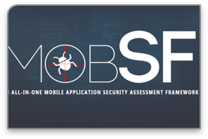


Tools​​
mobile security framework(MOBSF)​
is an open-source framework capable of performing end to end security testing of mobile applications.​
Programing Mistake Detector(PMD)​
it’s a source code analyzer, used to find unused code, Bugs, Errors, Design problems.​
Spot Bugs
Spot Bugs is an extension used for static code analysis to find bugs, logical errors and useless (functions, conditions, variables).​
Snyk
Find vulnerabilities in your code, open-source dependencies, containers all powered by Snyk’s

Slide 7
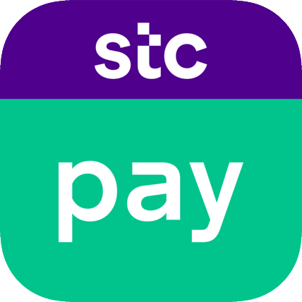
STC PAY​​
STC Pay is a digital wallet to complete daily operations, after the Cabinet approved the transfer of STC Pay to an approved digital bank to become one of the first digital banks in the Kingdom of Saudi Arabia.​
The STC Pay digital wallet is designed to make payments, whether personal or local or international money transfers.​

Slide 8
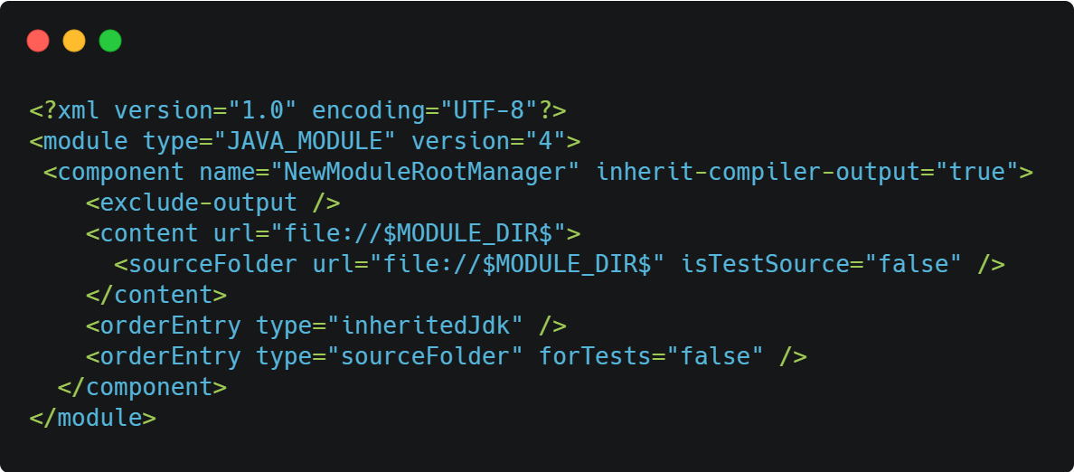
MANIFEST ANALYSIS​
Manifest analysis is a new form of technique used to dedicate android malicious behaviors by analyzing the manifest file. It mostly focuses on permissions in the applications.

Slide 9
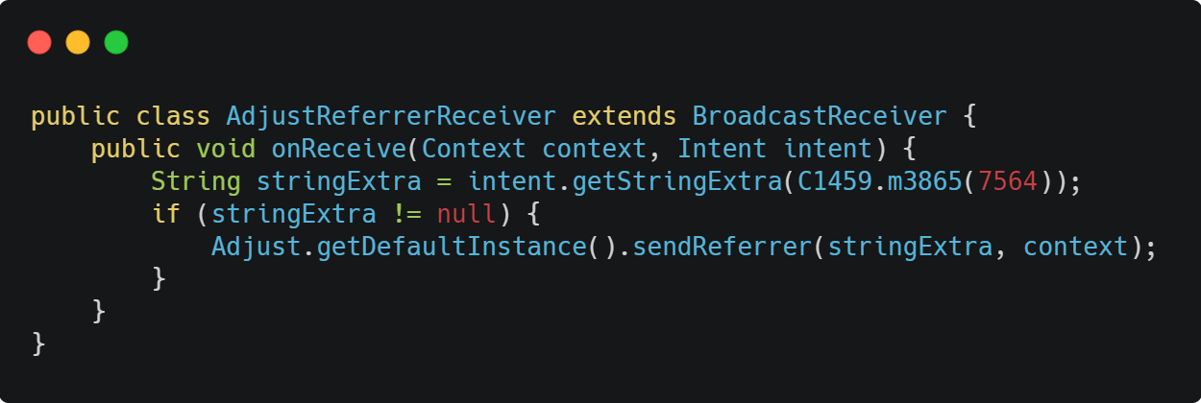
ISSUES IN THE MANIFEST FILE​​
Broadcast receiver: is an android API that allows sending and receiving android application events such as (valid payment, notify the host). with that being said. Each class that implements this API does not check for permission(AdjustReferrerReceiver) this means that a malicious application can take control of this component and can cause threats to the application.​

Slide 10

DATABASE​
STC Pay uses a Firebase. A firebase is a cloud hosted database that allows you to store data and sync it with your users in real time and it is NoSQL database type. In general, the dissection of picking a certain database for your application is very crucial and it breaks down to multiple aspects​
maintenance cost
service stability
security

Slide 11
SECURITY ,COST AND SERVICES STABILITY ​​​
Security​
Firebase has no default implementation of security measures. It relies on the development team to implement the security aspect of the Database. however, it provides default authentication that includes email and password and as a development team you can add more custom authentication to your database.​
Total cost and service stability​
In general , a firebase database is not expensive, it does not have a fixed price. Looking at it from a stability standpoint Firebase is a very powerful service that can help with developing applications quickly without having to implement new components or modules. Firebase was built for scalability and performance to put it into perspective the application can go from 1 user to 1million users without having to change any code related to the database.​

Slide 12
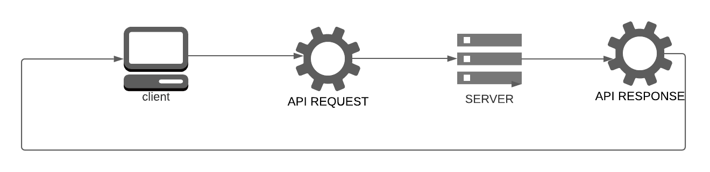
API​​
API is a set of definitions and protocols that allow applications to access data with another software.​
In our application analysis we found multi-APIs and libraries that have been used to improve the application. We will mention some of them and give a brief explanation of their purpose:​

Slide 13
API​​ cont.
Notifications for Android​
Notifications are short messages that inform the users of information from your app such as cashback offers. There are types of notifications have been used in STC Pay : ​​
Notification Manger:​
To create a new notification and add content into notifications and manage the channels. Also, can set a color, the icon for your application by NotificationCompat.​
Notifications Channels :​
If you have different types of notifications in your app some of the notifications the user is interested in and some of them they didn’t want to receive. By the Notifications Channels, the user can turn off the category that controls some of the notifications​

Slide 14
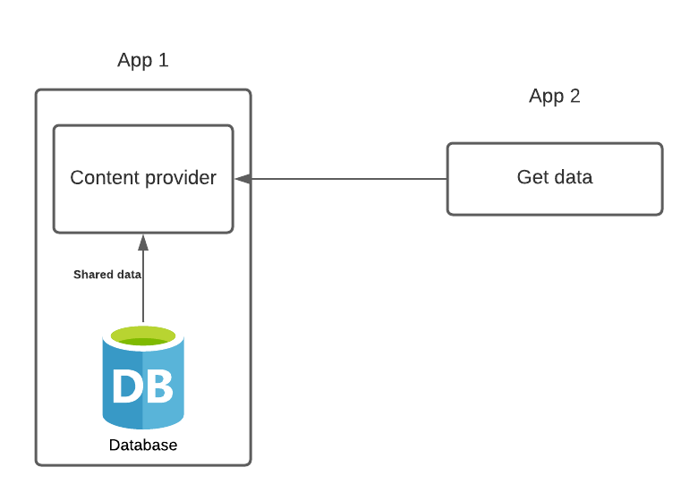
API​​ cont.
Android Content Provider​:
In the android system, every application has its own database and files which are stored in the application folder in the system. In android another application cannot access this folder unless the folder is stored in the content provider, other applications can easily access and make use of this data. ​
By content provider you can:​
fetch data from a content provider.​
insert, update, or delete data . ​
Advantage of Android Content Provider : ​
Applications that are shared in the content provider must grant permission to access data by other applications.

Slide 15
sOurce code analysis​
After analyzing the source code using the tools we mentioned earlier we found some problems that may make it vulnerable to attackers if not handled properly
In addition, we found some good attribute that make the app more secure

Slide 16
source code analysis​ cont.
Warnings:
CWE: or common weakness enumeration is a list of common software weakness types or errors in software code or design that could result in software vulnerability if it was attacked, the CWE list is community developed list that addresses the issues in the source code.
Here are some examples we found in the STC Pay app:

Slide 17
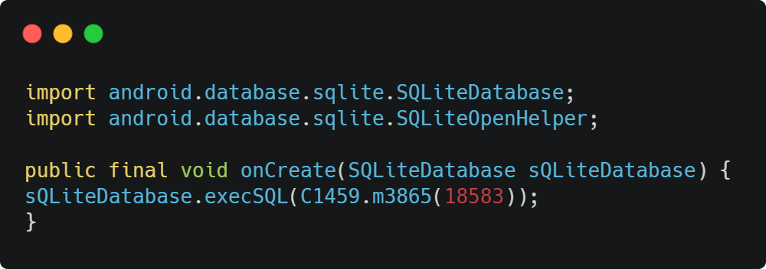
source code analysis​ cont.
SQL Injection(CWE-89):
SQL databases hold sensitive data and SQL injection allows the attackers to insert a query to make changes to sensitive data that they are not normally allowed to view or belong to some other users.
Prevention: Since the input field is the main gate for the attacker to send these queries, we recommend developers to use:
Input validation.
Use firewalls.

Slide 18
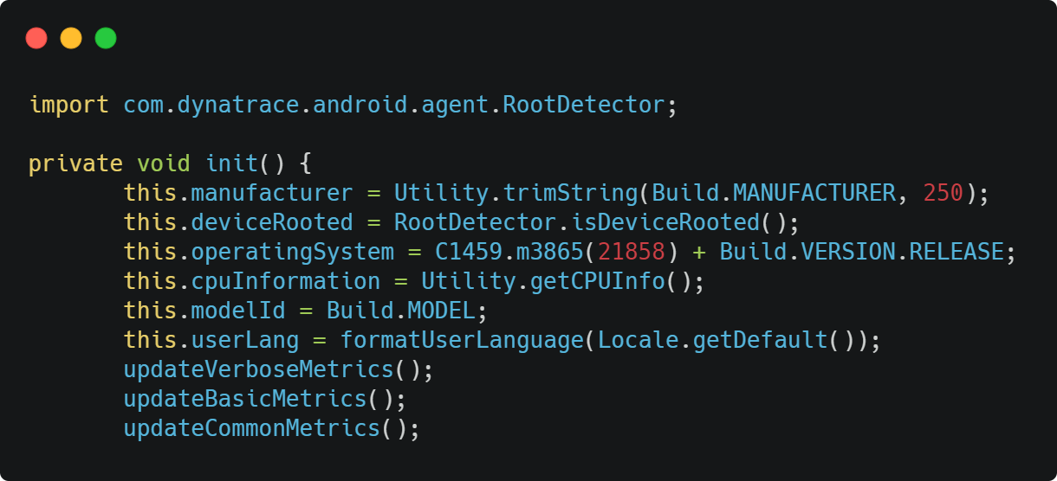
source code analysis​ cont.
Here is a good example we found in STC Pay app:
Root checker:
The software uses a method that checks if the android device is rooted or not, which makes the android device capable of doing a lot more than what it was intended to do.

Slide 19
Code quality

Slide 20
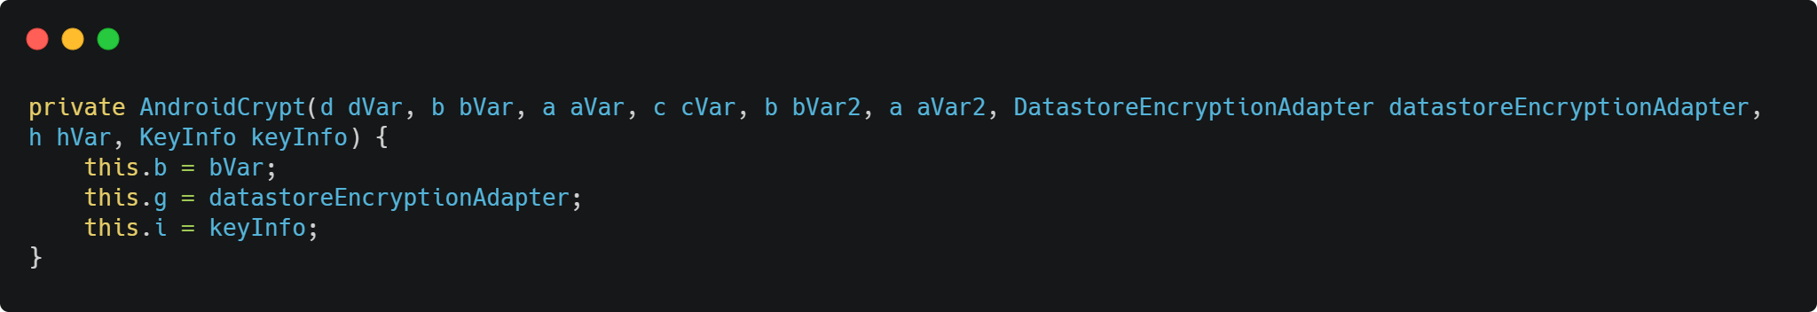
CLEAN CODE​
Unused Formal Parameter​
arguments in the method or the constructor parameter that aren’t used to initialize something or computing it, dVar, aVar, cVar, bVar2 aVar2, hVar aren’t used in the constructor and might confused other developer​
​

Slide 21
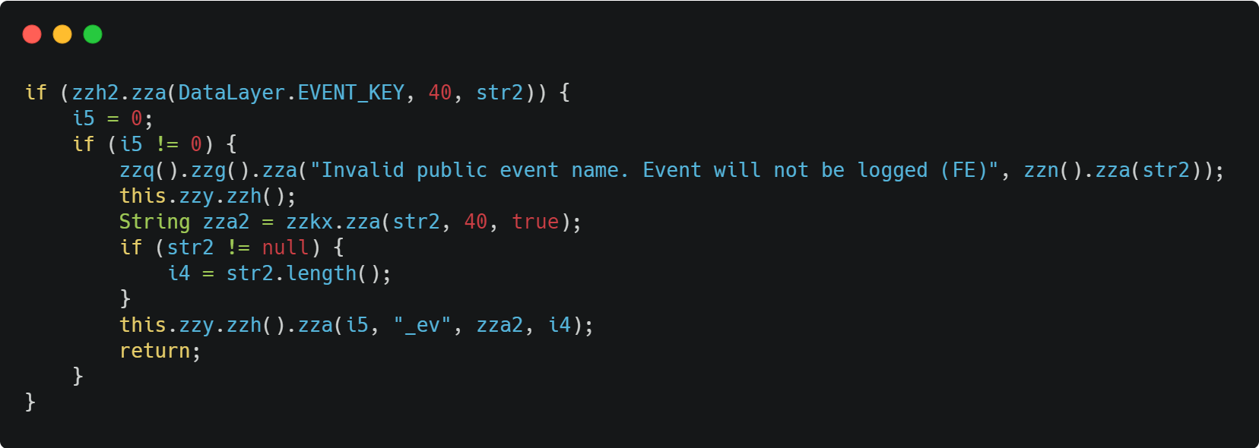
CLEAN CODE​
Unnecessary if statement:
i5 is assigned then used in an if statement, the statement will always be false, and the condition must be removed
​

Slide 22
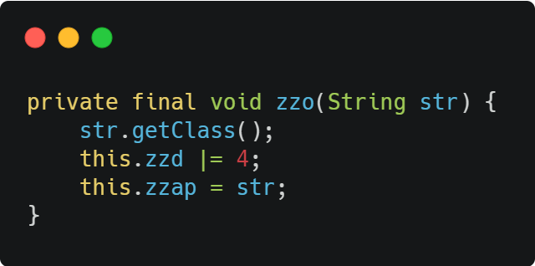
CLEAN CODE​
Unnecessary method call:
.getClass() have no effect unless it is assigned to a variable
​

Slide 23
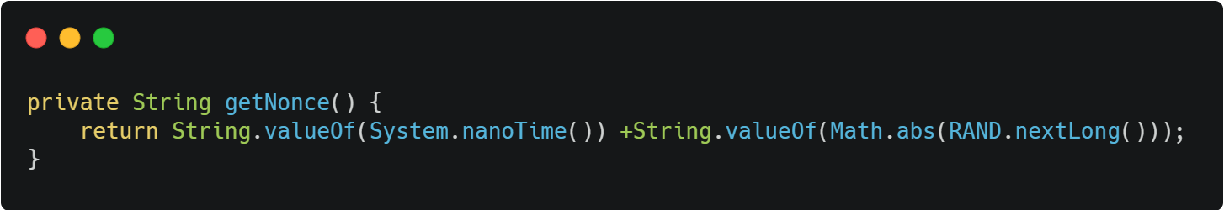
bugs
Bad attempt to compute absolute value of random integer :
This code generates a random integer and then computes the absolute value of that random integer. If the number returned by the random number is too large the method should throw an Arithmetic Exception for this value.

Slide 24
Code Documentation
Before we talk about code documentation, we would like to talk about code ambiguously(obfuscation).After looking at the source code of STC Pay we noticed that most of the classes are filtered out including the methods and the variable names, some classes don't even have a single line of code in them. Of Course, we understand that this is a method of protecting the source code of the application and it's called code obfuscation. But this leaves little to no room to inspect the code documentation.​

Slide 25
Code Documentation cont.
our initial plan was to say that the quality of the code documentation is very low and it does not meet the Code Documentation standards however, this assumption is wrong. From a security perspective it does not make any sense to make the code obfuscated but leave the documentation that describes the function/class and what it receives and what output does it produce on display. We have come to the conclusion that the development team have also obfuscated the code documentation as well, thus we can't give a status to the code documentation​

Slide 26
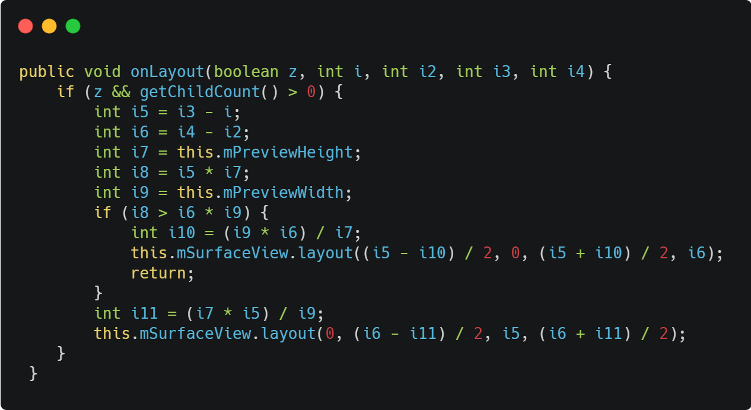
CODE OBFUSCATION​

