Slide 2
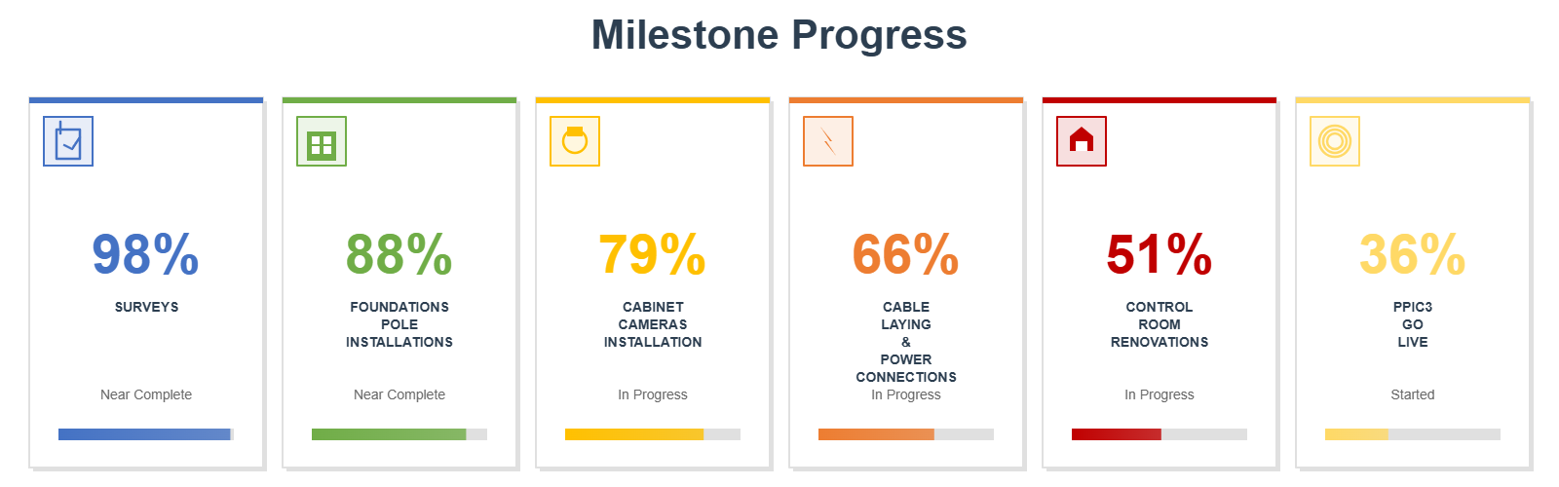
Milestone Progress

Slide 3
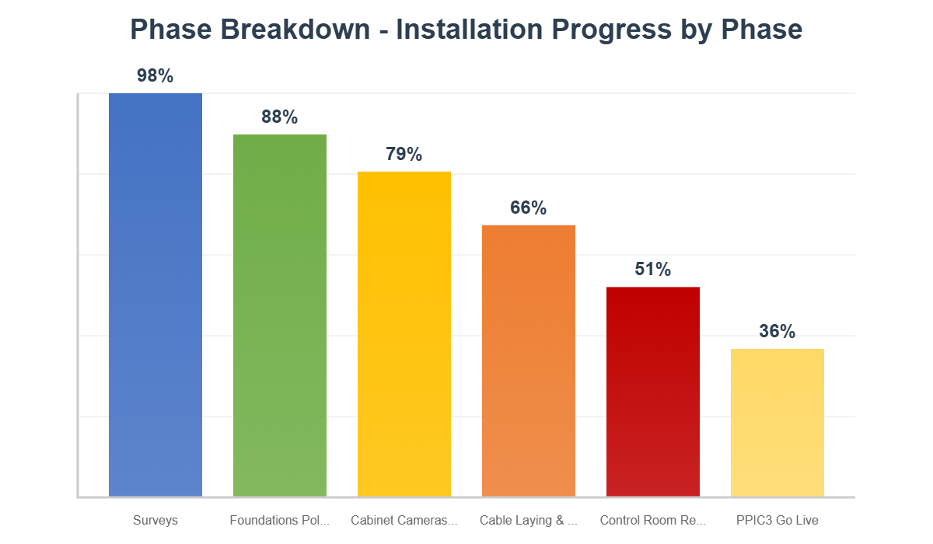
Phase Breakdown Analysis

Slide 4
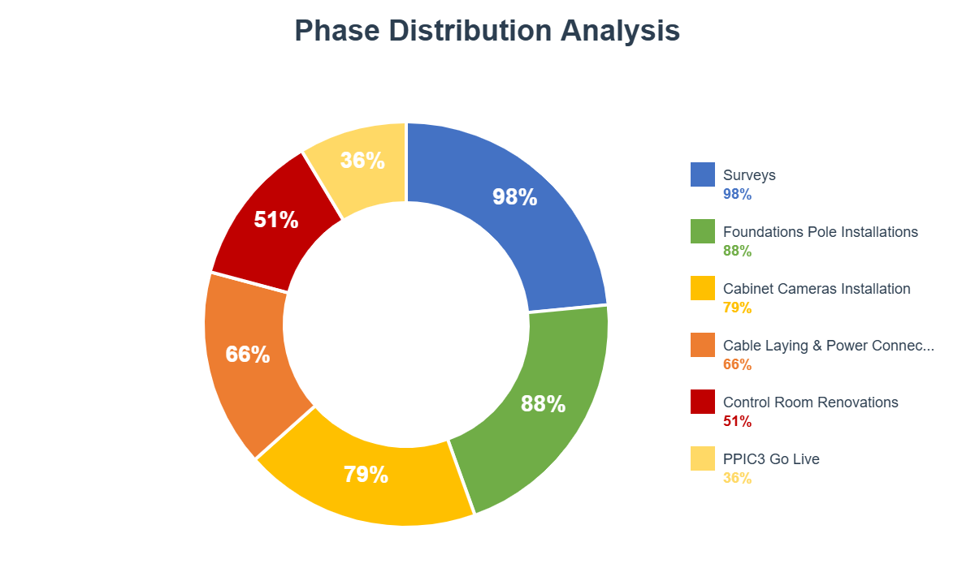
Phase Distribution Analysis

Slide 5
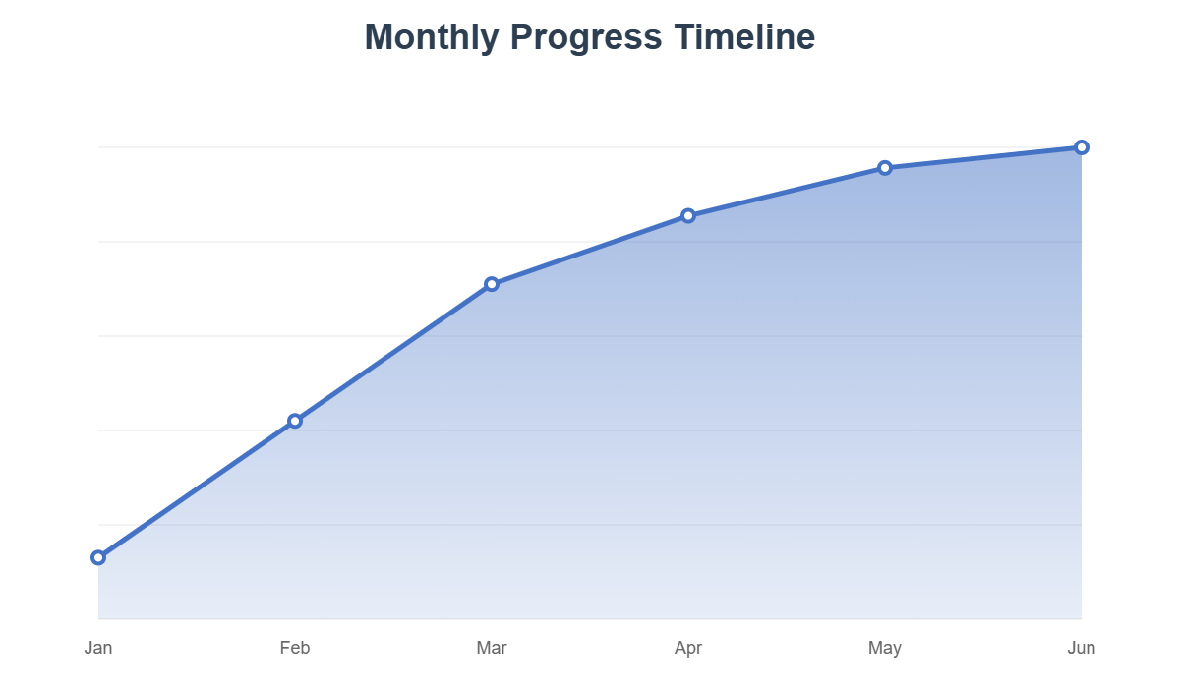
Monthly Progress Timeline

Slide 6
Key Insights & Recommendations
Overall Progress: 69% - Good
Completed Phases: 0 out of 6 phases fully completed
In Progress Phases: 5 phases actively under implementation
Early Stage Phases: 1 phases requiring attention and acceleration
Highest Progress Phase: 98% - Leading phase performance
Lowest Progress Phase: 36% - Requires immediate focus

