Slide 1

Toxicity Detection in Finnish Using Machine Translation
Anni Eskelinen, Laura Silvala, Filip Ginter, Sampo Pyysalo, Veronika Laippala
TurkuNLP
University of Turku

Slide 2
Intro
Finnish is a low-resource language
No toxicity model or dataset available for Finnish
Objectives:
Toxicity data for Finnish
Translated data
Native Finnish annotated data
Model for toxicity detection in Finnish
Compare translation-based and model-based transfer
Notes:
making a dataset takes a lot of effort, so transfer is often a better option

Slide 3
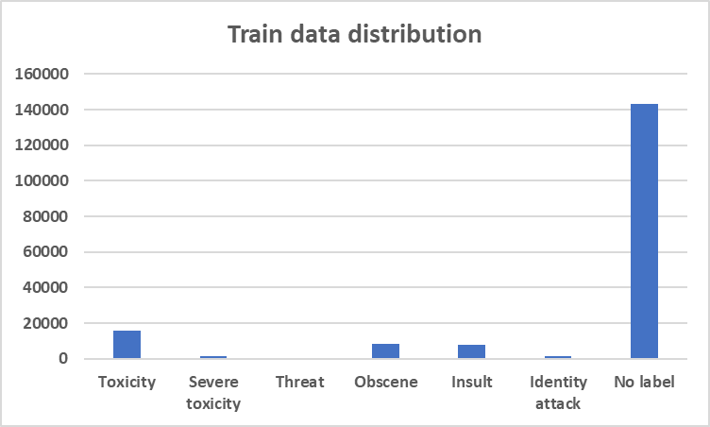
Data 1/2
Jigsaw Toxicity dataset
Train & test size:
159,571 & 63,978
Labels:
toxicity, severe toxicity, identity attack, insult, obscene and threat
Translation:
Deep-L & Opus-MT
Backtranslation Deep-L
Notes:
CROWDSOURCED!
The dataset itself does not have label definitions but the definitions can be found in the perspective API
EXAMPLE toxicity: ”rude, disrespectful, or unreasonable language that is likely to make someone leave a discussion”
Multi-label: a comment can have multiple labels or none, whereas multi-class can only have one of many labels
Only about 10% is toxic in both train and test
As many toxicity types appear together the counts amount to more than the actual size is
Translation deepl docx files of comments
Opus-mt model, first needs to be split into sentences with e.g. udpipe

Slide 4
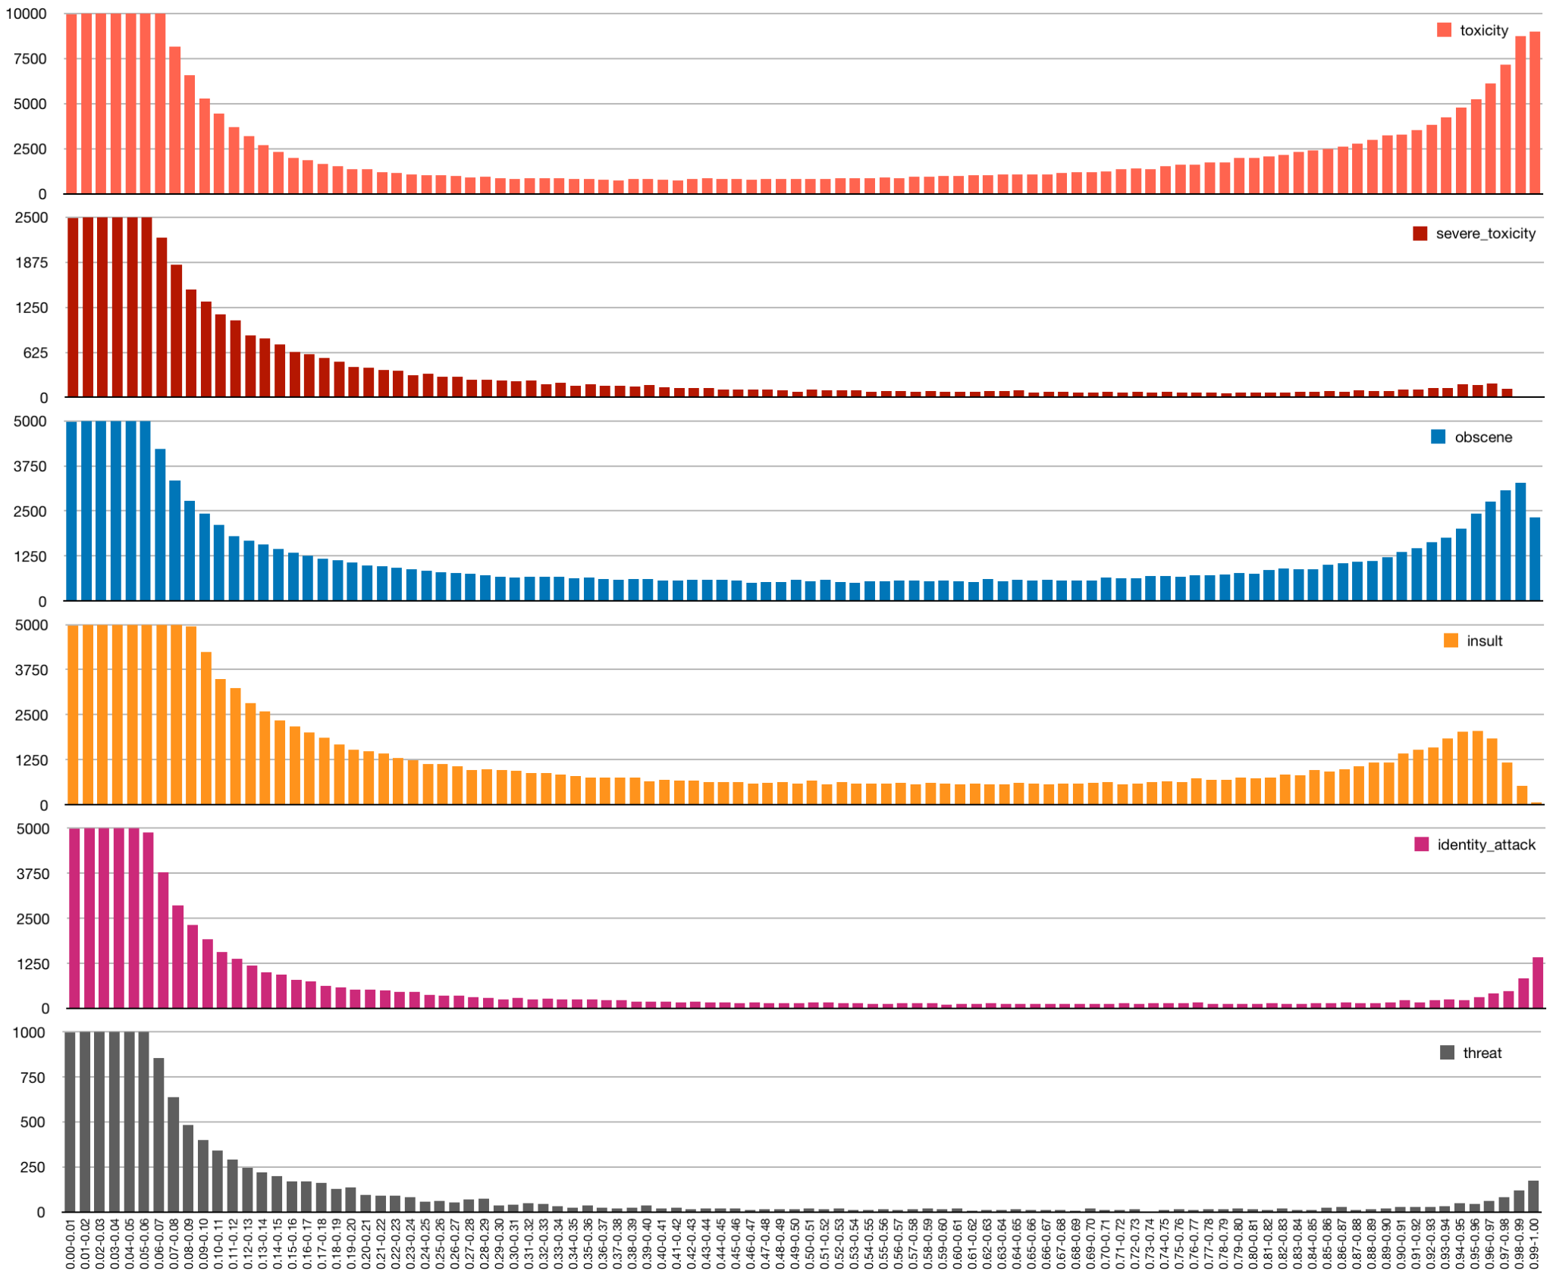
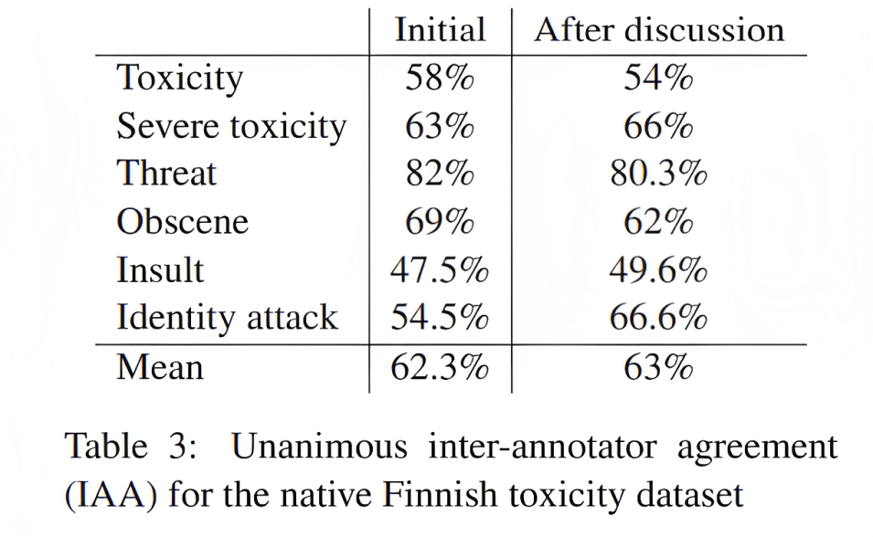
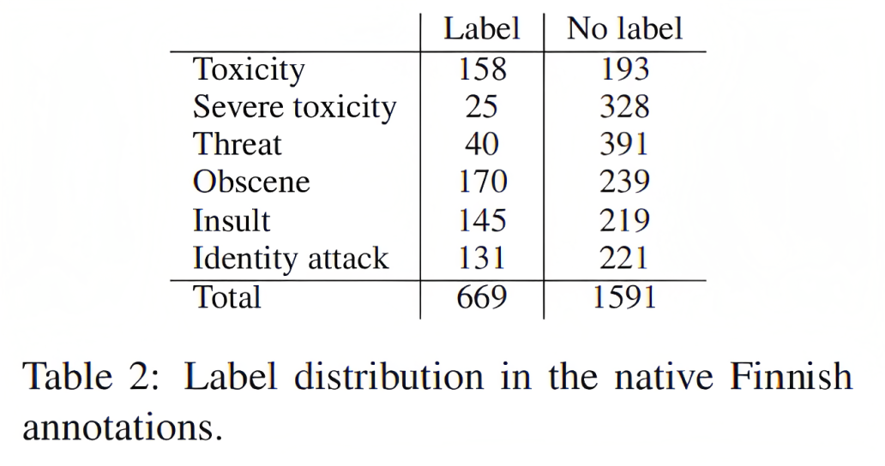
Data 2/2
Suomi24 annotated test set:
2260 examples
Sampling
Annotation process
-> Guidelines
Agreement
Notes:
30% toxic in our final test set although some might have been missed
Sampling 100 000, classified with a model based on finbert base, 500 for each label in 10% bins, 50 comments from each
Classifier is mostly certain of the probabilities so low or high
And then some in the middle where not so sure
Annotation process as basis we used the definitions in the perspective API
Guidelines in huggingface
overall agreement pretty low for some things ANNOTATED SUBJECTIVITY IS AN ISSUE WITH TOXICITY DATA
unanimous agreement because for the final dataset we only took unanimous comments or comments that were otherwise resolved
agreement lower sometimes after discussion, maybe our guidelines weren’t clear or maybe there were some other types of comments we did not account for

Slide 5
Data examples
EXPLICIT CONTENT WARNING!
Jigsaw:
Obscene, severe_toxicity, toxicity penis 8===D~~penis 8===D~~penis 8===D~~penis 8===D~~penis 8~penis 8===D~~
Obscene, insult, severe_toxicity, toxicity Lopettakaa vittu tekemästä tätä, senkin jälkeenjääneet lapset, te pilaatte kaiken kfarilla.
Stop fucking doing this, you retarded kids, you're going to ruin it for everyone on the kfar.
Annotated:
Toxicity Kannattaako noiden vanhojen kuolevien akkojen väkisin pressaksi vallanhimossaan pyrkiä.
Is it worth it for those old dying hags to try to become president by force in their need for power.
Insult jutuistasi ja sensuroinneistasi päätellen voi kuvitella ihan helposti. Valehtelija olet ja valheellisen propagandan levittäjä. Isänmaan vihollinen.
Judging from your stories and censoring I can easily imagine. You are a liar and a distributor of false propaganda. An enemy of the motherland.

Slide 6
Methods
Models:
XLM-R
FinBERT
BERT
Large variants for final numbers
Multi-label, custom loss function, no preprocessing
Metrics:
F1-micro
F1-macro
Precision (micro)
Recall (micro)
Roc_auc with the thresholded label
Notes:
Custom loss function, has weights that give more importance to the labels that have less examples
micro and macro, global vs. Separately, does not take imbalance into account
ROC AUC = area under the ROC curve

Slide 7
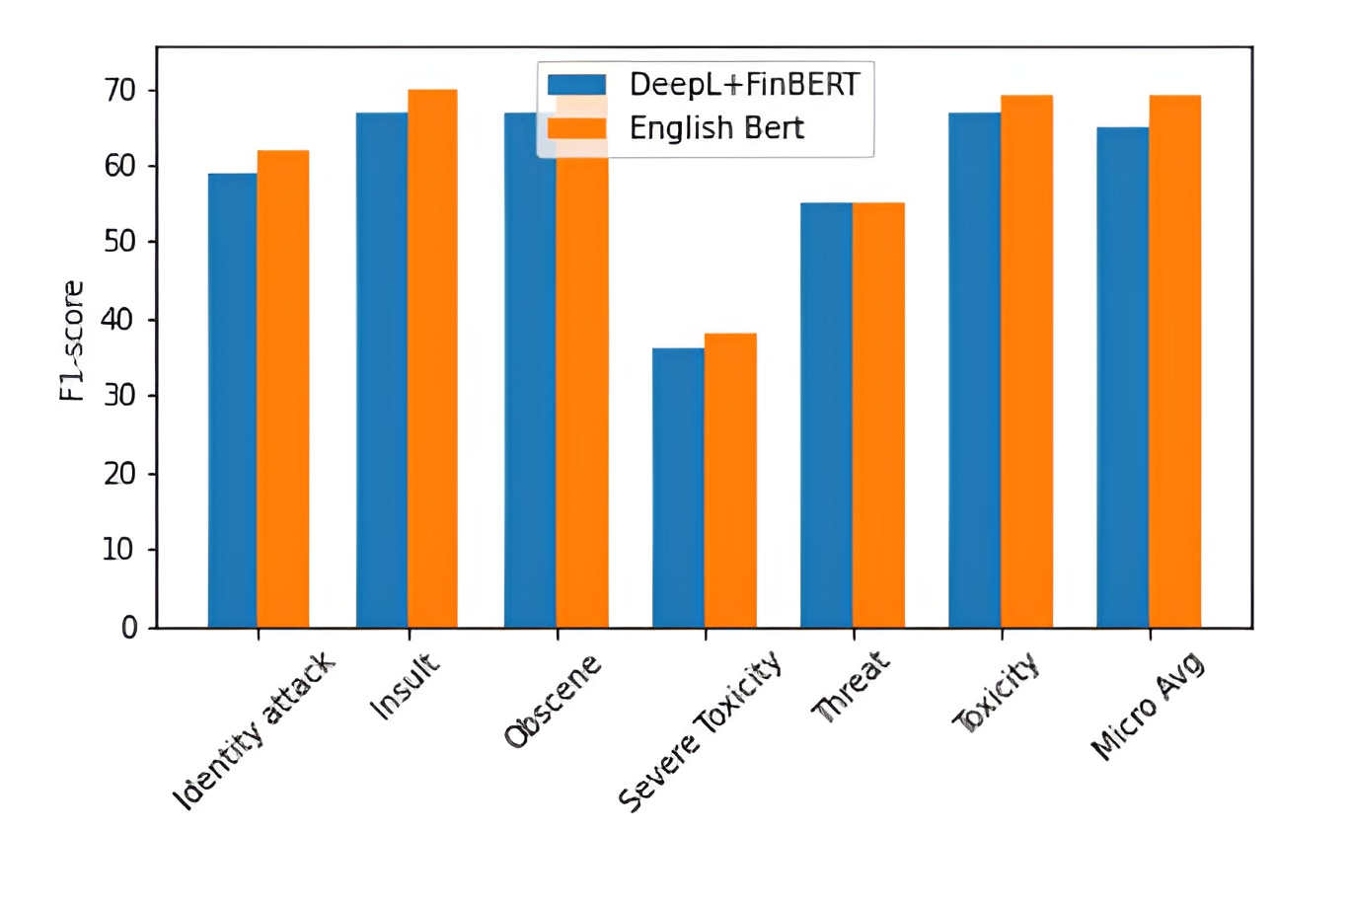
Results 1/2
Model | Train | Test | F1-micro
BERT | En | En | 0.69
FinBERT | Fi-DeepL | Fi-DeepL | 0.66
FinBERT | Fi-Opus-MT | Fi-Opus-MT | 0.65
XLM-R | Fi-DeepL | Fi-DeepL | 0.65
XLM-R | En | Fi-DeepL | 0.57
XLM-R | Fi-DeepL+En | Fi-DeepL | 0.65
BERT | Backtr-En | En | 0.67
Notes:
Recall is better than precision for all although I do not show it here, that is better for moderation at least (maybe leave out)

Slide 8
Error analysis
Senkin pikku paskiainen == Senkin pikku paskiainen
You little son of a bitch == You little son of a bitch
True: insult, obscene, severe toxicity, toxicity
Pred: insult, obscene, toxicity
Wikipedia on täysin hyödytön
Wikipedia is completely useless
True: insult
Pred: no label
Notes:
If you are wondering why does the first example look like that, it is originally in the jigsaw data like this
Ex. 1 error might be due to translation, can communicate affection, or is not as toxic the english version, mainly “pikku”
Ex. 2 subjectivity, whether you can insult something that is inanimous
Also due to the jigsaw dataset being crowdsourced we might run into discrepancies in labels in general

Slide 9
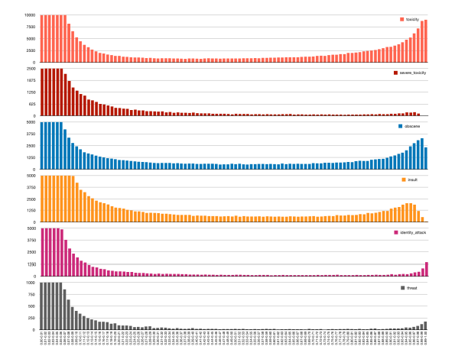
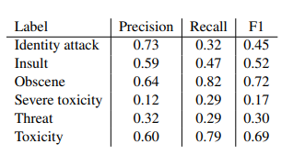
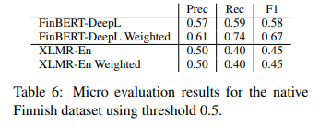
Results 2/2
Annotated results
Notes:
Class specific scores were for weighted

Slide 10
Error analysis
Oletko mahdollisesti homoseksuaali?
Are you possibly gay?
Bin: identity attack 0.8-0.9
True: no label
Pred: toxicity
Notes:
Remember original bin with finbert base
Error analysis: it’s a known issue that classifiers trained on this data have a tendency to mispredict neutral discussion involving identity terms as toxic
Ex. gay is toxic to the model due to the identity word
Although technically this might be said insultingly

Slide 11
Conclusions
Translation-based transfer worked better than model-based transfer
Results for the annotated data match the results for training after weighing
The best Finnish model, the translated Jigsaw data and our own native Finnish annotated data (with guidelines for annotation) are up in the TurkuNLP Huggingface for everyone to use!

Slide 12

Thank you for listening!
Any questions?

