Slide 1
Performing side channel attack on a commercial AES-256 device
Mika Kaustinen, Tero Jokela, Ohto Myllynen, Lauri Koskinen

Slide 2
Acknowledgements
This chain of research projects have been funded by Finnish Defence Research Agency (FDRA) CryptoLaboratory in order to create deeper ability to evaluate different secure HW implementations.
Governments need to be able to say with some level of certainty that crypto implementations are secure
This leads to formal approval and evaluation processes
Evaluation also includes side channel resistance testing
FDRA crypto laboratory encourages and promotes related research

Slide 3
Side-channel attack?
In cryptography, a side-channel attack is any attack based on information gained from the physical implementation of a cryptosystem, rather than brute force or theoretical weaknesses in the algorithms (Wikipedia)
For example, electromagnetic leaks can provide an extra source of information, which can be exploited to break the system
Some side-channel attacks require technical knowledge of the internal operation of the system on which the cryptography is implemented, others are effective as black-box attacks

Slide 4
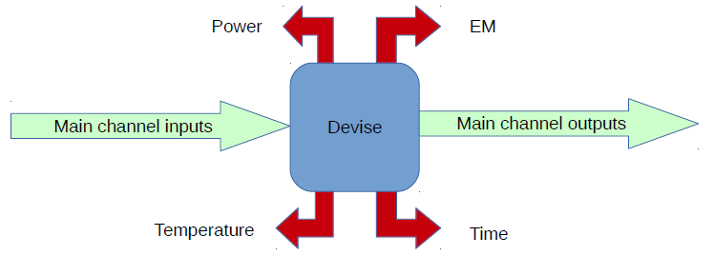
Side channels
Anything other than the main channel that can be measured is a side channel
Practical attack conditions
Possibility to monitor the processing of the secret data
Have a way to record processing duration
Have basic computational & statistical tool
Have some knowledge of the implementation
Notes:
For example, in the device that I’ll show you, we knew that it was AES

Slide 5
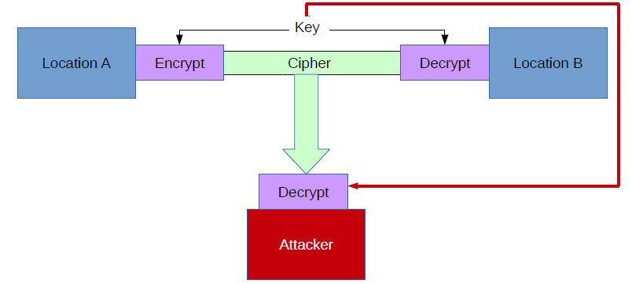
Encryption basics
Any encryption can be always be broken by a brute-force attack (i.e. guessing)
Just try all keys
DES, amount of keys 2⁵⁶, time needed for 1 key ~ 1 day
AES, amount of keys 2¹²⁸, time needed for 1 key ~ 10000000000000 years

Slide 6
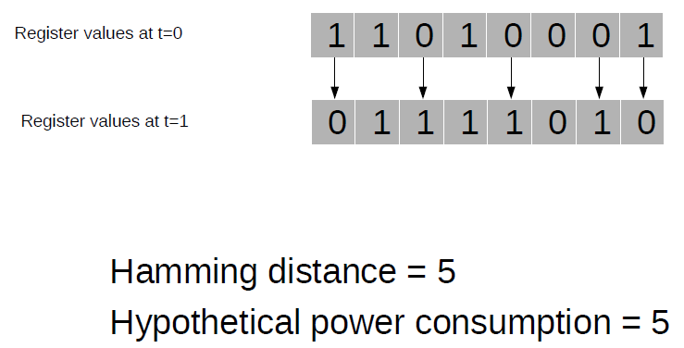
Information leakage
The power consumption of a integrated circuit depends on
the manipulated data
the executed instruction
The power consumption (and EM emission) of the device can be modelled using leakage models.
Leakage models
Hamming Weight and Hamming Distance
Transitions weight (flipping bits on a bus state)
Notes:
Unless you are using an Enigma machine…

Slide 7
The target
Addonics CipherUSB AES-256 ECB
Connected between PC and USB memory
Notes:
We knew it was AES, no idea on implementation (CPU, accelerator)

Slide 8
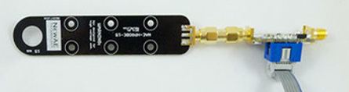
Side-channel attack
An electromagnetic probe (NewAE) with low-noise amplifier and isolated power supply were used together with an oscilloscope to record typically 5000 - 10000 plaintext encryptions.
The plaintexts, encrypted plaintexts i.e. ciphertexts, and recorded oscilloscope traces of the electromagnetic probe were then used in the actual attack.
Correlation power analysis (CPA) is used as the statistical attack method (in Matlab)

Slide 9
Side-channel attack Measurement setup
Oscilloscope
PC: C#-program
EM-signal
EM-signal saved
Triggering
EM-probe signal
PC: SikuliX-program
AES-256 USB-device
New random plaintext

Slide 10
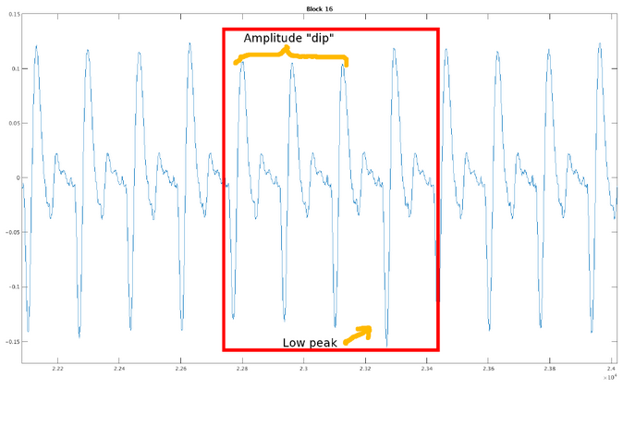
Searching for the encryption by writing ”0”.

Slide 11
Correlation power analysis (CPA)
Finding correlation between modeled power consumption (Hamming distance) and measured traces allows us to extract the AES round keys one byte at a time
On the correct time, the power consumption of all traces is correlated with the correct key
On other times and other keys the traces should show low correlation
We can compare correlation results of all key guesses and pick the one with the largest absolute value.

Slide 12
Correlation power analysis (CPA)
EM-measurements
Ciphers (encrypted plaintexts)
Intermediate values
Key guesses
Hypothetical power
Correlation analysis
Correct key

Slide 13
Correlation of different byte values of round key byte

Slide 14
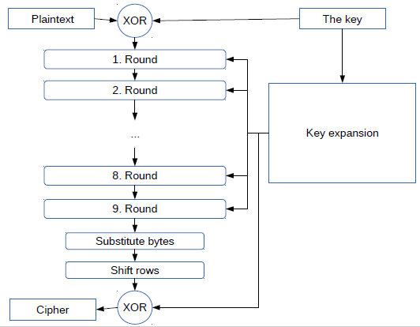
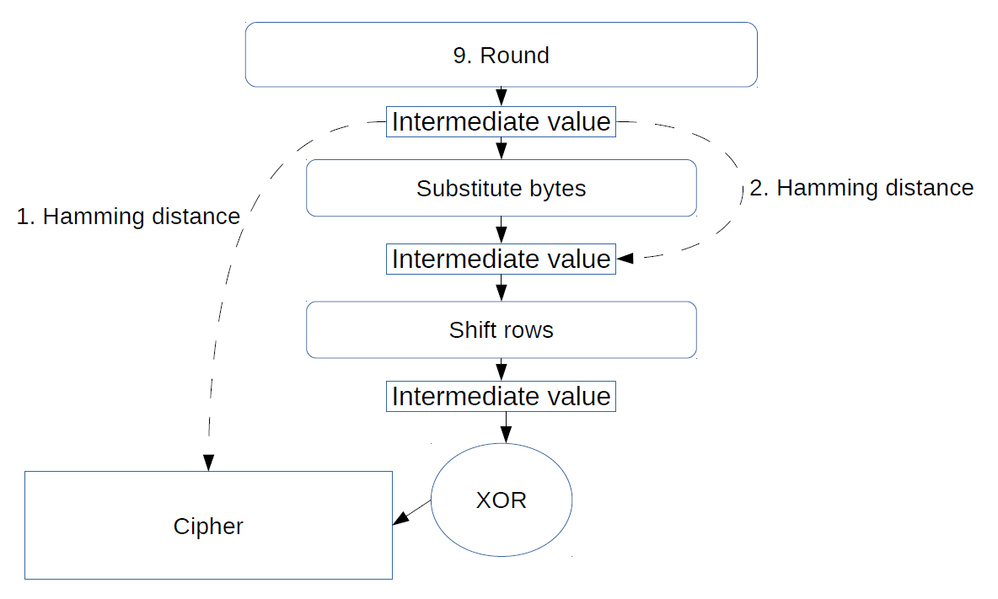
Possible intermidiates to use in attack
Notes:
AES 128, not 256
The difference of the last AES encryption round to the previous rounds is the lack of MixColumns operation,

Slide 15
Round Keys
In AES-256 the two last (rounds 13 and 14) round keys (XOR operation of the state and the key) is the weak point in terms of the side channel
The difference of the last AES encryption round to the previous rounds is the lack of MixColumns operation simplifiying the attack
Finding the two round keys allows us to calculate back the full secret key of the module
Several measurements were required to find right measurement setup for oscilloscope and electromagnetic head position
In our attack 30 out of the 32 round key bytes were found and the two remaining were found using brute force
Notes:
Interpolation ON in oscilloscope

Slide 16
Important points
Enough traces
5000 – 10000 plaintexts were measured, can be done over night
Actual attack and analysis takes few hours
Power model matches actual power consumption
Oscilloscope setup
EM head position
Correct intermediate values
Possible countermeasures

Slide 17
Conclusions
Addonics CipherUSB device secret key found in the attack.
Possible to decrypt all encrypted data
Additional data block is found which might allow decryption without the device.
Side-channel attacks pose a serious threat to the security of cryptographic devices.
Leaked EM emission allowed side-channel attack that finds the key much faster than brute force-attack (if even possible).
In consequence, implementations have to be evaluated for their resistivity against such attacks and the incorporation of different countermeasures has to be considered.

