Slide 1
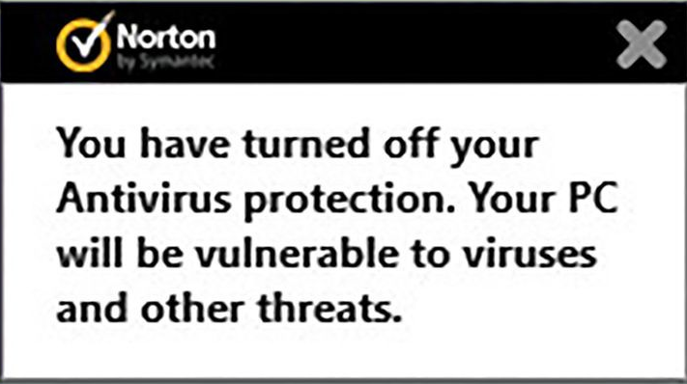
The Anti-virus is dead, long live the new anti-virus!
¤¤¤¤¤Tommi Äijälä
¤¤13th April 2017
¤¤¤¤¤¤¤¤¤TurkuSec

Slide 2



"The King is dead,
long live The King!"
Charles VII of France
Declared upon the accession to the French throne of Charles VII after the death of his father Charles VI in 1422.
Source: https://en.wikipedia.org/wiki/Charles_VII_of_France

Slide 3
Who? Me?
Tommi Äijälä, 37yo
Turku AMK graduate
Worked in the IT industry for ~18 years
Currently Senior Security Specialist at Nixu
Everything Is say here is my own opinion not the opinion of my employer!

Slide 4
2014
”Antivirus is dead” -Bryan Dye
(Symantec Senior Vice President)

Slide 5
Who died?
Traditional Anti-virus is about 30 years old. It looks at incoming data from downloads, removable media and other sources for patterns of characters, called signatures. This antivirus approach used to be effective in preventing the compromise of many endpoints. The math is simple -- antivirus companies used to identify a new malware entity, and get their signatures updated more quickly than the typical malware could make it across the internet.
Two major factors have greatly diminished the effectiveness of antivirus technology.
First, malware can traverse the internet at a rate nobody ever imagined was possible. Today, a new virus can become widespread on the internet before the antivirus vendors even know it exists. Second, virus authors have learned to produce variants, which are version of their illicit programs that function the same way, but have deliberate changes in their signature to evade antivirus programs.

Slide 6
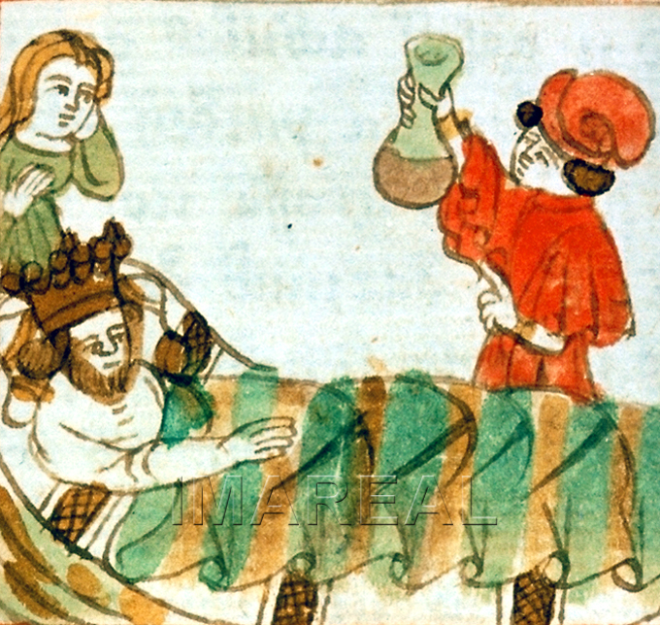
The average life expectancy in middle ages was 35 years…
…we tend to overlook one very important word there: average. Infant mortality was brutal, since vaccinations against childhood diseases didn't exist yet and medicine was still underdeveloped (to put it lightly). If you survived to adult age in the middle ages the life expectancy was much longer was easily 50-60yo.

Slide 7
Who is the new king?
Next-generation security software
Non-signature techniques to find malware
AI, cloud and and defense in depth

Slide 8

Lets look at some next-gen anti-virus software….
Image: theadvancedapes.com

Slide 9
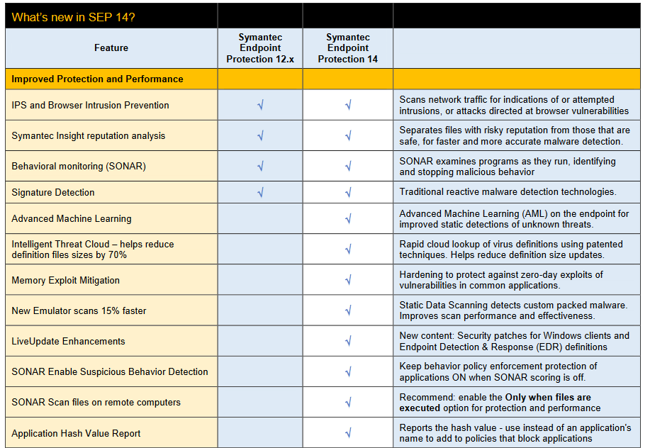
Symantec Endpoint security (Oct 2016)
Image source: Symantec

Slide 10
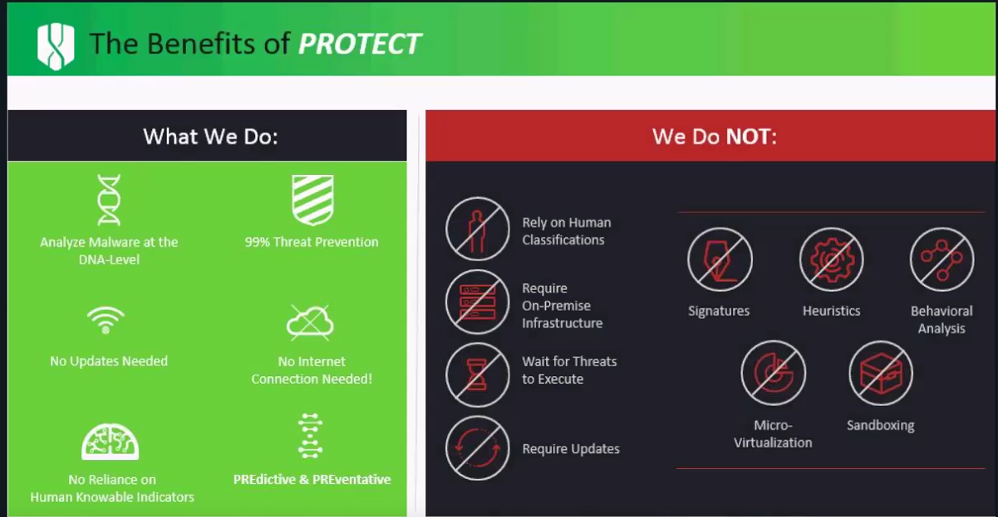
Cylance Protect
Image source: Cylance

Slide 11
Cylance Protect
What the company does is build a mathematical model of how software should work and then prevents anything else from running. The result is an antivirus/anti-malware program that requires only about 30 megabytes of space and doesn't need frequent updates. There's no huge database of virus signatures to check, and nothing to go out of date.
The software works by examining anything that tries to run on the computer, regardless of whether it's running directly or being loaded from the Web. The software analyzes the internal workings and checks to see what it's presenting itself as. This means, according to CMO Greg Fitzgerald, that a Word document shouldn't contain executable code, code that's presenting itself as an application should have a user interface, and drivers shouldn't be executables. "If it has an icon saying it's a Word file, it should be a Word file," he said.

Slide 12

Sophos endpoint
We’re taking a new approach to protection. Sophos Endpoint blocks malware and infections by identifying and preventing the handful of techniques and behaviors used in almost every exploit.
Sophos Endpoint doesn’t rely on signatures to catch malware, which means it catches zero-day threats without adversely affecting the performance of your device. So you get protection before those exploits even arrive.
Image source: Sophos

Slide 13
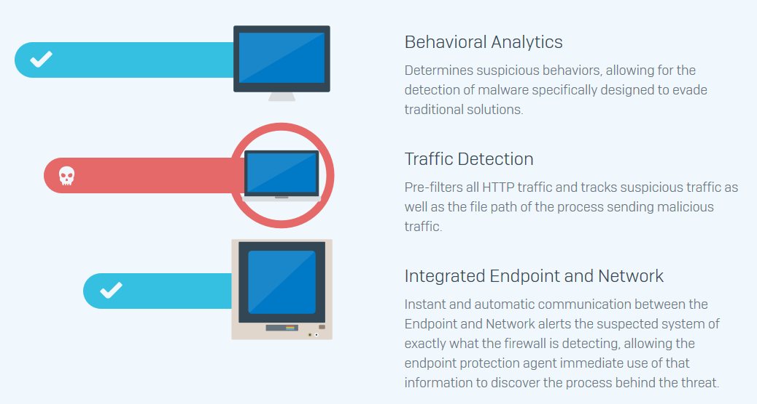
Sophos endpoint
Image source: Sophos

Slide 14


Palo Alto Traps
Exploit Attack
1. Exploit attempt contained in a PDF sent by “known” entity.
2. PDF is opened and exploit techniques are set in motion to exploit vulnerability in Acrobat Reader.
3. Exploit evades AV and drops a malware payload onto the target.
4. Malware evades AV, runs in memory.
Exploit Technique
Blocked
Normal Application Execution
Traps Exploit Prevention Modules (EPM)
Traps EPM
1. Exploit attempt blocked. Traps requires no prior knowledge of the vulnerability.
Slide source: Palo Alto
Notes:
Now let’s look at the same scenario again, this time with our Traps Exploit Prevention Modules in place.
Our Traps Advanced Endpoint Protection agent runs on the endpoint and injects these exploit prevention modules into each application that runs. This process is seamless and transparent to the end-user.
Note that the exploit prevention modules require no knowledge of where the vulnerabilities are in the application. So you are protected from exploitation of both known and unknown vulnerabilities.
Click forward: Exploit Technique Blocked.
As you can see, as soon as the exploit technique is attempted, it is blocked by Traps. At this point Traps would terminate the application and send a notification to the end-user and the administrator console with detailed information about the attempted attack.
No malicious code was allowed to execute so no harm has been done.
Now – You might be wondering: “What if the attacker invents a new exploit technique? Or What if the attacker is able to circumvent one of the exploit prevention modules?” Click forward…

Slide 15
Palo Alto Traps
Exploit Technique
Blocked
Exploit Attack
1. Exploit attempt contained in a PDF sent by “known” entity.
No Malicious Activity
2. PDF is opened and exploit techniques are set in motion to exploit vulnerability in Acrobat Reader.
3. Exploit evades AV and drops a malware payload onto the target.
Exploit Technique
1
4. Malware evades AV, runs in memory.
Normal Application Execution
Traps Exploit Prevention Modules (EPM)
Traps EPM
1. Exploit attempt blocked. Traps requires no prior knowledge of the vulnerability.
2. If you turn off EPM #1, the first technique will succeed but the next one will be blocked, still preventing malicious activity.
Slide source: Palo Alto
Notes:
As mentioned previously, an attack will only be successful if a series of exploit techniques succeed – usually 3-5.
So let’s walk through the scenario where the first exploit prevention module is bypassed and Exploit technique #1 succeeds.
Click
Click again to the second exploit technique being blocked.
Due to the chain-like nature of exploit techniques, even if one succeeds, the next one will be blocked. This will break the chain and prevent successful exploitation of the vulnerable application. So despite the fact that one technique succeeded, the exploit still failed and no malicious activity occurred on the system..
Click – “No Malicious Activity” comes up and the file type starts changing from PDF to other types
Remember, we use adobe acrobat as an example here but this can be any application, including proprietary applications. The nature of the Traps exploit prevention modules is such that they do not require any prior knowledge of the application, how it works, or its vulnerabilities.

Slide 16
Exploit techniques protection
CPL Protection | Software logic flaw | Protects against vulnerabilities related to the display routine for Windows Control Panel shortcut images, which can be used in malware creation.
DEP | Memory corruption | Data execution prevention (DEP). Prevents areas of memory designated as containing data from running as executable code.
DLL-Hijacking Protection | Software logic flaw | Prevents DLL-hijacking attacks where the attacker attempts to load DLLs from insecure locations to gain control of a process. Also prevents the attacker from loading malicious CPL (control panel) files.
DLL Security | Software logic flaw | Prevents access to crucial DLL metadata from untrusted code locations.

Slide 17
Exploit Techniques protection
Exception Heap Spray Check | Memory corruption | Detects instances of heap sprays upon occurrence of suspicious exceptions (indicative of exploitation attempts).
Font Protection | Software logic flaw | Prevents improper font handling, a common target of exploits.
GS Cookie | Software logic flaw | Enhances the granularity of Windows buffer security checks to protect against buffer overrun , a common attack technique that exploits code that does not enforce buffer size restrictions. A change in the size of the security cookie that is used to allocate space indicates that the stack may have been overwritten; The process is terminated if a different value is detected.
Heap Corruption Mitigation | Memory corruption | Prevents triggering of heap corruption vulnerabilities such as double free.

Slide 18
Exploit techniques protection
Hot Patch Protection | Software logic flaw | Prevents use of a new technique that uses system functions to bypass DEP and address space layout randomization (ASLR).
Library Preallocation | Memory corruption | Enforces relocation of specific modules that exploitation attempts commonly utilize.
Memory Limit Heap Spray Check | Memory corruption | Detects instances of heap sprays using our proprietary algorithm upon a sudden increase in memory consumption (indicative of ongoing exploitation).
Null Dereference Protection | Memory corruption | Prevents malicious code from mapping to address zero in the memory space, making null dereference vulnerabilities unexploitable.

Slide 19
Exploit techniques protection
Packed DLLs | Memory corruption | An extension to the DLL Security module; provides support for packed DLLs that will be unpacked in memory.
Periodic Heap Spray Check | Memory corruption | Detects instances of heap sprays using our proprietary algorithm by examining the heap at predefined time intervals.
Random Preallocation | Memory corruption | Increases the entropy of the process's memory layout to reduce the chance of successful exploitation.
ROP Mitigation | Memory corruption | Protects against the use of return oriented programming (ROP) by protecting APIs used in ROP chains and from exploits using just-in-time compilation (JIT) engines.

Slide 20
Exploit techniques protection
SEH Protection | Memory corruption | Prevents hijacking of the Structured Exception Handler (SEH), a commonly exploited control structure called Linked List, which contains a sequence of data records.
Shellcode Preallocation | Memory corruption | Reserves and protects certain areas of memory commonly used to house payloads using heap spray techniques.
ShellLink Protection | Software logic flaw | Prevents shell-link logical vulnerabilities.
SysExit | Memory corruption | Protects against vulnerabilities related to a local privilege escalation attack.
UASLR | Memory corruption | Improves or altogether implements ASLR (module location randomization) with greater entropy, robustness, and strict enforcement.

Slide 21


Palo Alto
THREAT INTELLIGENCE CLOUD
Next-Generation Threat Intelligence
Cloud
Next-Generation Firewall
Inspects all traffic
Safely enables applications
Sends unknown threats to cloud
Blocks network based threats
Gathers potential threats from network and endpoints
Analysis and correlates threat intelligence
Disseminates threat intelligence to network and endpoints
AUTOMATED
NETWORK ENDPOINT
CLOUD
NATIVELY INTEGRATED
EXTENSIBLE
Next-Generation Endpoint
Inspects all processes and files
Prevents both known and unknown exploits
Protects fixed, virtual, and mobile endpoints
Lightweight client and cloud based
ADVANCED ENDPOINT PROTECTION
NEXT-GENERATION FIREWALL
Slide source: Palo Alto

Slide 22
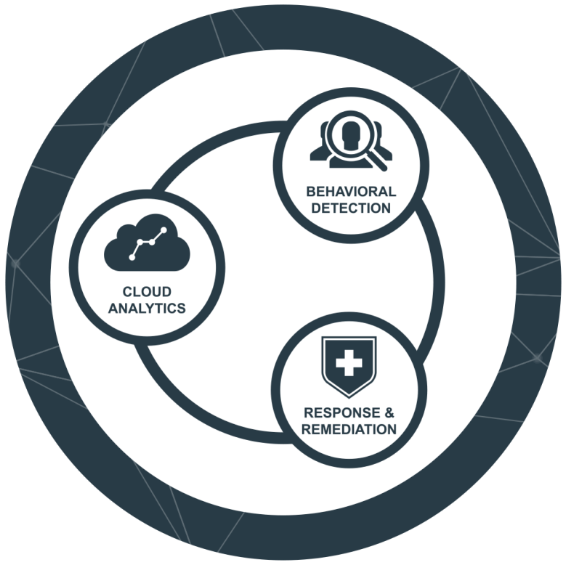
Carbon Black Defense
Stops file-based attacks: malware and ransomware
Stops next-gen attacks: memory-based, PowerShell, script-based, and obfuscated malware
Utilize collaborative threat intelligence to automatically stop attacks others have seen
No impact on end users or endpoint performance
Image source: Carbon Black

Slide 23

So does this mean anti-virus is
about to win the war?
Image source: Wikipedia

Slide 24
NO!
Maleware producers have some advantages:
They can test their malware against your product to make sure it bypasses it.
Users still do stupid shit mistakes.
You parents are still using an old OS with an expired virus-checker, happily ignoring the warnings at OS boot.
-> GO SEE YOUR PARENTS!

Slide 25
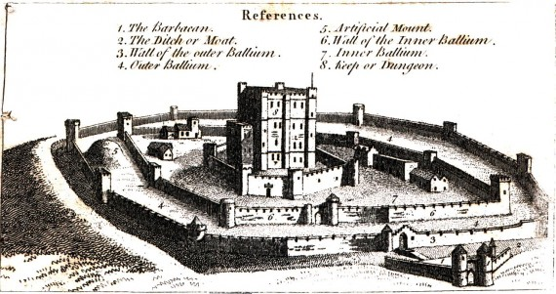
Defense in depth!
AWARENESS
ANTI-VIRUS
FIREWALL
MONITORING
BACKUP
SANDBOXING
LEAST PRIVILIGE
Image source: http://blog.smartbear.com/design/what-medieval-castles-can-teach-you-about-web-security/

Slide 26
Stopping email threats
The best defense against booby-trapped emails is your email gateway. Anti-spam technologies stop ransomware emails, while antivirus scans for and blocks email-borne threats. Blocking emails with macro attachments can help you avoid another common ransomware technique.

Slide 27
Stopping web threats
Web threats are neutralized at the firewall and web gateway. URL filtering blocks websites hosting ransomware, as well as their command and control servers. And by enforcing strict controls you can stop ransomware-related files from being downloaded at all.
Cloud sandboxing at both the email and web gateway blocks zero-day advanced threats, including ransomware. It’s like having your own private malware lab that runs suspicious files to determine behavior

Slide 28
Protecting your servers
Remember least privilege.
Also server whitelisting and lockdown keep your servers secure by whitelisting authorized applications and identifying what they can change and update – all other attempts to make changes are automatically blocked, stopping ransomware from taking action.
Malicious traffic detection stops ransomware from contacting command & control servers and downloading its payload.

Slide 29
Everyone together now.
Next-gen or not; your security products might be great individually, but even better when they work together. By enabling your endpoint and firewall to share security information and proactively respond to threats you get better protection against advanced threats.

Slide 30
Questions
Thank you!

