Slide 1
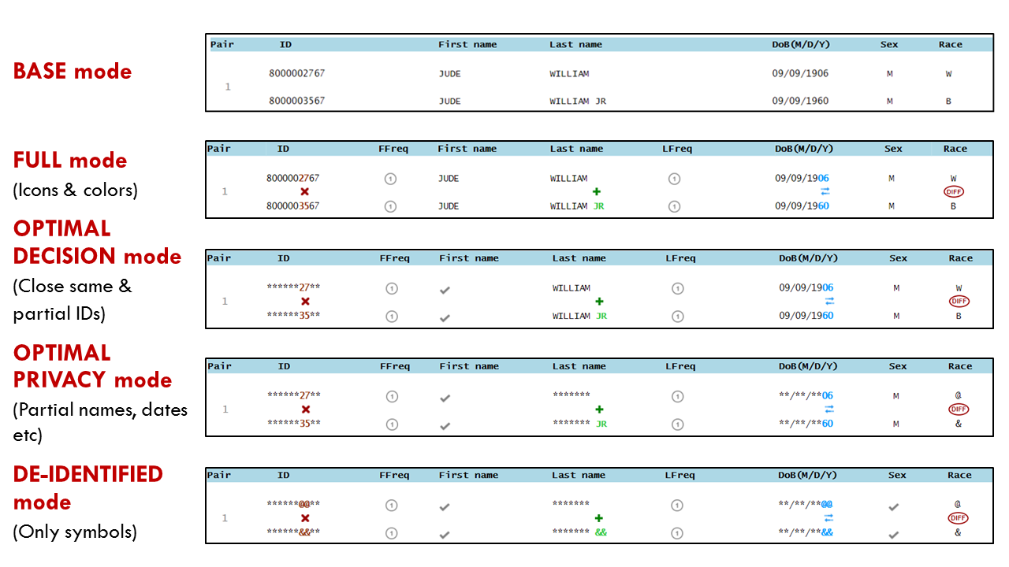
BASE Mode
Full disclosure without markup
This mode represents the current record linkage interfaces
that are being used.
All information are displayed as they are.
Highest privacy risk.

Slide 2
Full Mode
Full disclosure with markup
This mode represents an extension of BASE mode.
All information are displayed.
Markup is added: colors and icons are displayed to direct attention to the differences between records.
Still, has the highest privacy risk.

Slide 3
Masked Mode
Masked disclosure with markup
This is the completely de-identified mode.
There is NO risk of privacy loss because none of the
actual characters are displayed.

Slide 4
Minimum Mode
Minimum disclosure with markup
This mode opens a little more information than the
previous mode (de-identified mode).
Only the differences between items are shown.

Slide 5
Moderate Mode
Moderate disclosure with markup
This mode opens only information necessary for more
accurate linkage.
The risk of privacy loss is reduced.

Slide 6
Moderate Mode

Slide 7
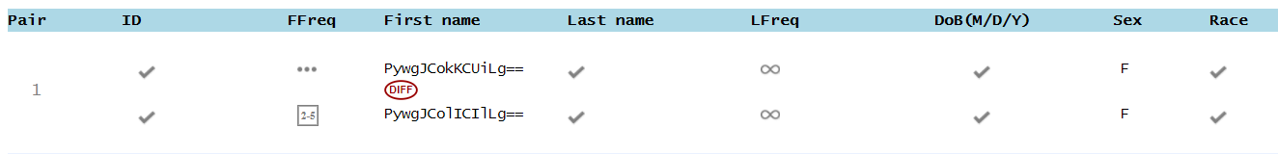
Encrypted Mode
encrypted disclosure with markup
Only have same/different icon
When information is identical, a pair of check marks will be displayed
When information is not identical, encrypted information will be displayed

