Slide 1
Interactive On-Demand Interface
That was hard, wasn't it?
Sometimes, data masking can hide data that might be essential for record linkage.
What if you could open up the masked data as you need to see more?
Over the next few pages, we will walk you through an interactive on-demand interface for record linkage.

Slide 2
Video on clickable interface

Slide 3

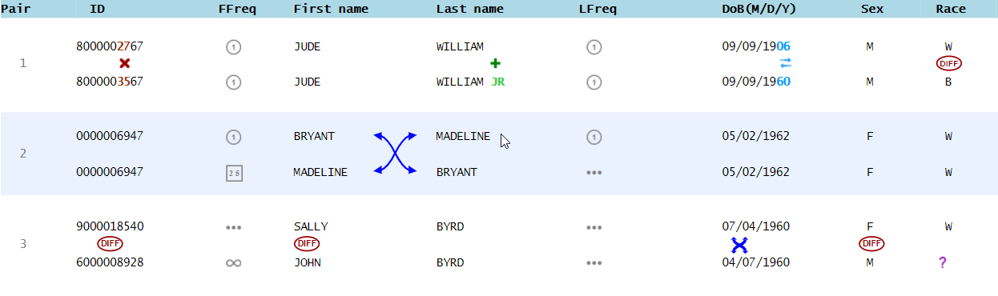
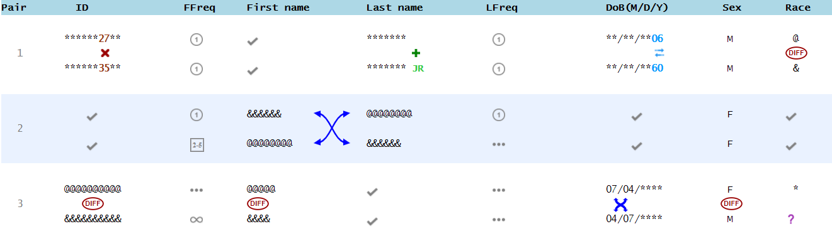
More Information with One Click
Did you pay attention to how cells were clicked open?
For cells that are completely identical or completely different,
all the contents will be fully opened in one click.

Slide 4
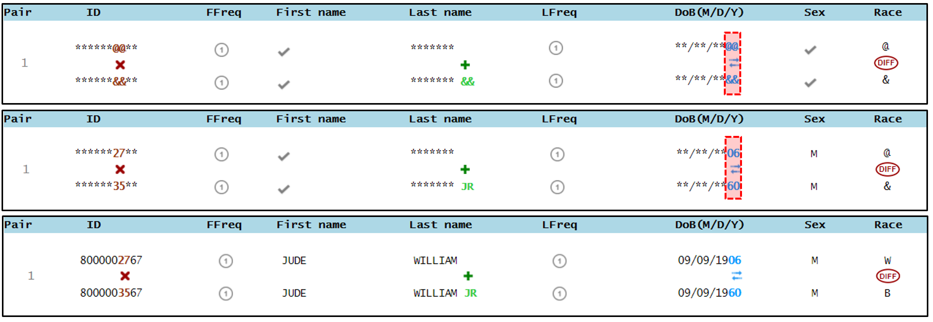
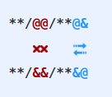
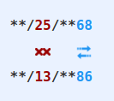
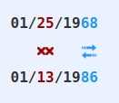
More Information with Two Clicks
For cells that are partly different, one click will only show details for the different parts. A second click will show the full information.
That means partially different cells can be clicked twice to open them fully
Remember, you might not need to see it all.
In the first example, you probably only need to see the JR and not William

Slide 5
What to open?
Check next slide for changes
Remember, you should only open the cells you need to make a good linkage decision.
Do not open cells unless you think it will help you make better decisions.
You will be given the most credit for correctly answering the most questions while opening as little of the data as possible.
Let’s look at an example next.

Slide 6
What to open?
Remember, you should open the relevant cells you need to make the correct linkage decision.
Do not open cells unless you think it will help you make better decisions but at the same time, if you need information to make good linkage decisions, go ahead and open it!
You will be given the most credit for correctly answering the most questions while opening up only the relevant cells.
Let’s look at an example next.

Slide 7
Video

Slide 8
What NOT to open?
If you don’t need to see the details to make a decision, DO NOT open it.
You may not need to open anything to make a decision, as in the example below.
Opening up the swapped name does not give you more information to make a decision.

Slide 9
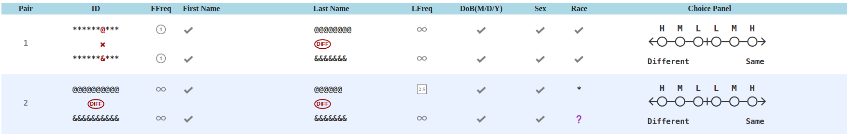
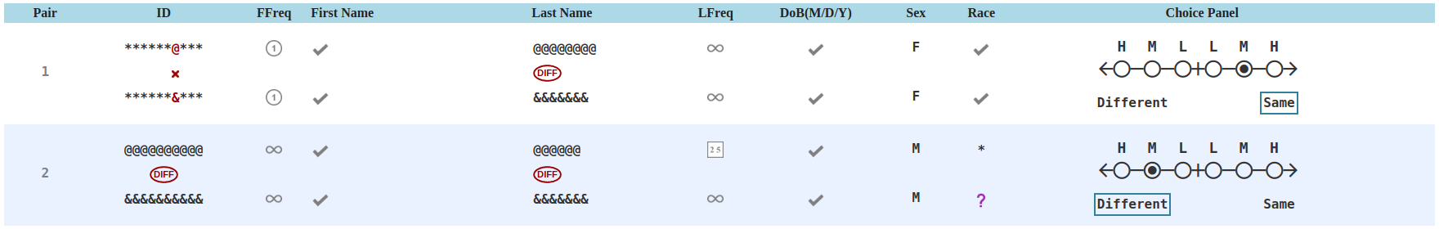
When you might want to open identical values?
Sometimes you might need to see the full items even when you know the values are the same:
Often females change their last name but males do not

Slide 10
Practice
Now try to make record linkage decisions as best you can.
Be smart and try to only open cells you need to see to make a good decision.

Slide 11
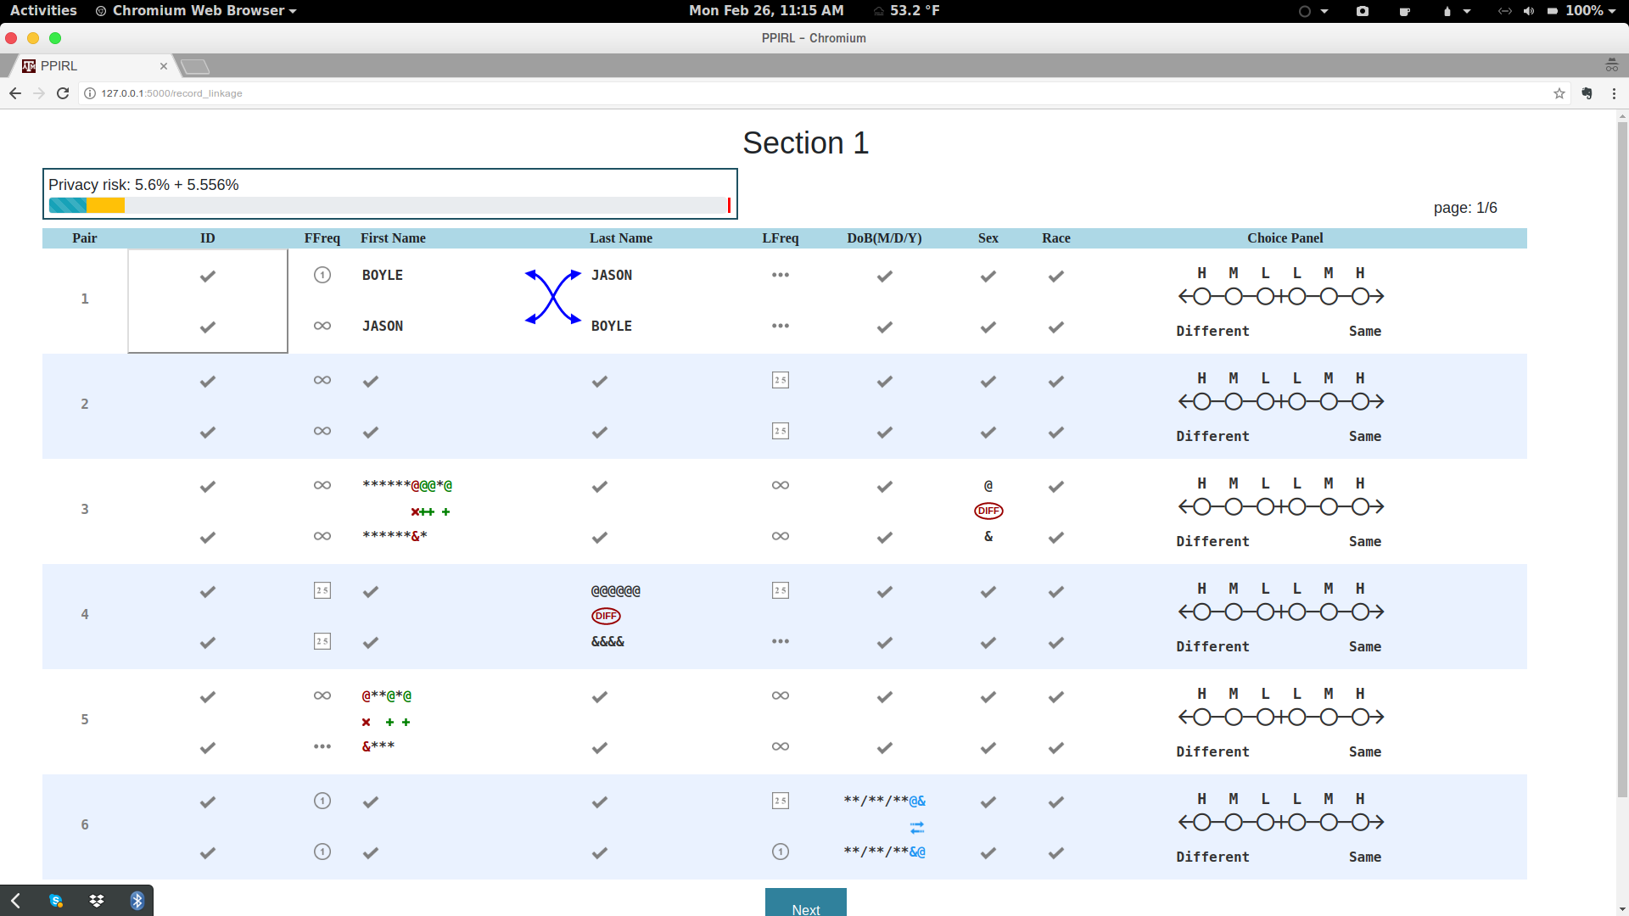
Privacy Meter
The meter will help you monitor how much you have opened up,
and how much you have left.
The blue bar indicates how much you have opened so far.
When you mouse over cells you want to open, the orange bar indicates how much the click would “cost”.
If you do not click, it goes away
If you click, it turns blue

Slide 12
Only for group that have a limit (everyone in pilot study)

Slide 13
Privacy Meter with Limit
100% (the full meter) is when all cells are fully open
What is the solid red line on the meter?
This is the maximum budget you have to spend (open up cells)
You will not be able to open anything else after you reach the solid red line.
If you reach the bar, then for the rest of the questions, you’ll have to make the best choice you can without opening anything else.
Be careful to only open cells that you need to make your decision.

Slide 14
How should you budget?
You have a total up to the solid red line to spend on answering all 36 questions over 6 pages
So, try not to use all of it on the first page.
Instead, try to spend roughly 1/6 on each page.

Slide 15
Now try doing the same practice question again, this time paying attention to the meter

Slide 16
Start of Section 1
Now you are ready for the main questions!
Don't be careless about opening cells, but don't be too cautious about it either. So long as you only open up what you need, you will be fine.
Remember the person who gets the MAXIMUM ANSWERS RIGHT WHILE OPENING UP RELEVANT CELLS WINS!
You will be linking pairs from two voter registry sources 4 years apart (April 2013 and March 2017) in one US county of population size approximately 1 million.
Click on the Next button when you are ready to start.

Slide 17
I feel this slide not needed. If we have start of section 1in the previous section and have another slide that's still tutorial, I fear the users may get weary
Main Goal: Most Answers Correct
While Opening Relevant Cells
Use your budget wisely to open up the relevant cells and make the correct linkage decisions – some pairs may not need any opening up whereas some might require looking at a few cells
Don't be careless about opening up and don't be too cautious about it either. So long as you only open up what you need, you will be fine.
Remember the person who gets the maximum answers right while opening up the relevant cells wins!

