Slide 1
Interactive On-Demand Interface
That was hard, wasn't it?
Sometimes, data masking can hide data that might be essential for record linkage.
What if you could open up the masked data as you need to see more?
Over the next few pages, we will walk you through an interactive on-demand interface for record linkage.

Slide 2
Video on clickable interface

Slide 3

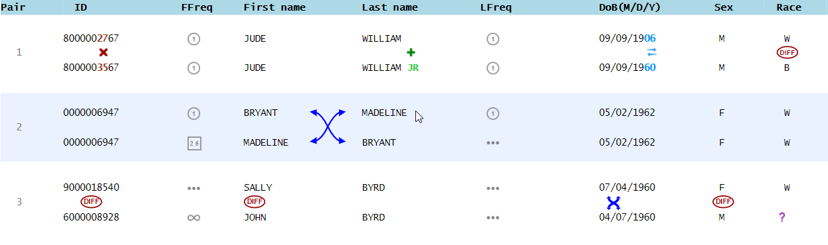
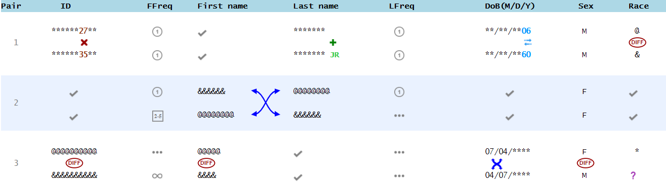
More Information with One Click
Did you pay attention to how cells were clicked open?
For cells that are completely identical or completely different,
all the contents will be fully opened in one click.

Slide 4
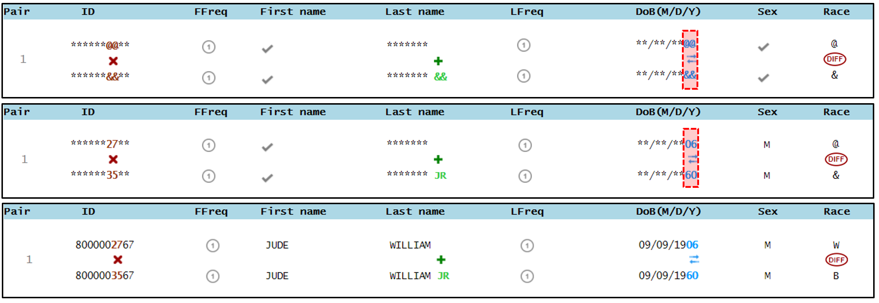
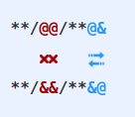
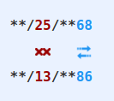
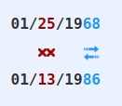
More Information with Two Clicks
For cells that are partly different, one click will only show details for the different parts. A second click will show the full information.
That means partially different cells can be clicked twice to open them fully
Remember, you might not need to see it all.
In the first example, you probably only need to see the JR and not William

Slide 5
What to open?
Remember, you should only open the cells you need to make a good linkage decision.
Do not open cells unless you think it will help you make better decisions.
You will be given the most credit for correctly answering the most questions while opening as little of the data as possible.
Let’s look at an example next.

Slide 6
Video

Slide 7
What NOT to open?
If you don’t need to see the details to make a decision, DO NOT open it.
You may not need to open anything to make a decision, as in the example below.
Opening up the swapped name does not give you more information to make a decision.

Slide 8
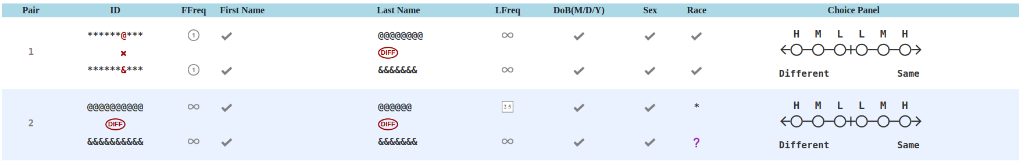
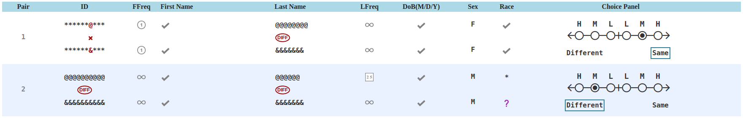
When you might want to open identical values
Sometimes you might need to see the full items even when you know the values are the same:
Often females change their last name but males do not

Slide 9
Practice
Now try to make record linkage decisions as best you can.
Be smart and try to only open cells you need to see to make a good decision.

Slide 10
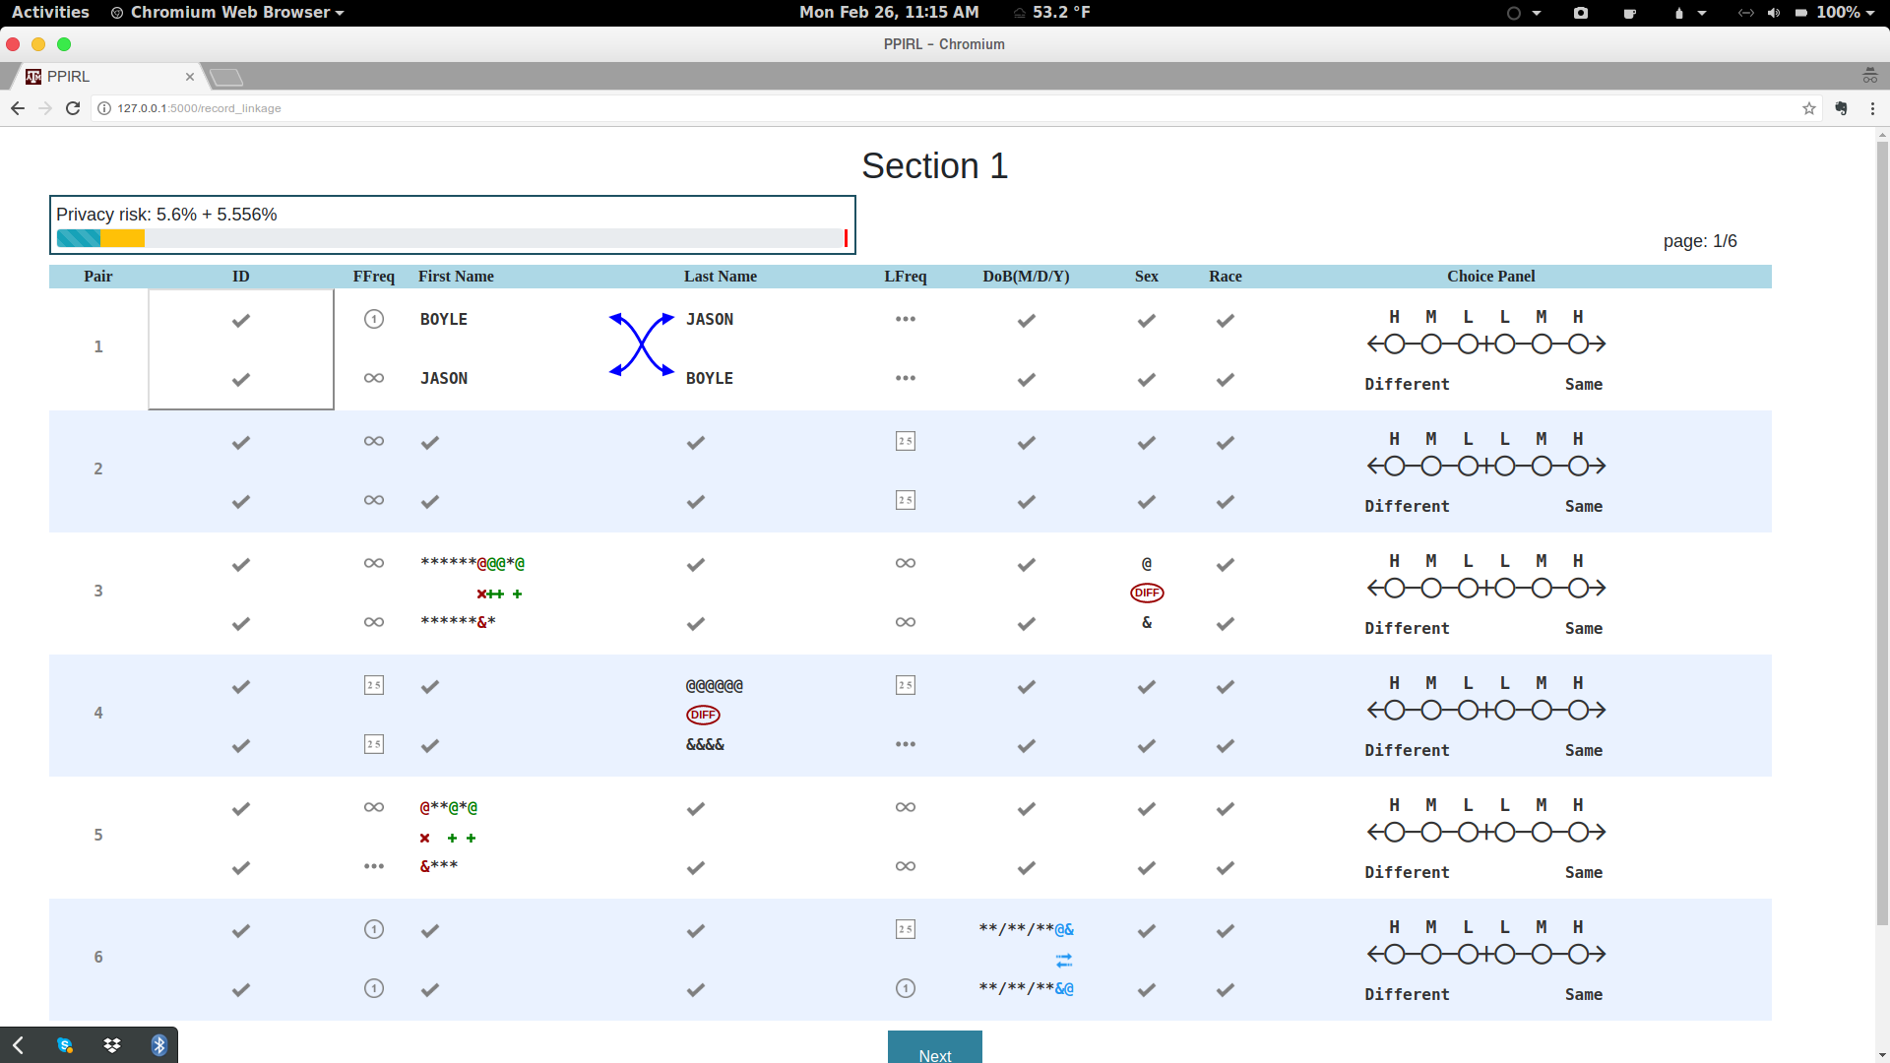
Privacy Meter
The meter will help you monitor how much you have opened up,
and how much you have left.
The blue bar indicates how much you have opened so far.
When you mouse over cells you want to open, the orange bar indicates how much the click would “cost”.
If you do not click, it goes away
If you click, it turns blue
Notes:
Guru, update figure

Slide 11
Only for group that have a limit (everyone in pilot study)

Slide 12
Privacy Meter with Limit
100% (the full meter) is when all cells are fully open
What is the solid red line on the meter?
This is the maximum budget you have to spend (open up cells)
You will not be able to open anything else after you reach the solid red line.
If you reach the bar, then for the rest of the questions, you’ll have to make the best choice you can without opening anything else.
Be careful to only open cells that you need to make your decision.
Notes:
Guru, update figure

Slide 13
How should you budget?
You have a total up to the solid red line to spend on answering all 36 questions over 6 pages
So, try not to use all of it on the first page.
Instead, try to spend roughly 1/6 on each page.
Notes:
Guru, update figure

Slide 14
Now try doing the same practice question again, this time paying attention to the meter

