Slide 1
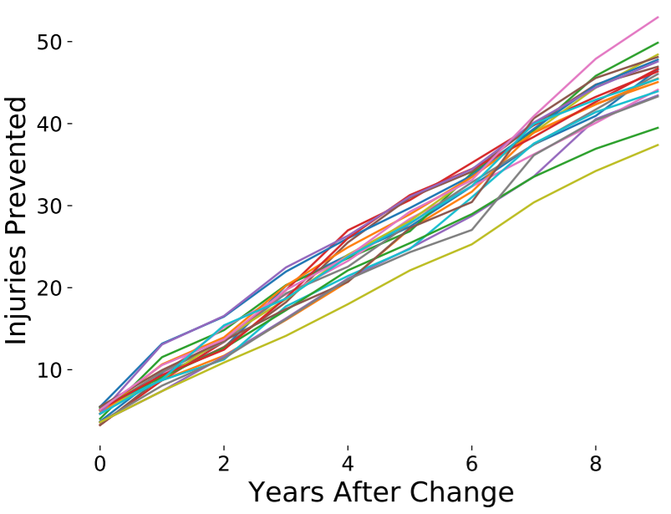
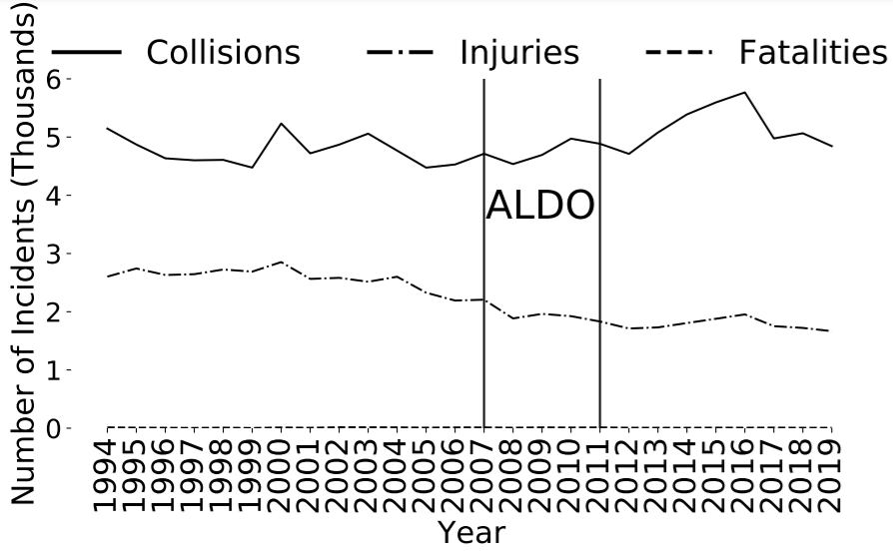
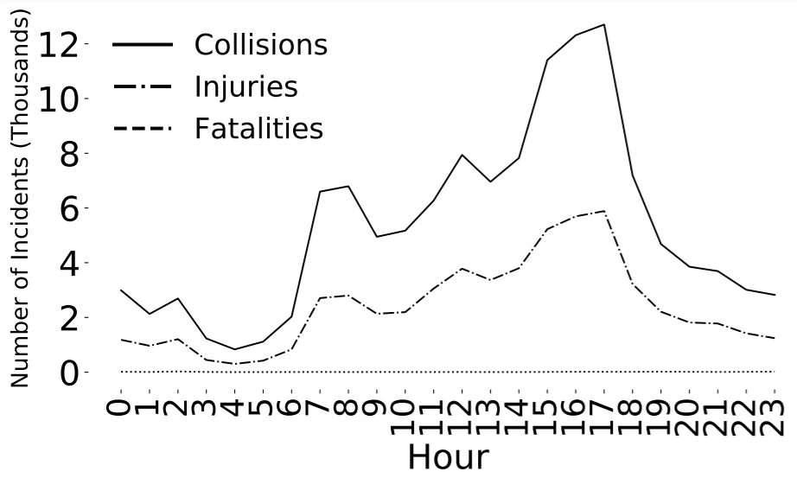
Data Science in Madison
Turner Entenmann

Slide 2
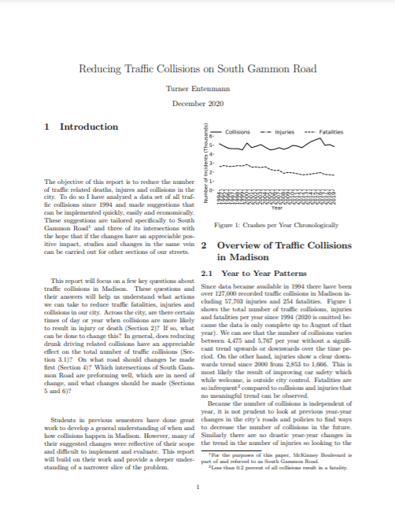
My Project
Semester long paper
Free to choose what to work on
I chose traffic collisions, specifically on S Gammon Rd.
Focus on plots and other visualizations
Emphasis on using Python to parse files and generate the visualizations

Slide 3
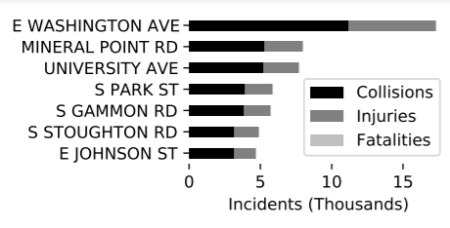
Why did I choose traffic?
Opportunity to build upon previous work
Potential for real change in my city
South Gammon because of collision density

Slide 4
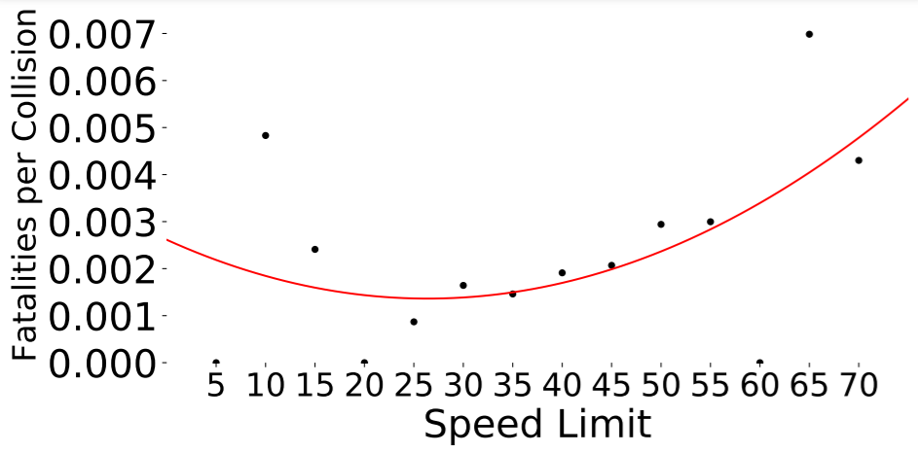
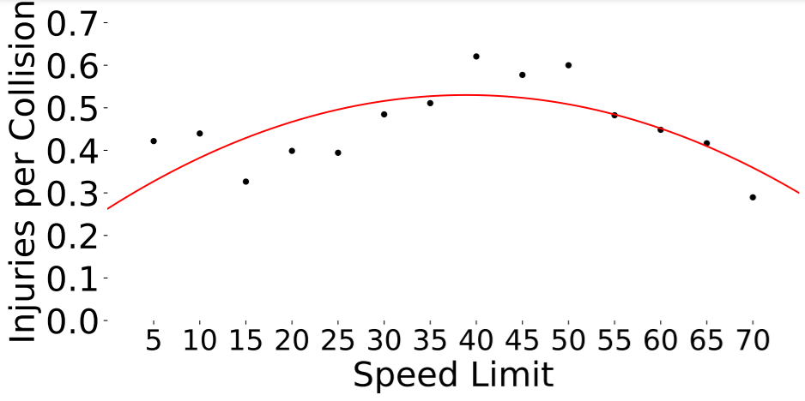
Where Did I Get the Data?
Data provided by Wisconsin Traffic Operations & Safety Laboratory
Challenges
Complicated – over 100,000 crashes recorded and 50 data points per crash
Incomplete – missing or incorrectly entered data can cause crashes or errors

Slide 5
Live coding demo

Slide 6
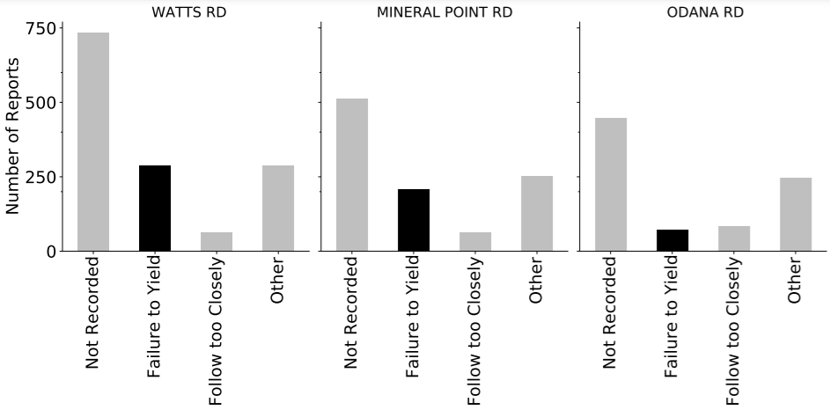
Presenting My Results
Presented plots weekly to the class
Wrote final paper with LaTeX
Presented to City of Madison Data Team

