Slide 1

Annotation of you-pronouns in Early Modern English texts using machine learning techniques
A project by Maria Irena Szawerna for Machine learning for statistical NLP: Advanced LT2326

Slide 2
What is this project about? I
Copious amounts of literature on second-person singular EME or Shakespearean pronouns:
Whether you forms are singular or plural is either disregarded or manually annotated by every researcher separately.
Busse (2002) tries to extrapolate his results using estimates from a smaller corpus, but admits that in reality those results are not necessarily true to the source material (pp. 30, 40-42).

Slide 3
What is this project about? II
My own research for an MA thesis at a different university forced me to hand-annotate Shakespeare’s plays for this feature:
Software that annotated pronouns for that particular feature could be very useful for potential future quantitative research in the field.
Goal: developing a method for you-pronoun annotation using Machine Learning techniques.

Slide 4
Background information I: previous research
Many inquiries into whether taggers developed on modern languages work on their historical variants:
Spelling, punctuation need standardization.
OOV tokens.
Lower accuracy due to older grammar rules.
Sparsity of source material.
Not always tagging for features like number.

Slide 5
Background information II: previous research
Older literature focuses on testing modern taggers and determining what is causing issues:
Adesam, Y., & Bouma, G. (2016), , Bollmann, M. (2013), Hiltunen, T., & Tyrkkö, J. (2013), Hupkes, D., & Bod, R. (2016), Rayson, P., Archer, D., Baron, A., Culpeper, J., & Smith, N. (2007), Scheible, S., Whitt, R. J., Durrell, M., & Bennett, P. (2011).
Newer research focuses on the use of Feature or Word Embeddings:
Kulick, S., Ryant, N., & Santorini, B. (2022), Yang, Y., & Eisenstein, J. (2016).

Slide 6
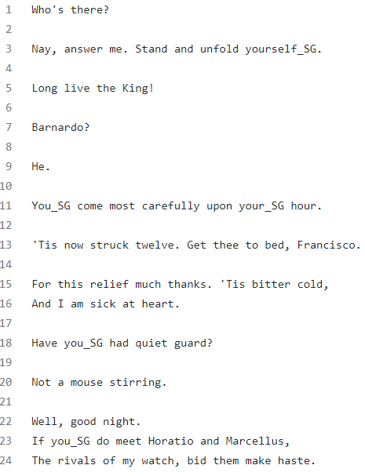
Background information III: data
Modernized spelling versions from The Folger Shakespeare.
Manually trimmed and annotated versions of As You Like It and Hamlet.
_SG, _PL, _UNK tags.

Slide 7
Methods and implementation I
Annotating only the number of a pronoun:
Not fully a POS-tagging problem, could be viewed as a classification problem.
Classes should be represented equally and _UNK is very rare – binary classification problem (_SG, _PL).
Utilizing BERT embeddings but not simply fine-tuning it to the task:
Kulick, Ryant, & Santorini (2022) argue in favor of word embeddings.
Fine-tuning BERT does not make for a good project.

Slide 8
Methods and implementation II
Determining the number of a pronoun:
No morphological distinction between you_SG and you_PL except for yourself and yourselves.
Contextual clues (nouns/NPs of address, previously addressing with thou, etc.).
Bidirectional LSTM:
Takes the given context (sentence) into the account.
Timestep representations can be accessed at the index of a pronoun making it possible to classify more than one pronoun per sentence.

Slide 9
Methods and implementation III
Implementation:
Jupyter Notebook for easy step-by-step execution.
Custom functions for extracting the annotated data and turning it into samples.
BERT embeddings sourced from the penultimate layer thereof.
PyTorch for Dataloaders and the model architecture itself.
Bidirectional LSTM
Classification layers: Dropout (0.05), Linear, LeakyReLU, Linear, Sigmoid.
BCELoss, Adam

Slide 10
Methods and implementation III
Evaluation:
Accuracy, recall, precision, F1 (sklearn.metrics).
DataFrame with decoded classes.
Annotating another play (Macbeth).

Slide 11
Results I
The project has been executed and is available on GitHub:
It has been re-run multiple times to try to pick the best hyperparameters.
The best performing model has been saved.
The following measures have been recorded for this model:
Accuracy = 0.8
Recall = 0.7692307692307693
Precision = 0.8108108108108109
F1 = 0.7894736842105263

Slide 12
Results II
Qualitative analysis: shorter sentences are more likely to be misclassified.
In testing data:
Beggar that I am, I am even poor in thanks; but I thank you, and sure, dear friends, my thanks are too dear a halfpenny.
Predicted: PL, true: PL
To you I give myself, for I am yours.
Predicted: PL, true: SG
In Macbeth:
Kind gentlemen, your_PL pains Are registered where every day I turn The leaf to read them.
[Enter Messenger.] What is your_PL tidings?

Slide 13
Conclusions
Sentence-level context may not be enough:
Short sentences do not contain the key clues.
Sometimes out-of-utterance information could be relevant.
Word embeddings:
A promising strategy as long as the source material is similar enough.
Still a fair bit of OOV and mis-parsed words.

Slide 14
Bibliography
Adesam, Y., & Bouma, G. (2016). Old Swedish Part-of-Speech Tagging between Variation and External Knowledge. Proceedings of the 10th SIGHUM Workshop on Language Technology for Cultural Heritage, Social Sciences, and Humanities, 32–42.
Bollmann, M. (2013). POS Tagging for Historical Texts with Sparse Training Data. Proceedings of the 7th Linguistic Annotation Workshop and Interoperability with Discourse, 11–18.
Busse, U. (2002). Linguistic Variation in the Shakespeare Corpus: Morpho-syntactic variability of second person pronouns. John Benjamins Publishing Company.
Hiltunen, T., & Tyrkkö, J. (2013). Tagging Early Modern English Medical Texts (1500-1700). Corpus Analysis with Noise in the Signal 2013 (conference).
Hupkes, D., & Bod, R. (2016). POS-tagging of Historical Dutch. Proceedings of the Tentch International Conference on Language Resources and Evaluation (LREC’16), 77-82.
Kulick, S., Ryant, N., & Santorini, B. (2022). Parsing Early Modern English for Linguistic Research. Proceedings of the Society for Computation in Linguistics 2022, 143–157.
Rayson, P., Archer, D., Baron, A., Culpeper, J., & Smith, N. (2007). Tagging the Bard: Evaluating the Accuracy of a Modern POS Tagger on Early Modern English Corpora. Proceedings of Corpus Linguistics 2007.
Scheible, S., Whitt, R. J., Durrell, M., & Bennett, P. (2011). Evaluating an ‘off-the-shelf’ POS-tagger on Early Modern German text. Proceedings of the 5th ACL-HLT Workshop on Language Technology for Cultural Heritage, Social Sciences, and Humanities, 19–23.
The Folger Shakespeare. N.d. Download Shakespeare’s Plays, Sonnets, and Poems. Available from: https://shakespeare.folger.edu/download/
Yang, Y., & Eisenstein, J. (2016). Part-of-Speech Tagging for Historical English. Proceedings of the 2016 Conference of the North American Chapter of the Association for Computational Linguistics: Human Language Technologies, 1318–1328.

