Slide 1
Evaluating the Stanza NLP toolkit’s performance on historical Polish Maria Irena Szawerna, MA (Universität Heidelberg), MA (Göteborgs universitet)

Slide 2
Roadmap
Research Context
Original project
Related work
Data
Example
Research Question
Experiment
Results
Future Work
Conclusions

Slide 3
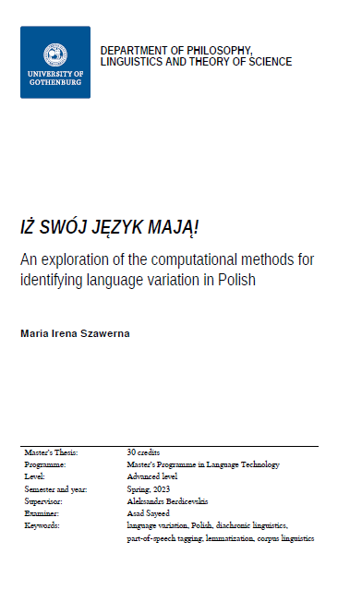
Related Research
MA thesis project at the University of Gothenburg
Quantitative and corpus research in historical linguistics
Part-of-speech tagging of historical data
Methods for dealing with language variation in NLP

Slide 4
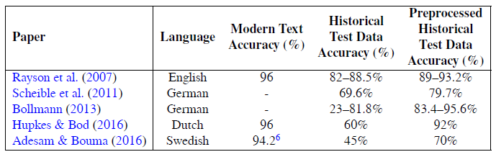
Related Research
Waszczuk et al. (2018): precision and recall both around 88.3% for baroque texts and 90.3% for texts from 1830–1918.

Slide 5
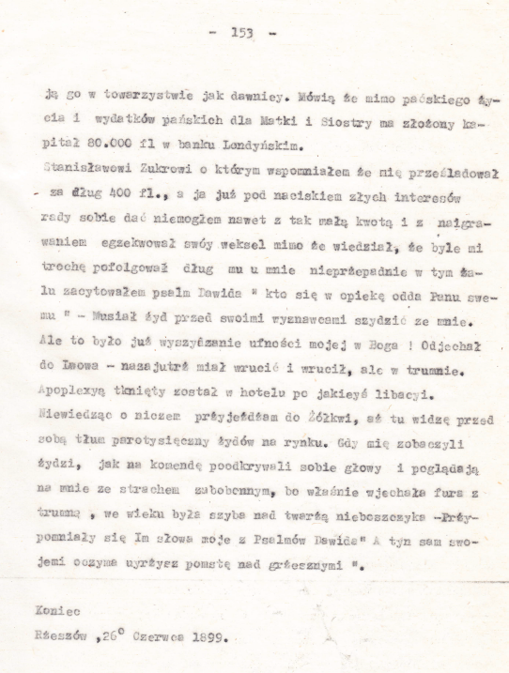
Data
1899 memoir from the Kresy region.
Visible variation in e.g. spelling, still intelligible for a native speaker.
Manual UD-style annotation (with pre-annotation).
Total: 37 405 tokens.
UPOS-annotated: 10 286 tokens.
XPOS-annotated, lemmatized: 3271 tokens.

Slide 6
Data – example
Original:
Odjechał do Lwowa – nazajutrż miał wrucić i wrucił, ale w trumnie.
Apoplexyą tknięty został w hotelu po jakieyś libacyi.
Modernized spelling:
Odjechał do Lwowa – nazajutrz miał wrócić i wrócił, ale w trumnie.
Apopleksją tknięty został w hotelu po jakiejś libacji.
Heavily modernized language:
Pojechał do Lwowa – miał wrócić dzień później, i wrócił, ale w trumnie.
Dostał udaru w hotelu po jakiejś imprezie.
English:
He drove away to Lviv – and he was supposed to return the day after and that he did, but in a coffin.
He had suffered a stroke at a hotel after some party.

Slide 7
Research Question
How well does the Stanza NLP toolkit perform on a sample of
19th-century Polish and what errors does it tend to make?

Slide 8
Experiment
XPOS- and UPOS-tagging, lemmatization
Error annotation
Tools and resources:
Stanza NLP toolkit
Other appropriate Python libraries and modules
Jupyter Notebook
PDB-UD

Slide 9
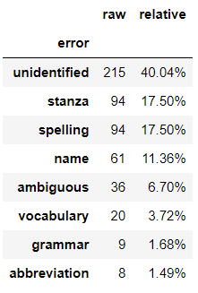
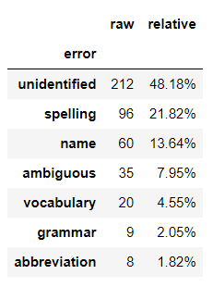
Results: lemmatization
 | Accuracy (original) | Accuracy (lowercase)
PDB-UD | 90.89% | 92.34%
Historical | 83.58% | 86.55%

Slide 10
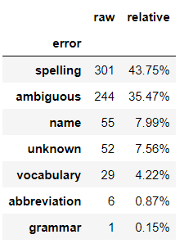
Results: UPOS-tagging
 | Accuracy
PDB-UD | 98.40%
Historical | 93.31%

Slide 11
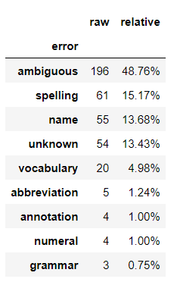
Results: XPOS-tagging
 | Accuracy
PDB-UD | 94.29%
Historical | 87.71%

Slide 12
Results: trends in errors
Spelling: y (suchey instead of suchej)
Spelling: nie (niemają instead of nie mają)
Spelling/pronunciation: e (małem instead of małym)
Spelling/pronunciation: rż (warżenia instead of warzenia)
Spelling: capitalization (Dziedzica instead of dziedzica)

Slide 13
Results: trends in errors
Grammar: nonstandard inflection (człowiecze instead of człowieku)
Grammar: vocative vs. nominative (Asińdźka instead of Asińdźko)
Grammar: impersonal verb forms
Vocabulary: proper names
Vocabulary: other OOV items
Ambiguity: numerals
Ambiguity: verb-derived nouns and adjectives
Miscellaneous errors.

Slide 14
Future work
Comparison to more data
More data from the same time and region
Older data
Contemporary non-standard data
Research on pre-processing methods
Completing the annotation of the data, verifying the quality of the annotation

Slide 15
Conclusions: back to Research Question
How well does the Stanza NLP toolkit perform on a sample of 19th-century Polish and what errors does it tend to make?
Significantly worse performance
Errors related to dialectical and diachronic variation
Miscellaneous errors
Stanza is not fully reliable as an annotation tool for nonstandard data, but can be used for preannotation

Slide 16
Thesis and conference repository
Thesis and code available at: https://github.com/Turtilla/swe-ma-thesis, upcoming at: https://gupea.ub.gu.se/
Presentation and code available at: https://github.com/Turtilla/WSMF-presentation

Slide 17
Thank you for your attention!

Slide 18
Bibliography
Adesam, Y. & Bouma, G. (2016). Old Swedish part-of-speech tagging between variation and external knowledge. In Proceedings of the 10th SIGHUM Workshop on Language Technology for Cultural Heritage, Social Sciences, and Humanities (pp. 32–42). Berlin, Germany: Association for Computational Linguistics.
Bender, E. M., Gebru, T., McMillan-Major, A., & Shmitchell, S. (2021). On the dangers of stochastic parrots: Can language models be too big? In Proceedings of the 2021 ACM Conference on Fairness, Accountability, and Transparency, FAccT ’21 (pp. 610–623). New York, NY, USA: Association for Computing Machinery.
Bird, S., Loper, E., & Klein, E. (2009). Natural Language Processing with Python. O’Reilly Media. Blodgett, S. L., Barocas, S., Daumé III, H., & Wallach, H. (2020). Language (technology) is power: A critical survey of “bias” in NLP. In Proceedings of the 58th Annual Meeting of the Association for Computational Linguistics (pp. 5454–5476). Online: Association for Computational Linguistics.
Bollmann, M. (2013). POS tagging for historical texts with sparse training data. In Proceedings of the 7th Linguistic Annotation Workshop and Interoperability with Discourse (pp. 11–18). Sofia, Bulgaria: Association for Computational Linguistics.
Dipper, S. & Waldenberger, S. (2017). Investigating diatopic variation in a historical corpus. In Proceedings of the Fourth Workshop on NLP for Similar Languages, Varieties and Dialects (VarDial) (pp. 36–45). Valencia, Spain: Association for Computational Linguistics.
Donoso, G. & Sánchez, D. (2017). Dialectometric analysis of language variation in Twitter. In Proceedings of the Fourth Workshop on NLP for Similar Languages, Varieties and Dialects (VarDial) (pp. 16–25). Valencia, Spain: Association for Computational Linguistics.
Dorn, R. (2019). Dialect-specific models for automatic speech recognition of African American Vernacular English. In Proceedings of the Student Research Workshop Associated with RANLP 2019 (pp. 16–20). Varna, Bulgaria: INCOMA Ltd.
Dunaj, B. (2019). “Historia języka polskiego” Zenona Klemensiewicza a potrzeba nowej syntezy. LingVaria, 14.
Długosz-Kurczabowa, K. & Dubisz, S. (2006). Gramatyka historyczna Języka Polskiego. Wydawnictwa Uniwersytetu Warszawskiego.
Eisenstein, J. (2015). Systematic patterning in phonologically-motivated orthographic variation. Journal of Sociolinguistics, 19.
Estarrona, A., Etxeberria, I., Etxepare, R., Padilla-Moyano, M., & Soraluze, A. (2020). Dealing with dialectal variation in the construction of the Basque historical corpus. In Proceedings of the 7th Workshop on NLP for Similar Languages, Varieties and Dialects (pp. 79–89). Barcelona, Spain Online): International Committee on Computational Linguistics (ICCL).

Slide 19
Garcia, M. & García Salido, M. (2019). A method to automatically identify diachronic variation in collocations. In Proceedings of the 1st International Workshop on Computational Approaches to Historical Language Change (pp. 71–80). Florence, Italy: Association for Computational Linguistics.
Garimella, A., Amarnath, A., Kumar, K., Yalla, A. P., N, A., Chhaya, N., & Srinivasan, B. V. (2021). He is very intelligent, she is very beautiful? On Mitigating Social Biases in Language Modelling and Generation. In Findings of the Association for Computational Linguistics: ACL-IJCNLP 2021 (pp. 4534–4545). Online: Association for Computational Linguistics.
Garrette, D. & Alpert-Abrams, H. (2016). An unsupervised model of orthographic variation for historical document transcription. In Proceedings of the 2016 Conference of the North American Chapter of the Association for Computational Linguistics: Human Language Technologies (pp. 467–472). San Diego, California: Association for Computational Linguistics.
Gruszczyński, W., Adamiec, D., Bronikowska, R., & Wieczorek, A. (2020). ELEKTRONICZNY KORPUS TEKSTÓW POLSKICH Z XVII I XVIII W. – PROBLEMY TEORETYCZNE I WARSZTATOWE. (pp. 32–51).
Hämäläinen, M., Partanen, N., & Alnajjar, K. (2021). Lemmatization of historical old literary Finnish texts in modern orthography. In Actes de la 28e Conférence sur le Traitement Automatique des Langues Naturelles. Volume 1 : conférence principale (pp. 189–198). Lille, France: ATALA.
Hovy, D. (2018). The social and the neural network: How to make natural language processing about people again. In Proceedings of the Second Workshop on Computational Modeling of People’s Opinions, Personality, and Emotions in Social Media (pp. 42–49). New Orleans, Louisiana, USA: Association for Computational Linguistics.
Hovy, D. & Purschke, C. (2018). Capturing regional variation with distributed place representations and geographic retrofitting. In Proceedings of the 2018 Conference on Empirical Methods in Natural Language Processing (pp. 4383–4394). Brussels, Belgium: Association for Computational Linguistics.
Hovy, D. & Spruit, S. L. (2016). The social impact of natural language processing. In Proceedings of the 54th Annual Meeting of the Association for Computational Linguistics (Volume 2: Short Papers) (pp. 591–598). Berlin, Germany: Association for Computational Linguistics.
Hupkes, D. & Bod, R. (2016). POS-tagging of Historical Dutch. In LREC 2016: Tenth International Conference on Language Resources and Evaluation (pp. 77–82). Paris: European Language Resources Association (ELRA).

Slide 20
Jenset, G. B. & McGillivray, B. (2017). Quantitative Historical Linguistics: A Corpus Framework. Oxford University Press.
Johannessen, J., Kåsen, A., Hagen, K., Nøklestad, A., & Priestley, J. (2020). Comparing methods for measuring dialect similarity in Norwegian. In Proceedings of the 12th Language Resources and Evaluation Conference (pp. 5343–5350). Marseille, France: European Language Resources Association.
Johannsen, A., Hovy, D., & Søgaard, A. (2015). Cross-lingual syntactic variation over age and gender. In Proceedings of the Nineteenth Conference on Computational Natural Language Learning (pp. 103–112). Beijing, China: Association for Computational Linguistics.
Jurgens, D., Tsvetkov, Y., & Jurafsky, D. (2017). Incorporating dialectal variability for socially equitable language identification. In Proceedings of the 55th Annual Meeting of the Association for Computational Linguistics (Volume 2: Short Papers) (pp. 51–57). Vancouver, Canada: Association for Computational Linguistics.
Jurman, G., Riccadonna, S., & Furlanello, C. (2012). A Comparison of MCC and CEN Error Measures in Multi-Class Prediction. PLOS ONE, 7(8), 1–8.
Klemensiewicz, Z. (1976). Historia Języka Polskiego. Państwowe Wydawnictwo Naukowe.
Kurzowa, Z. (1983). Polszczyzna Lwowa i Kresów Południowo-Wschodnich do 1939 roku. Państwowe Wydawnictwo Naukowe.
Manning, C., Surdeanu, M., Bauer, J., Finkel, J., Bethard, S., & McClosky, D. (2014). The Stanford CoreNLP natural language processing toolkit. In Proceedings of 52nd Annual Meeting of the Association for Computational Linguistics: System Demonstrations (pp. 55–60). Baltimore, Maryland: Association for Computational Linguistics.
McEnery, T., Baker, P., & Burnard, L. (2000). Corpus resources and minority language engineering. In Proceedings of the Second International Conference on Language Resources and Evaluation (LREC’00) Athens, Greece: European Language Resources Association (ELRA).
McGillivray, B. & Jenset, G. B. (2023). Quantifying the quantitative (re-)turn in historical linguistics. Palgrave Communications, 10(1), 1–6.
McKinney, W. (2010). Data Structures for Statistical Computing in Python. In Stéfan van der Walt & Jarrod Millman (Eds.), Proceedings of the 9th Python in Science Conference (pp. 56 – 61).
Ossolineum (n.d.). Katalogi Ossolineum. https://katalogi.ossolineum.pl/. Accessed: 03.04.2023.
Pedregosa, F., Varoquaux, G., Gramfort, A., Michel, V., Thirion, B., Grisel, O., Blondel, M., Prettenhofer, P., Weiss, R., Dubourg, V., Vanderplas, J., Passos, A., Cournapeau, D., Brucher, M., Perrot, M., & Duchesnay, E. (2011). Scikit-learn: Machine learning in Python. Journal of Machine Learning Research, 12, 2825–2830.
Peirsman, Y., Geeraerts, D., & Speelman, D. (2010). The automatic identification of lexical variation between language varieties. Natural Language Engineering, 16(4), 469–491.
Ponti, E. M., O’Horan, H., Berzak, Y., Vulić, I., Reichart, R., Poibeau, T., Shutova, E., & Korhonen, A. (2019). Modeling Language Variation and Universals: A Survey on Typological Linguistics for Natural Language Processing. Computational Linguistics, 45(3), 559–601.

Slide 21
Qi, P., Zhang, Y., Zhang, Y., Bolton, J., & Manning, C. D. (2020). Stanza: A Python natural language processing toolkit for many human languages. In Proceedings of the 58th Annual Meeting of the Association for Computational Linguistics: System Demonstrations.
Rayson, P., Archer, D., Baron, A., Culpeper, J., & Smith, N. (2007). Tagging the Bard: Evaluating the accuracy of a modern POS tagger on Early Modern English corpora.
Regnault, M., Prévost, S., & Villemonte de la Clergerie, E. (2019). Challenges of language change and variation: towards an extended treebank of medieval French. In Proceedings of the 18th International Workshop on Treebanks and Linguistic Theories (TLT, SyntaxFest 2019) (pp. 144–150). Paris, France: Association for Computational Linguistics.
Sánchez-Marco, C., Boleda, G., & Padró, L. (2011). Extending the tool, or how to annotate historical language varieties. In Proceedings of the 5th ACL-HLT Workshop on Language Technology for Cultural Heritage, Social Sciences, and Humanities (pp. 1–9). Portland, OR, USA: Association for Computational Linguistics.
Scheible, S., Whitt, R. J., Durrell, M., & Bennett, P. (2011). Evaluating an ‘off-the-shelf’ POStagger on early Modern German text. In Proceedings of the 5th ACL-HLT Workshop on Language Technology for Cultural Heritage, Social Sciences, and Humanities (pp. 19–23). Portland, OR, USA: Association for Computational Linguistics.
Soria, C., Russo, I., Quochi, V., Hicks, D., Gurrutxaga, A., Sarhimaa, A., & Tuomisto, M. (2016). Fostering digital representation of EU regional and minority languages: the digital language diversity project. In Proceedings of the Tenth International Conference on Language Resources and Evaluation (LREC’16) (pp. 3256–3260). Portorož, Slovenia: European Language Resources Association (ELRA).
The pandas development team (2020). pandas-dev/pandas: Pandas.
Universal Dependencies (n.d.b). UD for Polish. https://universaldependencies.org/pl/index.html. Accessed: 04.04.2023.
Waszczuk, J., Kieraś, W., & Woliński, M. (2018). Morphosyntactic disambiguation and segmentation for historical polish with graph-based conditional random fields. In P. Sojka, A. Horák, I. Kopeček, & K. Pala (Eds.), Text, Speech, and Dialogue (pp. 188–196). Cham: Springer International Publishing.
Wróblewska, A. (2018). Extended and enhanced Polish dependency bank in Universal Dependencies format. In Proceedings of the Second Workshop on Universal Dependencies (UDW 2018) (pp. 173–182). Brussels, Belgium: Association for Computational Linguistics.
Zampieri, M., Malmasi, S., & Dras, M. (2016). Modeling language change in historical corpora: The case of Portuguese. In Proceedings of the Tenth International Conference on Language Resources and Evaluation (LREC’16) (pp. 4098–4104). Portorož, Slovenia: European Language Resources Association (ELRA).
Zampieri, M., Nakov, P., & Scherrer, Y. (2020). Natural language processing for similar languages, varieties, and dialects: A survey. Natural Language Engineering, 26, 595 – 612.

