Slide 1

A young boy with a tree made of trees: Domain Adaptation of an LSTM-based Image Caption Generation Model
A project by Dominik Künkele and Maria Irena Szawerna for the LT2318 HT22 Artificial Intelligence: Cognitive Systems course.

Slide 2
Introduction (Maria)
Usefulness of image captioning software.
Do we need to re-train models for every domain?
CNN+LSTM image captioning models.
Can we adapt a pretrained model to a new domain?

Slide 3
Materials and Methods (Dominik)
The image captioning model from Xu et al. 2015, implemented by Nikolai for one of the tutorials in the course.
Changes:
Relation filter(s)
Unknown filter
Excluding UNK tokens from caption generation.
Flickr8k (original) and imageCLEF (new domain)
Human judgement questionnaire

Slide 4
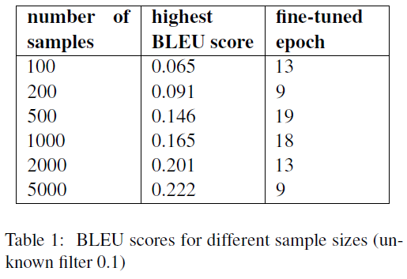
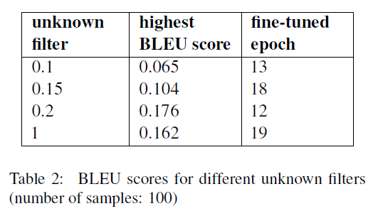
Results (Dominik)

Slide 5
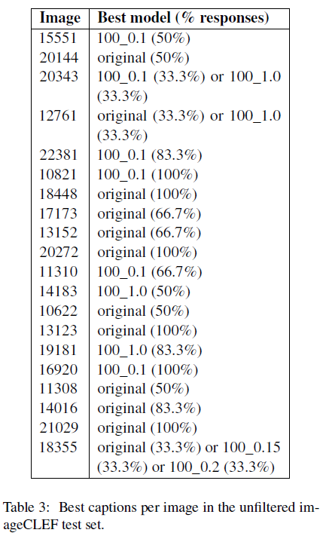
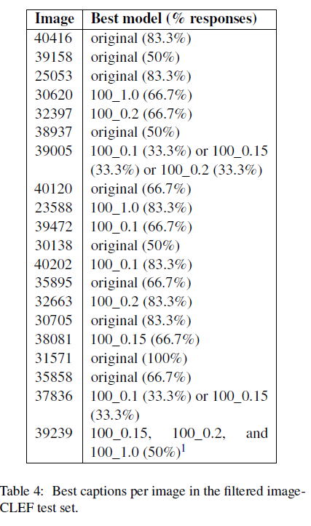
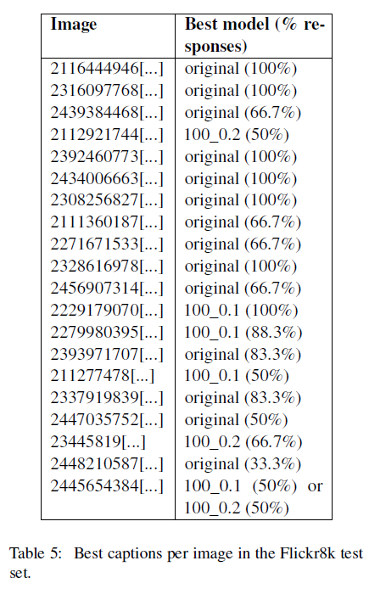
Results (Maria)
Overall: captions were deemed to be low-quality, r u b b i s h, to quote one of the participants.

Slide 6
Discussion (Dominik)
The fine-tuning was much more disruptive than expected.
Differences in caption structure (syntax) and vocabulary are major.
Less data – grammatical but thematically unfitting captions.
More data – ungrammatical, theoretically thematically fitting captions (UNK tokens).
Small improvements based on human judgements, but the captions are still bad.

Slide 7
Conclusions (Maria)
We have addressed our questions and found out what issues impede domain adapatation.
Ideas for future research:
Testing the influence of other hyperparameters.
Testing the same thing on a different model architecture.
Fine-tuning on a more similar dataset.
Exploring ways of mitigating the discovered issues.

Slide 8
Thank you for your attention!

