Slide 1
Evaluating a Modern Polish POS-Tagger on Historical Data
A project by
Maria Irena Szawerna for LT2314 Language Technology Resources

Slide 2
Background
POS information can be useful in other types of research (e.g. corpus linguistics).
POS taggers are created for big modern languages or require much data to train.
Solution: using modern POS taggers on historical data?
Issues: OOV items, variation in spelling and punctuation, different grammar...
These problems can be solved, but first they need to be identified.
Most research has been done on Germanic languages.

Slide 3

Research question:
How well does the GATE Cloud tagger for Polish perform on historical data and what kinds of mistakes does it tend to make?

Slide 4
Materials and methods
GATE Cloud tagger for Polish, trained on Universal Dependencies treebanks.
Manually annotated data from 19th century memoirs, 3000+ tokens.
Code in a Jupyter Notebook file: data preprocessing, tagger annotation, an array of evaluation measures (quantitative and qualitative).
Manual error analysis.

Slide 5
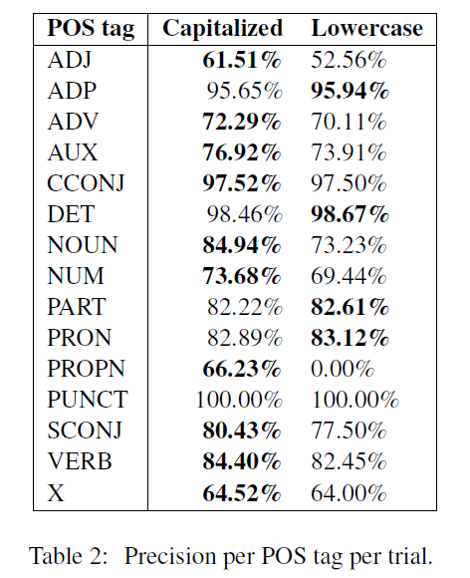
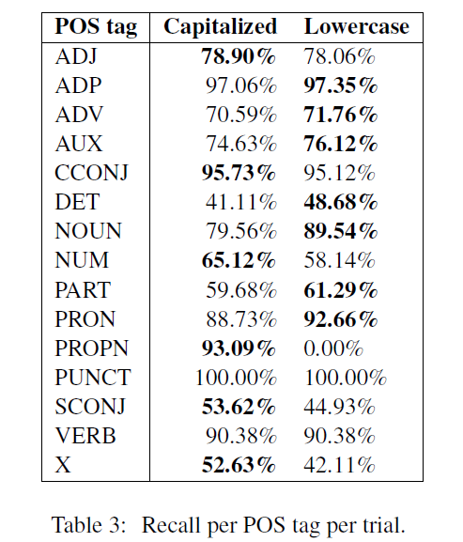
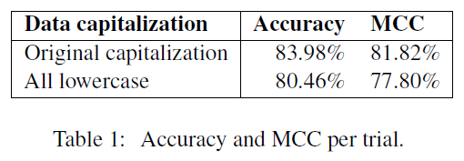
Results

Slide 6
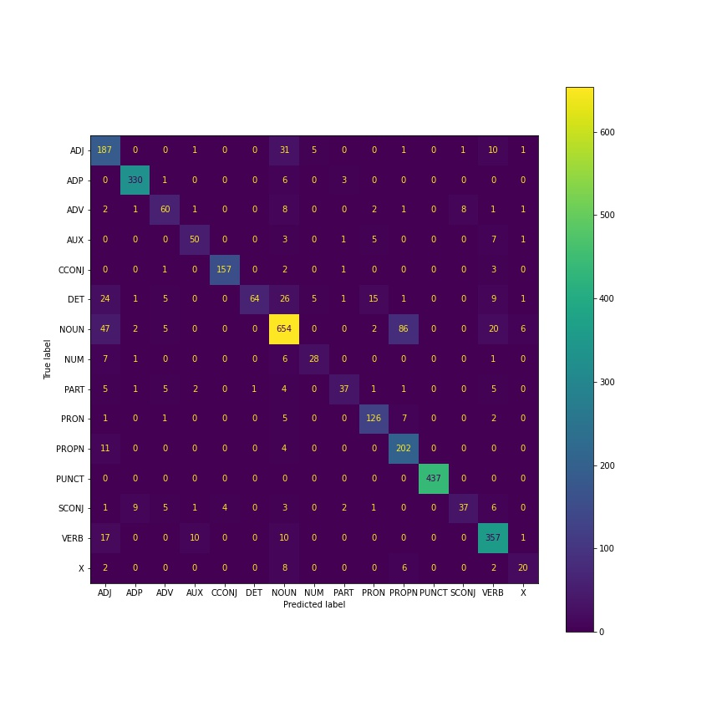
Confusion matrix (original capitalization)

Slide 7
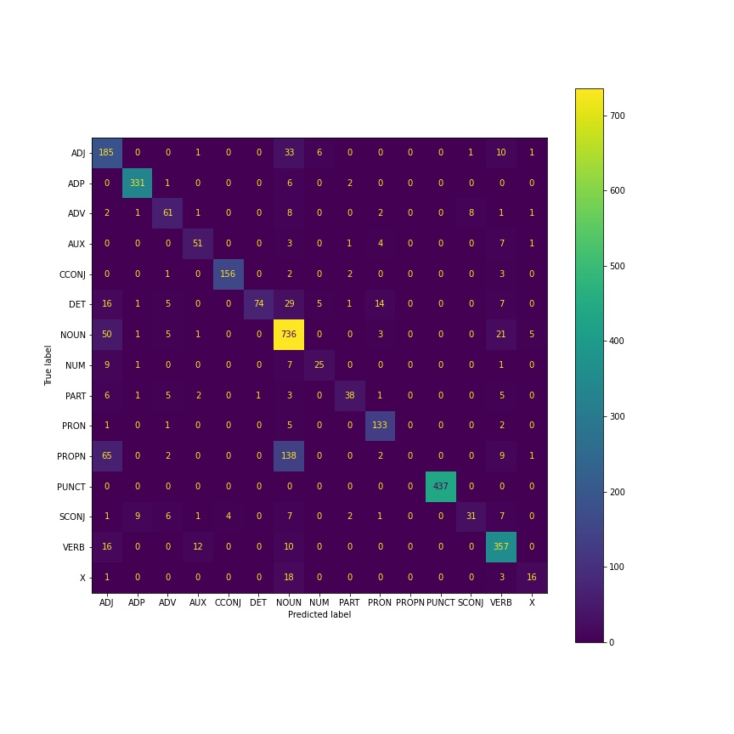
Confusion matrix (lowercase)

Slide 8
Qualitative error analysis
Jupyter Notebook
Capitalization, confusing word endings, variation in spelling, the ability of some words to function as multiple classes, and archaic vocabulary.
Mysterious cases.

Slide 9
Errors: examples (original capitalization)
Word-final y instead of j:
Ambiguous word class:
Archaic or nonstandard spelling:
Nonstandard capitalization:
Surnames (adjectival paradigm):
UD annotation-induced class ambiguity:
Lexical/grammatical similarity to Polish:

Slide 10
Discussion
Performance better than expected (above 80%).
Issues similar to the ones described in the literature, except the confusing endings.
Lowercasing the data does not bring obvious benefits, and is detrimental to PROPN detection.

Slide 11
Future Work
Influence of punctuation.
Testing other taggers on the same data.
Testing this tagger on different kinds of historical data.
Testing taggers on modern nonstandard data.
Developing methods for preprocessing the data.

Slide 12
Thank you for your attention

