Slide 1
Computational methods for identifying language variation in Polish
Initial results presentation by
Maria Irena Szawerna

Slide 2
What is this project about? - recap
Using computational methods to assess and identify the differences between two texts.
Orthography, morphology, syntax
A 19th-century Polish memoir (manually annotated) vs. modern Polish corpora (and maybe 17th/18th c.).
Historical data, results relevant for potential preprocessing for using modern tools.
Potentially relevant for other nonstandard data and the processing thereof.
Comparison based on the performance of POS taggers and lemmatizers, statistical comparisons.

Slide 3
Resources (to be continued)
NKJP (The National Corpus of the Polish Language)
Polish UD treebanks
Morfeusz 2 tagger
UD POS tagger
Marmot tagger
BERT for Polish
Stanza toolkit
Korba (The Electronic Corpus of 17th and 18th century Polish)
Wspomnienia Juliusza Czermińskiego (Juliusz Czermiński’s Memoir)
Polish Dependency Bank (PDB)

Slide 4
Plan
Weeks 3-6: consulting with the supervisor, gathering resources and background reading.
Week 5: presenting the thesis plan.
Weeks 6-8: deciding what annotation to use and carrying it out on a chunk of the data.
(Additionally) Weeks 7-8: spring break.
Week 9: training a BERT-based POS tagger.
Weeks 10-12: testing the taggers and the lemmatizer.
Weeks 13-14: error analysis, identifying methods for processing the error statistics into usable language variation information.
Weeks 15-22: finishing writing, spare time in case any of the stages before take longer than expected, working with the NKJP programming access, if obtained.

Slide 5
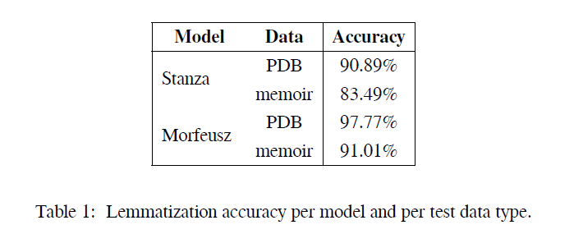
Preliminary results
Repository: https://github.com/Turtilla/swe-ma-thesis (private)

Slide 6
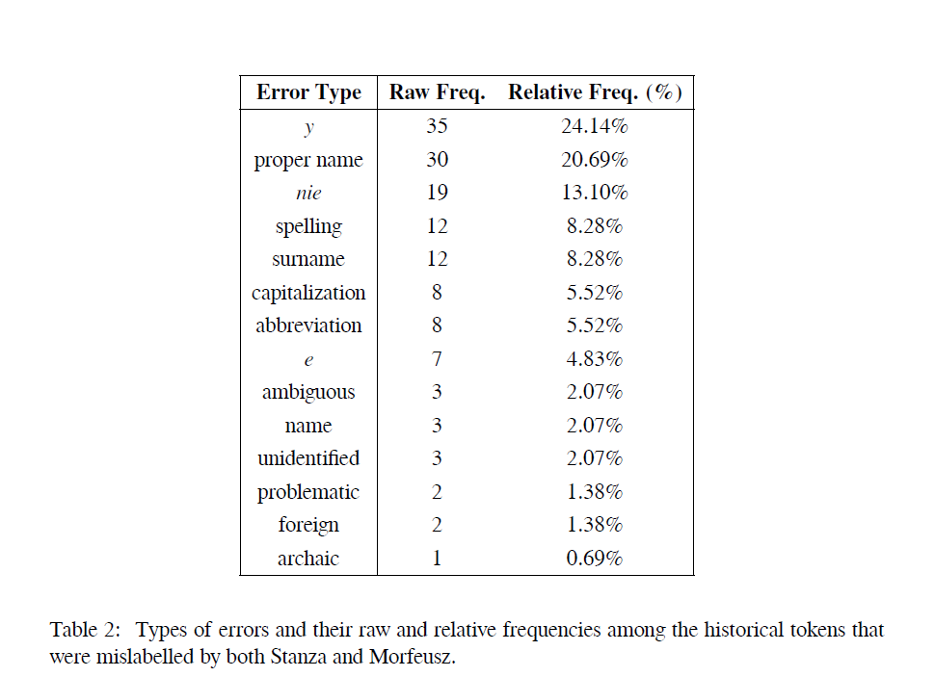

Slide 7
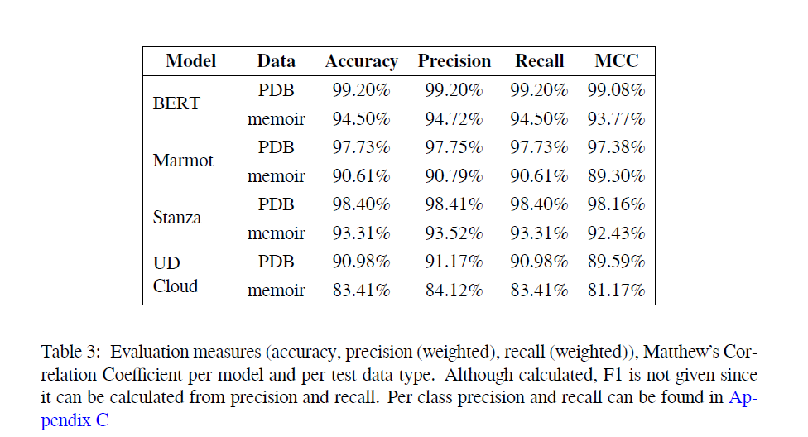

Slide 8
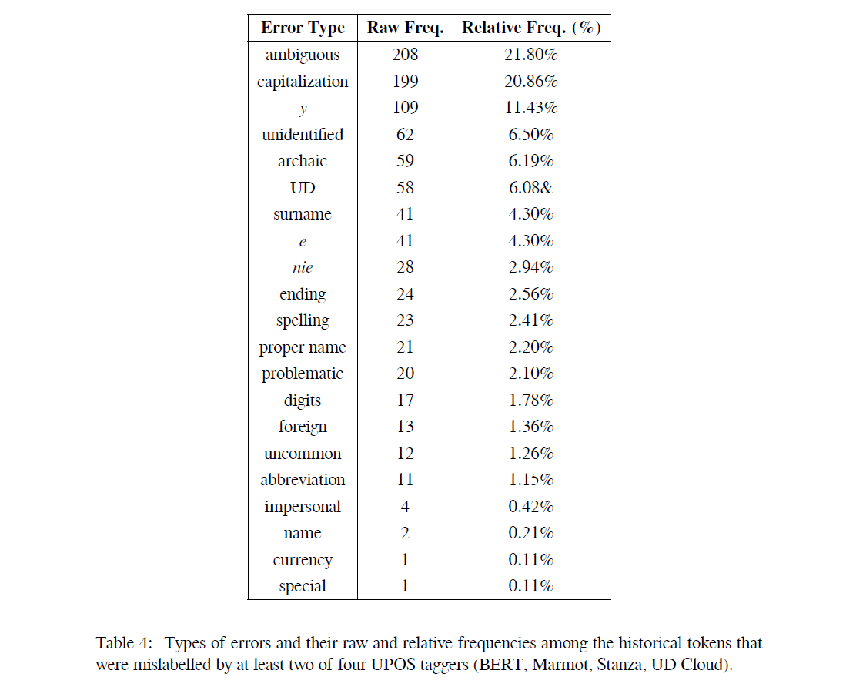

Slide 9
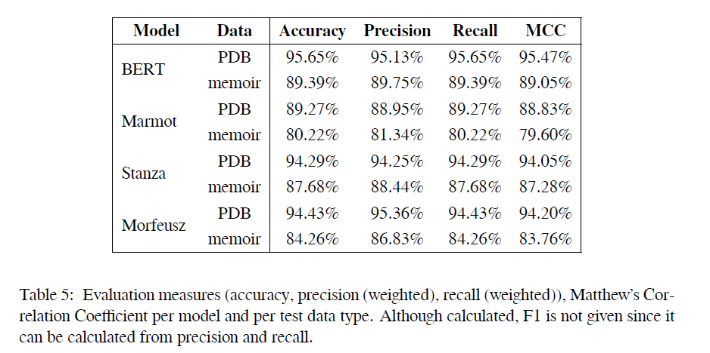

Slide 10
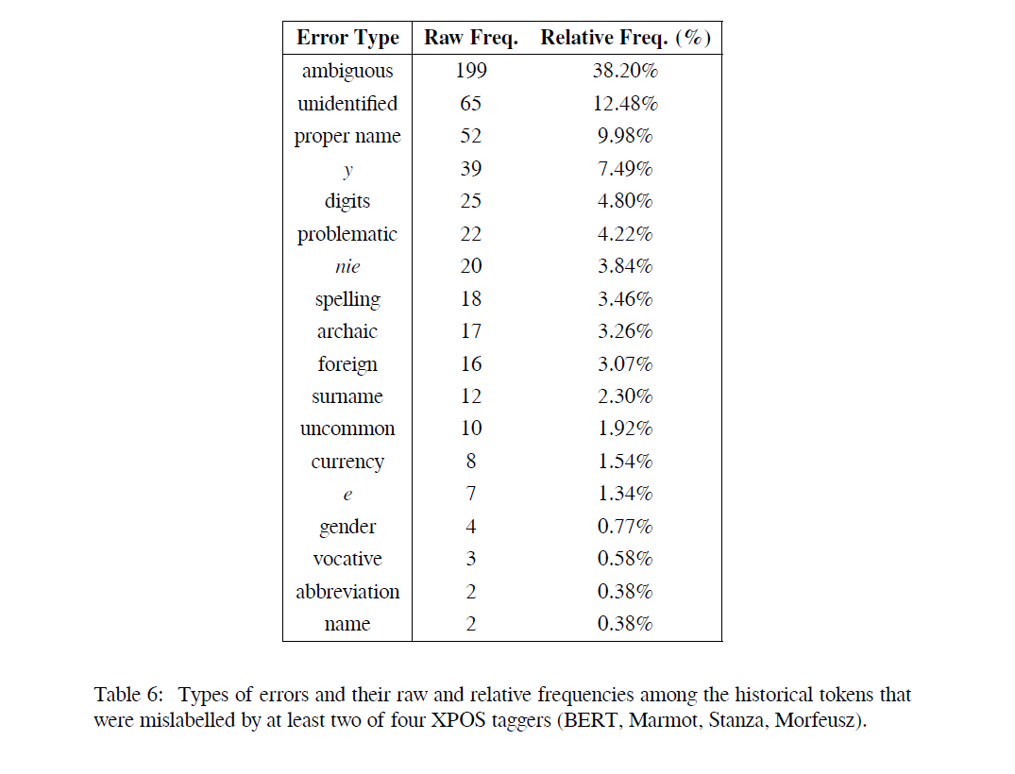

Slide 11
NKJP
PDB: Out of 7583 queries 44 (0.5802452855070552%) had no hits in NKJP.
Historical: Out of 4302 queries 346 (8.04277080427708%) had no hits in NKJP.

Slide 12
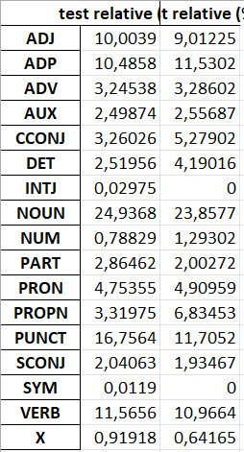
N-grams
The results for XPOS are very large and not very informative.
The results for UPOS show some variation but require more analysis on my end.

Slide 13
References
Bird, S., Loper, E., & Klein, E. (2009). Natural Language Processing with Python. O’Reilly Media
Bollmann, M. (2013). POS tagging for historical texts with sparse training data. In Proceedings of the 7th Linguistic Annotation Workshop and Interoperability with Discourse (pp. 11–18). Sofia, Bulgaria: Association for Computational Linguistics.
Długosz-Kurczabowa, K. & Dubisz, S. (2006). Gramatyka historyczna Języka Polskiego. Wydawnictwa Uniwersytetu Warszawskiego.
Gruszczyński, W., Adamiec, D., Bronikowska, R., & Wieczorek, A. (2020). ELEKTRONICZNY KORPUS TEKSTÓW POLSKICH Z XVII I XVIII W. – PROBLEMY TEORETYCZNE I WARSZTATOWE. (pp. 32–51).
Hupkes, D. & Bod, R. (2016). POS-tagging of Historical Dutch. In LREC 2016: Tenth International Conference on Language Resources and Evaluation (pp. 77–82). Paris: European Language Resources Association (ELRA).
Johannsen, A., Hovy, D., & Søgaard, A. (2015). Cross-lingual syntactic variation over age and gender. In Proceedings of the Nineteenth Conference on Computational Natural Language Learning (pp. 103–112). Beijing, China: Association for Computational Linguistics.
Kieraś, W. & Woliński, M. (2017). Morfeusz 2 – analizator i generator fleksyjny dla języka polskiego. Język Polski, XCVII(1), 75–83.
Kłeczek, D. (2021). Dkleczek/bert-base-polish-cased-v1 · hugging face. https://huggingface.co/dkleczek/bert-base-polish-cased-v1.
Manning, C., Surdeanu, M., Bauer, J., Finkel, J., Bethard, S., & McClosky, D. (2014). The Stanford CoreNLP natural language processing toolkit. In Proceedings of 52nd Annual Meeting of the Association for Computational Linguistics: System Demonstrations (pp. 55–60). Baltimore, Maryland: Association for Computational Linguistics.
McKinney, W. (2010). Data Structures for Statistical Computing in Python. In Stéfan van der Walt & Jarrod Millman (Eds.), Proceedings of the 9th Python in Science Conference (pp. 56 – 61).
Mueller, T., Schmid, H., & Schütze, H. (2013). Efficient higher-order CRFs for morphological tagging. In Proceedings of the 2013 Conference on Empirical Methods in Natural Language Processing (pp. 322–332). Seattle, Washington, USA: Association for Computational Linguistics.
Ossolineum (n.d.). Katalogi Ossolineum. https://katalogi.ossolineum.pl/ . Accessed: 03.04.2023.
Pedregosa, F., Varoquaux, G., Gramfort, A., Michel, V., Thirion, B., Grisel, O., Blondel, M., Prettenhofer, P., Weiss, R., Dubourg, V., Vanderplas, J., Passos, A., Cournapeau, D., Brucher, M., Perrot, M., & Duchesnay, E. (2011). Scikit-learn: Machine learning in Python. Journal of Machine Learning Research, 12, 2825–2830.
Przepiórkowski, A., Bańko, M., Górski, R. L., & Lewandowska-Tomaszczyk, B., Eds. (2012). Narodowy Korpus Języka Polskiego. Wydawnictwo Naukowe PWN.
PWN (n.d.). Słownik języka polskiego. https://sjp.pwn.pl/ . Accessed: 04.04.2023.
PWN Editorial Team (n.d.). około - definicja, synonimy, przykłady użycia. Accessed: 05.04.2022.
Pęzik, P. (2012). Wyszukiwarka PELCRA dla danych NKJP. In A. Przepiórkowski, M. Bańko, R. L. Górski, & B. Lewandowska-Tomaszczyk (Eds.), Narodowy Korpus Jezyka Polskiego (pp. 253–273). Wydawnictwo PWN.
Qi, P., Zhang, Y., Zhang, Y., Bolton, J., & Manning, C. D. (2020). Stanza: A Python natural language processing toolkit for many human languages. In Proceedings of the 58th Annual Meeting of the Association for Computational Linguistics: System Demonstrations.
Rayson, P., Archer, D., Baron, A., Culpeper, J., & Smith, N. (2007). Tagging the Bard: Evaluating the accuracy of a modern POS tagger on Early Modern English corpora.
Saloni, Z., Woliński, M., Wołosz, R., Gruszczyński, W., & Skowrońska, D. (2015). Słownik gramatyczny języka polskiego. Warsaw, 3rd edition.
The pandas development team (2020). pandas-dev/pandas: Pandas.
The University of Sheffield (n.d.). Universal dependencies POS tagger for pl / Polish. Accessed: 29.12.2022.
Universal Dependencies (n.d.a). UD for Polish. https://universaldependencies.org/pl/index.html . Accessed: 04.04.2023.
Universal Dependencies (n.d.b). Universal Dependencies. https://universaldependencies.org/treebanks/pl-comparison.html . Accessed: 04.04.2023.
Universal Dependencies (n.d.c). Universal POS tags. https://universaldependencies.org/u/pos/ . Accessed: 17.04.2023.
Waszczuk, J. (2012). Harnessing the CRF complexity with domain-specific constraints. The case of morphosyntactic tagging of a highly inflected language. In Proceedings of COLING 2012 (pp. 2789–2804). Mumbai, India: The COLING 2012 Organizing Committee.
Waszczuk, J., Kieraś, W., & Woliński, M. (2018). Morphosyntactic disambiguation and segmentation for historical Polish with graph-based conditional random fields. In International Conference on Text, Speech, and Dialogue (pp. 188–196).: Springer.
Wolf, T., Debut, L., Sanh, V., Chaumond, J., Delangue, C., Moi, A., Cistac, P., Rault, T., Louf, R., Funtowicz, M., Davison, J., Shleifer, S., von Platen, P., Ma, C., Jernite, Y., Plu, J., Xu, C., Le Scao, T., Gugger, S., Drame, M., Lhoest, Q., & Rush, A. (2020). Transformers: State-of-the-art natural language processing. In Proceedings of the 2020 Conference on Empirical Methods in Natural Language Processing: System Demonstrations (pp. 38–45). Online: Association for Computational Linguistics.
Wróblewska, A. (2018). Extended and enhanced Polish dependency bank in Universal Dependencies format. In Proceedings of the Second Workshop on Universal Dependencies (UDW 2018) (pp. 173–182). Brussels, Belgium: Association for Computational Linguistics.

