Slide 1
IŻ SWÓJ JĘZYK MAJĄ! An exploration of the computational methods for identifying language variation in Polish Maria Irena Szawerna
Master’s Programme in Language Technology
LT2402, Spring 2023
Supervisor: Aleksandrs Berdicevskis
Examiner: Asad Sayeed
Opponent: Nadina-mariana suditu

Slide 2
A niechaj narodowie wżdy postronni znają,
Iż P o l a c y nie gęsi, iż swój język mają!
And may the other nations finally know
that Poles are not geese, that they have their own language!
Mikołaj Rej, 1562

Slide 3
Roadmap
Data
Example
Research Questions
Background and Related Work
Experiments
Results
Ethical Considerations
Critiques and Limitations
Future Work
Conclusions

Slide 4
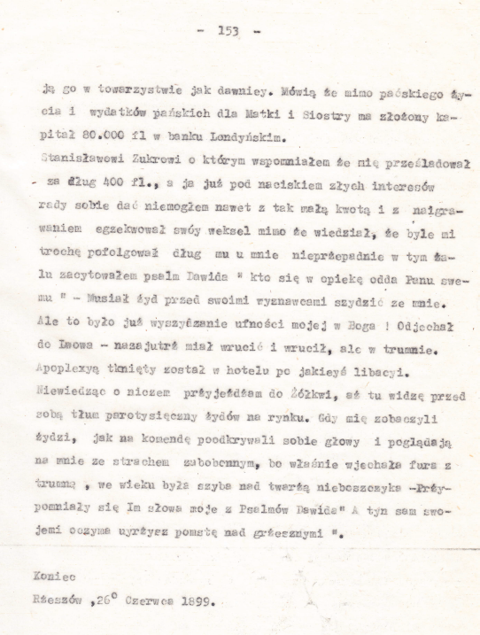
Data
1899 memoir.
Copied over from a manuscript.
Visible variation in e.g. spelling, still intelligible for a native speaker.
Manual UD-style annotation (with pre-annotation).
Total: 37 405 tokens.
UPOS-annotated: 10 286 tokens.
XPOS-annotated, lemmatized: 3271 tokens.

Slide 5
Data – example
Original:
Odjechał do Lwowa – nazajutrż miał wrucić i wrucił, ale w trumnie.
Apoplexyą tknięty został w hotelu po jakieyś libacyi.
Modernized spelling:
Odjechał do Lwowa – nazajutrz miał wrócić i wrócił, ale w trumnie.
Apopleksją tknięty został w hotelu po jakiejś libacji.
Heavily modernized language:
Pojechał do Lwowa – miał wrócić dzień później, i wrócił, ale w trumnie.
Dostał udaru w hotelu po jakiejś imprezie.
English:
He drove away to Lviv – and he was supposed to return the day after and that he did, but in a coffin.
He had suffered a stroke at a hotel after some party.

Slide 6
Research Questions
Is it possible to identify language variation in terms of orthography, morphology, and syntax in a Polish text using tools and resources such as lemmatizers, POS-taggers, and modern corpora?
In what ways does the text in question, a 19th-century memoir by Juliusz Czermiński, differ from modern standard Polish?

Slide 7
Background and Related Work
Features and changes characteristic of 19th-century Polish and the Kresy dialects.
Quantitative and corpus research in historical linguistics.
Part-of-speech tagging of historical data.
Methods for dealing with language variation in NLP.
Detecting and modelling language variation and change.
Appropriate models and tools (Polbert, Marmot, Morfeusz2+Concraft-pl, Cloud UD tagger, Stanza), resources (PDB-UD, National Corpus of Polish).

Slide 8
Experiments
POS-tagging and lemmatization:
BERT, Marmot, Stanza, University of Sheffield UD Cloud tagger, Morfeusz2.
Error annotation for selected erroneous tags.
N-gram (uni, bi, tri) statistics – approximation of syntactic variation.
National Corpus of Polish vocabulary comparison.
Tool | UPOS-tagging | XPOS-tagging | Lemmatization
BERT | Yes | Yes | -
Marmot | Yes | Yes | -
Stanza | Yes | Yes | Yes
Morfeusz | - | Yes | Yes
UD Cloud | Yes | - | -

Slide 9
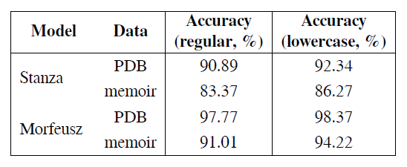
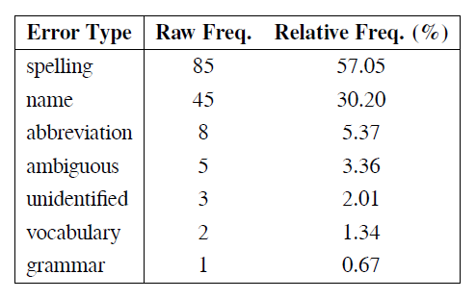
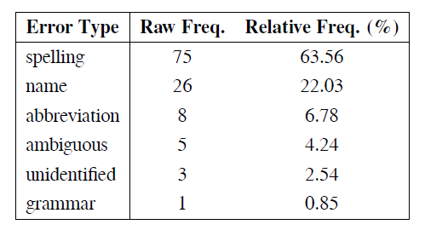
Results: lemmatization
Original capitalization
Lowercased

Slide 10
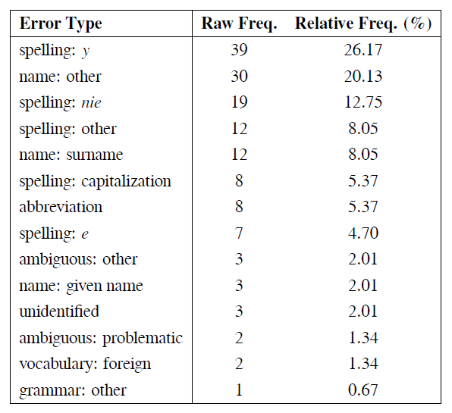
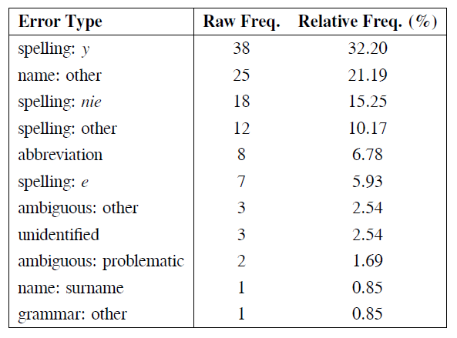
Original capitalization
Lowercased

Slide 11
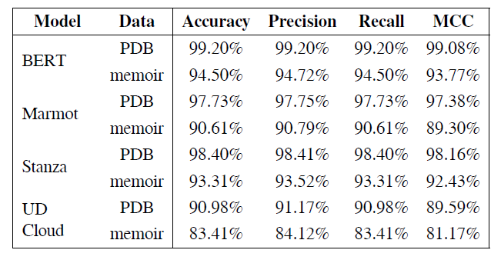
Results: UPOS tagging

Slide 12
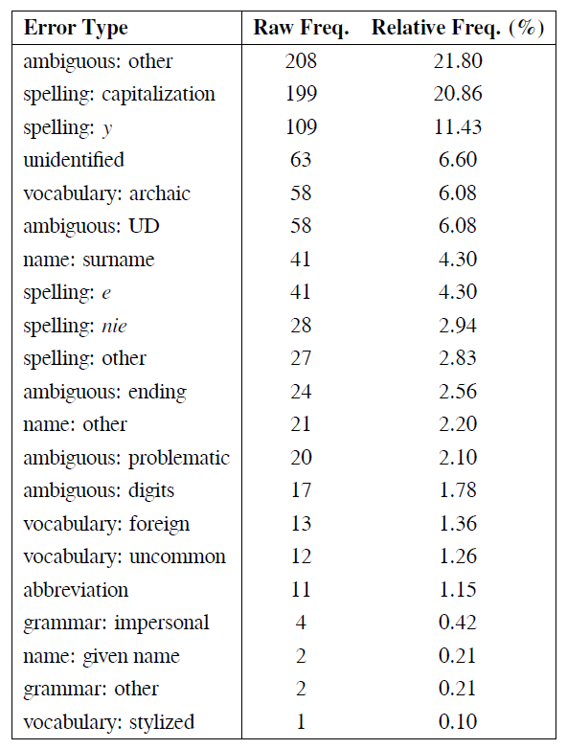
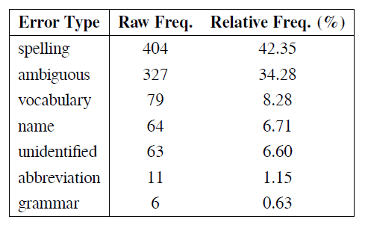

Slide 13
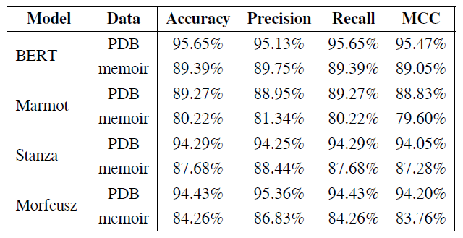
Results: XPOS tagging

Slide 14
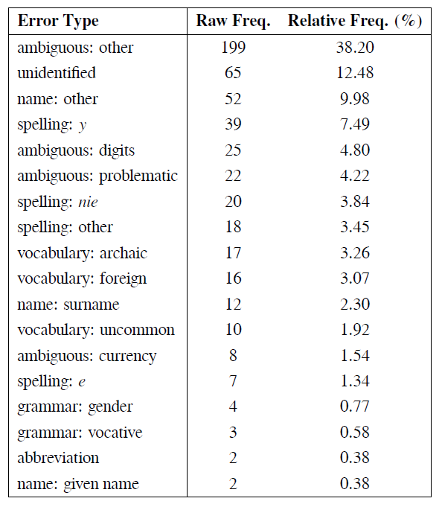
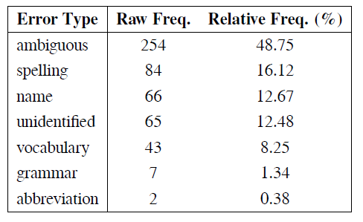

Slide 15
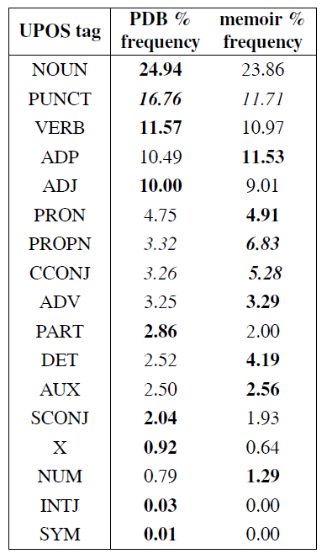
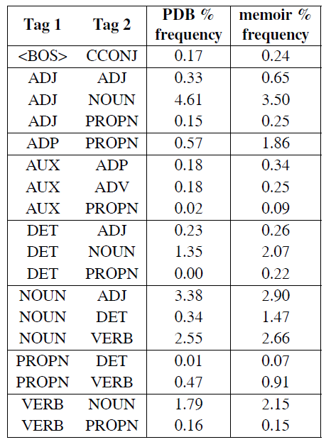
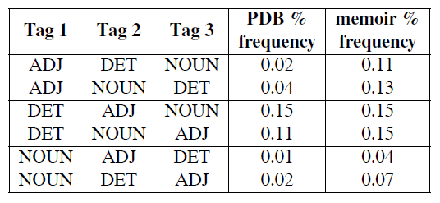
Results: n-gram statistics

Slide 16
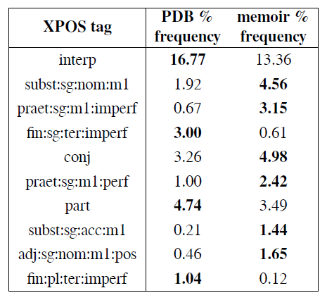

Slide 17
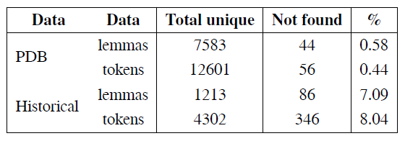
National Corpus of Polish vocabulary comparison

Slide 18
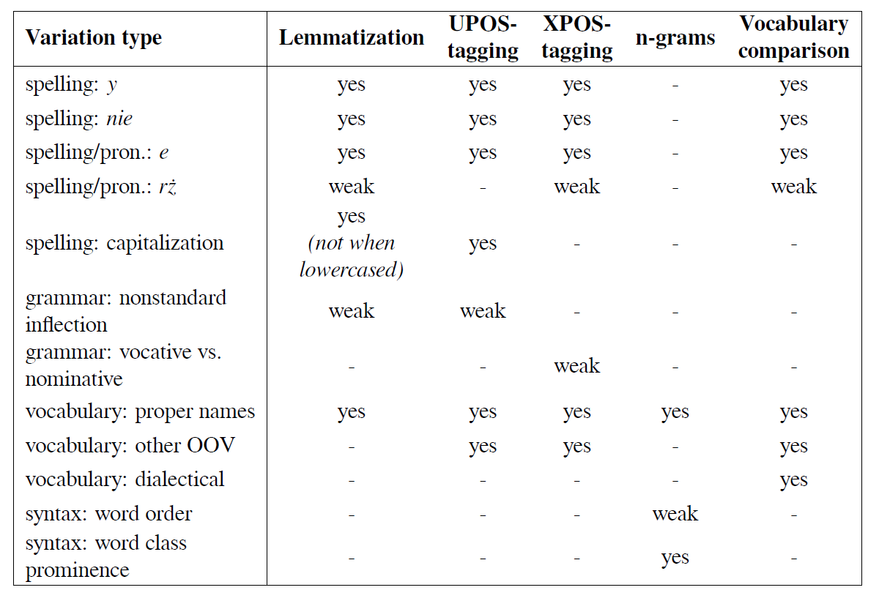
Results

Slide 19
Ethical considerations
Old data.
Not expecially computationally heavy.
Explores utilizing tools for underrepresented dialects or languages.
Gender annotation on pronouns – gender bias?
# sent_id = train-s2896
# text = - Ty nie wiesz? (ENG: Do you not know?)
# orig_file_sentence = 200-2-000093_morph_5.47-s#7092
...
2 Ty ty PRON ppron12:sg:nom:m1:sec ...
...

Slide 20
Critiques and limitations
Potential transctiption errors, only some data used.
Not representative of Kresy Polish, just one author.
No comparison to older data.
Potentially imperfect annotation.
Potentially not ideal training setup for taggers.
Subjective error annotation.
Lacking n-gram result analysis.

Slide 21
Future work
Completing the annotation of the data.
Adding the syntactic structure annotation.
Comparison to more data.
More data from the same time and region.
Older data.
Contemporary non-standard data.
Tagger or lemmatizer confidence.
Cross-tool agreement.

Slide 22
Conclusions: back to Research Questions
Is it possible to identify language variation in terms of orthography, morphology, and syntax in a Polish text using tools and resources such as lemmatizers, POS-taggers, and modern corpora?
Yes, with orthography (and pronunciation) being the most prominent ones.
In what ways does the text in question, a 19th-century memoir by Juliusz Czermiński, differ from modern standard Polish?
See the table in the Results section.

Slide 23
Thesis and repository
Both available at: https://github.com/Turtilla/swe-ma-thesis

Slide 24
Thank you for your attention!

Slide 25
Bibliography
Adesam, Y. & Bouma, G. (2016). Old Swedish part-of-speech tagging between variation and external knowledge. In Proceedings of the 10th SIGHUM Workshop on Language Technology for Cultural Heritage, Social Sciences, and Humanities (pp. 32–42). Berlin, Germany: Association for Computational Linguistics.
Bender, E. M., Gebru, T., McMillan-Major, A., & Shmitchell, S. (2021). On the dangers of stochastic parrots: Can language models be too big? In Proceedings of the 2021 ACM Conference on Fairness, Accountability, and Transparency, FAccT ’21 (pp. 610–623). New York, NY, USA: Association for Computing Machinery.
Bird, S., Loper, E., & Klein, E. (2009). Natural Language Processing with Python. O’Reilly Media. Blodgett, S. L., Barocas, S., Daumé III, H., & Wallach, H. (2020). Language (technology) is power: A critical survey of “bias” in NLP. In Proceedings of the 58th Annual Meeting of the Association for Computational Linguistics (pp. 5454–5476). Online: Association for Computational Linguistics.
Bollmann, M. (2013). POS tagging for historical texts with sparse training data. In Proceedings of the 7th Linguistic Annotation Workshop and Interoperability with Discourse (pp. 11–18). Sofia, Bulgaria: Association for Computational Linguistics.
Dipper, S. & Waldenberger, S. (2017). Investigating diatopic variation in a historical corpus. In Proceedings of the Fourth Workshop on NLP for Similar Languages, Varieties and Dialects (VarDial) (pp. 36–45). Valencia, Spain: Association for Computational Linguistics.
Donoso, G. & Sánchez, D. (2017). Dialectometric analysis of language variation in Twitter. In Proceedings of the Fourth Workshop on NLP for Similar Languages, Varieties and Dialects (VarDial) (pp. 16–25). Valencia, Spain: Association for Computational Linguistics.
Dorn, R. (2019). Dialect-specific models for automatic speech recognition of African American Vernacular English. In Proceedings of the Student Research Workshop Associated with RANLP 2019 (pp. 16–20). Varna, Bulgaria: INCOMA Ltd.
Dunaj, B. (2019). “Historia języka polskiego” Zenona Klemensiewicza a potrzeba nowej syntezy. LingVaria, 14.
Długosz-Kurczabowa, K. & Dubisz, S. (2006). Gramatyka historyczna Języka Polskiego. Wydawnictwa Uniwersytetu Warszawskiego.
Eisenstein, J. (2015). Systematic patterning in phonologically-motivated orthographic variation. Journal of Sociolinguistics, 19.
Estarrona, A., Etxeberria, I., Etxepare, R., Padilla-Moyano, M., & Soraluze, A. (2020). Dealing with dialectal variation in the construction of the Basque historical corpus. In Proceedings of the 7th Workshop on NLP for Similar Languages, Varieties and Dialects (pp. 79–89). Barcelona, Spain Online): International Committee on Computational Linguistics (ICCL).
Garcia, M. & García Salido, M. (2019). A method to automatically identify diachronic variation in collocations. In Proceedings of the 1st International Workshop on Computational Approaches to Historical Language Change (pp. 71–80). Florence, Italy: Association for Computational Linguistics.
Garimella, A., Amarnath, A., Kumar, K., Yalla, A. P., N, A., Chhaya, N., & Srinivasan, B. V. (2021). He is very intelligent, she is very beautiful? On Mitigating Social Biases in Language Modelling and Generation. In Findings of the Association for Computational Linguistics: ACL-IJCNLP 2021 (pp. 4534–4545). Online: Association for Computational Linguistics.
Garrette, D. & Alpert-Abrams, H. (2016). An unsupervised model of orthographic variation for historical document transcription. In Proceedings of the 2016 Conference of the North American Chapter of the Association for Computational Linguistics: Human Language Technologies (pp. 467–472). San Diego, California: Association for Computational Linguistics.
Gruszczyński, W., Adamiec, D., Bronikowska, R., & Wieczorek, A. (2020). ELEKTRONICZNY KORPUS TEKSTÓW POLSKICH Z XVII I XVIII W. – PROBLEMY TEORETYCZNE I WARSZTATOWE. (pp. 32–51).
Hämäläinen, M., Partanen, N., & Alnajjar, K. (2021). Lemmatization of historical old literary Finnish texts in modern orthography. In Actes de la 28e Conférence sur le Traitement Automatique des Langues Naturelles. Volume 1 : conférence principale (pp. 189–198). Lille, France: ATALA.
Hovy, D. (2018). The social and the neural network: How to make natural language processing about people again. In Proceedings of the Second Workshop on Computational Modeling of People’s Opinions, Personality, and Emotions in Social Media (pp. 42–49). New Orleans, Louisiana, USA: Association for Computational Linguistics.
Hovy, D. & Purschke, C. (2018). Capturing regional variation with distributed place representations and geographic retrofitting. In Proceedings of the 2018 Conference on Empirical Methods in Natural Language Processing (pp. 4383–4394). Brussels, Belgium: Association for Computational Linguistics.
Hovy, D. & Spruit, S. L. (2016). The social impact of natural language processing. In Proceedings of the 54th Annual Meeting of the Association for Computational Linguistics (Volume 2: Short Papers) (pp. 591–598). Berlin, Germany: Association for Computational Linguistics.
Hupkes, D. & Bod, R. (2016). POS-tagging of Historical Dutch. In LREC 2016: Tenth International Conference on Language Resources and Evaluation (pp. 77–82). Paris: European Language Resources Association (ELRA).
Jenset, G. B. & McGillivray, B. (2017). Quantitative Historical Linguistics: A Corpus Framework. Oxford University Press.
Johannessen, J., Kåsen, A., Hagen, K., Nøklestad, A., & Priestley, J. (2020). Comparing methods for measuring dialect similarity in Norwegian. In Proceedings of the 12th Language Resources and Evaluation Conference (pp. 5343–5350). Marseille, France: European Language Resources Association.
Johannsen, A., Hovy, D., & Søgaard, A. (2015). Cross-lingual syntactic variation over age and gender. In Proceedings of the Nineteenth Conference on Computational Natural Language Learning (pp. 103–112). Beijing, China: Association for Computational Linguistics.
Jurgens, D., Tsvetkov, Y., & Jurafsky, D. (2017). Incorporating dialectal variability for socially equitable language identification. In Proceedings of the 55th Annual Meeting of the Association for Computational Linguistics (Volume 2: Short Papers) (pp. 51–57). Vancouver, Canada: Association for Computational Linguistics.
Jurman, G., Riccadonna, S., & Furlanello, C. (2012). A Comparison of MCC and CEN Error Measures in Multi-Class Prediction. PLOS ONE, 7(8), 1–8.
Kieraś, W. & Woliński, M. (2017). Morfeusz 2 – analizator i generator fleksyjny dla języka polskiego. Język Polski, XCVII(1), 75–83.
Klemensiewicz, Z. (1976). Historia Języka Polskiego. Państwowe Wydawnictwo Naukowe.
Kurzowa, Z. (1983). Polszczyzna Lwowa i Kresów Południowo-Wschodnich do 1939 roku. Państwowe Wydawnictwo Naukowe.
Kłeczek, D. (2021). Dkleczek/bert-base-polish-cased-v1 · hugging face. https://huggingface.co/dkleczek/bert-base-polish-cased-v1.

Slide 26
Manning, C., Surdeanu, M., Bauer, J., Finkel, J., Bethard, S., & McClosky, D. (2014). The Stanford CoreNLP natural language processing toolkit. In Proceedings of 52nd Annual Meeting of the Association for Computational Linguistics: System Demonstrations (pp. 55–60). Baltimore, Maryland: Association for Computational Linguistics.
McEnery, T., Baker, P., & Burnard, L. (2000). Corpus resources and minority language engineering. In Proceedings of the Second International Conference on Language Resources and Evaluation (LREC’00) Athens, Greece: European Language Resources Association (ELRA).
McGillivray, B. & Jenset, G. B. (2023). Quantifying the quantitative (re-)turn in historical linguistics. Palgrave Communications, 10(1), 1–6.
McKinney, W. (2010). Data Structures for Statistical Computing in Python. In Stéfan van der Walt & Jarrod Millman (Eds.), Proceedings of the 9th Python in Science Conference (pp. 56 – 61).
Mueller, T., Schmid, H., & Schütze, H. (2013). Efficient higher-order CRFs for morphological tagging. In Proceedings of the 2013 Conference on Empirical Methods in Natural Language Processing (pp. 322–332). Seattle, Washington, USA: Association for Computational Linguistics.
Ossolineum (n.d.). Katalogi Ossolineum. https://katalogi.ossolineum.pl/. Accessed: 03.04.2023.
Pedregosa, F., Varoquaux, G., Gramfort, A., Michel, V., Thirion, B., Grisel, O., Blondel, M., Prettenhofer, P., Weiss, R., Dubourg, V., Vanderplas, J., Passos, A., Cournapeau, D., Brucher, M., Perrot, M., & Duchesnay, E. (2011). Scikit-learn: Machine learning in Python. Journal of Machine Learning Research, 12, 2825–2830.
Peirsman, Y., Geeraerts, D., & Speelman, D. (2010). The automatic identification of lexical variation between language varieties. Natural Language Engineering, 16(4), 469–491.
Ponti, E. M., O’Horan, H., Berzak, Y., Vulić, I., Reichart, R., Poibeau, T., Shutova, E., & Korhonen, A. (2019). Modeling Language Variation and Universals: A Survey on Typological Linguistics for Natural Language Processing. Computational Linguistics, 45(3), 559–601.
Przepiórkowski, A., Bańko, M., Górski, R. L., & Lewandowska-Tomaszczyk, B., Eds. (2012). Narodowy Korpus Języka Polskiego. Wydawnictwo Naukowe PWN.
PWN (n.d.). Słownik języka polskiego. https://sjp.pwn.pl/. Accessed: 04.04.2023.
PWN Editorial Team (n.d.). około - definicja, synonimy, przykłady użycia. Accessed: 05.04.2022.
Pęzik, P. (2012). Wyszukiwarka PELCRA dla danych NKJP. In A. Przepiórkowski, M. Bańko, R. L. Górski, & B. Lewandowska-Tomaszczyk (Eds.), Narodowy Korpus Jezyka Polskiego (pp. 253–273). Wydawnictwo PWN.
Qi, P., Zhang, Y., Zhang, Y., Bolton, J., & Manning, C. D. (2020). Stanza: A Python natural language processing toolkit for many human languages. In Proceedings of the 58th Annual Meeting of the Association for Computational Linguistics: System Demonstrations.
Rayson, P., Archer, D., Baron, A., Culpeper, J., & Smith, N. (2007). Tagging the Bard: Evaluating the accuracy of a modern POS tagger on Early Modern English corpora.
Regnault, M., Prévost, S., & Villemonte de la Clergerie, E. (2019). Challenges of language change and variation: towards an extended treebank of medieval French. In Proceedings of the 18th International Workshop on Treebanks and Linguistic Theories (TLT, SyntaxFest 2019) (pp. 144–150). Paris, France: Association for Computational Linguistics.
Rej, M. (2015). Wybór Pism. Zakład Narodowy im. Ossolińskich.
Saloni, Z., Woliński, M., Wołosz, R., Gruszczyński, W., & Skowrońska, D. (2015). Słownik gramatyczny języka polskiego. Warsaw, 3rd edition.
Sánchez-Marco, C., Boleda, G., & Padró, L. (2011). Extending the tool, or how to annotate historical language varieties. In Proceedings of the 5th ACL-HLT Workshop on Language Technology for Cultural Heritage, Social Sciences, and Humanities (pp. 1–9). Portland, OR, USA: Association for Computational Linguistics.
Scheible, S., Whitt, R. J., Durrell, M., & Bennett, P. (2011). Evaluating an ‘off-the-shelf’ POStagger on early Modern German text. In Proceedings of the 5th ACL-HLT Workshop on Language Technology for Cultural Heritage, Social Sciences, and Humanities (pp. 19–23). Portland, OR, USA: Association for Computational Linguistics.
Soria, C., Russo, I., Quochi, V., Hicks, D., Gurrutxaga, A., Sarhimaa, A., & Tuomisto, M. (2016). Fostering digital representation of EU regional and minority languages: the digital language diversity project. In Proceedings of the Tenth International Conference on Language Resources and Evaluation (LREC’16) (pp. 3256–3260). Portorož, Slovenia: European Language Resources Association (ELRA).
The pandas development team (2020). pandas-dev/pandas: Pandas.
The University of Sheffield (n.d.). Universal dependencies POS tagger for pl / Polish. Accessed: 29.12.2022.
Universal Dependencies (n.d.a). SubGender: sub-gender or animacy of masculine referents. https://universaldependencies.org/pl/feat/SubGender.html.
Universal Dependencies (n.d.b). UD for Polish. https://universaldependencies.org/pl/index.html. Accessed: 04.04.2023.
Universal Dependencies (n.d.c). Universal Dependencies. https://universaldependencies.org/treebanks/pl-comparison.html. Accessed: 04.04.2023.
Universal Dependencies (n.d.d). Universal POS tags. https://universaldependencies.org/u/pos/. Accessed: 17.04.2023.
Vaswani, A., Shazeer, N., Parmar, N., Uszkoreit, J., Jones, L., Gomez, A. N., Kaiser, L., & Polosukhin, I. (2017). Attention is all you need.
Waszczuk, J. (2012). Harnessing the CRF complexity with domain-specific constraints. the case of morphosyntactic tagging of a highly inflected language. In Proceedings of COLING 2012 (pp. 2789–2804). Mumbai, India: The COLING 2012 Organizing Committee.
Waszczuk, J., Kieraś, W., & Woliński, M. (2018). Morphosyntactic disambiguation and segmentation for historical polish with graph-based conditional random fields. In P. Sojka, A. Horák, I. Kopeček, & K. Pala (Eds.), Text, Speech, and Dialogue (pp. 188–196). Cham: Springer International Publishing.
Wolf, T., Debut, L., Sanh, V., Chaumond, J., Delangue, C., Moi, A., Cistac, P., Rault, T., Louf, R., Funtowicz, M., Davison, J., Shleifer, S., von Platen, P., Ma, C., Jernite, Y., Plu, J., Xu, C., Le Scao, T., Gugger, S., Drame, M., Lhoest, Q., & Rush, A. (2020). Transformers: State-of-the-art natural language processing. In Proceedings of the 2020 Conference on Empirical Methods in Natural Language Processing: System Demonstrations (pp. 38–45). Online: Association for Computational Linguistics.
Wróblewska, A. (2018). Extended and enhanced Polish dependency bank in Universal Dependencies format. In Proceedings of the Second Workshop on Universal Dependencies (UDW 2018) (pp. 173–182). Brussels, Belgium: Association for Computational Linguistics.
Zampieri, M., Malmasi, S., & Dras, M. (2016). Modeling language change in historical corpora: The case of Portuguese. In Proceedings of the Tenth International Conference on Language Resources and Evaluation (LREC’16) (pp. 4098–4104). Portorož, Slovenia: European Language Resources Association (ELRA).
Zampieri, M., Nakov, P., & Scherrer, Y. (2020). Natural language processing for similar languages, varieties, and dialects: A survey. Natural Language Engineering, 26, 595 – 612.

