Slide 1




MACHINE LEARNING TEAM PROGRESS UPDATE AND Q&A
erhtjhtyhy
OE/SC SPACE WEATHER MITIGATION PLANNING
HONGWEI JIN
PIETER GHYSELS
ALLEN ZOU
ADAM MATE
ARTHUR K. BARNES
RUSSELL BENT
Argonne National Laboratory
Lawrence Berkeley National Laboratory
PRASANNA BALAPRAKASH
Oak Ridge National Laboratory
Los Alamos National Laboratory
ADITI KRISHNAPRIYAN
University of California, Berkeley
03/23/2023

Slide 2
Overview
Problems studied:
Maximum loadability (MLD) problem
Prediction of optimal load given a set of specific setting on load buses
Blocker placement problem
Prediction of optimal blocker locations to mitigate the threat
Traditional solutions are computationally expensive
Proposed to investigate machine learning approach to find high-quality solutions in short computation time
Formulated the optimization problem into prediction problem and used graph neural networks
Notes:
Data gathering and preparation
Existing data used for heuristic approaches might not be suitable for machine learning training
Generate more perturbed data for machine learning

Slide 3
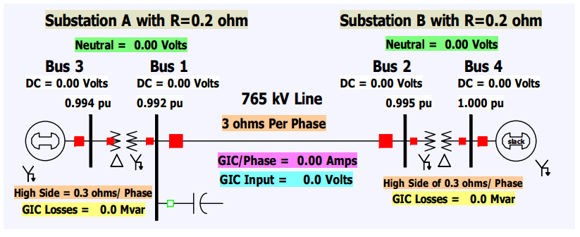
Electric grid with AC and DC networks
Example: B4GIC (four-bus geomagnetically induced currents)
Simple topology with one 765‐kV transmission line with a grounded wye‐delta transformer at either end
Ref: https://www.powerworld.com/files/G02_GMD_In_Simulator.pdf

Slide 4
Modeling the electric grid as AC and DC graphs
AC network
DC network
GMD_BUS
AC line
Bus
3
DC line
2
1
2
DC transformer
1
2
Transformer
1
4
3
4
1
3
4
5
6
2
Generator
Attach (no features)

Slide 5
Heterogeneous graph neural networks
3
2
Combining both AC and DC networks
1
2
Build the `HeteroData` for `PyG` (pytorch geometric)
Type of nodes with features:
bus, gmd_bus, gen
Type of edges with features:
branch, gmd_branch, branch_gmd
Connecting the AC network and DC network by the dashed lines
Learn the node presentation from both AC and DC networks
No edge features of the connections in dashed lines
GNN predictive models
Regression for maximum loadability problem
Take initial inputs of load buses and predict the optimized loads
Classification for gic blocker placement problem
Take `gmd_vdc` as part of `gmd_bus` feature and predict the label `blocker_placed`
1
4
3
4
5
6
2
1
Fig: Representation as
Heterogeneous Graph

Slide 6
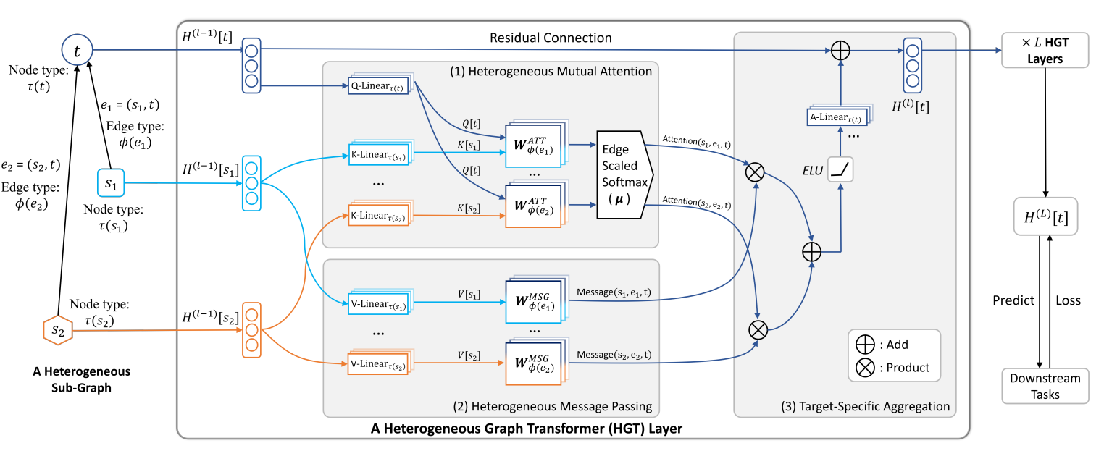
Heterogeneous graph neural networks
Ref: Hu, Ziniu, et al. "Heterogeneous graph transformer." Proceedings of The Web Conference 2020.

Slide 7



Model training
Optimized `status`, `qd`, `pd`
per each configuration
Base case + DC network
Randomly perturb on `load` (qd and pd values in load bus)
True value
Solve in PowerModelGMD.jl
…
Heuristic approach
Running in parallel
Machine learning approach
Loss measure
1
2
1
2
3
3
4
1
4
2
1
HGTConv
HGTConv
2
Linear
Linear
w. diff. node features
…
Pred. value
…
1
2
Convolutional layers on
heterograph
Hidden representation of
diff. nodes and diff. edges
MLP layers for prediction
3
4
1
2

Slide 8
Data statistics
AC Edges
Virtual Edges
AC Nodes
DC Node
DC Edge
(# entry, # feature) | bus | gen | gmd_bus | branch | branch_gmd | gmd_branch | bus_conn_gen | gmd_bus_attach_bus
B4GIC | (4, 15) | (1,20) | (6,3) | (3, 11) | (3, 18) | (3,4) | (1, 0) | (6,0)
B6GIC_nerc | (6, 15) | (1, 20) | (9,3) | (5,11) | (5, 18) | (6,4) | (1, 0) | (9,0)
Case24_IEEE_ETS_0 | (57, 15) | (33,20) | (77,3) | (71,11) | (71, 18) | (76,4) | (33,0) | (77,0)
EPRI21 | (19, 15) | (7,20) | (27,3) | (31, 11) | (31, 18) | (37,4) | (7, 0) | (27, 0)
OTS_test | (57, 15) | (33,20) | (77,3) | (71,11) | (71, 18) | (76,4) | (33,0) | (77,0)
UIUC150_95PCT_loading | (150, 15) | (27,20) | (248, 3) | (218,11) | (218, 18) | (250,4) | (27,0) | (248,0)
UIUC150 | (150, 15) | (27,20) | (248, 3) | (218,11) | (218, 18) | (250,4) | (27,0) | (248,0)
Nodes
Edges

Slide 9
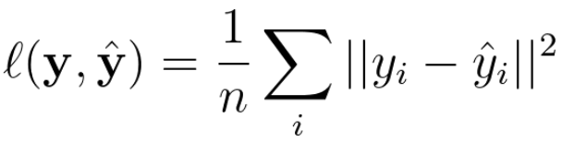
Maximum loadability problem
Data:
Base case: EPRI21 matpower configuration
Generate 500 random perturbations of load buses
Solve in PowerModelsGMD.jl with `solve_soc_gmd_mld`
Normalize features of nodes and edges for HeteroData
Task:
Prediction of `QD` (reactive power demand) in optimized load buses
Loss function:
Mean square error (MSE)
Model:
Heterogeneous graph neural network with mini-batch (efficient) training

Slide 10
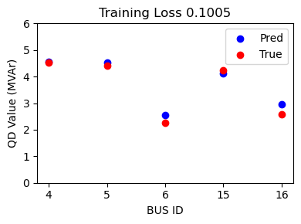
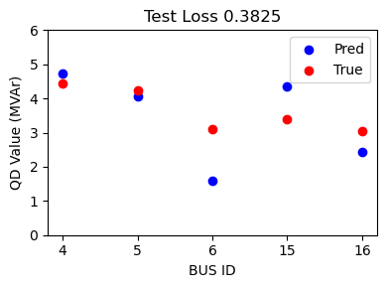
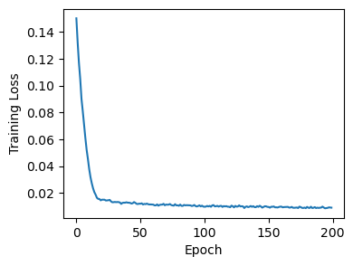
Maximum loadability problem
Preliminary results
Split the data into training/validation/testing with ratio 3:1:1
Findings:
Loss on the training converges
Models optimize well on training set, but not so good on testing set
GNN model takes < 1min to train 300 graphs
Heuristic approach takes ~ 1min to solve a single graph
Larger gap in test set

Slide 11
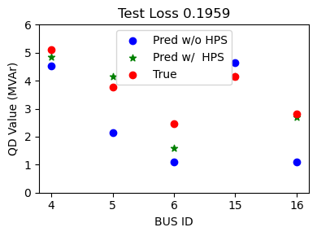

Maximum loadability problem
Improved results by hyperparameter search (HPS)
Tuning hyperparameters are critical for deep learning methods
Hyperparameters:
batch_size, hidden_channels, learning_rate, num_heads, num_layers, dropout, etc.
We use DeepHyper, one of the Rapids2 capability, to improve the accuracy
Bayesian optimization to find better hyperparameters
Big improvement
Ref: Balaprakash, Prasanna, et al. "DeepHyper: Asynchronous hyperparameter search for deep neural networks." 2018 IEEE 25th international conference on high performance computing (HiPC). IEEE, 2018.

Slide 12
Conclusions and plans
Heterogeneous GNNs are promising for the GMD power model problem
Next steps:
Automate GNN development by DeepHyper’s neural architecture search (NAS)
Build efficient GNN with larger electric grid model inputs
Build GNN with multiple power grids inputs, i.e., varies on graph sizes
Collaborate with SC Heuristic Team for the blocker placement problem
Build Physics-Informed Graph Neural Networks (PI-GNNs) with spatial and temporal information

Slide 13
Q & A

