Slide 1

Turtle Drop Studio
CGT 411

Slide 2
Members
Alan McBee - Senior: Web Programming & Video Compositing
Ben Carpenter - Senior: Web Programming & Data Visualization
Zach Vallow - Senior: Web Programming & Minor in Management
Joseph Hoggatt - Senior: UX Design & Minor in Psychology
Notes:
[Joe]

Slide 3
Business Plan
Web Firm
2 Currently Planned Projects
Hodson’s Bay Company - Bike Rental
IKMF Indiana - Krav Maga Studio
1 Client with Project Opportunity
Nectar Company - Cannabis Dispensary
Each planned for roughly one month
Notes:
Project Opportunity is a guaranteed website, but for an unspecified branch of the company
Zach is next

Slide 4
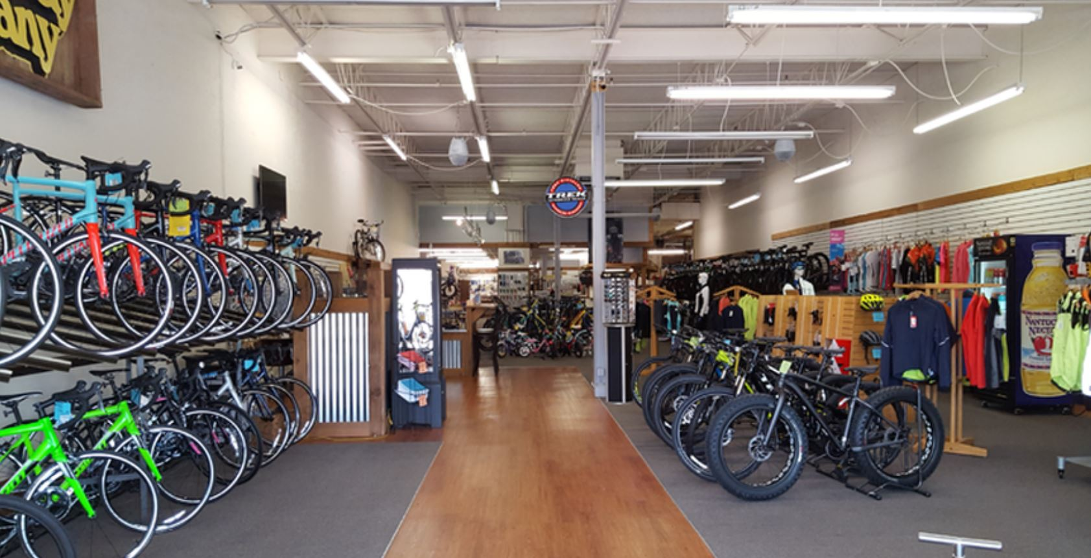
Hodson’s Bay Company
Needs:
Web host
Updated design
Modern Features
Outdoorsy feel
Web Pages
Home
About
Gallery
Service
Community
Notes:
[ZACH]
Hodson’s Bay Company is a small, family owned bike shop that can provide all your biking essentials. They desire a current but old fashion website that informs customers on what Hodson’s Bay Company will do for them.

Slide 5
Stakeholders
Hodson’s Bay Company
David Meadows - Co-Owner
Jennifer Meadows - Co-Owner
Employees
External Parties
Advisor - Perry Cox
Server Provider - Unknown
Database Provider - Unknown
Cyclists of the Lafayette/West Lafayette area
Notes:
[ZACH]
As we conduct more research we will conclude a valid service and database provider for the website.
(Alan is next)

Slide 6
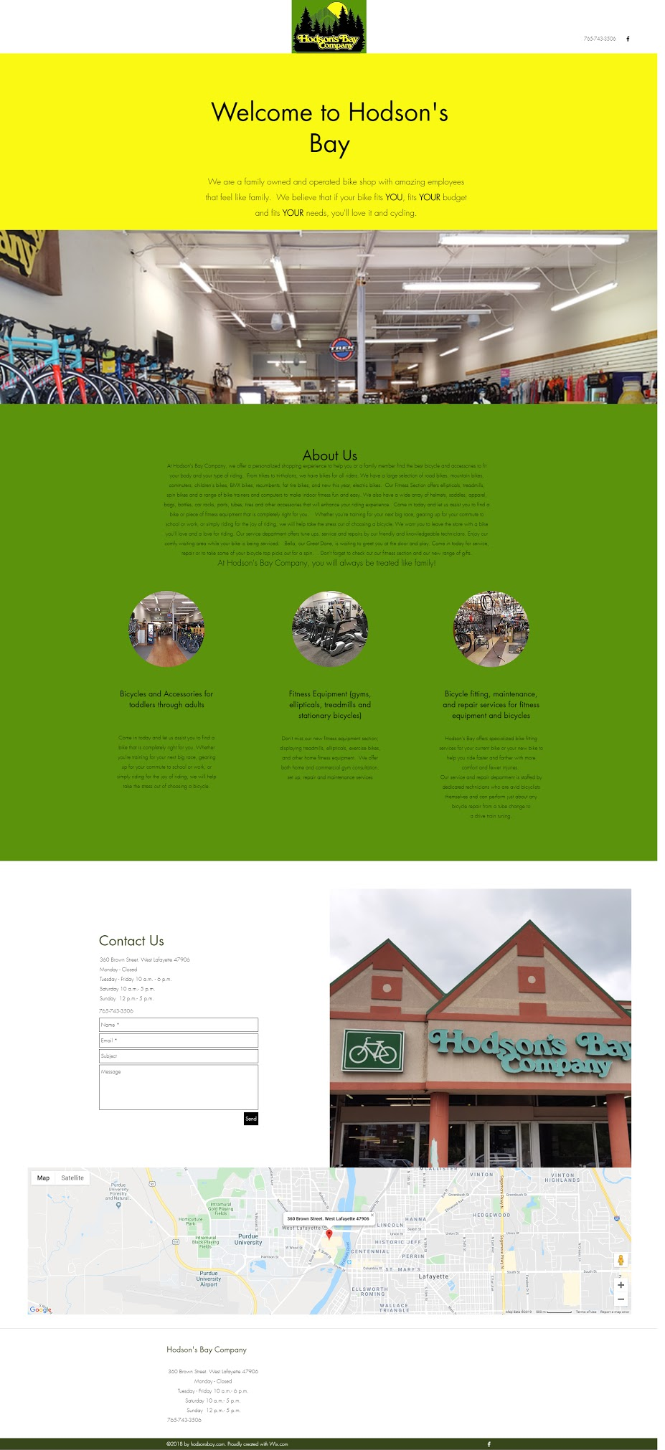
Scope
Beginning
Analyse the current website
Identify issues
Understand their needs and wants
Formulate a plan
End
Delivering a functional website
Perform stability tests
Gain approval from Hodson’s Bay Company owners

Slide 7

Deliverables
Home Page
Showcases service that Hodson’s Bay Company Provides
About Page
In depth summary
Descriptions of current employees
Gallery Page
Display of the current products
Service Page
List/Descriptions of all possible repairs
Images of different repairs
Community Page
A list of community businesses or clubs affiliated with Hodson’s Bay Company.

Slide 8
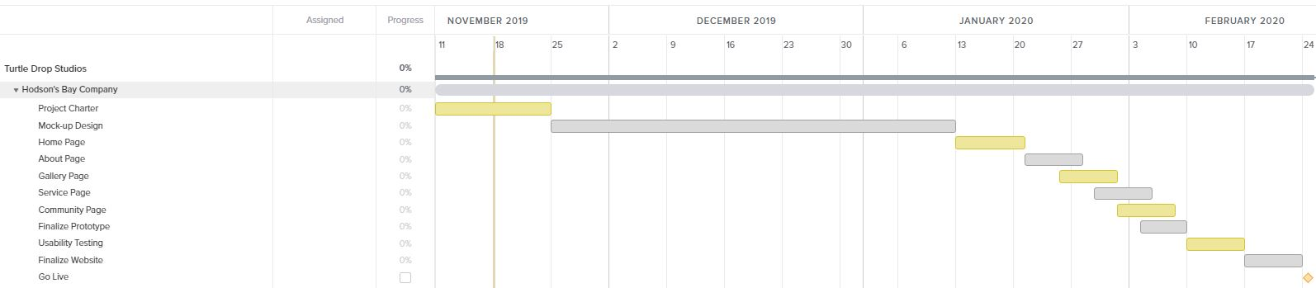
Schedule

Slide 9
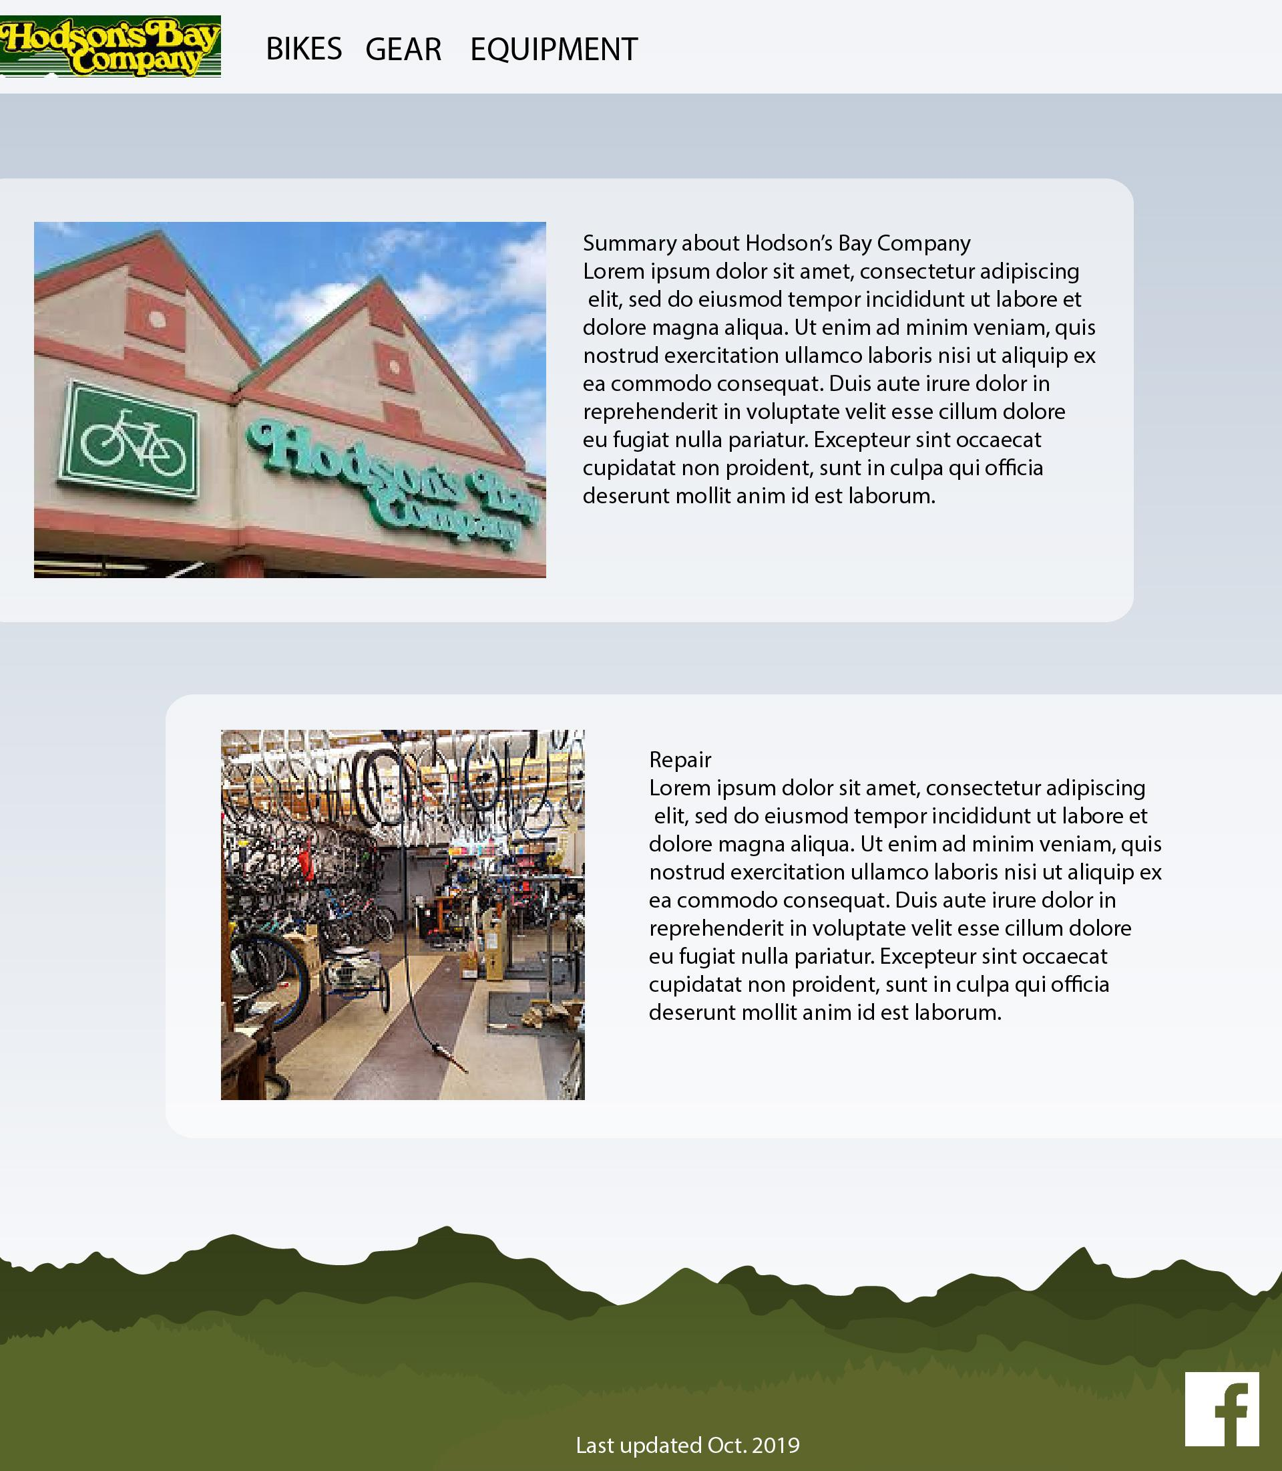
Prototype
Design
Outdoorsy feel
Clean
Pleasing Colors
Modern features
Must be approved by Hodson’s Bay Company’s owners.
* Not the final design

Slide 10
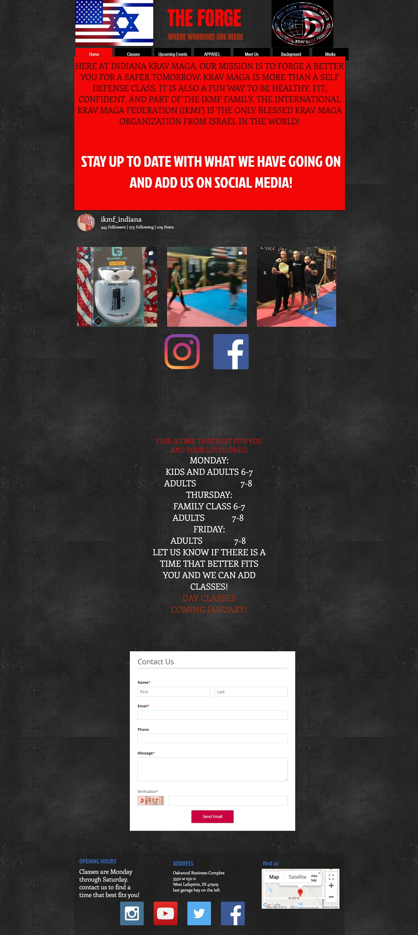
IKMF Indiana
Needs:
Updated design
Wants to keep a strong feel
Would like more organization and appeal to visitors
New Web Page Organization
Home
Classes
Upcoming Events
Apparel
Contact Page

Slide 11

Stakeholders
Problem
IKMF Indiana
Rob Mendenhall - Owner
External Parties
Advisor - Perry Cox
Server Provider - TBD
Krav Maga Students
Rob informed us that some of his clients informed him the current state of the website almost prevented them from attending the gym.
Notes:
[ZACH]
As we conduct more research we will conclude a valid service and database provider for the website.
(Alan is next)

Slide 12
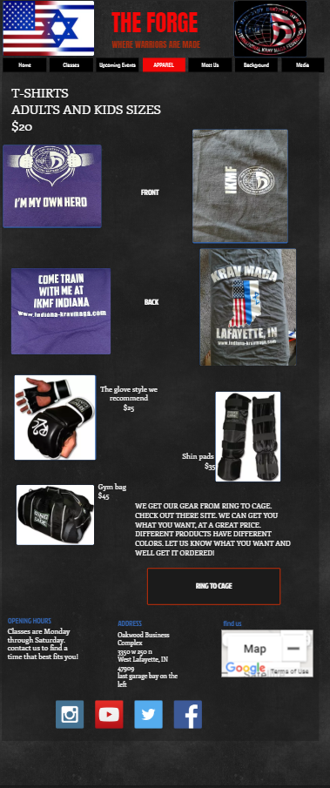
Scope
Beginning
Identify areas for improvement
Gather ideas for new features if needed/wanted
Current Desired New Features
Image carousel
Condensed Gallery Page
New Digital Logo
Client Newsletter
“Contact Us” popup
End
Delivering a functional website
Perform stability tests
Gain approval from Stakeholders

Slide 13
Deliverables
Home Page
General landing and about page for the IKMF Indiana
Would contain the new image carousel
Classes Page
More detailed information about signing up for classes and their scheduling
Events Page
An feed of information about special upcoming events
Apparel Page
Apparel inventory listings and costs
Links out to third party store
Gallery Page
A grid structured page containing a bulk of the images and media from their previous website.
Contact Page
A page that would allow users to get in touch with the gym
The final deliverable will be a functioning website with approved images/files being uploaded to the selected hosting service, and access completely turned over to the client.

Slide 14
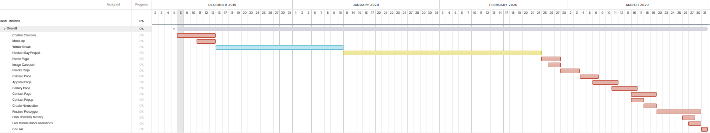
Schedule

Slide 15
Questions?

