Slide 1
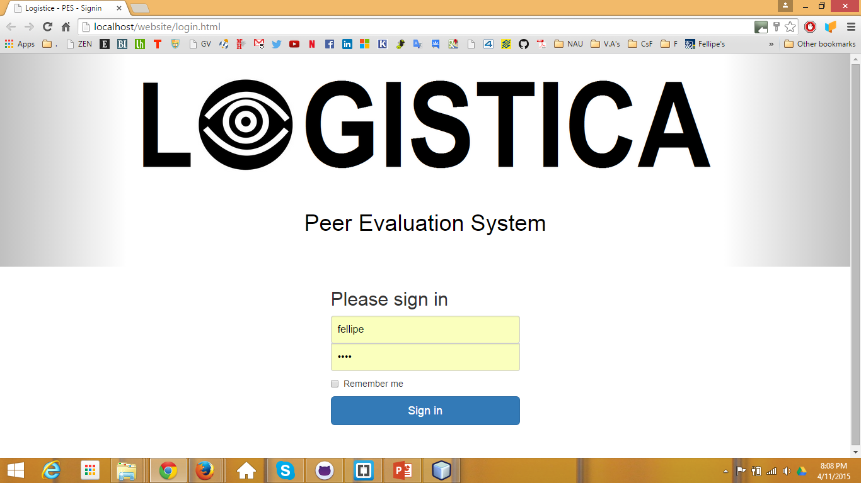
Fellipe logs in.

Slide 2
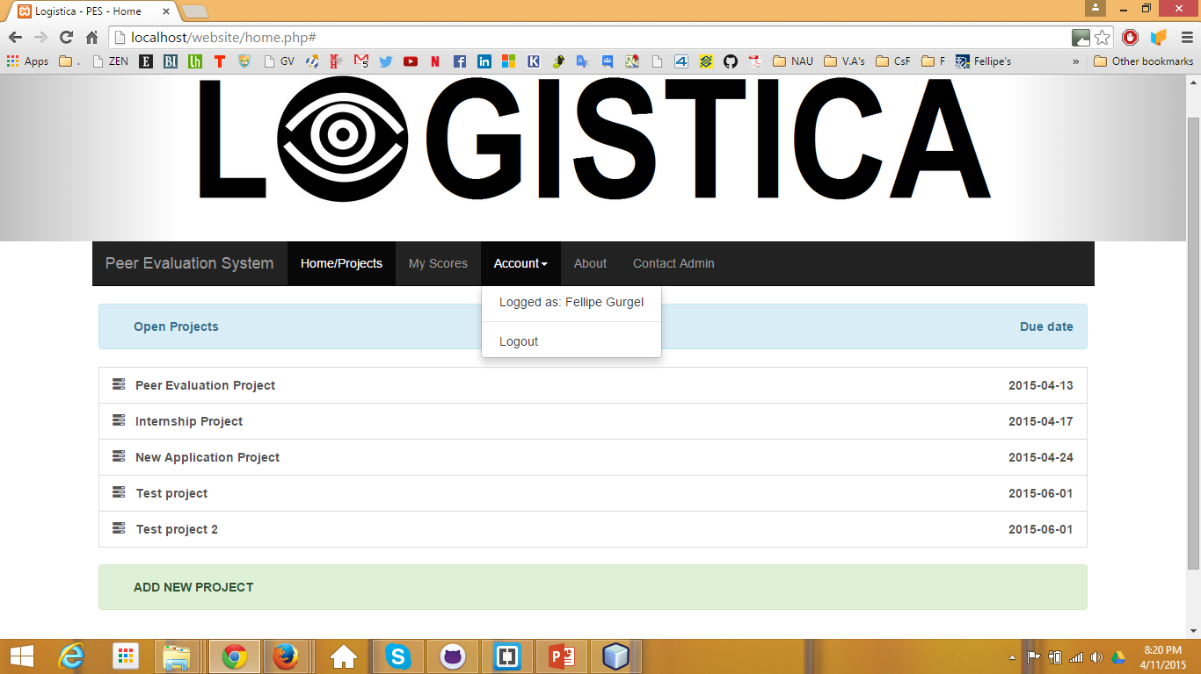
Fellipe is a supervisor
We can only see the projects for now. After we fix how to add employees to the projects (into the DB and through the form), we will be able to click on the project and see a list of the employees in it.
Only the supervisor can see this

Slide 3
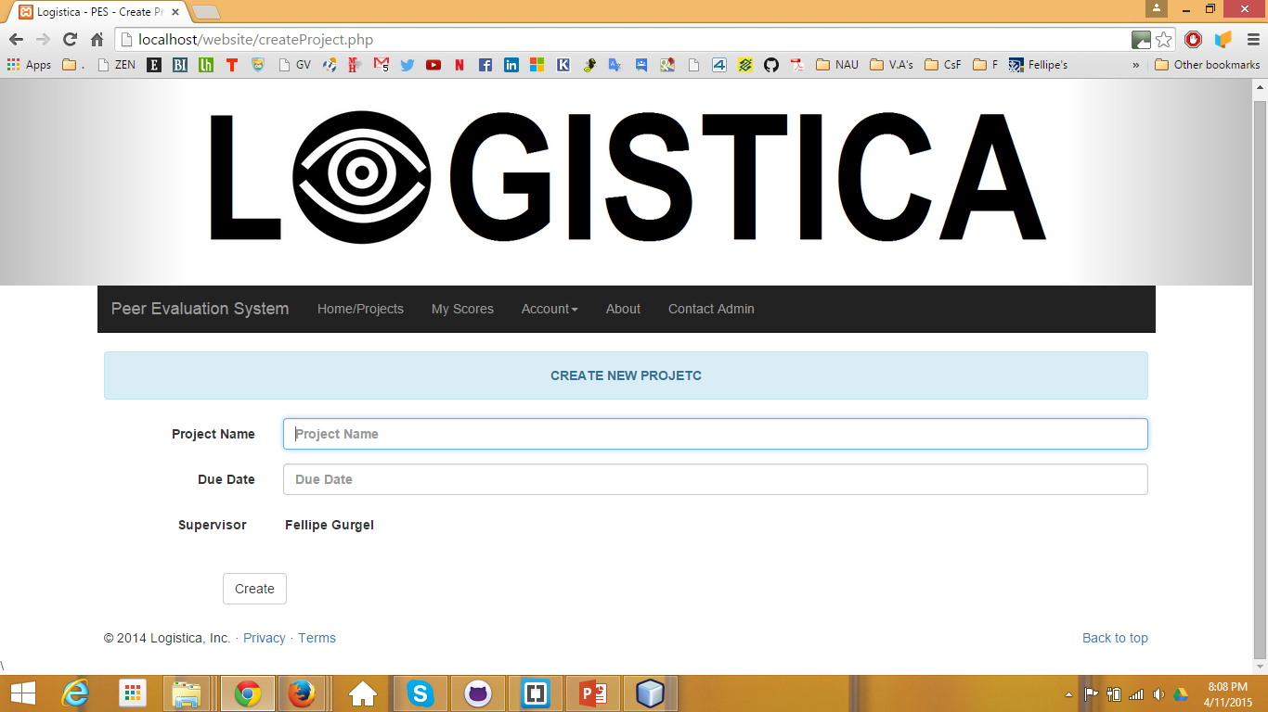
Not yet implemented: list the employees working on the project

Slide 4
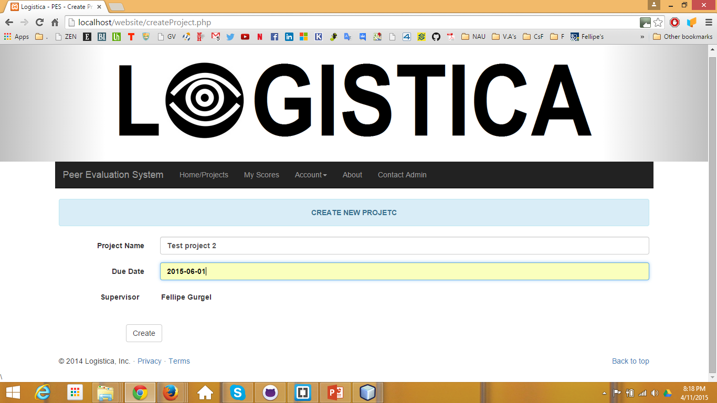
Fellipe clicks create

Slide 5
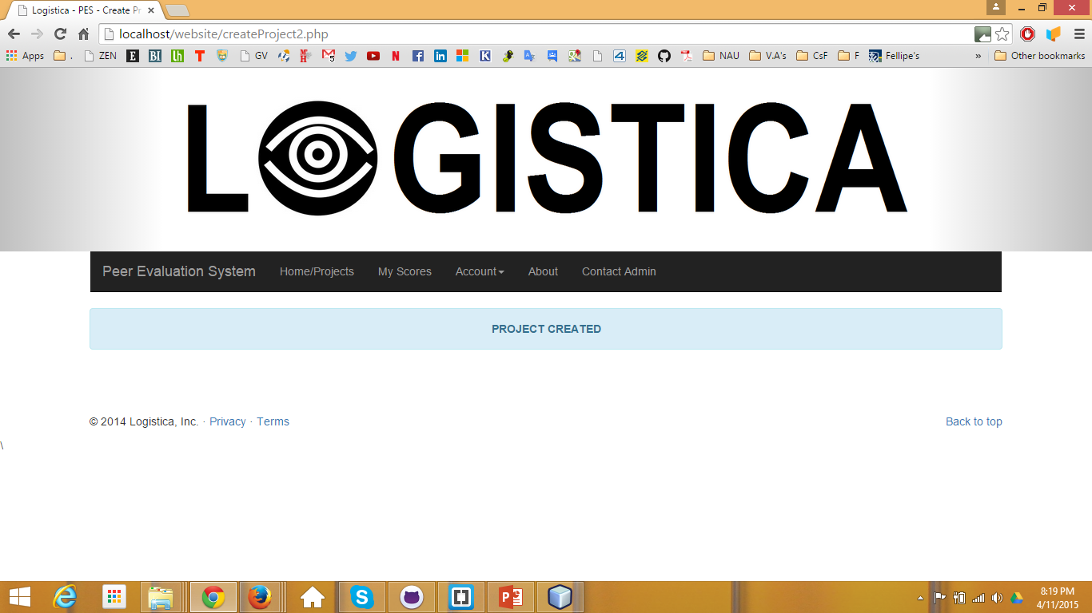
Confirmation page tells Fellipe it succeeded

Slide 6
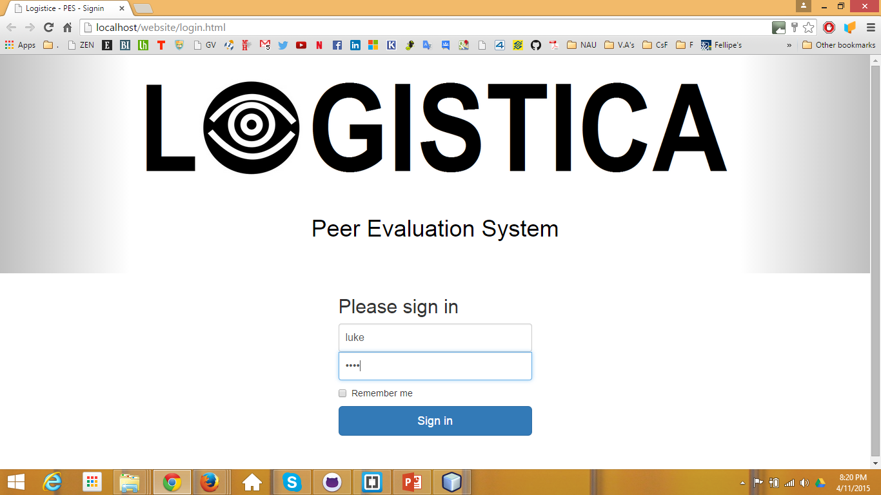
Luke logs in.

Slide 7
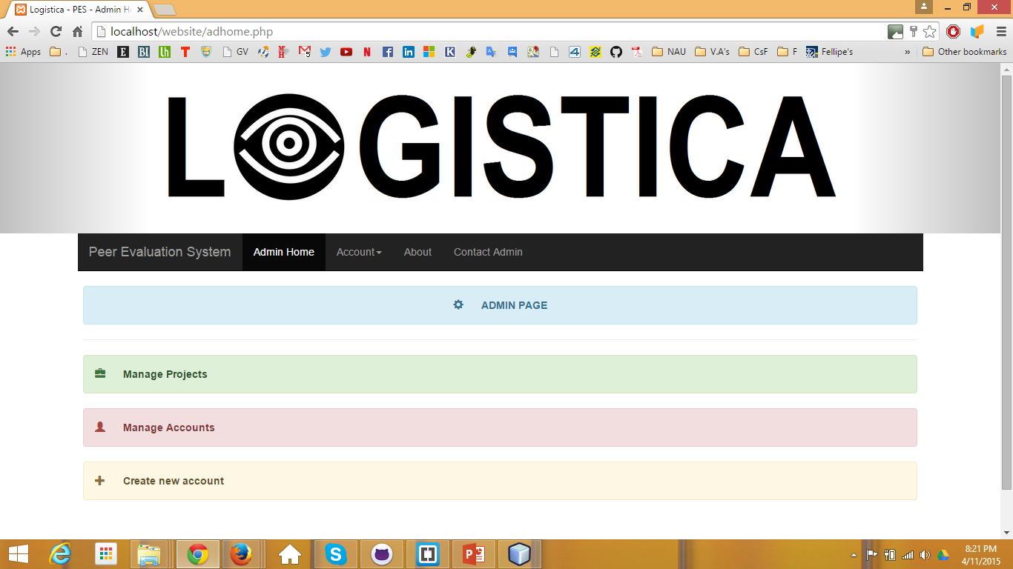
Luke is an admin
Luke can manage projects and accounts from his home page

Slide 8
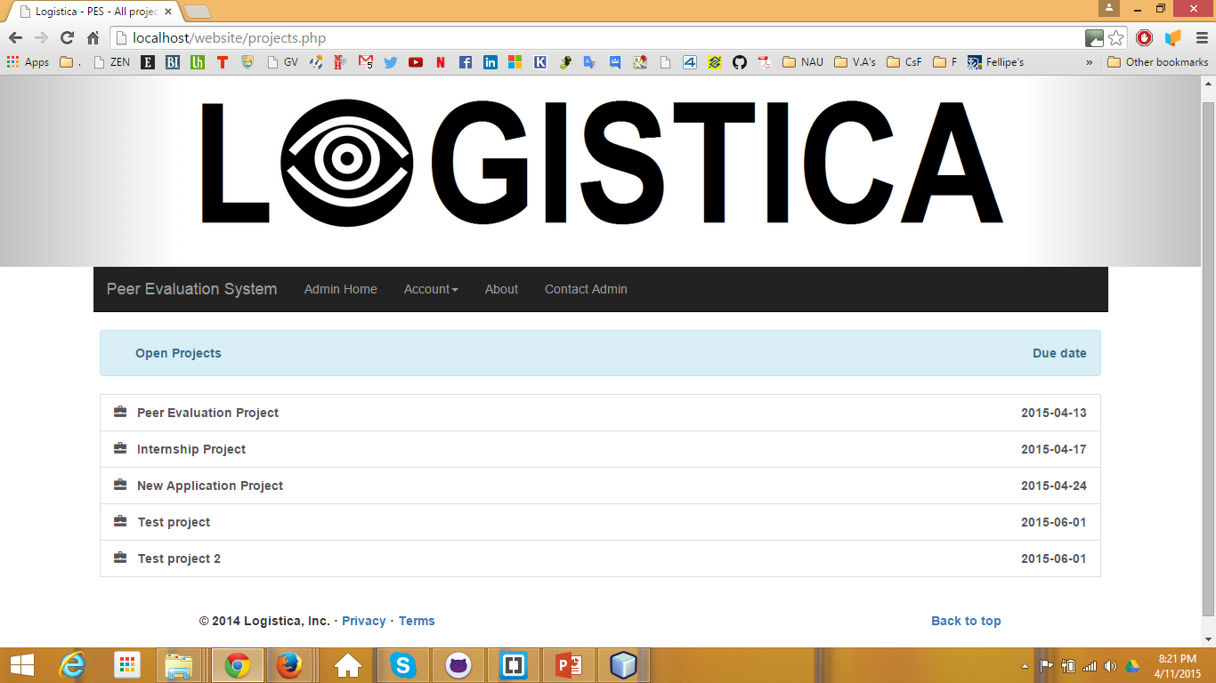
He clicks on “Manage Projects”
Not yet implemented: clicking on a project goes to a project edit page

Slide 9
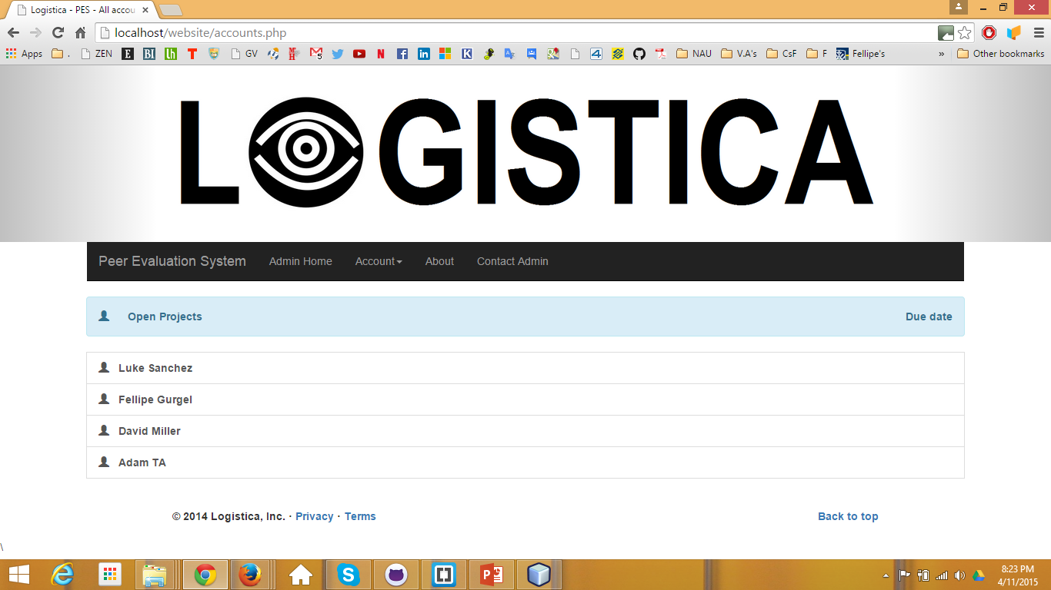
Luke clicks on “Manage Accounts”
Not yet implemented: clicking on a name goes to an account edit page

Slide 10
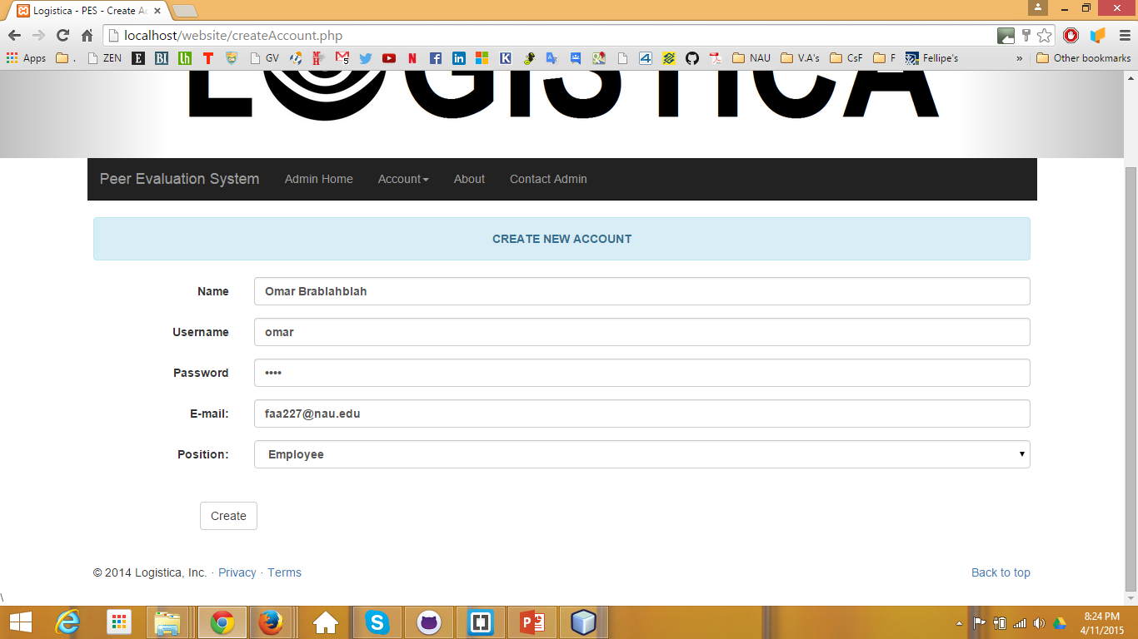
Luke clicks on “Create new Account.” Now he can add a new employee, supervisor, or admin

Slide 11

Confirmation page tells Luke it succeeded

Slide 12
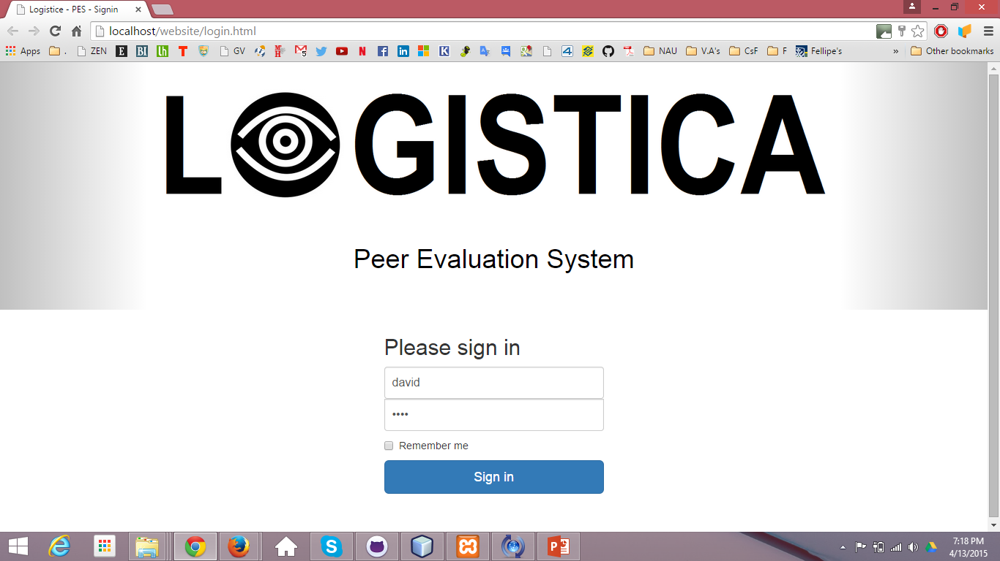
David logs in

Slide 13
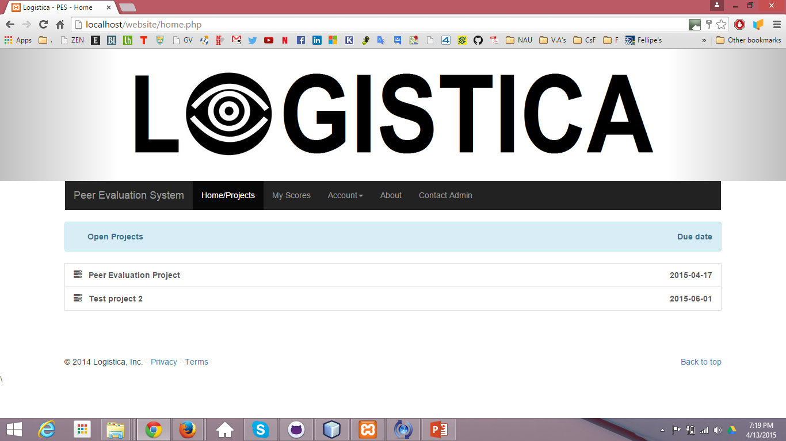
David is an ordinary employee. He only sees his own open projects.
List of projects that this employee is participating in.

Slide 14
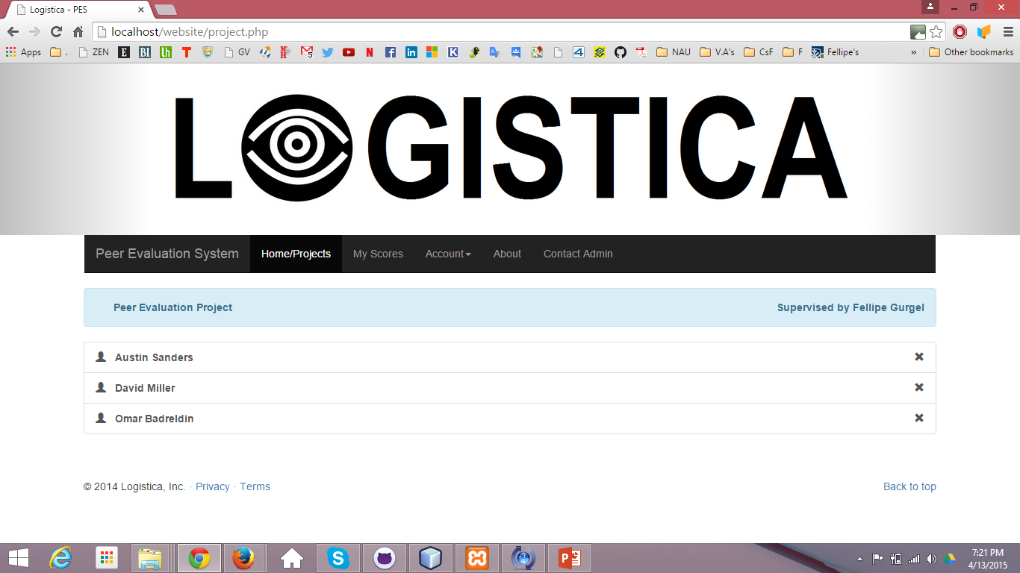
Peers in the same project

Slide 15
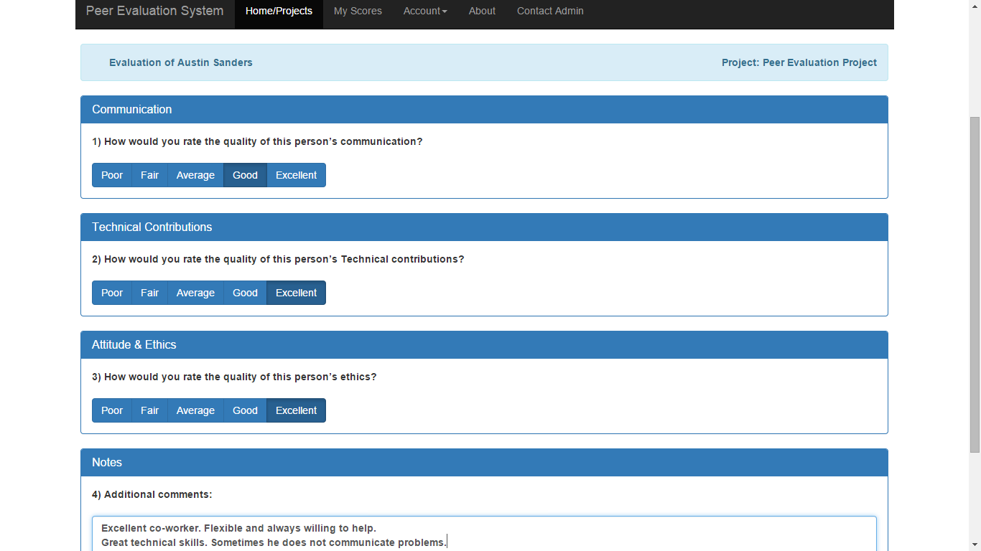
David can evaluate his peers.

Slide 16
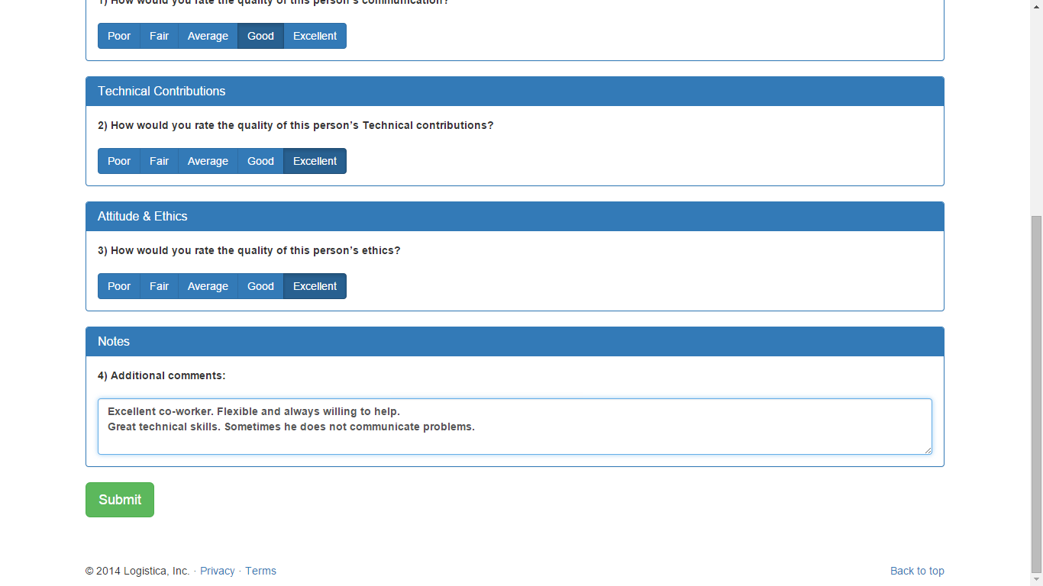
David submits the evaluation.

Slide 17

David sees that the evaluation is complete

