Slide 1
BSH ve Rakipleri Medya Analizi
Kasım 2024
Beyaz Eşya Sektörü - Medya Takip Raporu
Rapor Tarihi: 2025-11-30

Slide 2
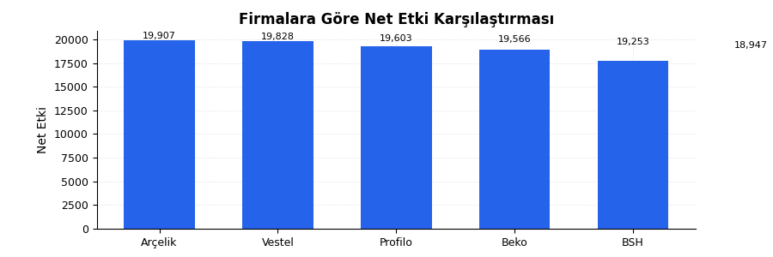
Yönetici Özeti
📊 Total Net Etki: 946,748
📊 Average Net Etki: 9,467.5
📊 Total Erişim: 5,416,638
📊 Average Erişim: 54,166.4
⭐ Highest Net Etki: Arçelik (19,907)

Slide 3
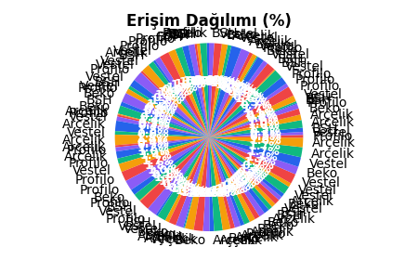
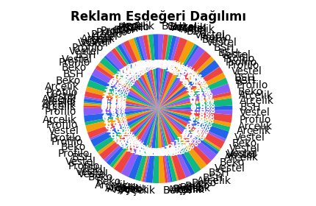
Medya Kapsam Analizi
Firma | Net Etki | Erişim | Reklam Eşdeğeri
Arçelik | 19,907 | 86,233 | 1,729.56
Vestel | 19,828 | 77,154 | 8,618.77
Arçelik | 19,603 | 54,308 | 5,454.56
Arçelik | 19,566 | 93,230 | 5,675.53
Profilo | 19,253 | 71,148 | 9,702.75
Beko | 18,947 | 53,901 | 9,108.74
Arçelik | 18,775 | 9,096 | 6,086.33
Beko | 18,568 | 76,577 | 8,216.69
Vestel | 18,179 | 57,412 | 6,852.53
Arçelik | 18,146 | 41,427 | 3,460.28
Vestel | 17,754 | 81,286 | 4,379.87
BSH | 17,730 | 7,746 | 7,145.35
BSH | 17,709 | 27,707 | 1,858.71
BSH | 17,387 | 39,995 | 8,547.49
Beko | 16,752 | 63,317 | 3,494.01
Vestel | 16,585 | 92,955 | 9,605.69
Profilo | 16,481 | 91,530 | 8,481.50
Profilo | 16,069 | 64,000 | 5,393.54
Vestel | 15,669 | 93,370 | 4,958.37
Profilo | 15,614 | 90,649 | 6,864.39
Profilo | 15,612 | 91,551 | 7,770.95
Arçelik | 15,453 | 48,964 | 4,944.45
BSH | 15,188 | 40,576 | 8,790.56
Beko | 15,131 | 56,844 | 4,384.08
Arçelik | 14,981 | 54,640 | 3,202.50
Vestel | 14,920 | 85,965 | 298.61
Profilo | 14,724 | 71,031 | 7,408.48
Beko | 14,555 | 55,450 | 7,050.46
BSH | 14,394 | 57,217 | 3,888.88
Vestel | 14,310 | 43,991 | 4,530.47
Vestel | 13,462 | 66,835 | 3,047.35
Arçelik | 13,025 | 51,629 | 3,367.90
Vestel | 12,853 | 39,338 | 2,400.32
Profilo | 12,652 | 94,844 | 2,198.50
Beko | 12,082 | 48,056 | 9,441.27
Vestel | 11,706 | 41,819 | 9,494.13
Arçelik | 11,683 | 10,980 | 8,470.21
BSH | 11,570 | 16,740 | 7,439.83
Profilo | 11,457 | 67,247 | 2,311.45
Vestel | 11,362 | 51,143 | 3,438.92
Beko | 10,280 | 72,815 | 7,318.12
Vestel | 10,217 | 70,664 | 5,521.95
Profilo | 9,785 | 2,178 | 4,805.56
Profilo | 9,666 | 92,411 | 4,193.51
Arçelik | 9,628 | 95,948 | 3,972.32
Vestel | 9,360 | 43,626 | 9,062.70
Profilo | 9,322 | 92,589 | 8,126.07
BSH | 9,276 | 33,131 | 9,506.58
BSH | 9,027 | 21,424 | 5,183.47
Beko | 8,977 | 72,925 | 3,323.26
Beko | 8,974 | 37,297 | 9,810.59
Profilo | 8,612 | 67,679 | 6,609.51
BSH | 8,554 | 53,821 | 1,866.72
BSH | 8,468 | 31,023 | 7,850.29
Profilo | 8,117 | 17,798 | 6,446.26
Arçelik | 8,033 | 80,067 | 8,003.34
Vestel | 8,028 | 36,960 | 2,419.31
Vestel | 7,973 | 90,911 | 9,704.80
Arçelik | 7,922 | 97,647 | 2,841.61
Arçelik | 7,162 | 82,911 | 4,129.42
BSH | 7,128 | 11,507 | 5,682.67
Beko | 6,856 | 60,927 | 1,993.66
Profilo | 6,777 | 25,784 | 9,928.65
BSH | 6,701 | 18,675 | 5,458.37
Vestel | 6,618 | 99,012 | 8,207.95
BSH | 6,552 | 38,604 | 5,294.33
BSH | 6,293 | 37,607 | 6,681.70
BSH | 6,266 | 10,465 | 609.06
BSH | 5,896 | 47,806 | 6,834.57
Profilo | 5,686 | 36,470 | 2,408.79
Vestel | 5,530 | 19,003 | 5,632.61
Profilo | 5,321 | 36,649 | 401.56
Vestel | 4,537 | 78,751 | 568.66
Beko | 4,416 | 70,005 | 9,766.39
Arçelik | 4,260 | 21,550 | 4,475.68
Vestel | 4,191 | 48,660 | 7,395.88
Arçelik | 4,001 | 36,624 | 4,156.33
BSH | 3,500 | 7,412 | 3,874.84
Arçelik | 3,281 | 41,453 | 8,513.47
Profilo | 3,197 | 11,623 | 2,919.08
Vestel | 3,022 | 77,928 | 2,343.54
Arçelik | 2,874 | 19,787 | 2,891.77
Arçelik | 2,858 | 87,883 | 4,753.81
BSH | 2,798 | 82,828 | 9,660.02
Arçelik | 2,791 | 35,009 | 4,864.00
BSH | 2,462 | 53,372 | 3,403.37
Arçelik | 2,410 | 80,676 | 2,121.93
Beko | 2,390 | 69,358 | 9,927.60
Beko | 2,150 | 86,971 | 8,653.30
Vestel | 2,019 | 36,994 | 2,365.54
Arçelik | 1,746 | 20,587 | 6,177.88
Profilo | 1,075 | 44,416 | 9,723.40
Arçelik | 1,066 | 64,930 | 8,441.72
Vestel | 964 | 27,930 | 5,759.90
Arçelik | 668 | 70,714 | 9,139.99
Profilo | 459 | 51,522 | 3,955.62
Profilo | 393 | 38,876 | 8,850.13
Vestel | 297 | 33,005 | 1,543.00
Beko | 166 | 54,675 | 439.80
BSH | 110 | 58,864 | 5,093.30

Slide 4
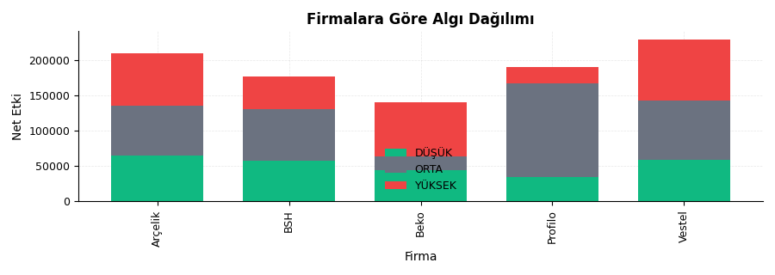
Algı Analizi
🔄 Arçelik leads Vestel by 79 (0.4%) in Net Etki
🏆 Top 3 in Net Etki: Arçelik, Vestel, Arçelik

Slide 5
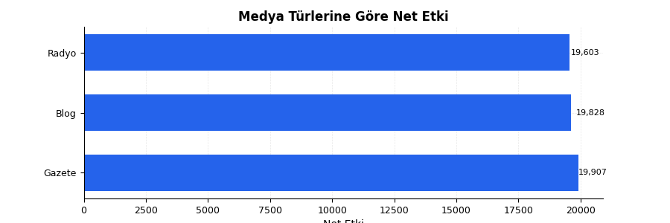
Medya Türü Dağılımı
Medya Tür | Net Etki | Erişim
Gazete | 19,907 | 86,233
Gazete | 19,828 | 77,154
Blog | 19,603 | 54,308
Radyo | 19,566 | 93,230
Radyo | 19,253 | 71,148

Slide 6
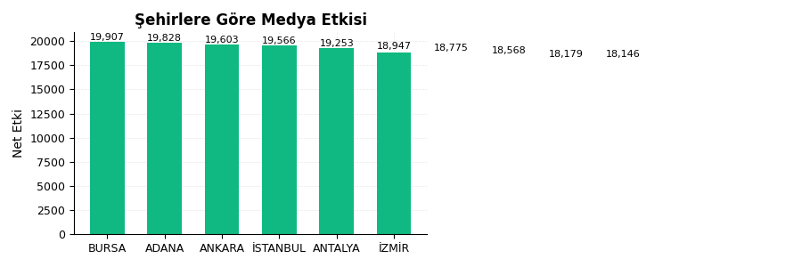
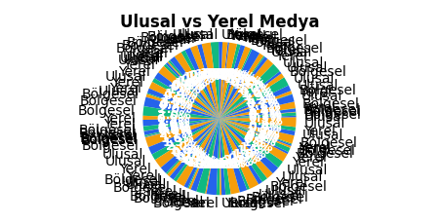
Coğrafi Dağılım
1. Highest Net Etki: BURSA (19,907)

