Slide 1

Örnek
Örnek
Örnek Örnek

Slide 2
Örnek
Firma | Toplam | Erişim | StxCm | Reklam Eşdeğeri | Net Etki
BOSCH | 945 | 10,567,211.00 | 1,904.61 | 703,721.62 | 937,459
BSH | 848 | 4,100,843.00 | 293.57 | 233,082.31 | 502,957
ARÇELİK | 104 | 7,034,682.00 | 7,455.87 | 394,576.19 | 2,444,844
PROFİLO | 97 | 792,502.00 | 617.73 | 48,613.75 | 133,587
SIEMENS | 84 | 2,820,017.00 | 463.20 | 121,854.21 | 213,372
BEKO | 80 | 6,458,668.00 | 10,210.34 | 244,763.72 | 3,234,329
VESTEL | 63 | 5,008,893.00 | 2,186.30 | 234,762.99 | 1,615,555
ARZUM | 33 | 2,033,924.00 | 2,045.54 | 85,936.53 | 805,571
PHILIPS | 28 | 2,260,762.00 | 2,140.57 | 137,351.87 | 1,213,355
DYSON | 28 | 2,066,244.00 | 1,713.62 | 133,884.20 | 706,486
SAMSUNG | 14 | 965,000.00 | 3,125.44 | 57,256.47 | 506,720
MIELE | 12 | 1,084,936.00 | 350.15 | 96,761.21 | 466,510
DELONGHI | 6 | 416,640.00 | 302.13 | 41,323.52 | 226,156
TEFAL | 5 | 89,250.00 | 305.97 | 21,286.96 | 83,427
LG TÜRKİYE | 4 | 361,020.00 | 47.91 | 13,364.15 | 142,460
FAKİR | 3 | 404,000.00 | 63.77 | 26,786.51 | 200,960
GAGGENAU | 2 | 132,000.00 | 2.02 | 747.60 | 5,280
ALTUS | 1 | 192,000.00 | 12.70 | 9,000.00 | 49,920

Slide 3
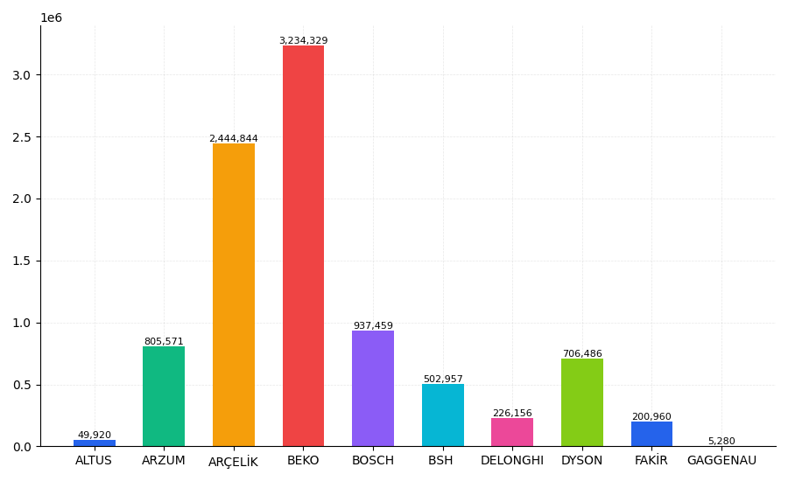

Slide 4
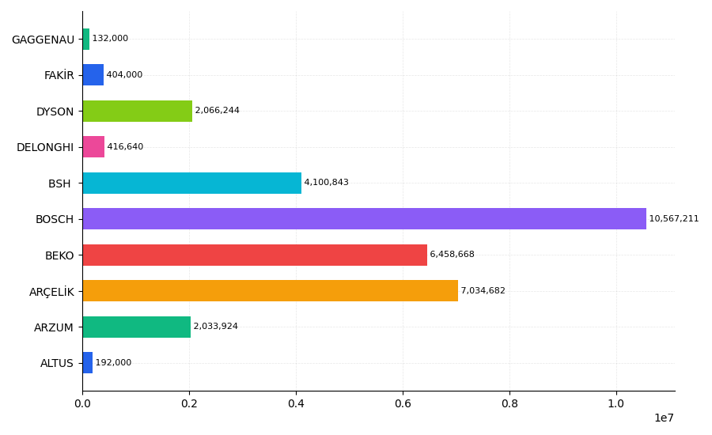

Slide 5
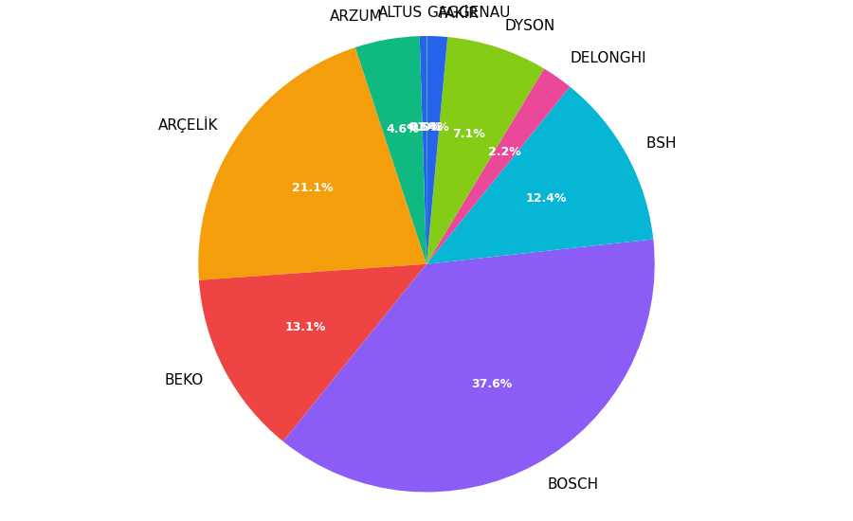

Slide 6
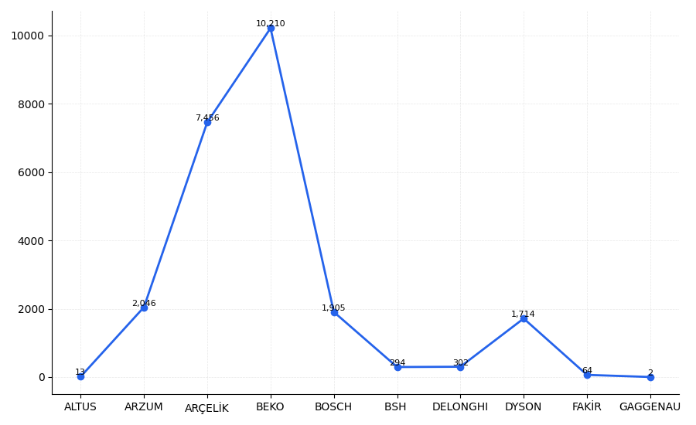

Slide 7
