Slide 1

Örnek
Örnek
Örnek Örnek

Slide 2
Örnek
Erişim | StxCm | Reklam Eşdeğeri
24,000.00 | 2.22 | 22.12
33,450.00 | 14.40 | 113.61
23,339,276.00 | 41,563.39 | 2,171,708.32
12,644,185.00 | 9,878.17 | 599,274.23
18,168,330.00 | 626.69 | 150,388.27
12,695,127.00 | 23,122.17 | 3,440,608.29
2,390,687.00 | 1,736.71 | 275,679.95
68,000.00 | 194.56 | 38,787.00
1,514,038.00 | 1,062.73 | 139,662.36
6,041,704.00 | 708.99 | 58,738.25
13,564,903.00 | 8,895.85 | 381,393.78
9,236,018.00 | 1,414.24 | 239,807.07

Slide 3
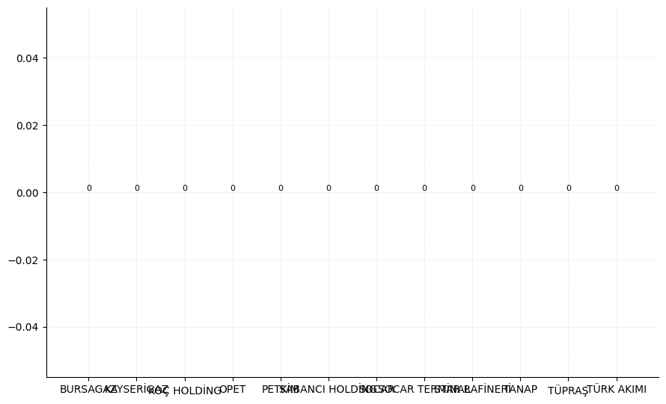

Slide 4
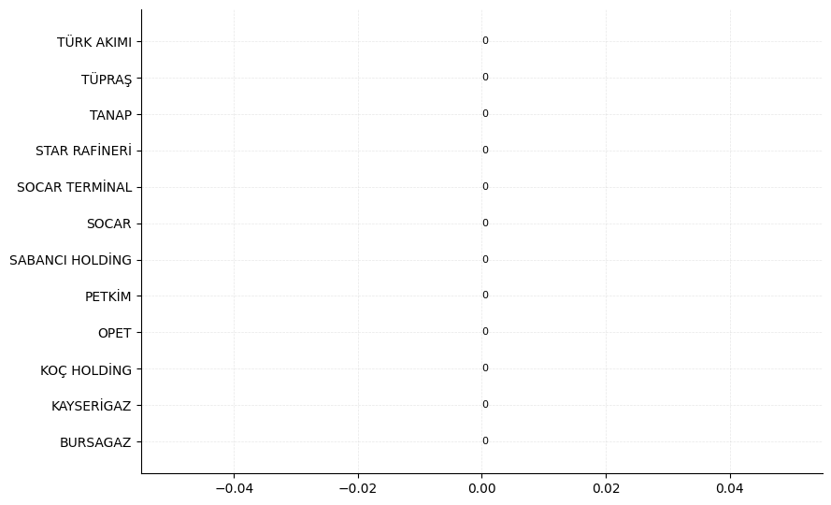

Slide 5
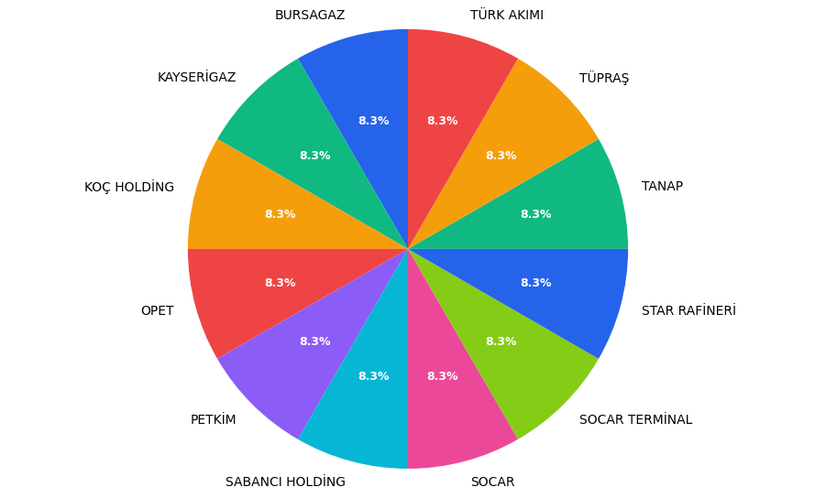

Slide 6
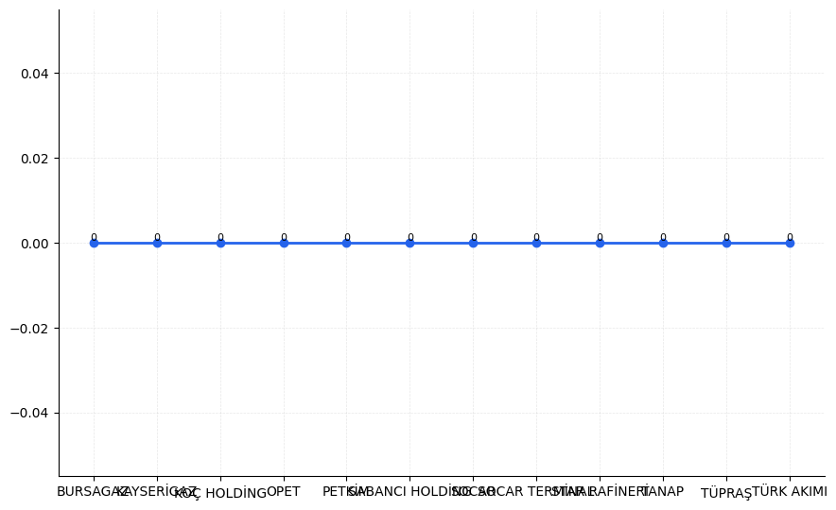

Slide 7
