Slide 1












$$P_{2}$$
$$W$$
$$P_{1}$$
$$P_{3}$$
current frame
last frame
$$I_{k−1}$$
$$p_{2}^{′}$$
$$p_{2}$$
$$I_{k}$$
$$p_{1}^{′}$$
$$p_{3}^{′}$$
$$p_{1}$$
$$p_{3}$$

Slide 2
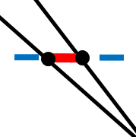









$$P$$
$$P^{′}$$
$$Q$$
$$z$$
$$z^{′}$$
$$e$$
$$f$$
$$o$$
$$o^{′}$$

Slide 3
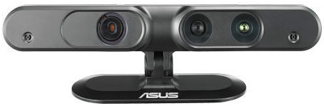
Motion Estimation Thread
Graph Optimization Thread
Mapping Thread
New Frame
Photometric and depth error function
Is Keyframe?
Global Graph Optimization
Last Frame
Weighting Function
Compute Bow &
Spatial Location Constraints
Mapping
Transformation Estimation
Local Graph Optimization
Update

Slide 4



map points
$$P_{2}$$
$$P_{1}$$
$$P_{i}$$
$$P_{3}$$
current frame
$$p_{2}^{′}$$
$$I_{c}$$
$$p_{i}^{′}$$
$$p_{3}^{′}$$
$$p_{1}^{′}$$
$$W$$

Slide 5














$$X_{2}$$
$$T_{32}$$
$$X_{3}$$
$$T_{43}$$
$$T_{21}$$
$$X_{4}$$
$$X_{1}$$
$$T_{54}$$
$$X_{n}$$
$$X_{5}$$
$$d$$
$$X_{i}$$
$$X_{j}$$
$$T_{ji}$$

Slide 6
Spatial Location Constraints
Current Frame
Spatial Location Constraints
Previous Keyframes
DBoW2
Candidates
Candidate
Candidates
Candidates

