Slide 1
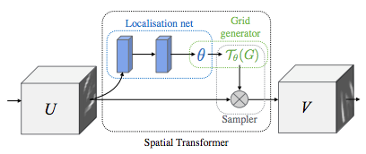
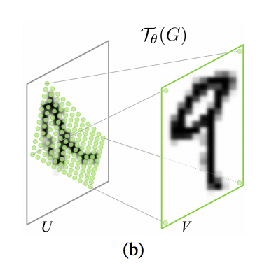
Input
Max Pooling
ST
Convolution
Flatten
ST
Convolution
Max Pooling
Convolution
ST
Output
Convolution
ST
Spatial Transformer:

