Slide 1
MOTOR IMAGERY EEG CLASSIFICATION: Identifying Rest Vs. Active States With Convolutional Neural Networks
Done by,
P. Pradeep

Slide 2
OBJECTIVES
Develop a CNN model to accurately distinguish between active motor imagery states and resting states from EEG data.
Implement effective data preprocessing and segmentation to improve EEG signal clarity and overall classification accuracy of the CNN model.

Slide 3
EEG - Electroencephalogram
EEG is a non-invasive technique that uses electrodes placed directly on the scalp to measure the electrical fields generated by the joint activity of populations of neurons located in the outer layers of the brain
Brain cells communicate via electrical impulses, and this activity shows up as signals on an EEG recording
As a rule-of-thumb, non-synchronous neural activity gives rise to fast (high frequency), low amplitude waves, while synchronized neural activity yields slow (low frequency), high amplitude waves.

Slide 4
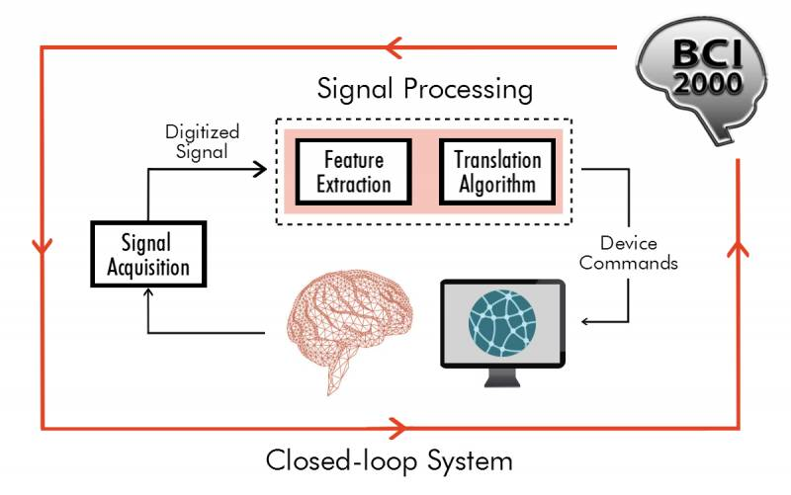
DATASET
EEG Motor Movement/Imagery Dataset - A set of 64-channel EEGs from subjects who performed a series of motor/imagery tasks has been contributed to PhysioNet by the developers of the BCI2000 instrumentation system for brain-computer interface research.
The experiments were performed on 109 subjects. Here we consider only 2 subjects.
There are 11 class labels in total, capturing different motor states:
Classes 0-9 represent various active states, including physical and imagined movements of eyes, hands, fists, and feet.
Class 10 represents a resting state with no active or imagined movement.
Fig. BCI 2000 System

Slide 5
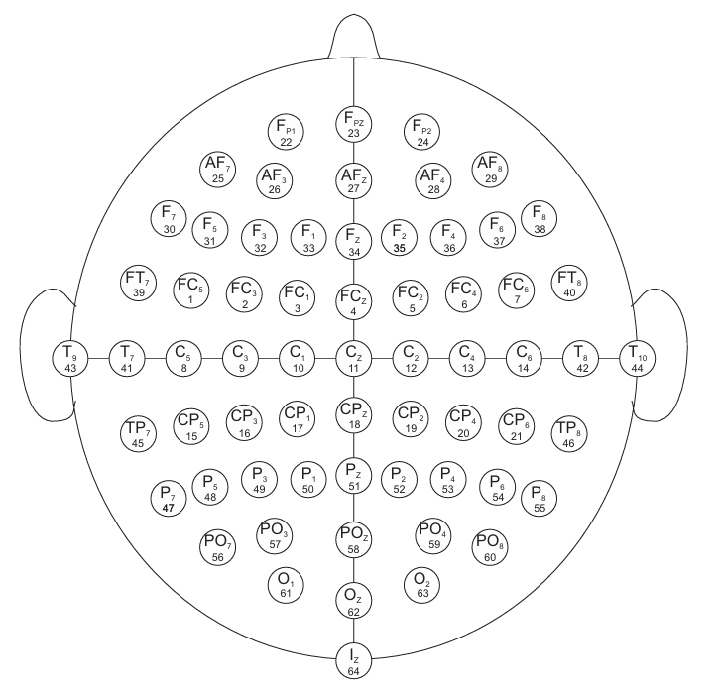
DATASET (Contd.)
Shape of the dataset (comprising data of subjects 1,2) [515200, 65]
515200 experimental runs/samples
64 features per sample (sampled output signals of the 64 channels) and the last column (65th column) comprises of the labels corresponding to the 64 features
Sample count of each label/class
y: {0: 19520, 1: 19520, 2: 30992, 3: 28288, 4: 30992, 5: 28288, 6: 30336, 7: 28944, 8: 28864, 9: 30416, 10: 239040}
Fig. 64 Channel Sharbrough

Slide 6
DATASET PRE-PROCESSING

Slide 7
RE-STRUCTURING THE CLASS LABELS
The dataset is structured to train a binary classifier model aimed at predicting whether a person is engaged in physical/imaginary movement (class 0) or is in a state of complete rest (class 1)
Sample count after grouping labels 0 to 9 into Class 0 and label 10 as Class 1
y: {276160, 239040}

Slide 8
NORMALIZATION OF THE DATASET
StandardScaler (Scikit-Learn) normalizer is applied on the dataset to standardize the features
Scales each feature to have a mean of 0 and standard deviation of 1
Test Set Size = 10% of Training Set

Slide 9
2D CNN ON MULTIVARIATE TIME SERIES DATA
Why 2D CNNs?
CNNs are ideal for learning spatial and temporal patterns in multivariate EEG data, allowing the model to capture intricate relationships between channels and across time
The 2D convolutional layers effectively handle the high-dimensional structure of EEG signals
By using CNNs, we leverage a powerful architecture capable of extracting robust features from noisy EEG data

Slide 10
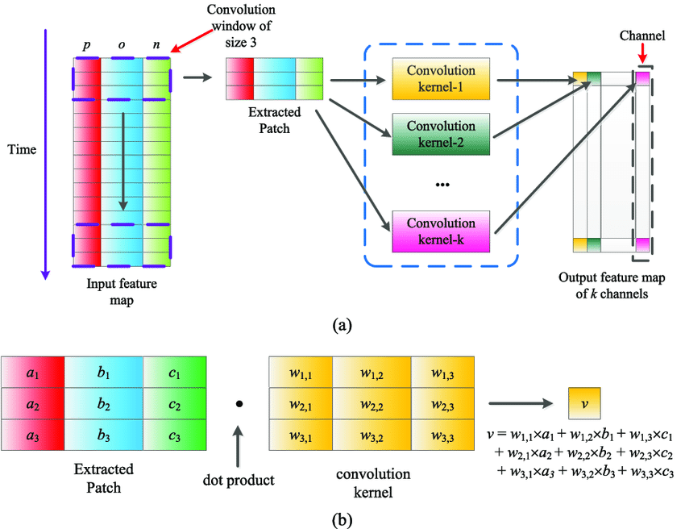
TEMPORAL WINDOWING EXAMPLE ILLUSTRATION
Fig. 2D convolution operation on a multivariate time-series dataset

Slide 11
TEMPORAL WINDOWING AND LABEL AGGREGATION
Applying the sliding window technique to segment the EEG data into overlapping time windows, capturing temporal dynamics in the data.
Window size = 24
50% Overlapping (Step size = 24/2 = 12)
Calculating the average of labels within each window to create a representative label for the window, especially useful in tasks where activities are continuous.
Dataset Shape Transformation: (515200, 65) (42932, 24, 64, 1)
[42932 windows, 24 samples per window, 64 features per sample and 1 class label per window]

Slide 12
TRAINING THE CNN MODEL

Slide 13
CNN ARCHITECTURE
Layer Type | Output Shape | Parameters
Conv2D | (None, 24, 64, 16) | 144
ReLU | (None, 24, 64, 16) | 0
MaxPooling2D | (None, 12, 16, 16) | 0
Conv2D | (None, 12, 16, 32) | 2,080
ReLU | (None, 12, 16, 32) | 0
MaxPooling2D | (None, 6, 8, 32) | 0
Flatten | (None, 1536) | 0
Dense | (None, 128) | 196,736
Dropout | (None, 128) | 0
Dense | (None, 2) | 258

Slide 14
HYPERPARAMETERS
Convolution Filter (Kernel) Size = (2,4) and Stride = 1
Max Pooling Filter (Kernel) Size = (2,2)
Binary Softmax Output – 2 neurons in the Final Dense layer
Loss Function – Sparse Categorical Cross Entropy Loss
Adam Optimizer
Learning Rate = 0.001
Batch Size = 128 and Total no. of Epochs = 40

Slide 15
RESULTS
TRAINING SET
CLASSIFICATION REPORT:
VALIDATION SET
CLASSIFICATION REPORT:
Final Training Set accuracy – 98%
Final Validation Set accuracy – 77%

Slide 16
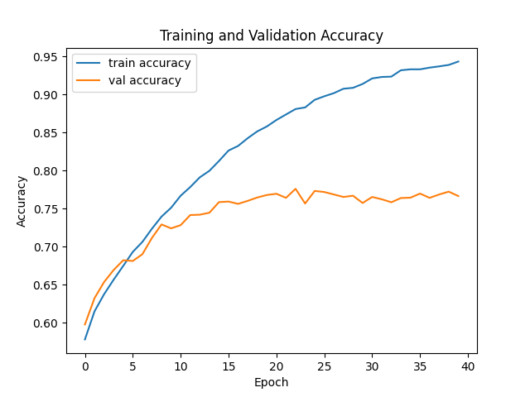
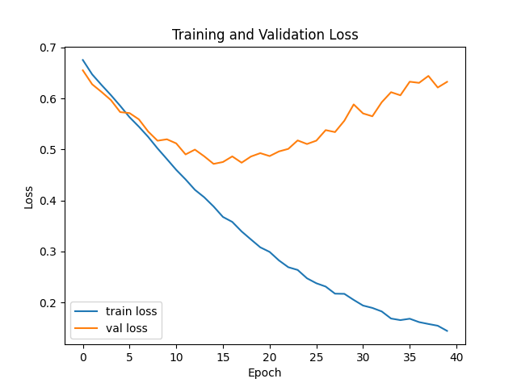
RESULTS (Contd.)

Slide 17
CONCLUSION
This project developed a CNN model to classify EEG data, effectively distinguishing between motor imagery/physical movement and resting states.
The approach utilized windowing techniques and data preprocessing to enhance model performance, achieving high classification accuracy on the training and test set.

Slide 18
FUTURE WORKS
Apply advanced optimization techniques, such as Bayesian optimization, to fine-tune the model’s parameters (e.g., learning rate, filter sizes, dropout rate) for improved accuracy and robustness.
Integrate CNN with LSTM layers to capture both spatial patterns and temporal dependencies in the EEG data, potentially enhancing the model’s ability to distinguish between motor imagery and rest states effectively.

