Slide 1
TIES4560 Demo 4
Tuukka Jurvakainen
Tuomas Moisio
Erkka Nurmi
Joonas Raja

Slide 2
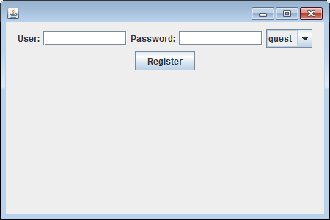
Implementation of Basic Auth
Java Client for adding users (only testing purposes)

Slide 3
Implementation of Basic Auth
Basic authentication for retrieving members.
Jersey-based application take care of authentication and authorization by implementing own SecurityFilter.
Authorization is organized via Security annotations (@RolesAllowed, etc.).

Slide 4
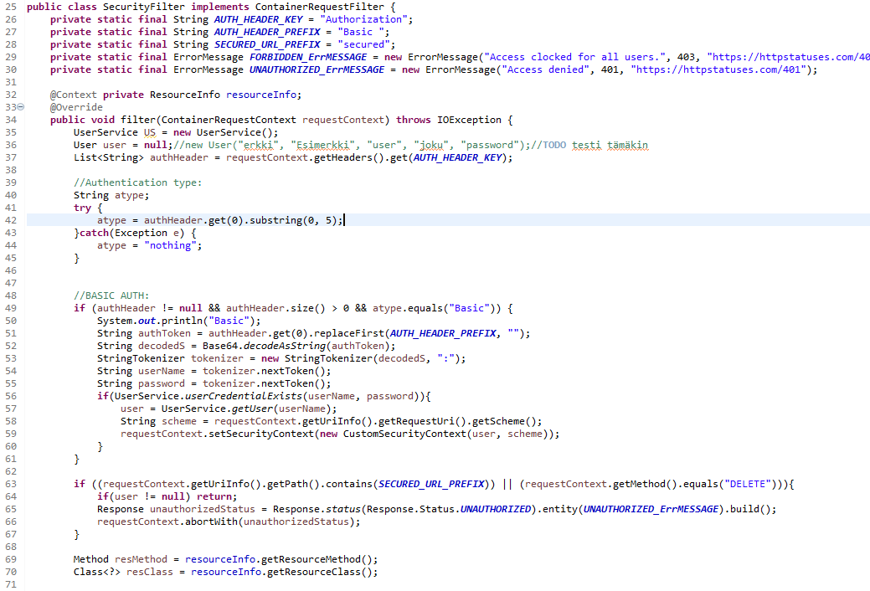

Slide 5
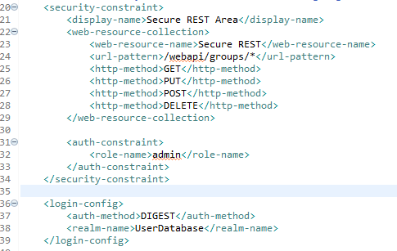
Implementation of Digest Auth
Protected resources, roles and access areas are configured at container level in web.xml

Slide 6
User data is stored at Tomcat-users.xml

Slide 7
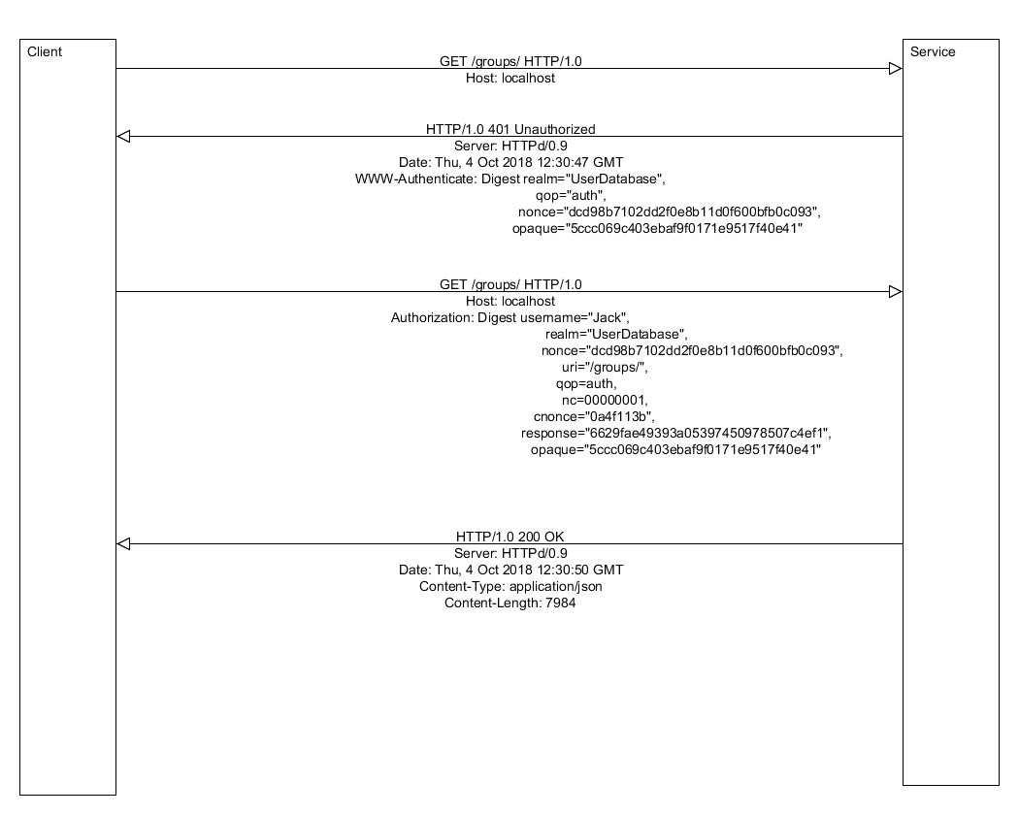
Authentication flow

