Slide 1
Employment Application Review System(EARS)
Prepared By: Faisal Ahmed Tusar
ID: 151-35-867

Slide 2
Features of the system
Log In to the system
Manage system users
Add a new faculty search
List and review applications
Set account’s setting

Slide 3
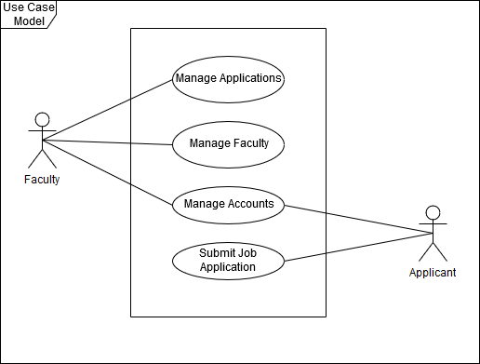
Use Case Diagram

Slide 4
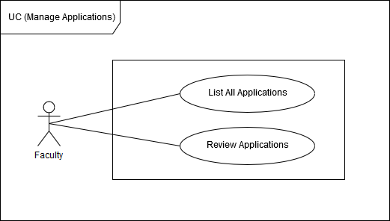
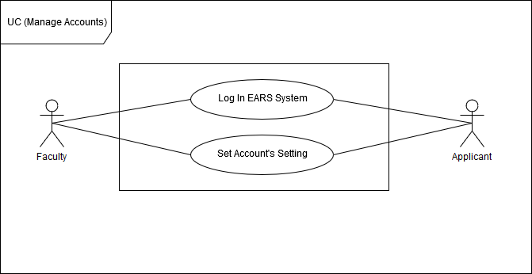
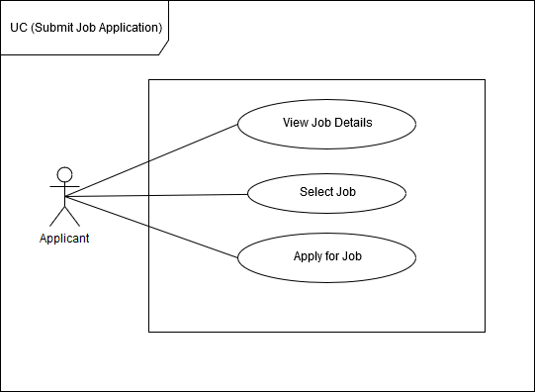
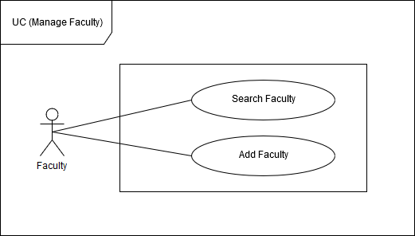
Continue…

Slide 5
Selected Use Case

Slide 6
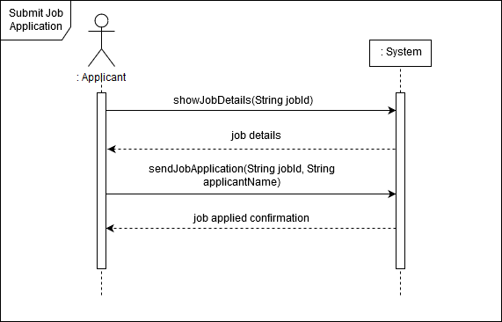
System Sequence Diagram

Slide 7
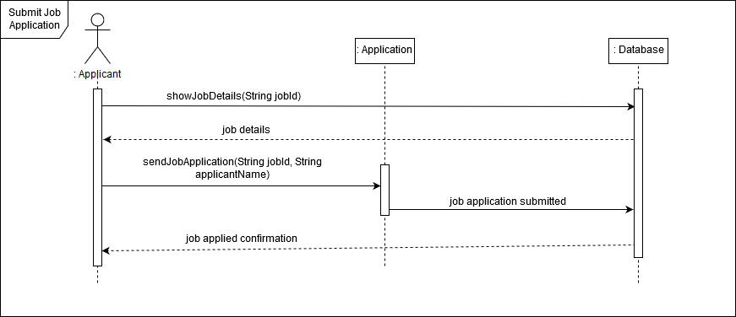
Sequence Diagram

Slide 8
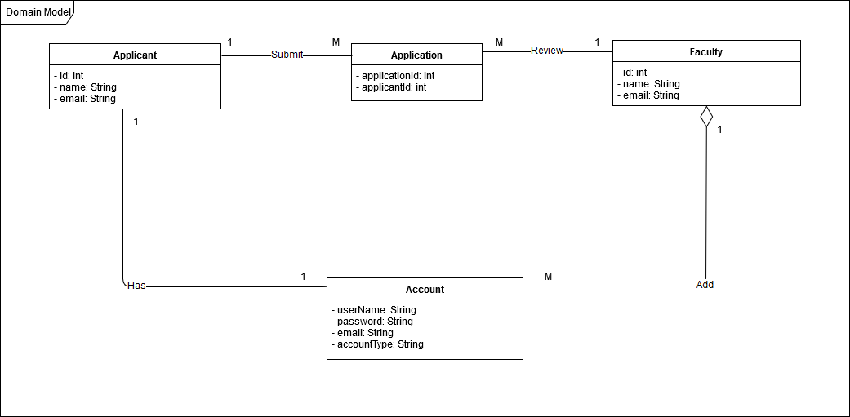
Domain Model

Slide 9
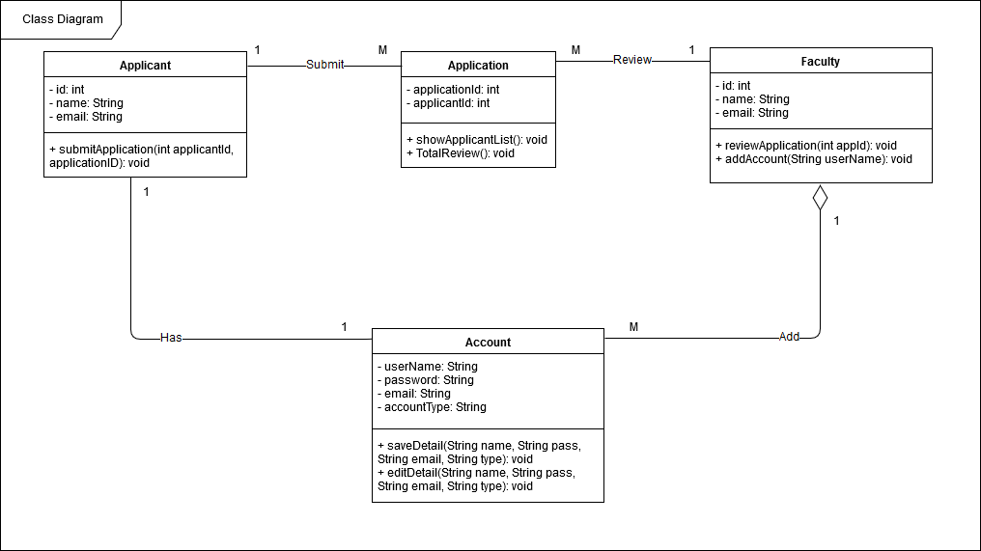
Class Diagram

Slide 10
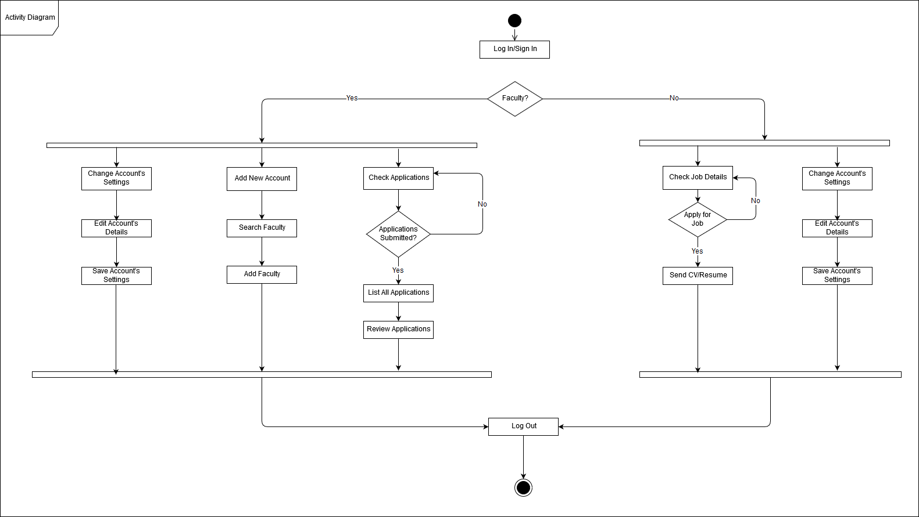
Activity Diagram

Slide 11

How It Works?

Slide 12
Thank You

