Slide 1


Slide 2
THEME
PROJECT MANAGEMENT SYSTEM
Track Progress
Organize Projects
Stay on Schedule (Task, Meetings, Report)

Slide 3
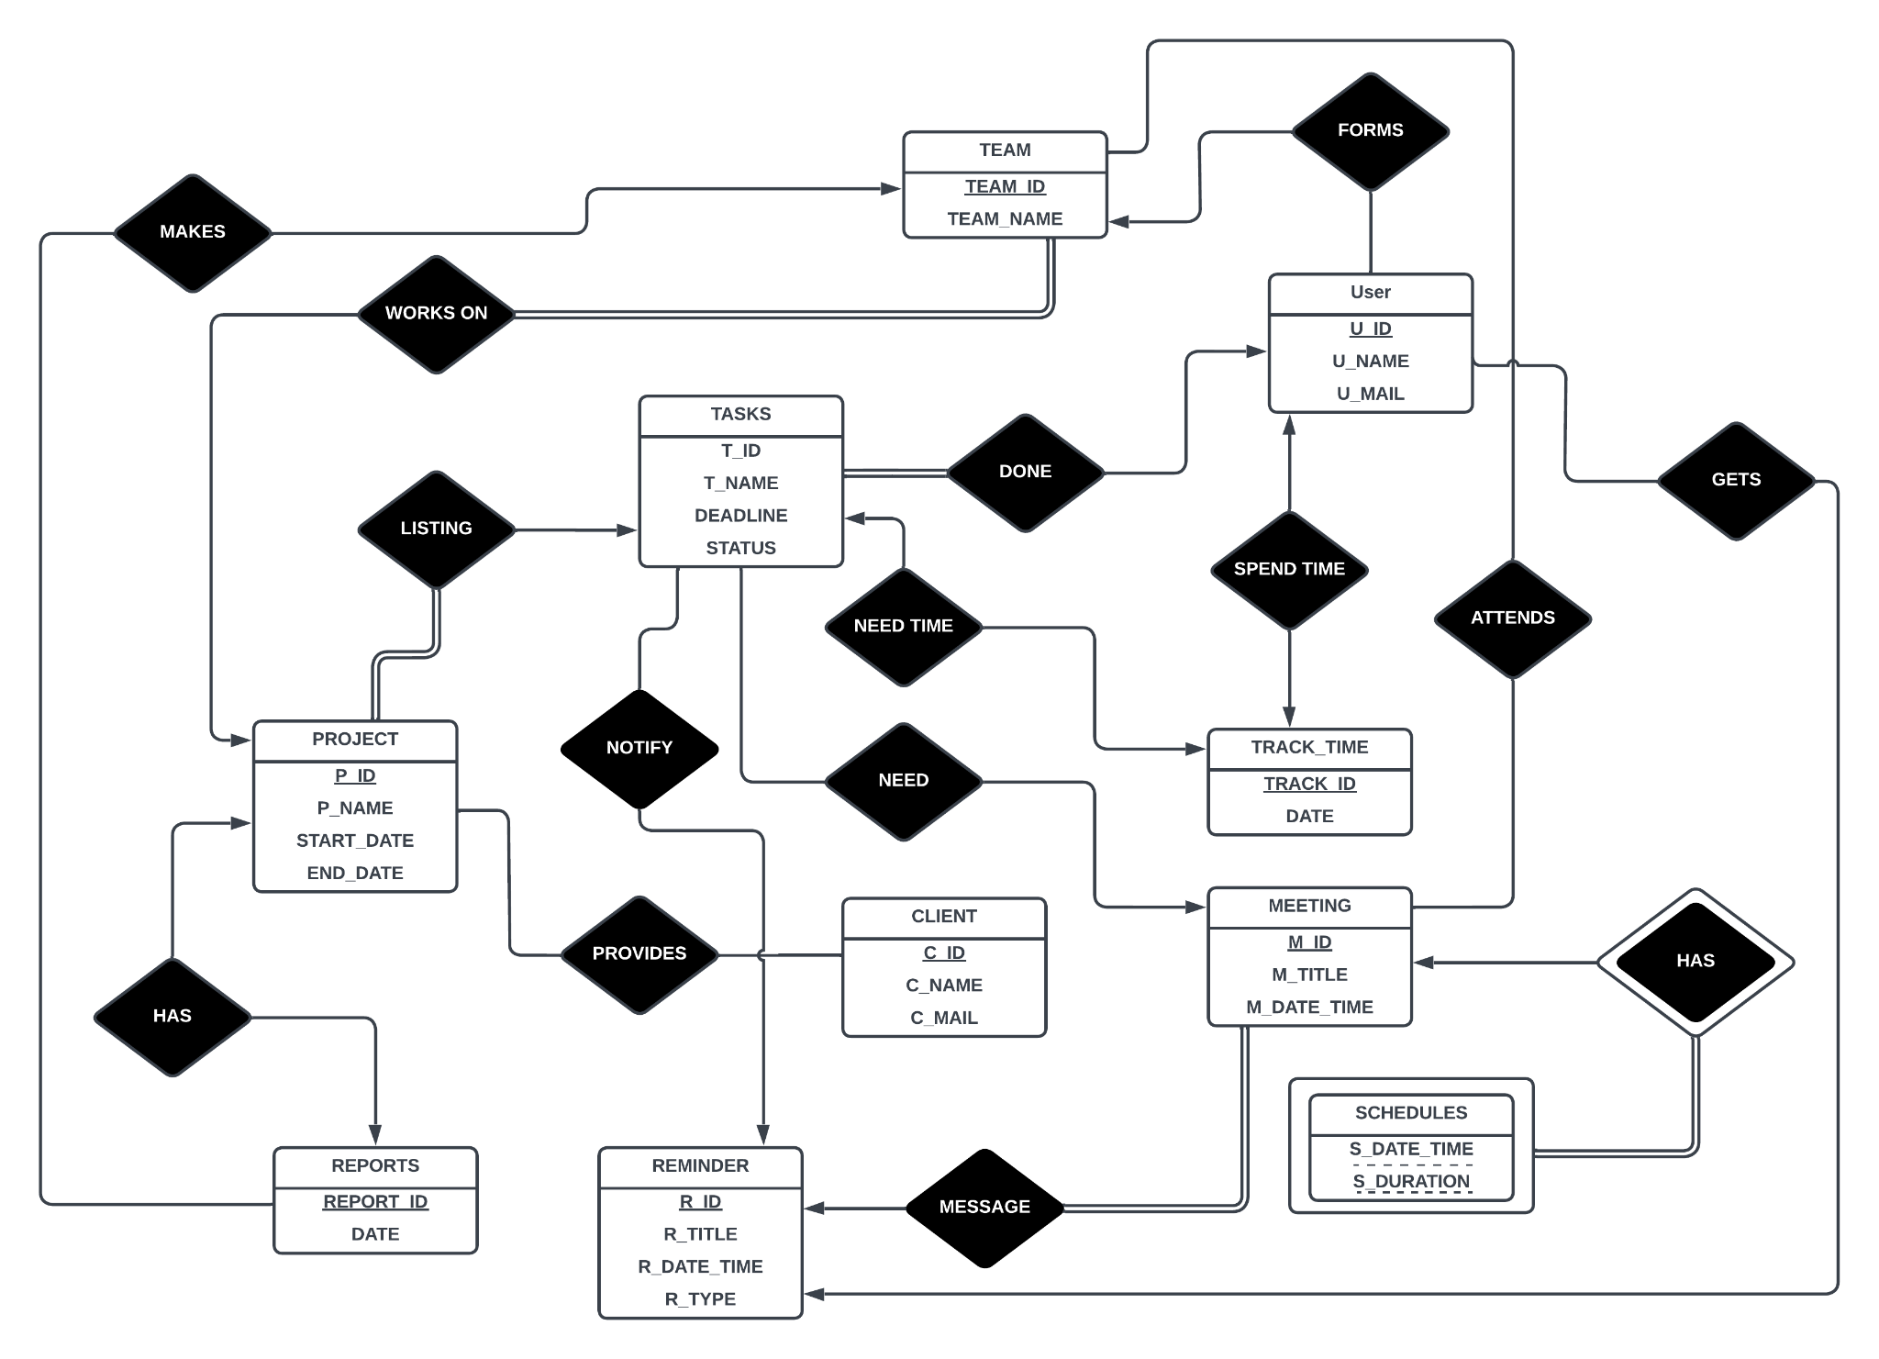
ER - DIAGRAM

Slide 4
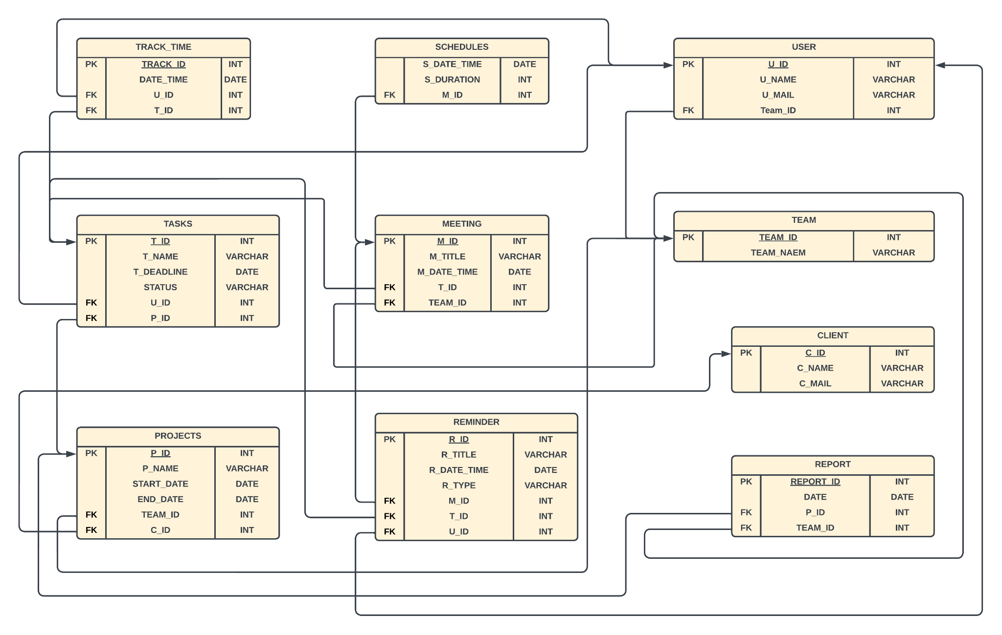
SCHEMA DIAGRAM

Slide 5
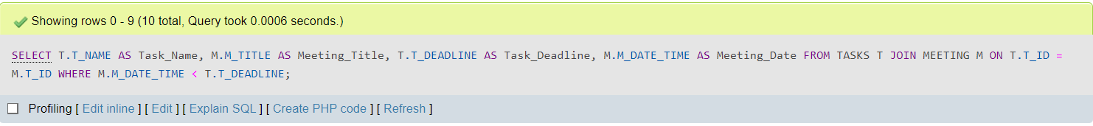
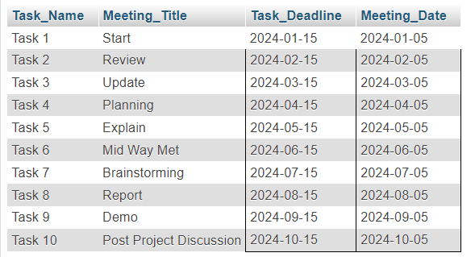
QUERY SAMPLE 01
Retrieve all tasks that are dependent on meetings occurring before their deadline:

Slide 6
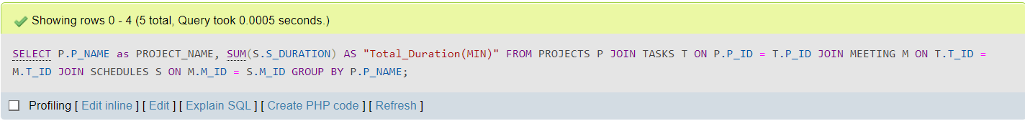
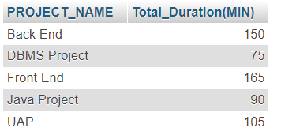
QUERY SAMPLE 02
Get the total duration of meetings for each project:

Slide 7
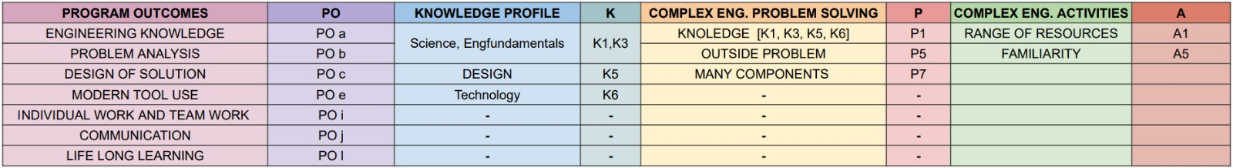
Relationship among PO, K, P and A

Slide 8
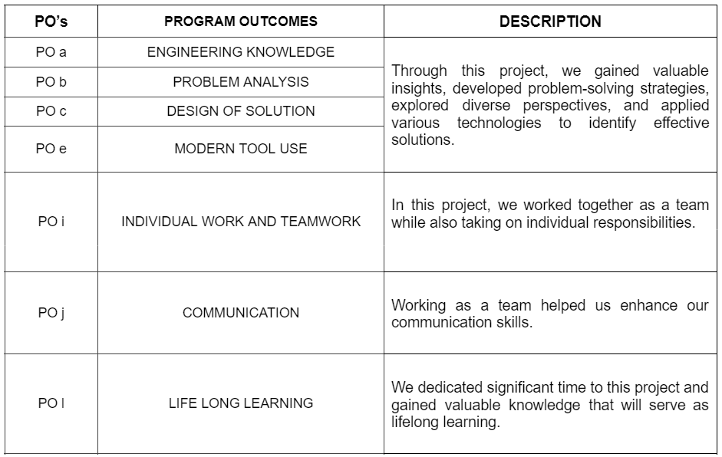
Program Outcomes (PO’s):

Slide 9
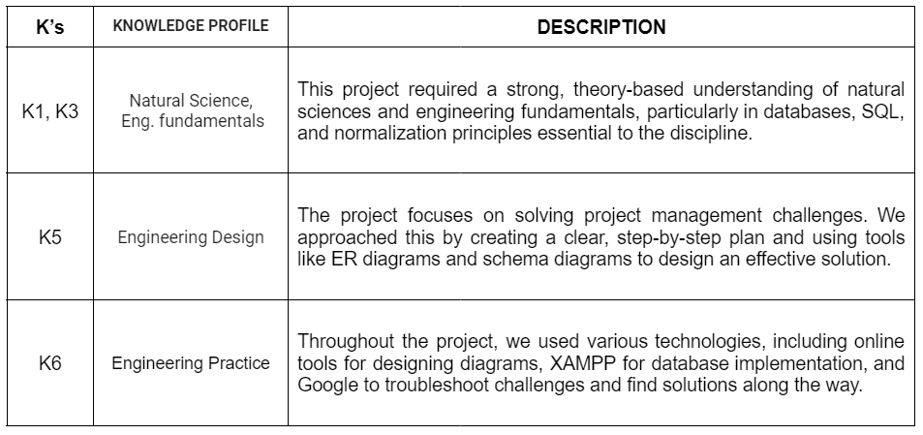
Knowledge Profile( K’s )

Slide 10
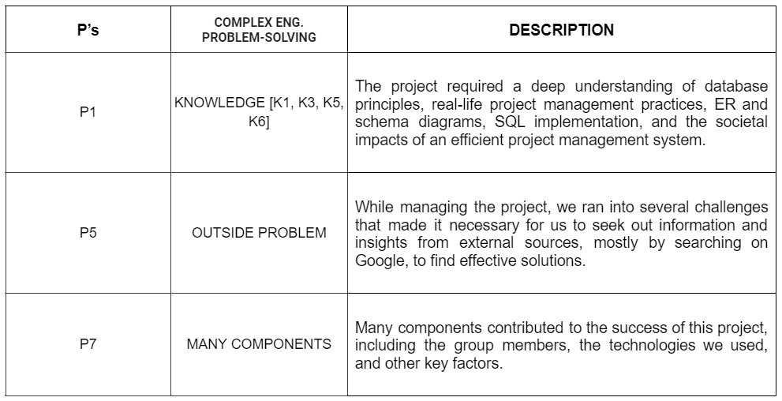
The Engineering Problems (P’s)

Slide 11
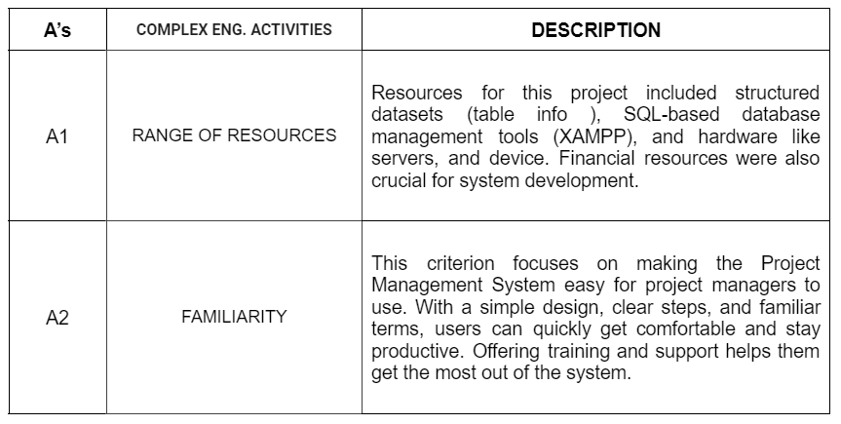
The Complex Engineering Activities (As)

Slide 12

THANK YOU !!

