Slide 1


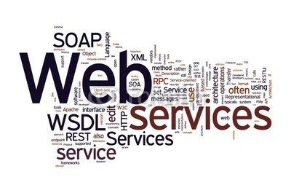

Web Applications and Services
IIS Web Hosting & Web Services
SoftUni Team
Technical Trainers
Software University
http://softuni.bg

Slide 2

Table of Contents
Internet Information Services (IIS)
How to create Virtual Directories and Web Sites?
How to deploy Web Applications?
Web Services Development
SOAP
WSDL
Creating and Consuming Web Services

Slide 3

Internet Information Services

Slide 4

Internet Information Services
Web hosting involves setting up a Web server with correct code files and settings so that remote users can successfully access a Web application
Internet Information Services (IIS) is an extensible web server created by Microsoft
Hosts web applications on the Windows operating system

Slide 5
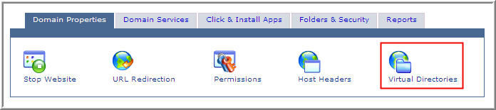
Internet Information Services
A Web site is a container of applications and virtual directories
Those directories can be accessed via URL
A Web server never exposes the actual physical address and location of files to the external world

Slide 6

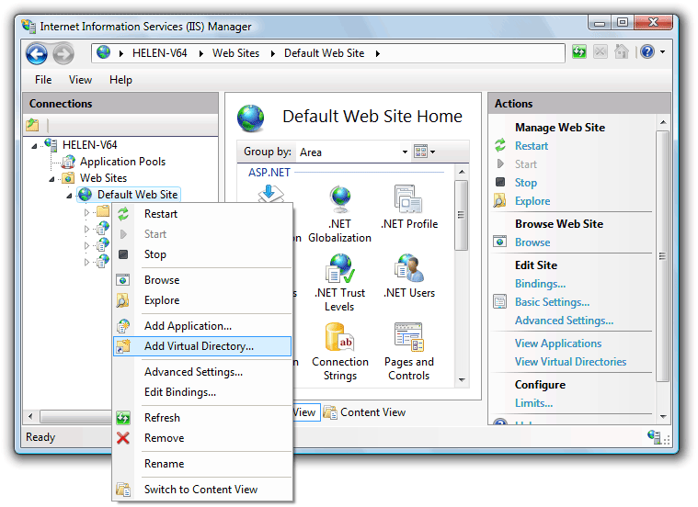
Creating Virtual Directories

Slide 7
Deploying Web Applications
Deployment of simple Web sites is accomplished by copying the files to the correct location
Using xcopy of FTP
Ideal for when the web applications and services simply require the files to be copied onto the Web server
Using Windows Installer
can perform a number of custom actions during the deployment process
perfect for deploying complex web sites

Slide 8
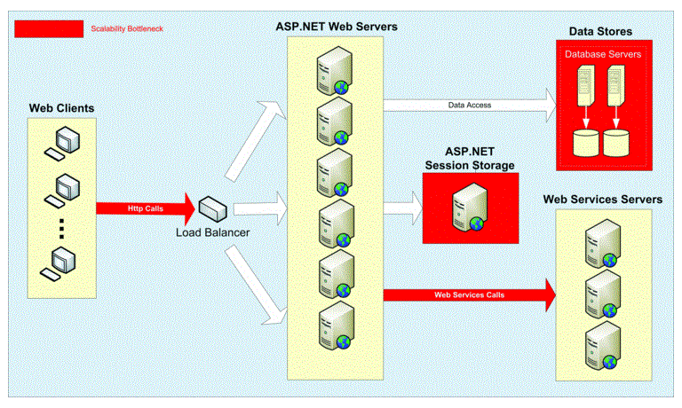
Web Services Development

Slide 9

Web Services Development
A Web service is a software component that can be accessed over a network using standard network protocols
Web services provide a way to interact with programming objects located on remote computers
Web services are described using the Web services description language (WSDL)

Slide 10

SOAP

Slide 11
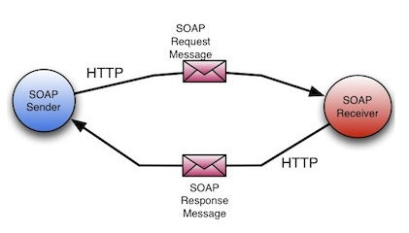
SOAP
SOAP (Simple Object Access Protocol) is a protocol specification for exchanging structured information in the implementation of web services in computer networks
SOAP relies on XML as its message format and uses HTTP for message transmission

Slide 12

WSDL

Slide 13
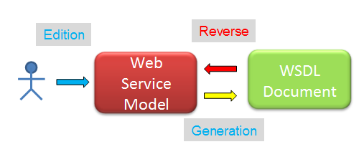
WSDL
WSDL (Web services description language) provides a standard for Web services
That standard specifies to the client:
what kind of messages it accepts
what results will be returned
Is an XML-based language

Slide 14

Creating Web Services

Slide 15
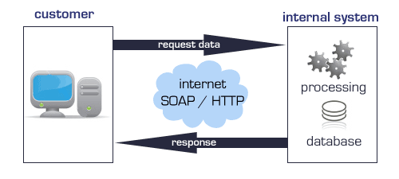
Consuming Web Services

Slide 16

Summary
What is Web hosting?
What is IIS?
How to create Virtual Directories?
How to deploy web applications?
Web Service Development
What is SOAP
What is WSDL
How to create Web Services?
How to consume Web Services?

Slide 17








Questions
https://softuni.bg/courses/javascript-applications/

