Slide 1

iCAR+100 Intelligent Car for medical and police support

Slide 2
Backgroud
Understanding the causes of deaths by “three delays” model in case of car accident:
Delay in recognizing danger signs/decision to seek care.
Delays in reaching a medical facility, and
Delay in receiving appropriate care once a facility is reached.

Slide 3
Goal
Demonstrate the practical application of real time monitoring of car health which results in saving passenger’s lives using multiple ECUs.

Slide 4
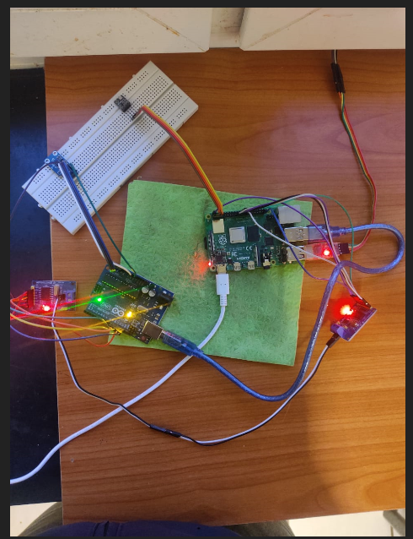
Hardware

Slide 5
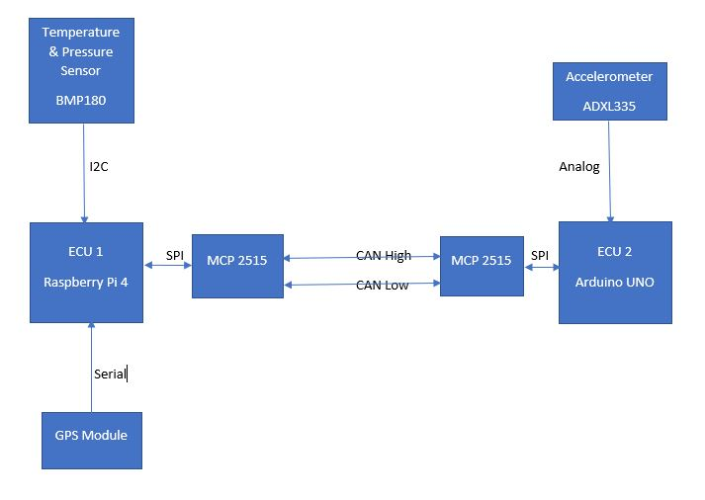
Block Diagram

Slide 6
Transmission technology used
CAN Protocol based communication(Two Wire)
I2C Protocol
Serial Communication
SMT protocol
Analog communication using ADC
SPI protocol

Slide 7
CAN Protocol : Backbone of this project
Developed by Robert bosch in 1985 and standardized to ISO-11898
CAN protocol implemented at Data link layer and Physical layer.
NRZ coding techniques is used.
For arbitration process, CSMA/CA + AMP is used.
To handle fault there are three states: Error passive, Error active and BUS OFF

Slide 8
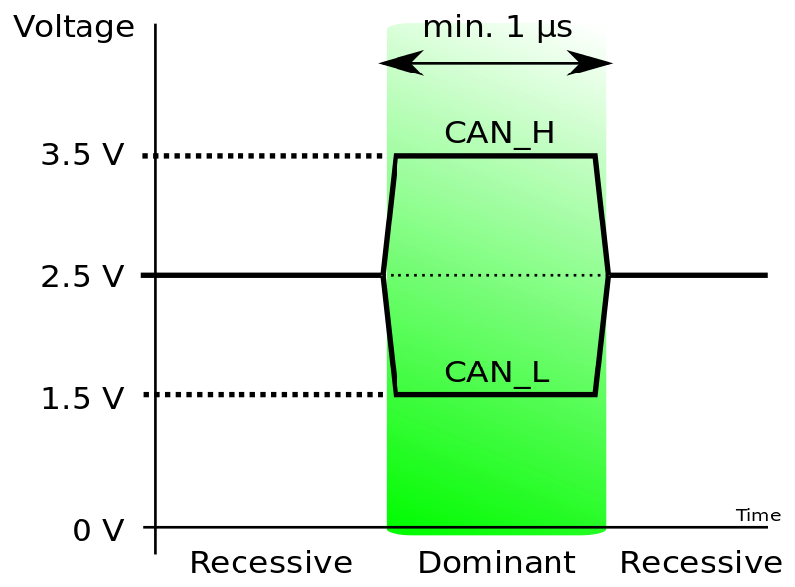
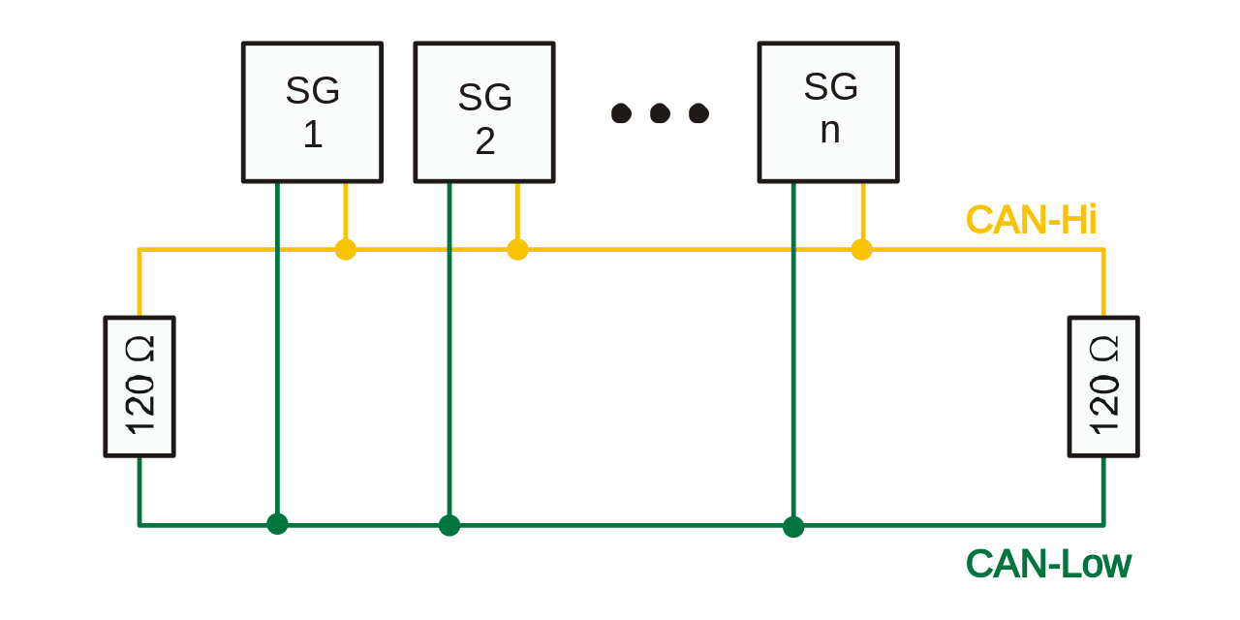
Signal bits and Can bus

Slide 9
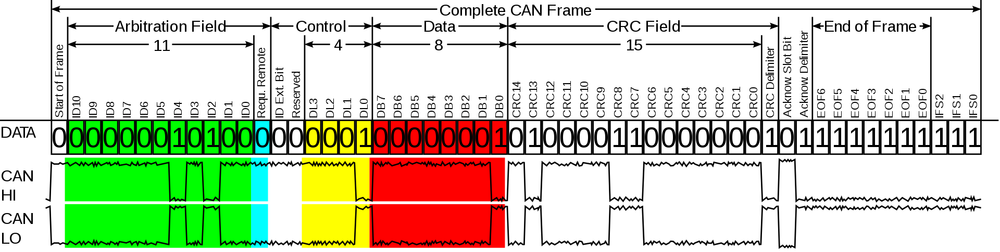
Standard CAN frame

Slide 10
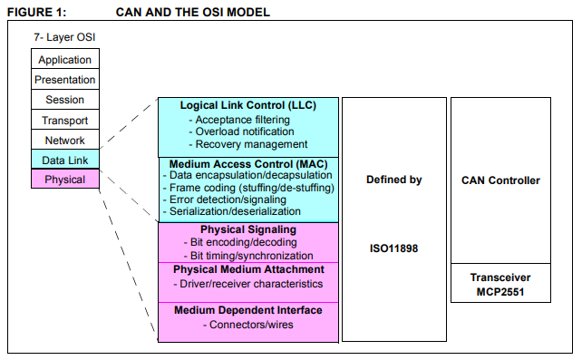
CAN OSI model

