Slide 1


Design engineering-1
L.D.COLLEGE OF ENGINEERING
PROJECT ON:-
(ULTRASONIC OBJECT FOR BLIND PEOPLE)
SUBMITTED BY:
SR. | STUDENT NAME | EN. NO.
1. | TUSHAR PRAJAPATI | 190280103059
2. | GOPAL SHANKHAT | 190280103067
3. | SMIT PATEL | 190280103053
4. | SMIT MAKWANA | 190280103023
FACULTY GUIDE:
PROF. Pooja Gohel

Slide 2
Ultrasonic object Detection glove
Design Engineering
PROF. Pooja Gohel
(Faculty Guide)

Slide 3
Group details :-
1. Group Members:- •Tushar prajapati (190280103059) •Gopal shankhat (190280103067) •Smit patel(190280103053) •Smit makvana(190280103023) 2. Div:- S 3. Branch:- Biomedical Engineering 4. Semestar:- 4’th 5. Team Id :- 291179 6. Subject :- Design Engineering 7. College:- Ld College Of Engineering

Slide 4
1. Introduction :-
Third eye for blinds is an innovation which helps the blind people to navigate with speed and confidence by detecting nearby obstacles using the help of ultrasonic waves and notify them with buzzer sound or vibration. They only need to wear this device as a band or cloth

Slide 5
2. Canvas of design engineering 1 :-
AEIOU canvas
Empathy canvas
Ideation canvas
Product development canvas
Mind mapping

Slide 6
Aeiou canvas :-
Activities
Especially for blind people
Ultrasonic sensor
transmitter send ultrasonic waves
Receiver recive the ultrasonic waves
Navigate blind people
Environment
Wireless device
Safe navigation
Hospital
Blind people can use every place
Interaction
Doctor
Nurse
Blind people
And other people
Object
Arduino
Ultrasonic sensor
Battery
Buzzer
Switch
Users👥
Blind people can use

Slide 7
Ideation Canvas :-
Activity
Especially for blind people
Ultrasonic sensor
Transmitter send ultrasonic waves
Receiver recive the ultrasonic waves
People
Doctor
Nurse
Blind people
Situation/Context/Location
Navigate the blind people
Guide user while walking
Navigate safely and easily every place
Props/solution
This device to help blind people walk
Estimate the distance From obstacles
Daily and routine life being easy for blind people

Slide 8
Empathy canvas :-
Users
Blind people
General people
Stakeholders
Blind student
Blind people
General people
Activity
Navigate blind people
It can make the life of blind people easier

Slide 9
Empathy canvas :-
Story boarding:
1.Happy: So the aim of the project is to develop a cheap and more efficient way to help visually impaired to navigate with greater comfort, speed and confidence. And his daily life becomes easier and he can travel easily
2.sad: This project only used for blind people , who get affected in their daily life problems . Limitation of this project is that it only notifies with the buzzer sound or Vibration by devices . It is because blind people only can understand by vibes around them .

Slide 10
Products development canvas:-
Purpose:
• blind people are suffering a lot of harder ship in there daily life.
•So the aim of the project is to develop a cheaper and more efficient way to help visually impaired to navigate with greater comfort, speed and confidence.
People:
Blind people
Blind student
Visually impaired people
Function:
To navigate visually impaired people easily
Makes the traveling of blind people easier
Features:
Low design time.
Low production cost.
This system is applicable for both the indoor and outdoor environment.
Less space .
Low power consumption.

Slide 11
Product development canvas :-
Reject/Redesign/Retain
Setting distance very easily
It is dynamic system
This device cannot work out of range
Costumers revalidation:
Make easy routine life for blind people
Feeling comfortable
Take quick decisions
Components:
Arduino
Ultrasonic sensor
Buzzer
Battery
Switch
Jumper wires

Slide 12
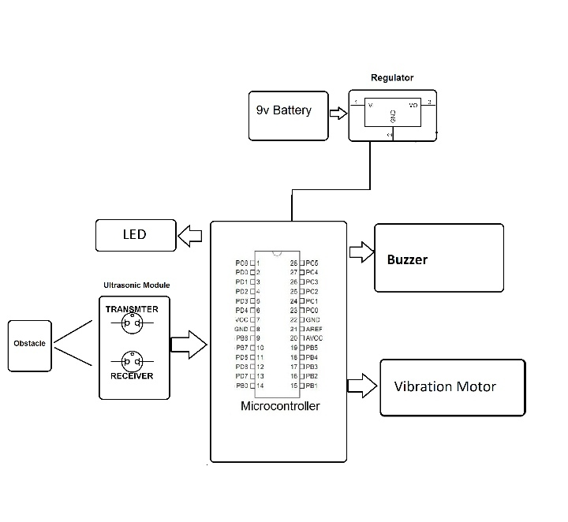
8. block DIAGRAM

Slide 13
Thank you.

