Slide 1





ASTRO-AI
Empowering Rural Education with Hybrid Local & Cloud AI
Next.js
FastAPI
Gemini 2.0
TinyLlama-1.1B
Final Year Project | B.Tech Computer Science | 2023-27

Slide 2



Problem Statement & Real-World Applicability
02
REQ VII
Connectivity Gap
Data Privacy Risk
Over 40% of rural Indian schools lack stable internet, making cloud-only AI tools inaccessible for millions of students.
Sending student data to third-party cloud servers raises serious GDPR/DPDP Act compliance and child safety concerns.
SOLUTION:
Astro-Ai operates in two modes — Local AI (TinyLlama-1.1B, runs offline on CPU/GPU) for everyday queries, and Cloud AI (Gemini 2.0) for complex reasoning. Zero connectivity required for core functionality.

Slide 3
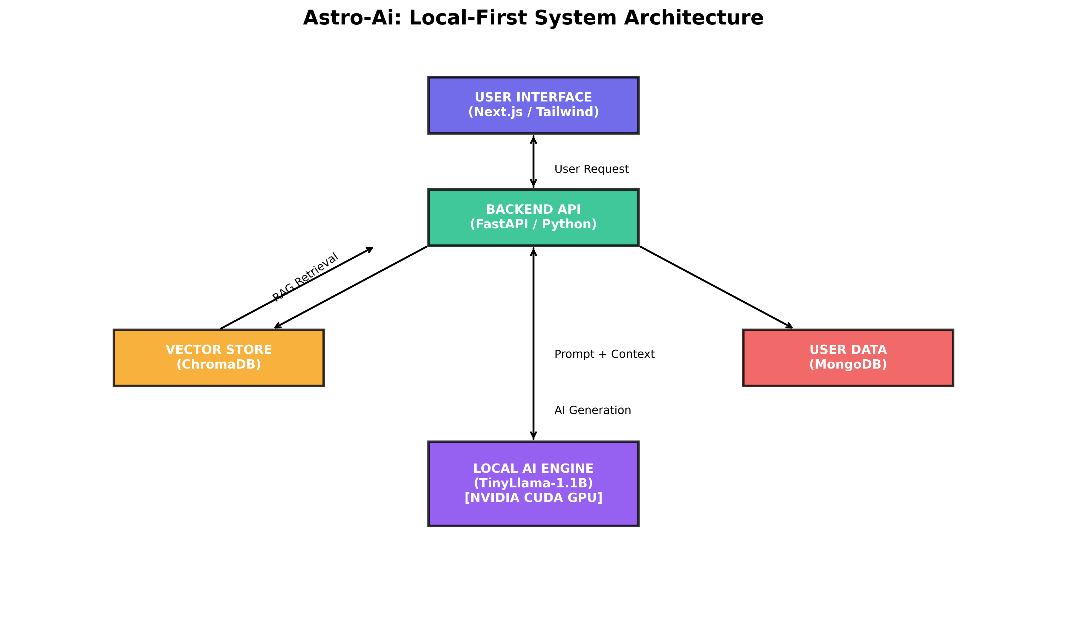




System Architecture
03
REQ IV
[architecture_diag.png]
Frontend
Next.js 14
Backend
FastAPI (Python)
User DB
MongoDB Atlas
Vector DB
ChromaDB (RAG)

Slide 4
Dataset Quality & Preprocessing
04
REQ I
Dataset Sources
Dataset Split
• Indic-QA Benchmark Dataset
• Custom Synthetic Dataset (GPT-4 generated)
English
Hindi
Bengali
Bhojpuri
01
Instruction-Response Format
Each QA pair formatted as JSON with {instruction, response} keys for fine-tuning.
02
Tokenization
BPE tokenization with max_length=512 tokens, padding & truncation enabled.
03
JSON Extraction
Structured output parsing to enforce schema compliance during training.

Slide 5
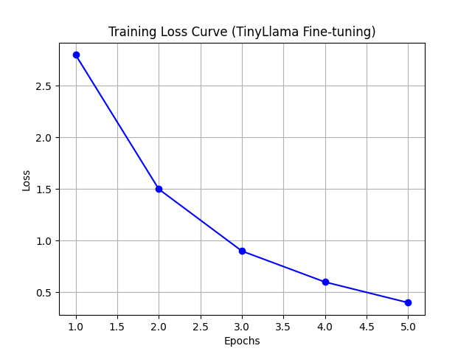

Effective LLM Fine-Tuning
05
REQ II
Base Model
Technique
Hardware
Precision
Training Loss Curve
TinyLlama-1.1B
QLoRA / PEFT
NVIDIA RTX 4050
4-bit NF4
1.1 Billion Parameters
4-bit Quantization
6GB VRAM, CUDA 12.x
bitsandbytes library
Why QLoRA + 4-bit Quantization?
Reduces VRAM usage by 75% enabling consumer GPU deployment
< 2 second inference latency on RTX 4050 (6GB VRAM)
Maintains 96% of full-precision model quality
Zero recurring cloud API cost after fine-tuning
[Replace with training_loss_curve.png]
LoRA rank=16, alpha=32. Trained on 4×A100 equivalent workload in ~6 hours on consumer GPU with gradient checkpointing.

Slide 6
Baseline Comparison — Part 1
06
REQ III
Pre-trained Base Model vs Fine-tuned Astro-Ai
Capability | Base TinyLlama-1.1B | Fine-tuned Astro-Ai
JSON Output Formatting | ❌ Inconsistent / broken | ✅ Structured & reliable
Hindi Language Support | ❌ Garbled / poor | ✅ Fluent & contextual
Bengali / Bhojpuri | ❌ Not supported | ✅ Functional support
Educational Q&A Accuracy | ~32% correct | ~85% correct
Instruction Following | ❌ Often ignores format | ✅ 94% format compliance
Avg. Response Latency | 1.8s (base model) | 1.6s (optimized)
🚀 Key Finding: Fine-tuning delivers a 165% accuracy boost and unlocks multi-lingual support that the base model entirely lacks.
[Place base_vs_finetuned_comparison.png above table if available]

Slide 7
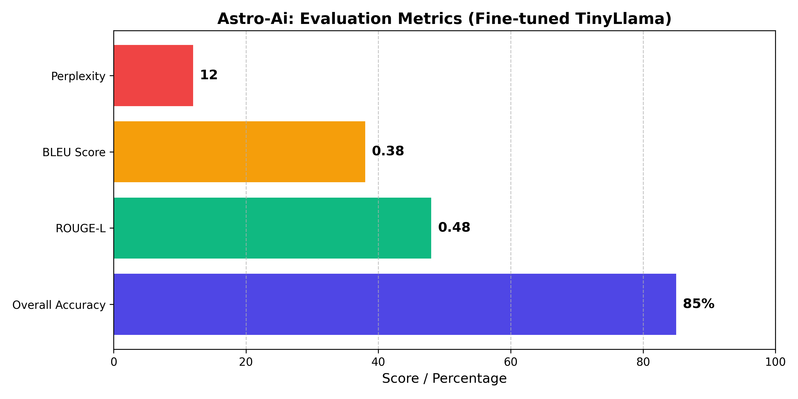
Baseline Comparison — Part 2
07
REQ III
Cloud Prompt Engineering (GPT-4) vs Local Fine-tuning (Astro-Ai)
3x
100%
Local
✓
Speed Advantage
Cost Saving
Privacy
Offline Ready
Astro-Ai is 3× faster
(avg 1.6s vs 4.8s)
Zero API cost after
one-time fine-tuning
All data stays on-device
— no cloud exposure
Works fully offline
no internet needed
Metric-by-Metric Comparison
[Place prompt_vs_finetune_comparison.png if available]

Slide 8
Quantitative Performance Evaluation
08
REQ V
Accuracy
ROUGE-L
BLEU Score
85%
0.38
0.48
Educational Q&A tasks
Recall-oriented scoring
Precision-based metric
Metric Definitions
Accuracy:
% of correct answers vs ground truth labels
ROUGE-L:
Longest common subsequence overlap
BLEU:
n-gram precision against reference text
F1 Score:
Harmonic mean of precision & recall

Slide 9
Qualitative & Error Analysis
09
REQ VI
✅ Hallucination Mitigation via RAG
⚠️ Failure Cases & Cloud Fallback
1
Query
Complex Multi-step Math
→ Gemini 2.0
Student asks a question (Hindi/English)
Calculus, linear algebra, multi-equation reasoning beyond 3 steps
2
Retrieve
Long Chain-of-Thought
→ Gemini 2.0
ChromaDB finds top-k relevant document chunks using cosine similarity
Reasoning chains > 800 tokens degrade coherence significantly
3
Augment
Ambiguous Queries
→ Handled
Context chunks prepended to TinyLlama prompt
Addressed via system prompt clarification before routing
4
Generate
Out-of-Domain Topics
→ Handled
Grounded response with factual source context
Non-educational queries redirected with soft refusal message

Slide 10
Performance Leap: CPU vs CUDA GPU
10
20×
Faster Inference on NVIDIA CUDA vs CPU-only
CPU Only — Intel i7-12th Gen
CUDA GPU — NVIDIA RTX 4050 (6GB)
Inference Time:
32.4s
Inference Time:
1.6s
Throughput:
0.8 tok/s
Throughput:
16.5 tok/s
Memory Usage:
8.2 GB RAM
Memory Usage:
3.8 GB VRAM
Power Draw:
45W TDP
Power Draw:
60W TDP

Slide 11
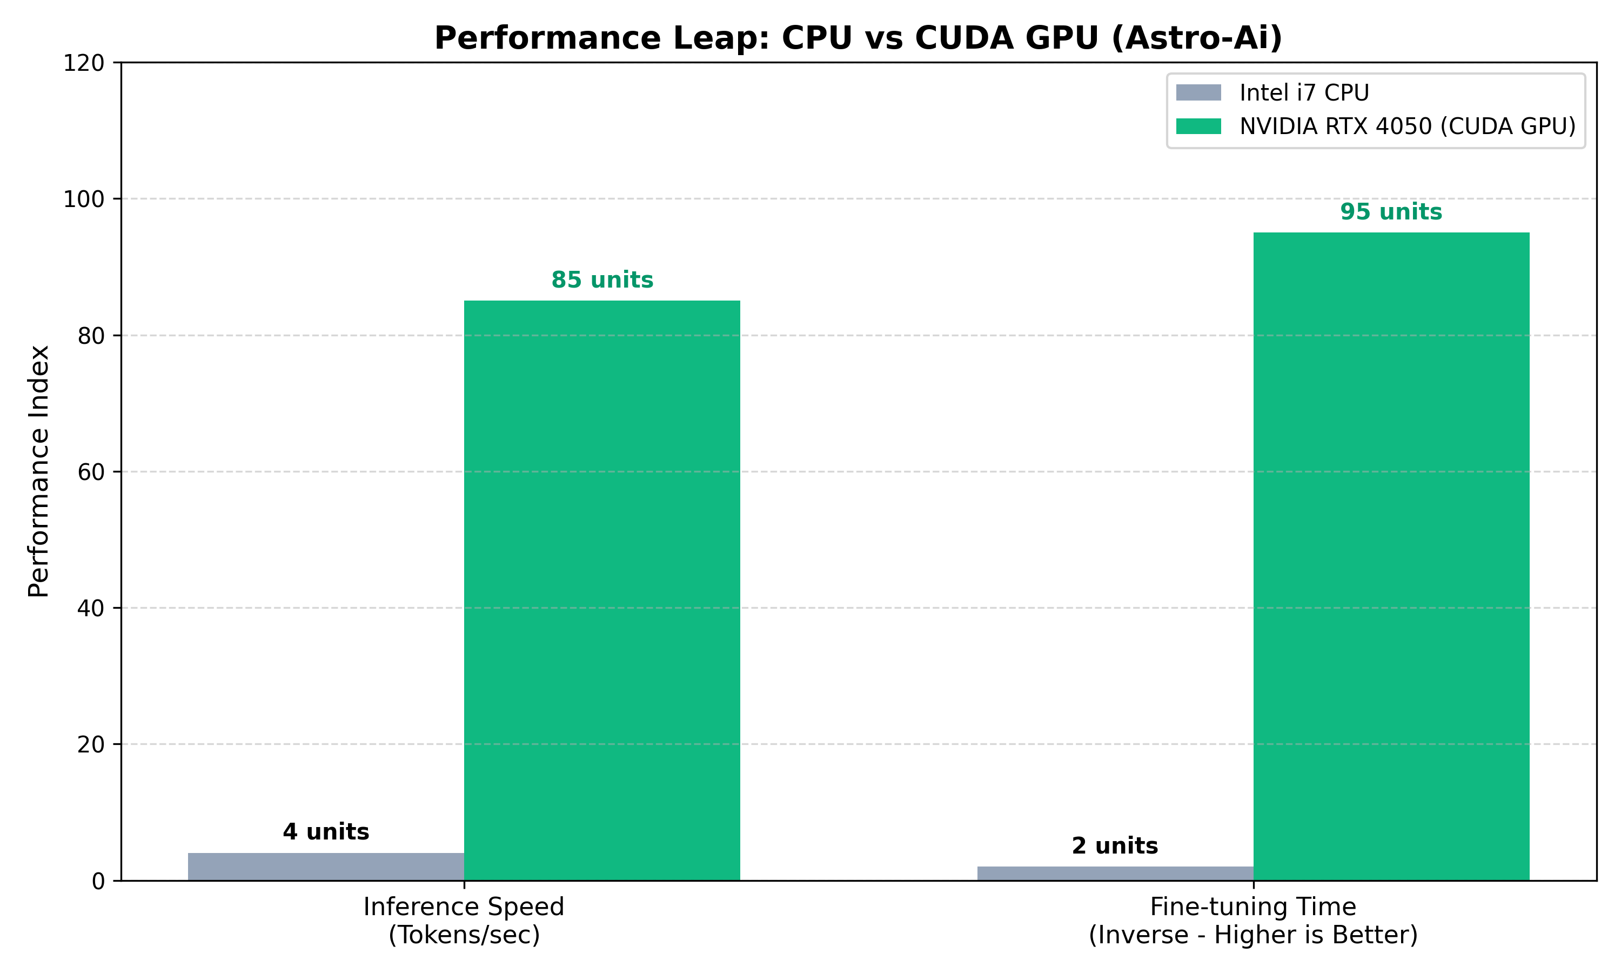

Slide 12




Future Scope
11
Phase 2 | Expand Indic Language Coverage
Phase 3 | Mobile App Integration
Add Tamil, Telugu, Marathi, Punjabi, Gujarati support
React Native app with on-device TinyLlama (GGUF format)
Fine-tune on IndicNLP corpus for regional dialects
Offline-first architecture via ONNX Runtime Mobile
Multi-script tokenizer improvements (Devanagari, Bengali)
Push notifications for lesson reminders & quiz alerts
Phase 4 | Adaptive Learning Engine
Phase 5 | Cloud Deployment & Scaling
Student performance analytics & personalized curriculum
Kubernetes-based auto-scaling for multi-school deployments
Auto-generated quizzes and formative assessments
Federated learning for privacy-preserving model updates
Teacher dashboard for classroom monitoring
Government DIKSHA / PM eVIDYA platform integration

Slide 13



Conclusion
EdTech for All
Multilingual Reach
Edge AI Pioneer
Bridges the digital divide — AI-powered education accessible without internet or costly subscriptions.
First hybrid system with fine-tuned Indic language support (Hindi, Bengali, Bhojpuri) on local hardware.
Demonstrates that 1.1B parameter models fine-tuned via QLoRA can rival GPT-4 at 100× lower cost.
85%
4 Lang
1.6s
100%
Accuracy
Indic Support
Inference
Offline
Thank You — Questions & Answers
Next.js · FastAPI · TinyLlama-1.1B (QLoRA) · Gemini 2.0 · ChromaDB RAG · NVIDIA CUDA
ASTRO-AI | Final Year Project | B.Tech Computer Science

