Slide 1
MATHEMATICS
VECTORS

Slide 2
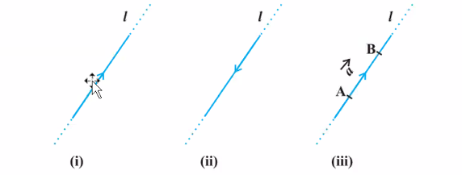
vectors
Quantity that has a magnitude as well as direction is called a vector.
In the image the point A from where the vector starts is called its initial point, and the point B where it ends is called its terminal point. The distance between initial & terminal points of a vector is called the magnitude( or length ) of the vector, denoted as a. The arrow indicates the direction of the vector.

Slide 3
POSITION VECTORS.
The position vector is used to specify the position of a certain body. Knowing the position of a body is vital when it comes to describing the motion of that body. The position vector of an object is measured from the origin, in general. Suppose an object is placed in the space .
consider a point p in space, having co-ordinates (x,y,z) with respect to the origin O (0,0,0). Then the vector having O and P as its initial & terminal points, respectively called the position vector of the point P with respect to O .
Position vector (r⃗ )=xi^+yj^+zk^
Where,
i^= unit vector along x-direction
j^= unit vector along y-direction
k^= unit vector along z-direction
So if an object is at a certain point P (say) at a certain time,
its position vector is given as described above.

Slide 4
TYPES OF VECTORS
Unit vectors: A vector which has a magnitude of unit length is called a unit vector. Suppose if x→ is a vector having a magnitude x then the unit vector is denoted by x̂ in the direction of the vector x→ and has the magnitude equal to 1.
Co-initial vectors: The vectors which have the same starting point are called co-initial vectors.
Colinear vectors: Vectors which lie along the same line or parallel lines are known to be collinear vectors. They are also known as parallel vectors.
Equal Vectors: If two vectors a⃗ and b⃗ have the same magnitude and direction regardless of the positions of their initial points, then they are Equal vectors. These vectors are written as a⃗ = b⃗ .
Negative of a Vector : Let’s say that there is a vector AB→ having a certain magnitude and direction. Now, if there is a vector whose magnitude is same as that of vector AB→ but the direction is opposite, then it is called negative of the given vector AB→. For example, vector BA→ is the negative of vector AB→. It is written as BA→ = – AB→.

Slide 5
DISPLACEMENT VECTORS:
The change in the position vector of an object is known as the displacement vector.
Suppose an object is at point A at time = 0 and at point B at time = t.
The position vectors of the object at point A and at point B are given as:
Position vector at point A=rA^=5i^+3j^+4k^
Position vector at point B=rB^=2i^+2j^+1k^
Now, the displacement vector of the object from time interval 0 to t will be:
rB^−rB^=−3i^−j^−3k^
The displacement of an object can also be defined as the vector distance between the initial point and the final point.
Suppose an object travels from point A to point B in the path shown in the black curve:

Slide 6
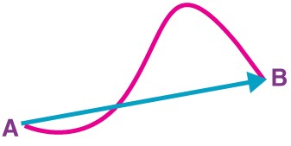
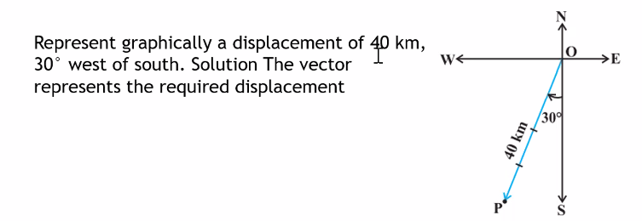
DISPLACEMENT VECTORS:

Slide 7
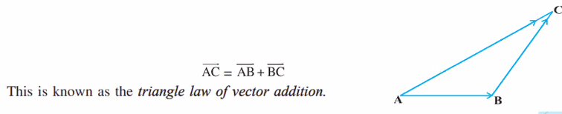
Addition of vectors:
vectors cannot be simply added algebraically.
Following are a few points to remember while adding vectors: Vectors are added geometrically and not algebraically. Vectors whose resultant have to be calculated behave independently of each other. Vector Addition is nothing but finding the resultant of a number of vectors acting on a body. Vector Addition is commutative. This means that the resultant vector is independent of the order of vectors.
The vector addition is done based on the Triangle law. Let us see what triangle law of vector addition is: Suppose there are two vectors: a→ and b→ . Now, draw a line AB representing a→ with A as the tail and B as the head. Draw another line BC representing (b→) with B as the tail and C as the head. Now join the line AC with A as the tail and C as the head. The line AC represent its the resultant sum of the vectors a→ and b→.

Slide 8
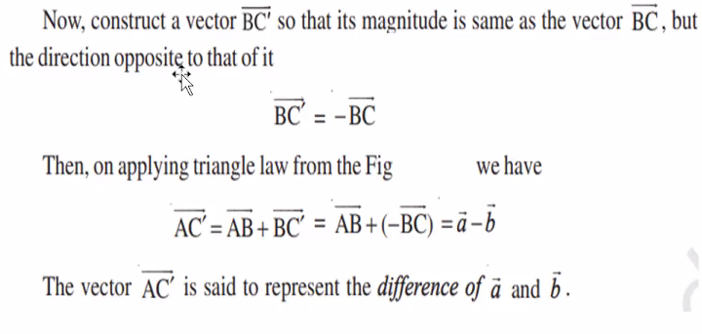
Addition of vectors:

Slide 9

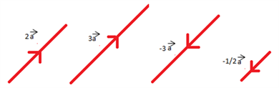
MULTIPLICATION OF VECTORS:
Multiplication of vectors with scalar:
When a vector is multiplied by a scalar quantity, then the magnitude of the vector changes in accordance with the magnitude of the scalar but the direction of the vector remains unchanged.

Slide 10
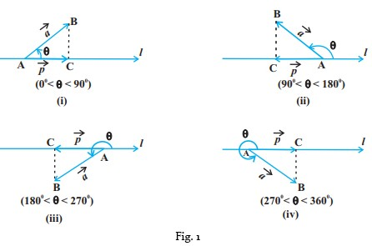
PROJECTION OF A VECTOR ON A LINE
Angle Between Two Vectors
Look at the figures given below:

Slide 11
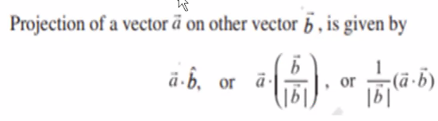
FORMULATION FOR PROJECTION
The equation is written:
We have:
= Projection of the vector a on the vector b
= vector a
= vector b
= product scale between vectors a and b
= module of vector b.

Slide 12
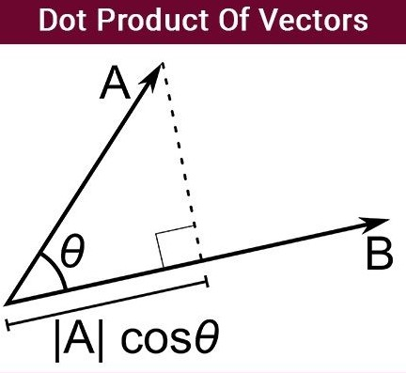
DOT Product OF Two Vectors:
the dot product of two vectors is the product of the magnitude of the two vectors and the cos of the angle between them.
Formulae :
a.b = ax * bx + ay * by

Slide 13
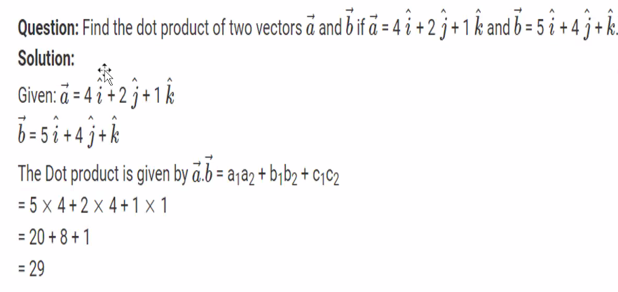
EXAMPLE ON DOT PRODUCT:

Slide 14
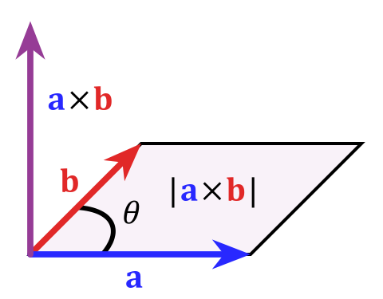
cross Product OF Two Vectors:
Let us assume that →aa→ and →bb→ are two vectors, such that →aa→= a1^i+a2^j+a3^ka1i^+a2j^+a3k^ and →bb→ = b1^i+b2^j+b3^kb1i^+b2j^+b3k^ then by using determinants.

Slide 15
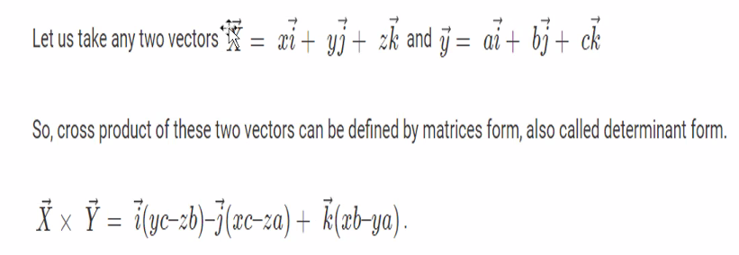
CROSS PRODUCT OF TWO VECTORS:

Slide 16
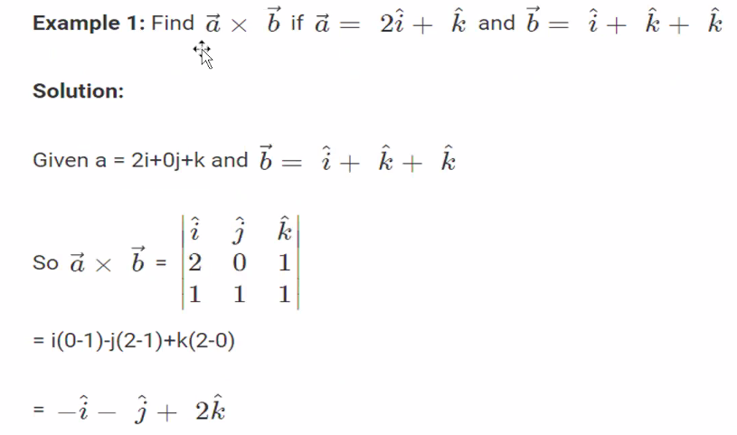
Example on cross vector:

Slide 17
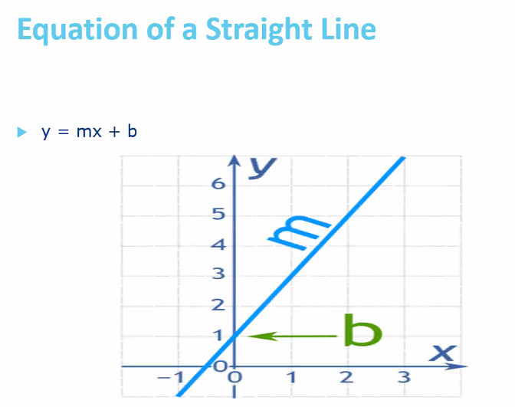
EQUATION OF A LINE:

Slide 18
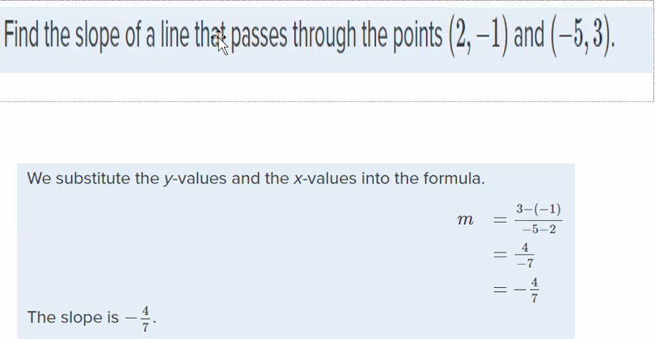
SLOPE M:
The slope of a line m , represents the change in y over the change in x. Given two points, (x1, y1) and (x2, y2), the following formula determines the slope of a line containing these points.
m = y2 – y1 / x2 – x1

Slide 19
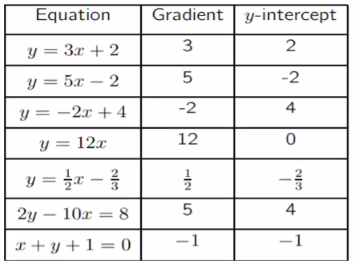
SLOPES OF M:

Slide 20
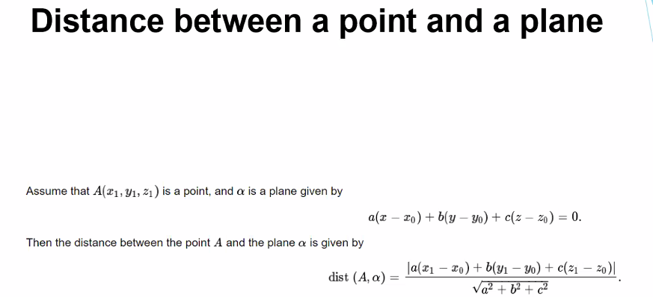
PLANE:

Slide 21
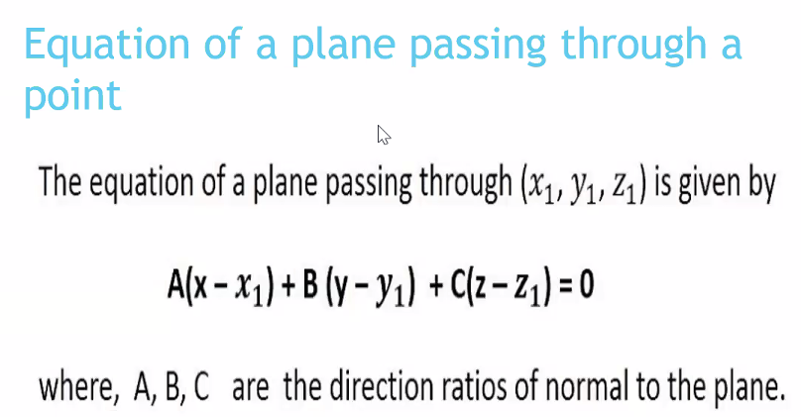
plane & Equation:

Slide 22
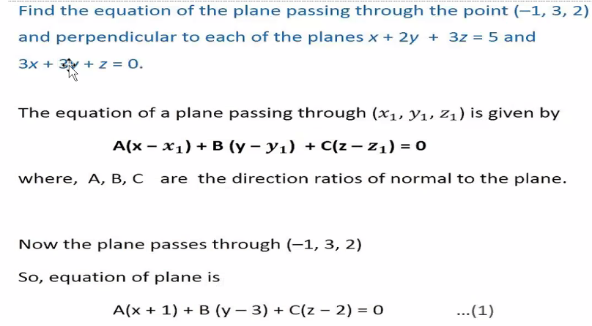
Examples on p-lane & equation:

Slide 23
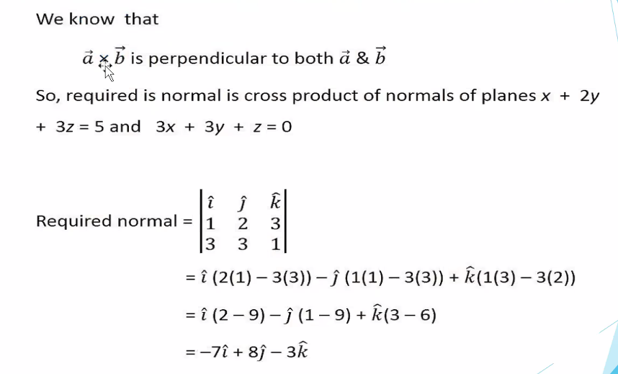
Examples on p-lane & equation:

Slide 24
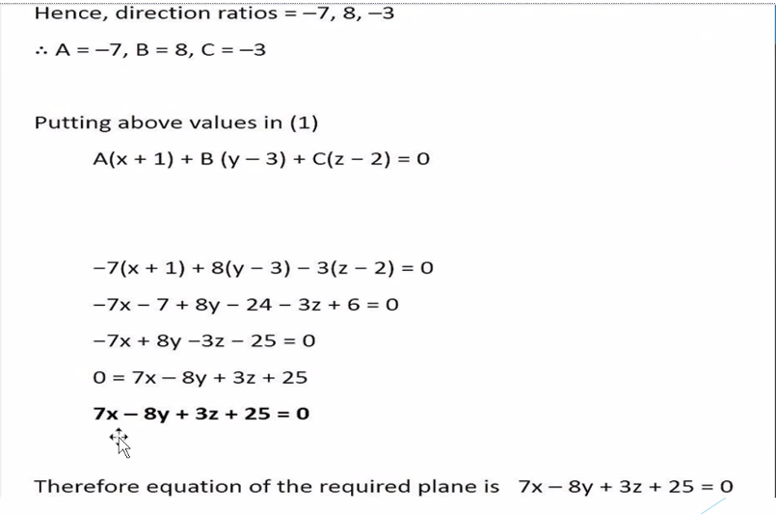
Examples on p-lane & equation:

