Slide 1
Detail Visual Analysis
BY: Tushar Goel
Bds batch
25 may

Slide 2
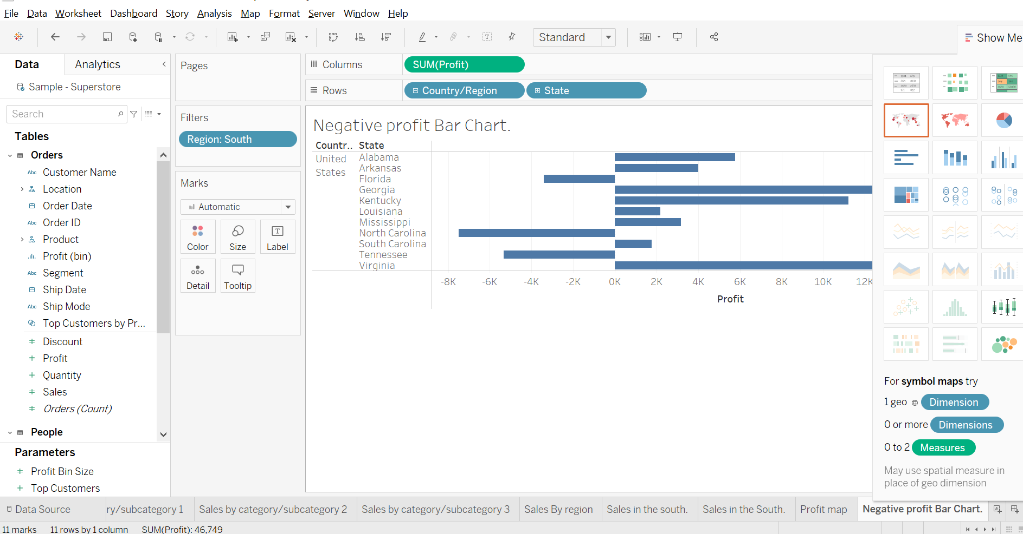
Represent the profit map in horizontal bar format.

Slide 3
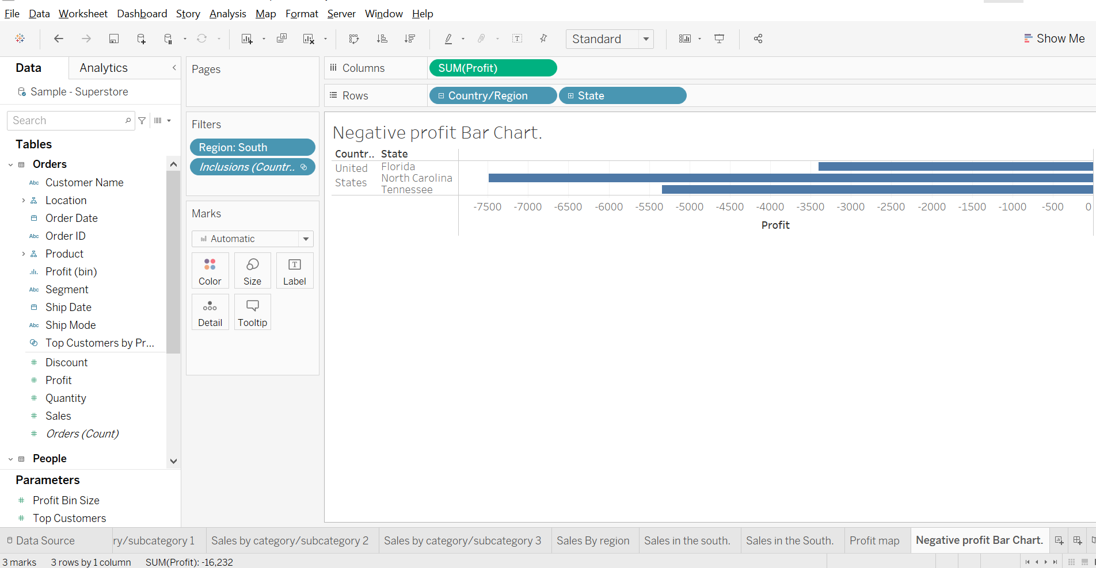
Show only the states having negative profit in the bar graph.

Slide 4
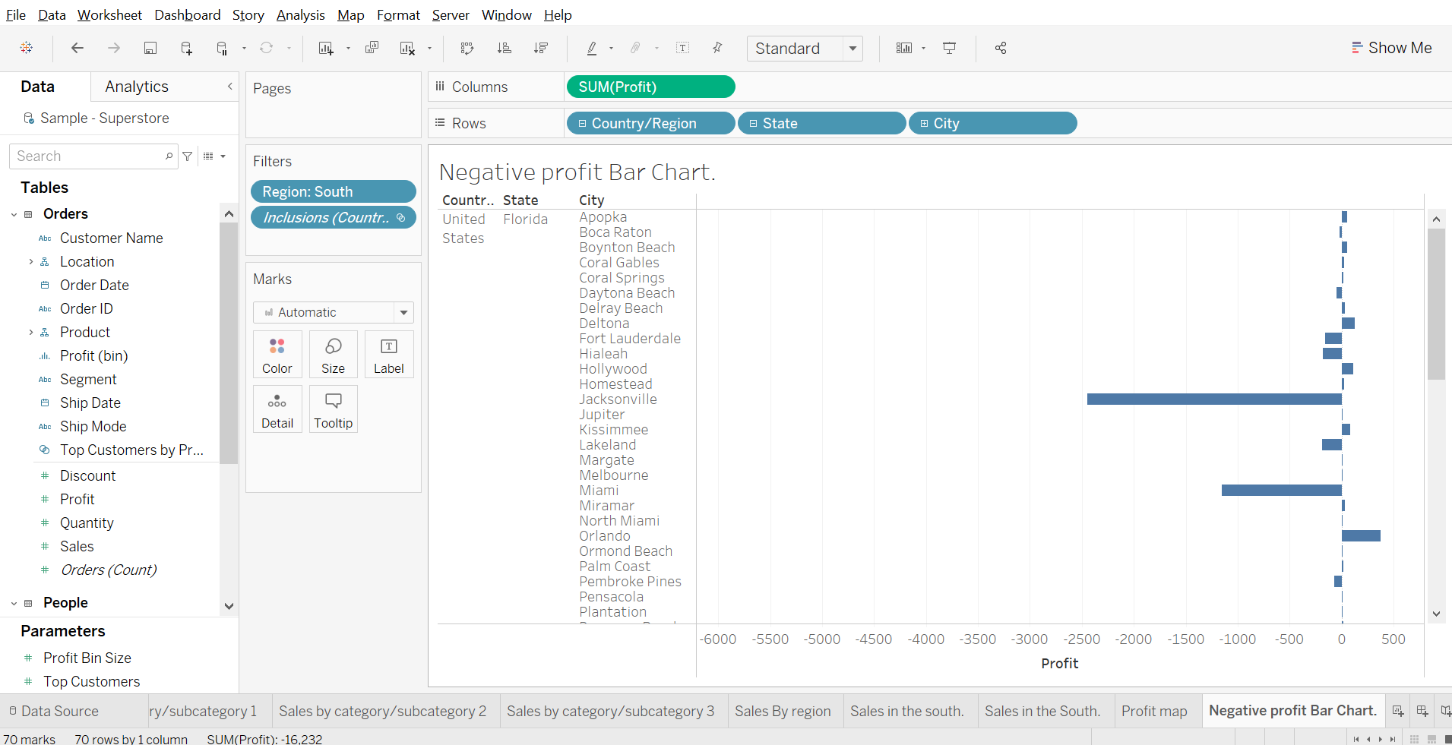
On the Rows shelf, click the plus icon on the State field to drill-down to the City level of detail.

Slide 5
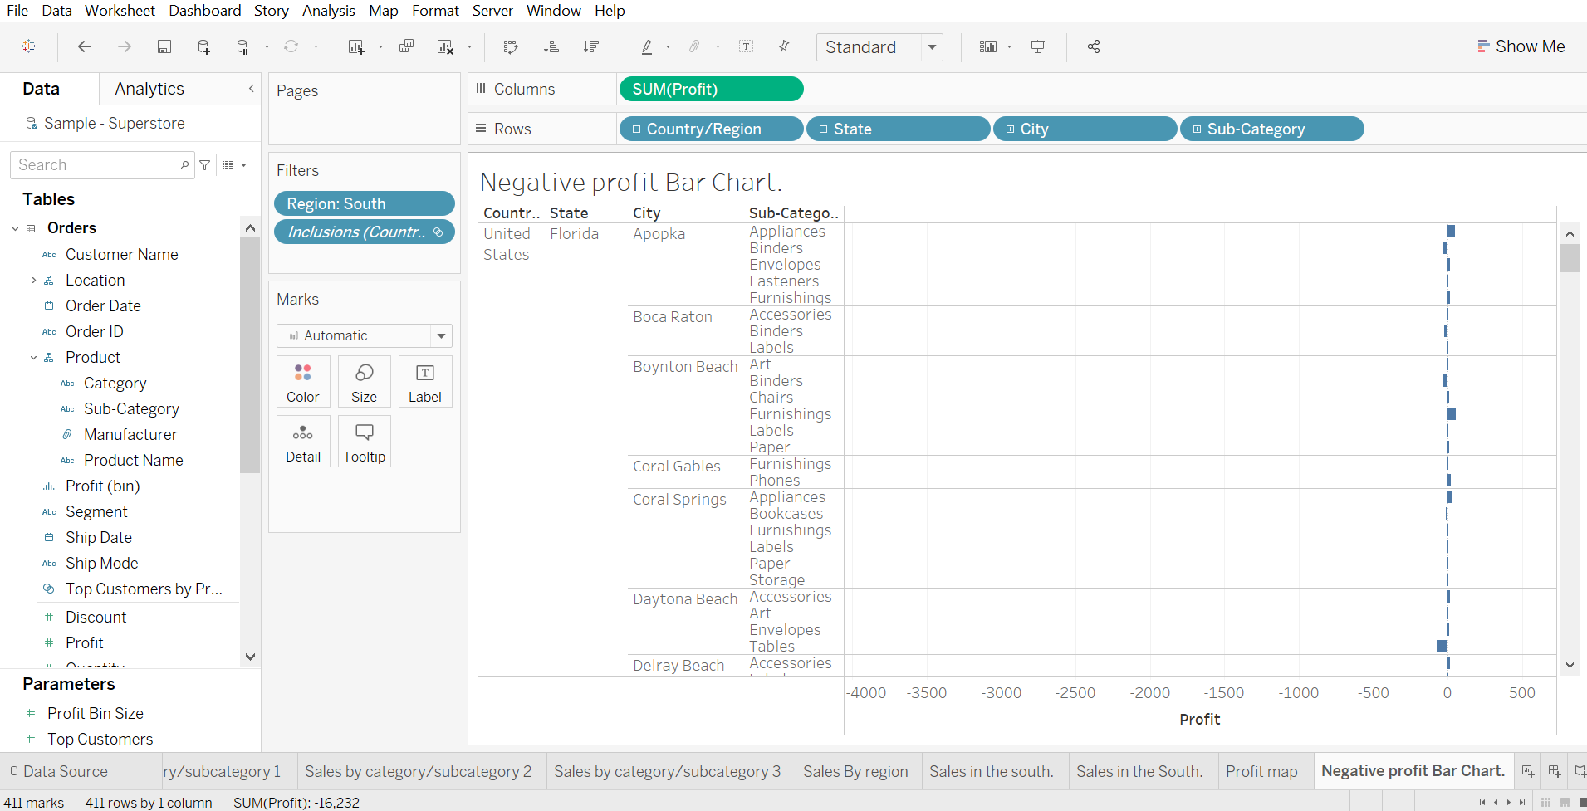
Show the profit, subcategory wise also.

Slide 6
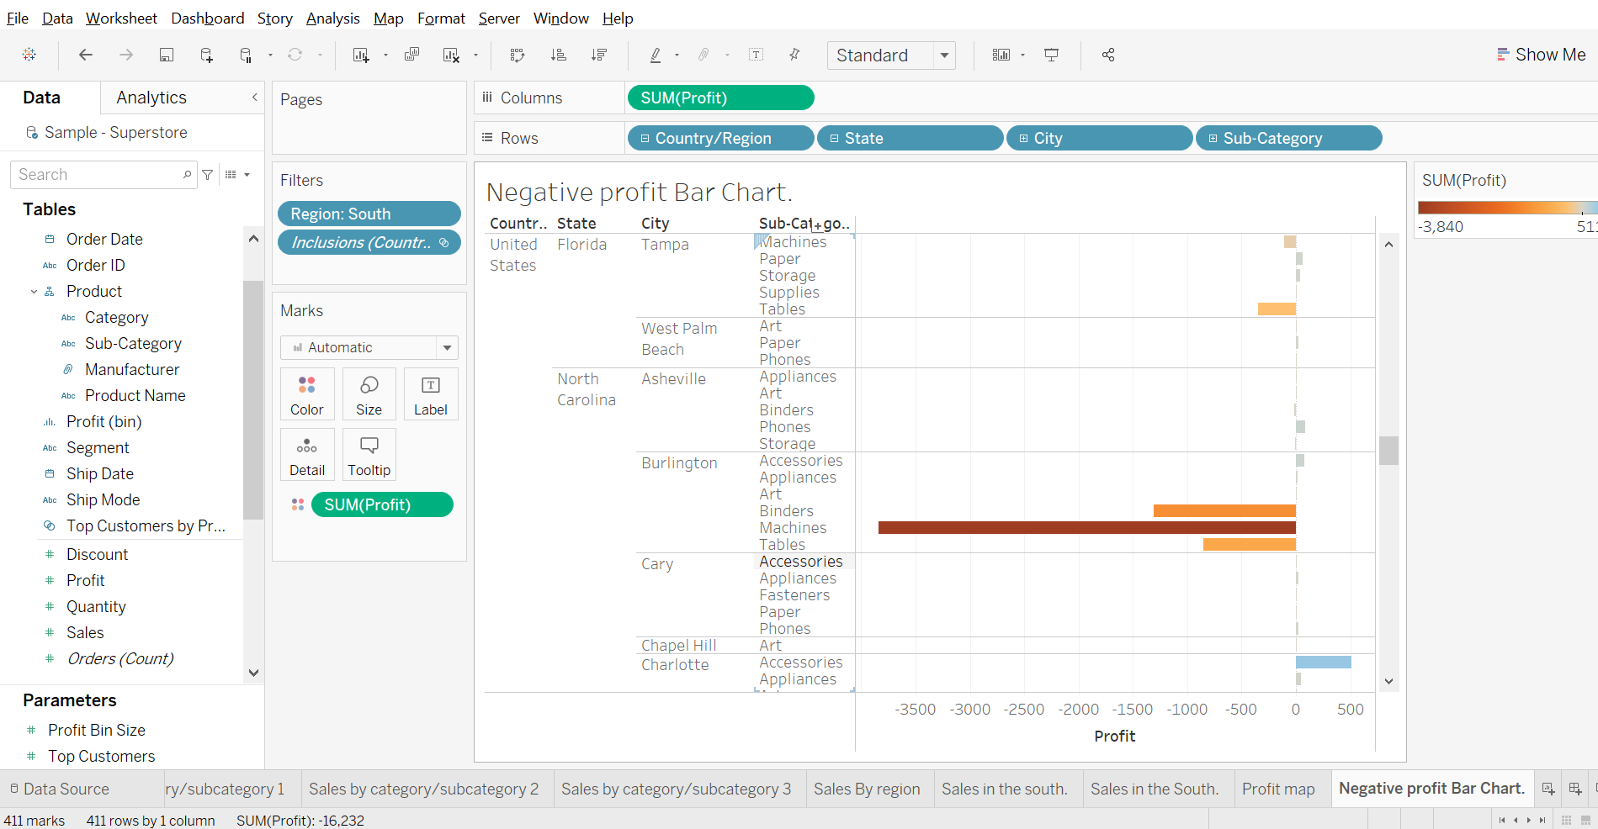
Show the profit in different color.

Slide 7
Provide information about the product having highest negative profit for all 3 states.
Here in this Florida has the highest negative profit & its machine sub-category
Here In north Carolina the highest negative profit is of machine sub-category.
Here in Tennessee the highest negative profit is of binders sub-category.

Slide 8
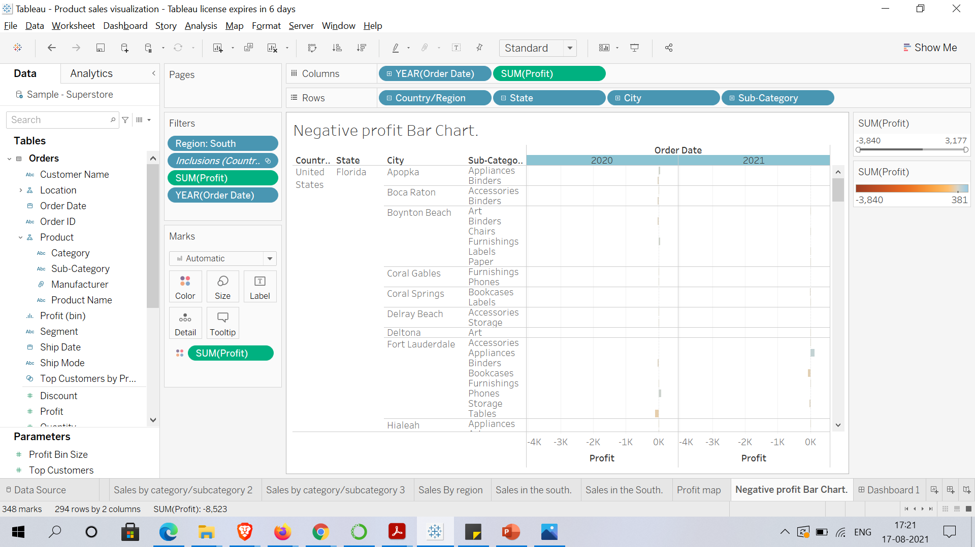
Check the profit in 2020 & 2021.

