Slide 1
Tableau Dashboard.
BY:TUSHAR GOEL
BDS BATCH
25 MAY

Slide 2
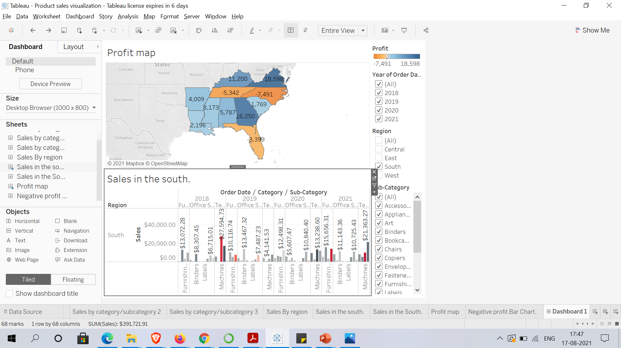
Build dashboard using the worksheets ‘profit map’ and ‘sales in the south’ to show some insights.

Slide 3
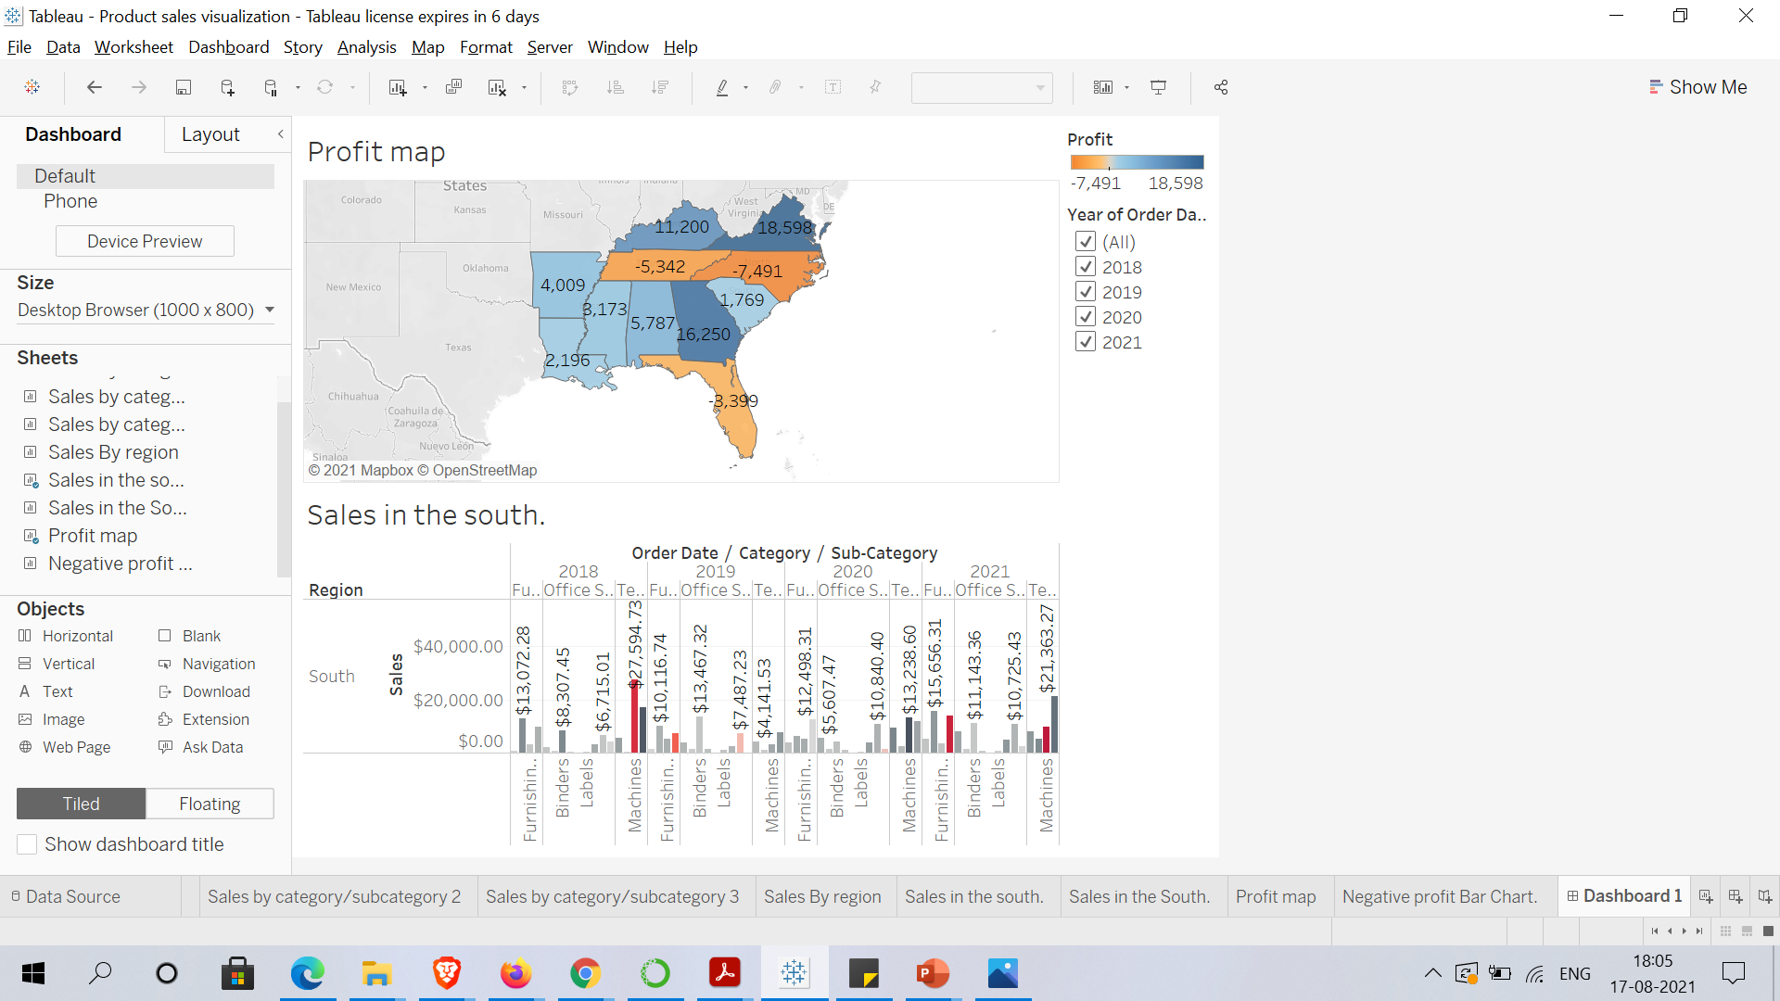
Remove the subcategory filter and other filters except ‘Year of order date’ option to vacate the space.

Slide 4
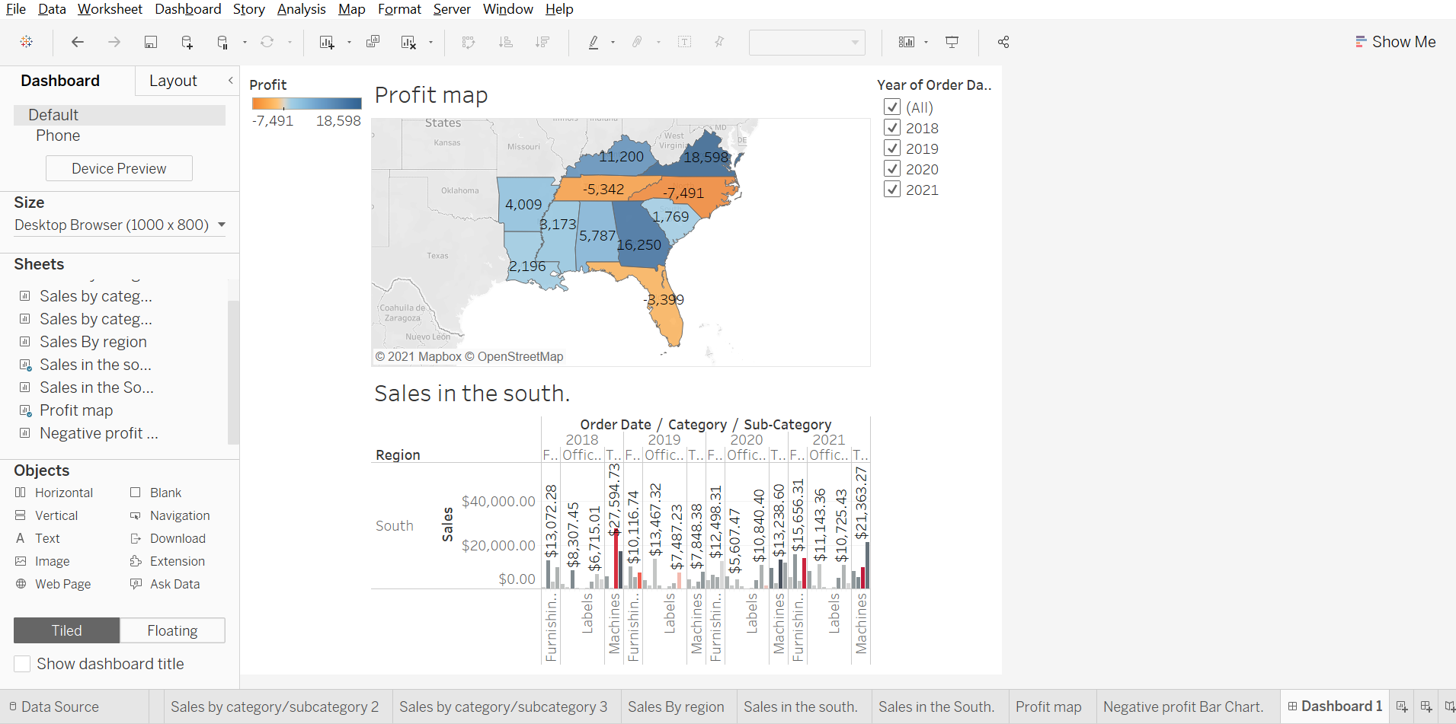
Select Profit color legend and drag it to Sales in the South.

Slide 5
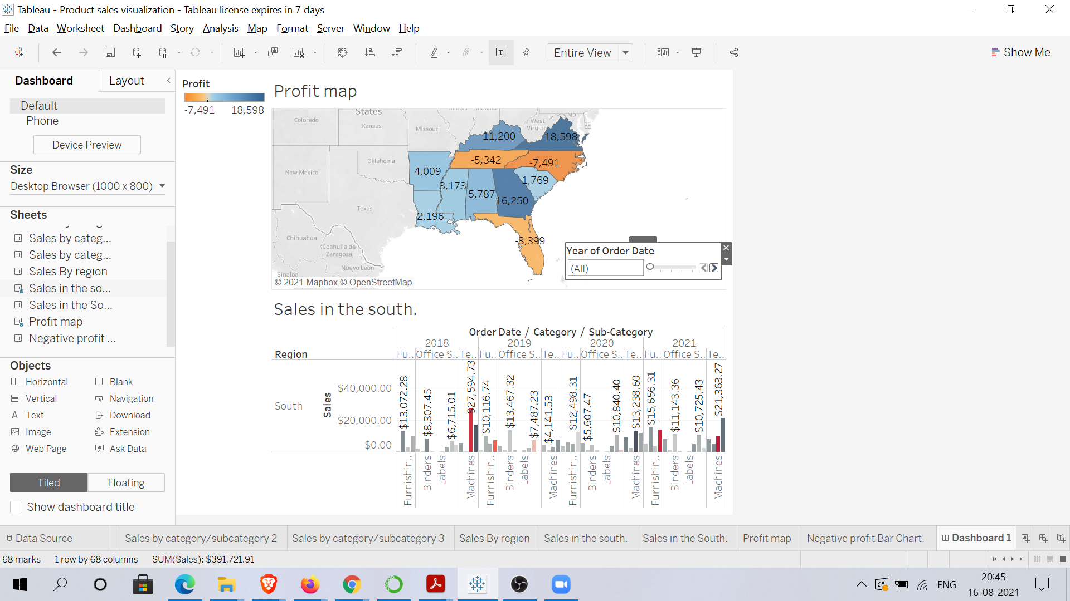
Create a slider for order of date filter.

Slide 6
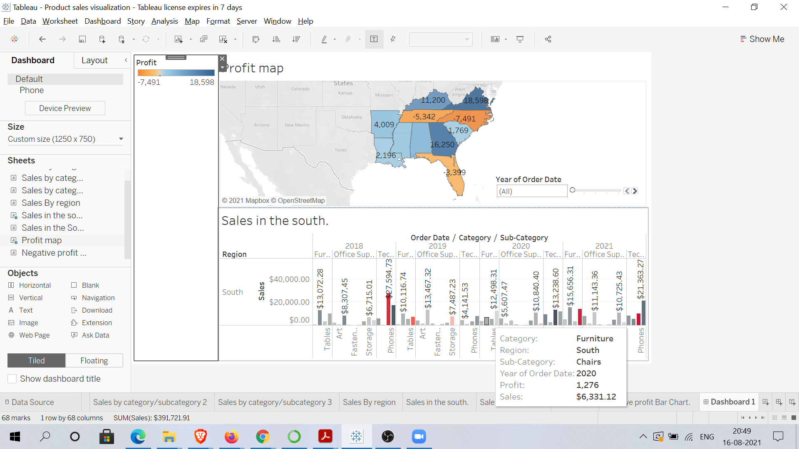
Resize your dashboard and make it 1250px wide by 750px length.

Slide 7
Make your dashboard interactive.

Slide 8
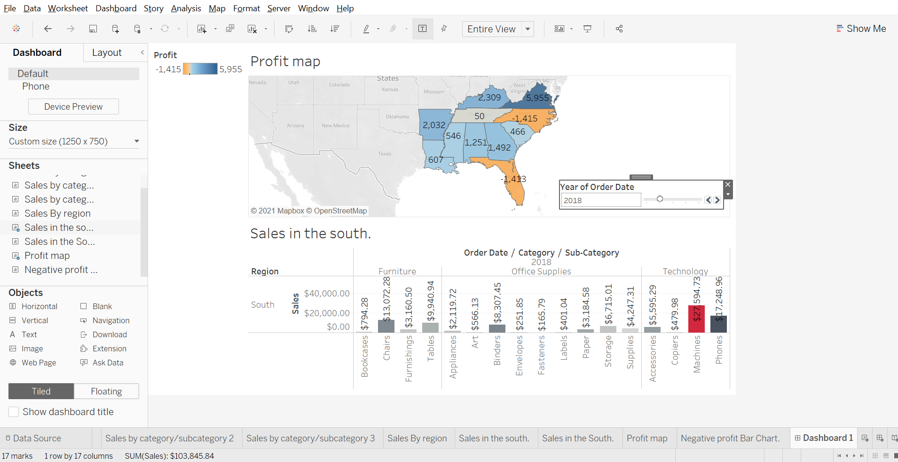
Show change in profits in the profit map based on the order date in your in your interactive dashboard.

Slide 9
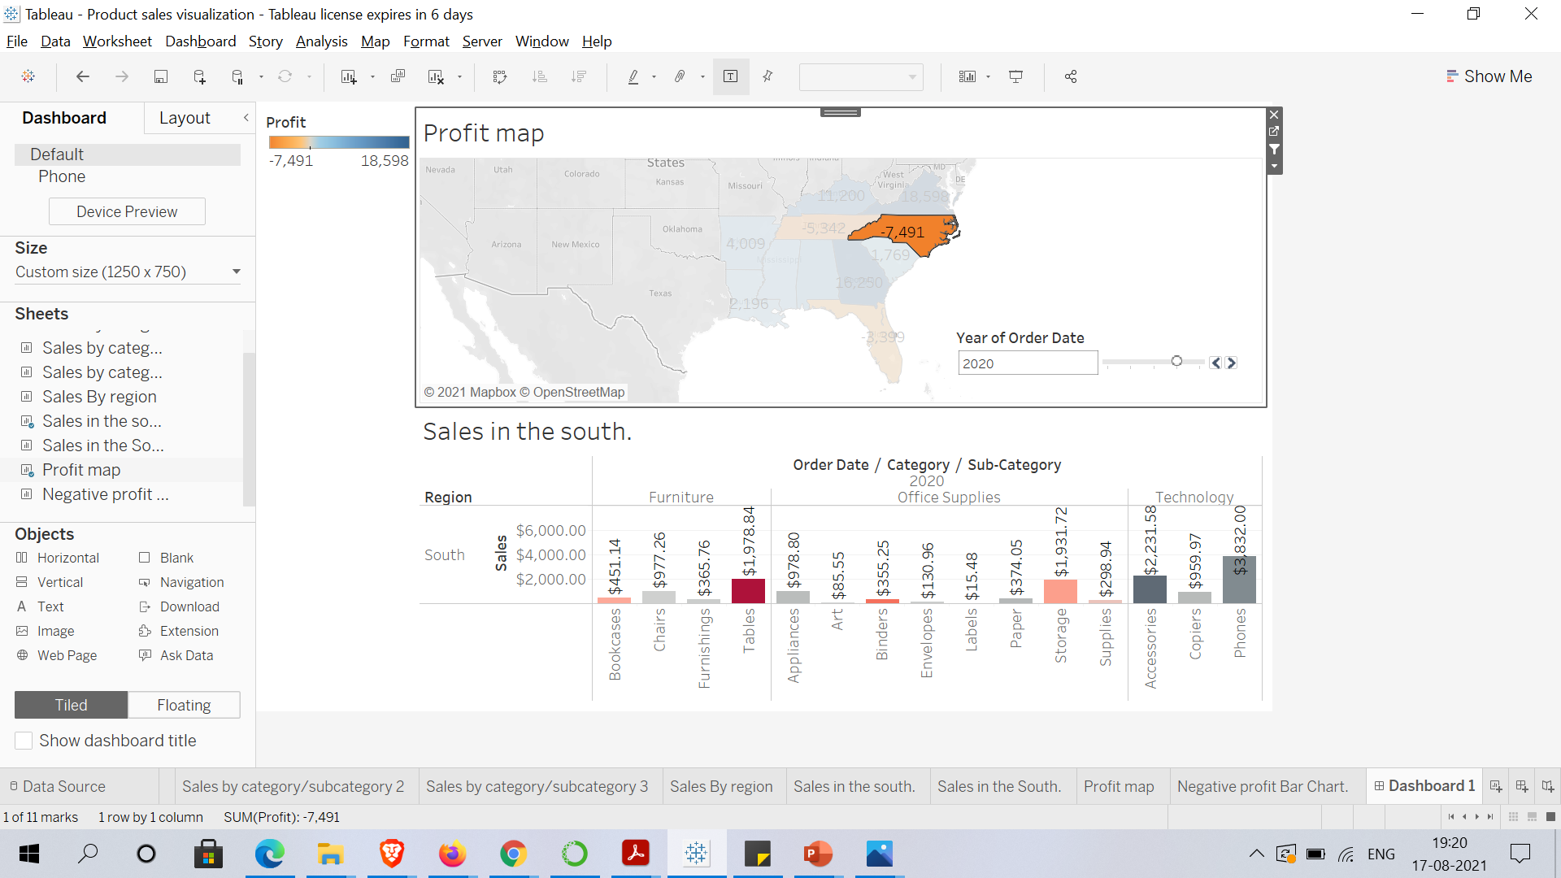
One by one click all the states in the profit map having negative profit and check both profit and sales for each state

Slide 10
Provide all the details about the product which is having highest negative profit in North Carolina.

