Slide 1
WEB DEVELOPER
Custom webpage , websites AND PORTFOLIO MAKER

Slide 2
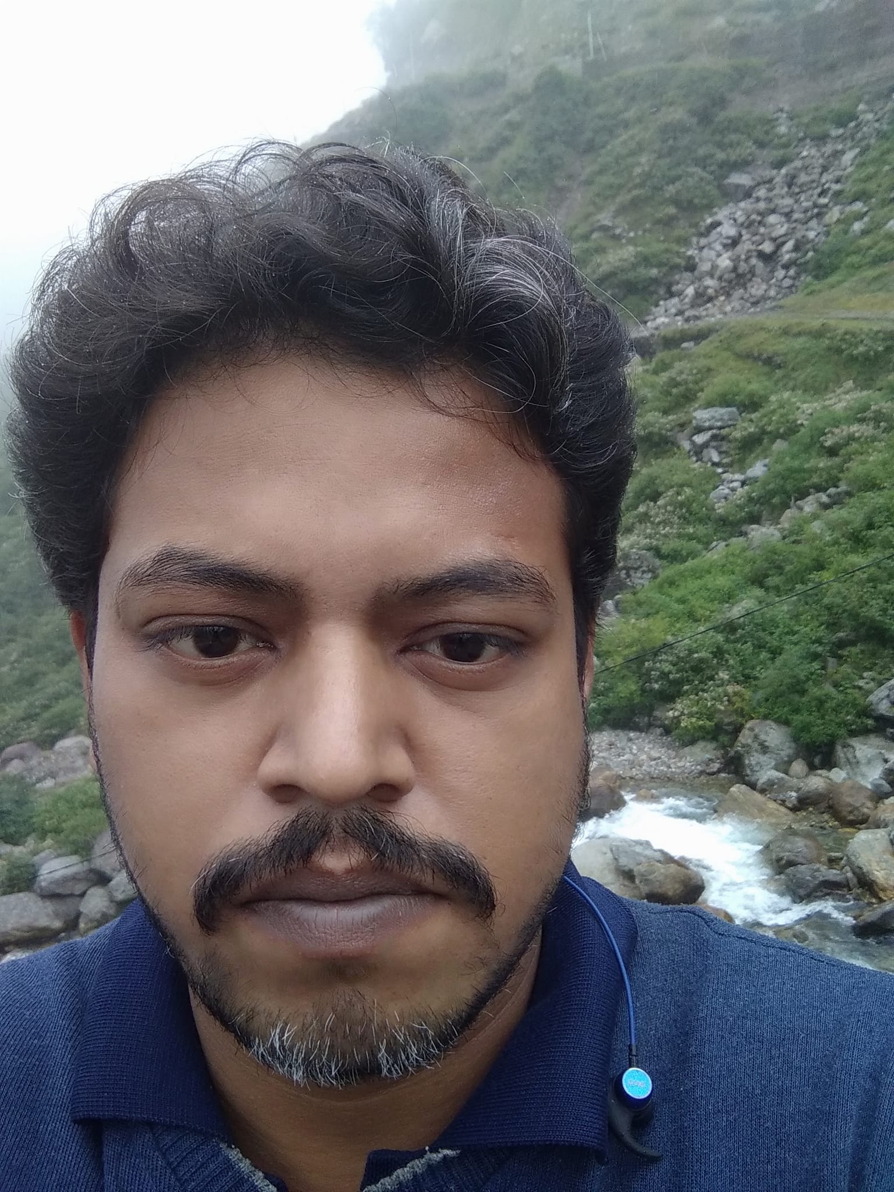
TUSHAR DEBNATH

Slide 3
EDUCATION
# SECONADRY – 1ST CLASS,2004
# HIGHER SECONADARY – 1ST CLASS,2006
# DIPLOMA IN COMPUTER SC & TECHNOLOGY – 1ST CLASS ,2012
# BACHELOR IN COMPUTER SCIENCE & TECHNOLOGY – 1ST CLASS,2024

Slide 4
WORK EXPERIENCE
# MORE than +13 YEARS OF EXPERIENCE IN ONLINE Assessment sector as a network administrator/exam co-Ordinator/EXAM CONTROLLER.
# 1K PROJECT SUCCESSFULLY CONDUCTED AS A EXAM CONTROLLER.
# more than + 3 years of experience in webSITE designER as a freelancer .

Slide 5
skills
# networking
# html5
# css3
# java script
# bootstrap
# git hub
# OTHER CMS

Slide 6
project
Link: “https://tushar-700.github.io/SONARBANGLAK/”

Slide 7
Strength & weakness
# weakness: seo part of a website, react.js and other js part, backend technology.
# strength: html5,css3,webhosting using git repository, making of website using CMS/ bootstrap.

