Slide 1

Mahatma Education Society Pillai HOC College of Engineering and Technology, Diploma Section - 1148, Rasayani.
Presentation on :- Web Scraping Using Python
Department of Computer Engineering
Under Guidance:
Mr. Sagar Mhatre
Presented By
Tushar Bhagwat

Slide 2
Introduction about Decode Tech Industry
Dcodetech” established in 2016. Dcodetech is a career and educational network for professionals and professional development. We offers a quality learning experience in the areas of IT training. Dcodetech’s focus is on providing advanced training and certifications in all technologies. We provide training for PYTHON, DATA SCIENCE, MACHINE LEARNING, DATA ANALYTICS, ARITIFICIAL INTELIGENCE, ORACLE, IOT, DIGITAL MARKETING, .NET, JAVA, PHP, IOS, ANDROID etc.

Slide 3
Overview
Abstract
Introduction of project
Tools and Technology used
Methodology
Working Of Project
How I made this Project
Output and Conclusion

Slide 4
Abstract
Web scraping is used by various arenas to gather data not effortlessly obtainable in other formats. It is a valuable tool even for just a casual programmer. If we require to check our latest homework assignments on our university page and have them emailed to us. WEB SCRAPING targets particular information on the pages visited or deny permissions of an installed application.

Slide 5
What is Web Scrapping?
Web scraping is an automatic method to obtain large amounts of data from websites. Most of this data is unstructured data in an HTML format which is then converted into structured data in a spreadsheet or a database so that it can be used in various applications. There are many different ways to perform web scraping to obtain data from websites. These include using online services, particular API’s or even creating your code for web scraping from scratch. Many large websites, like Google, Twitter, Facebook, StackOverflow, etc. have API’s that allow you to access their data in a structured format. This is the best option, but there are other sites that don’t allow users to access large amounts of data in a structured form or they are simply not that technologically advanced. In that situation, it’s best to use Web Scraping to scrape the website for data.
.

Slide 6
Introduction Of Projectoduction of project
Web Scrapping extracts the data from websites in the unstructured format. It helps to collect these unstructured data and convert it in a structured form.
Startups prefer web scrapping because it is a cheap and effective way to get a large amount of data without any partnership with the data selling company.
There are other popular programming languages, but why we choose the Python
over other programming languages for web scraping? Below we are describing a list of Python's features that make the most useful programming language for web scrapping.

Slide 7
Tools and Technology used
Language- Python
Additional Libraries- Beautiful Soup4(bs4), Pandas.
Software- Microsoft Excel
Software for Coding- Visual studio and Jupyter Notebook

Slide 8
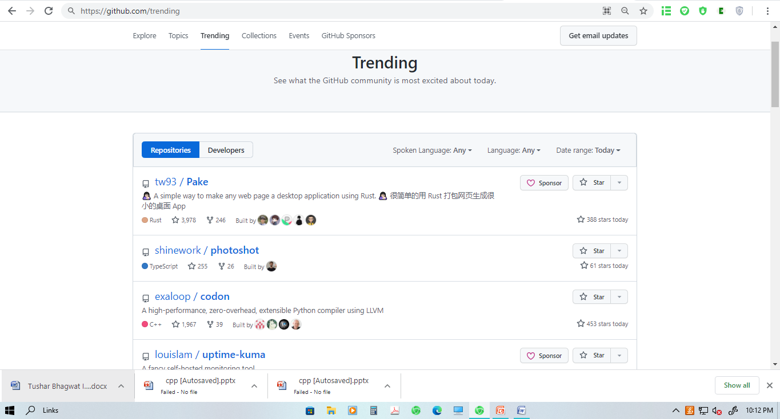
Methodology
In my project, we developed a program for scraping datas from Github Repositories. We successfully scrap the data such as username, repository name, rating(stars) and its url.

Slide 9
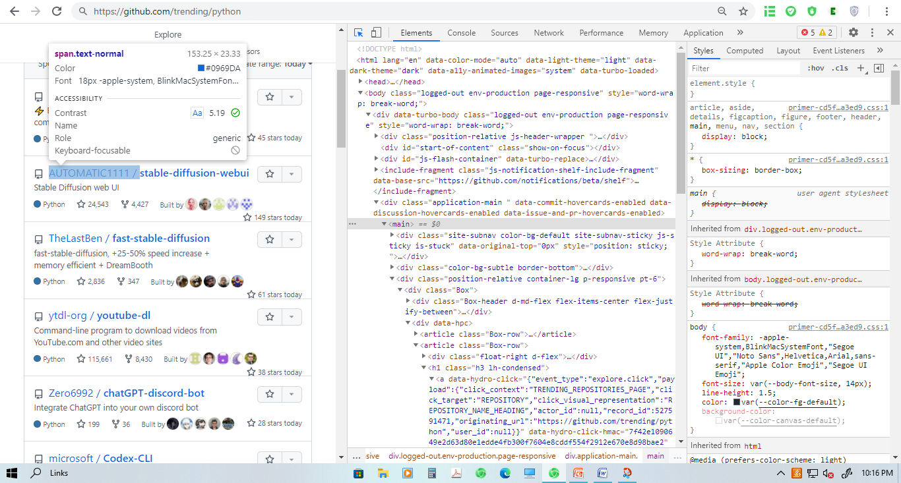
WORKING OF PROJECT

Slide 10
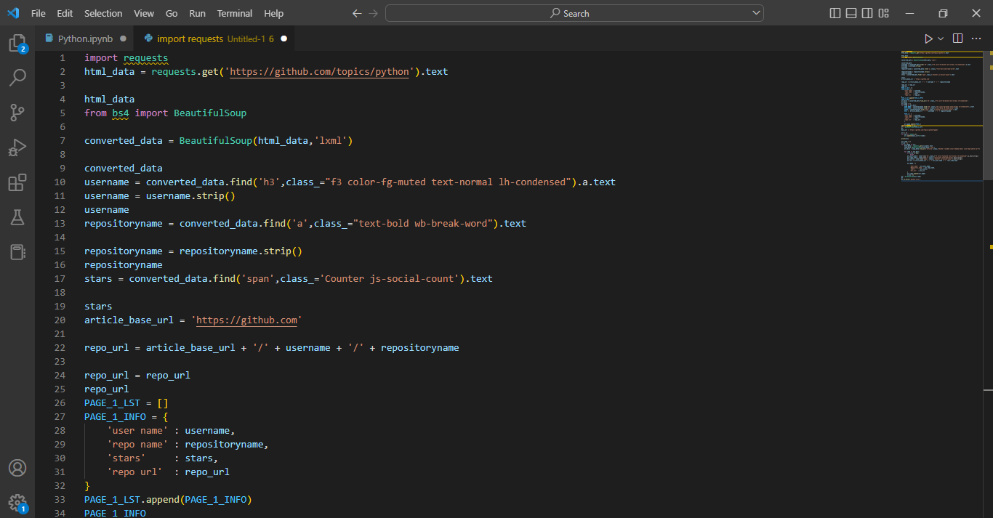
WORKING Of PROJECT
4
5

Slide 11
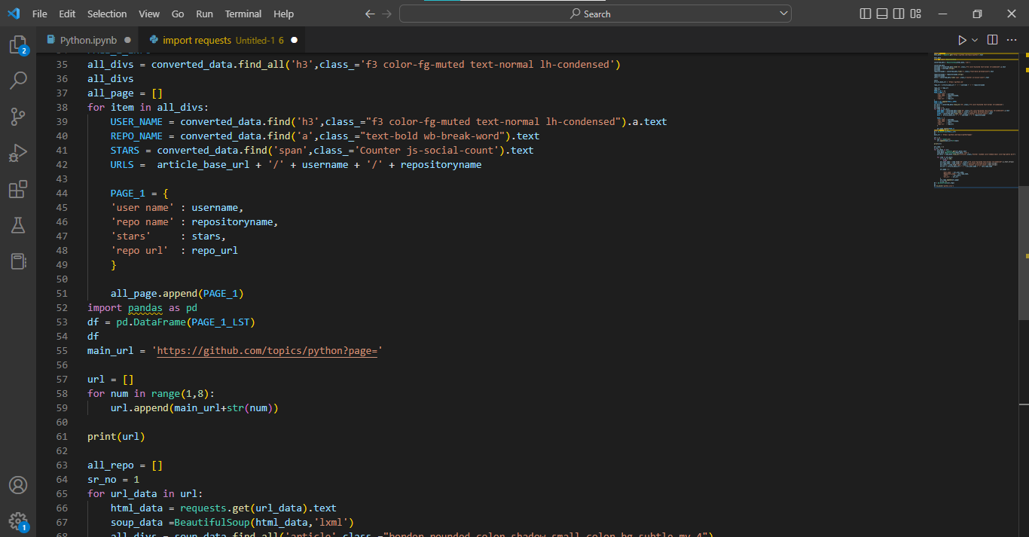
WORKING Of PROJECT

Slide 12
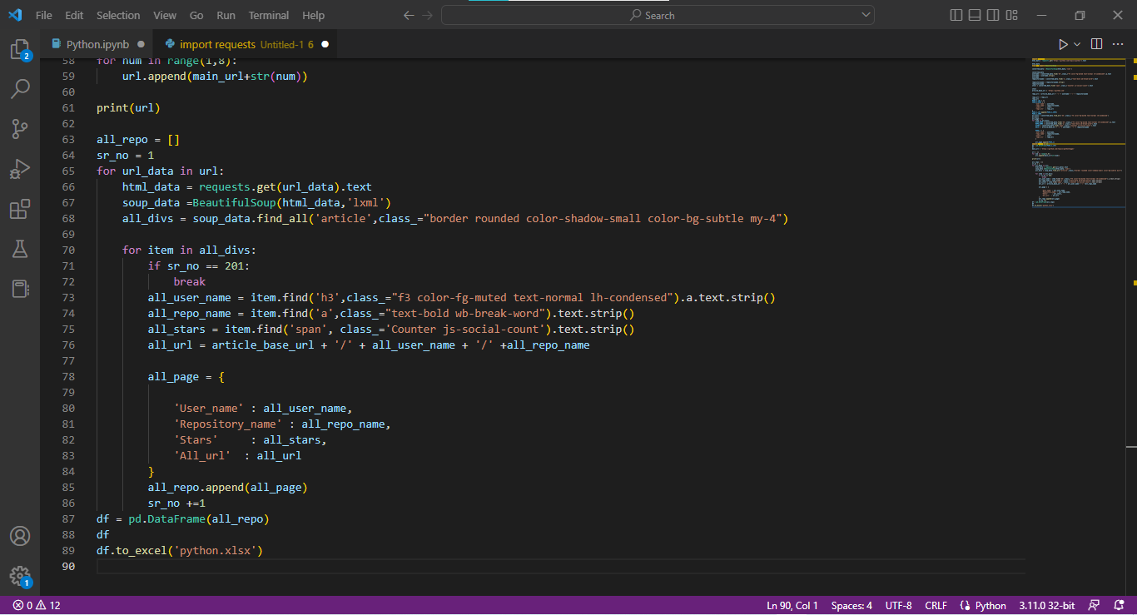
WORKING Of PROJECT

Slide 13
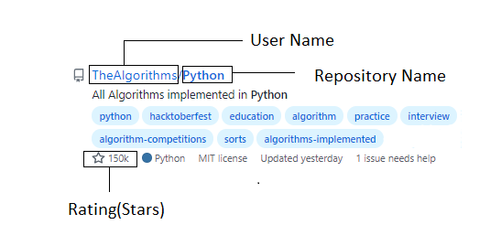
Steps

Slide 14
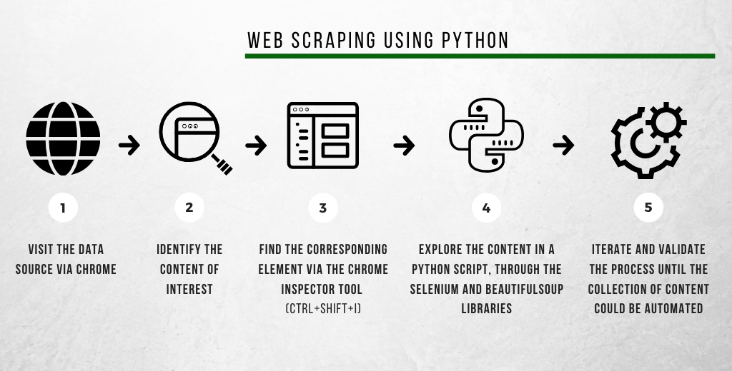
Steps

Slide 15
How I Made This Project
I use some popular libraries for making this project. They are Beautiful Soup4, pandas etc.
I use html part from the website using inspect element.
I create a code than accept request from website for scraping data, such as repository name, username, stars(rating) and Links.
I convert the raw part of website into html. And started working on single data to scrap as mention above in point 3
I create a code that send all scraped data in excel sheet.
And Excel sheet are ready to use neatly and well professional.

Slide 16
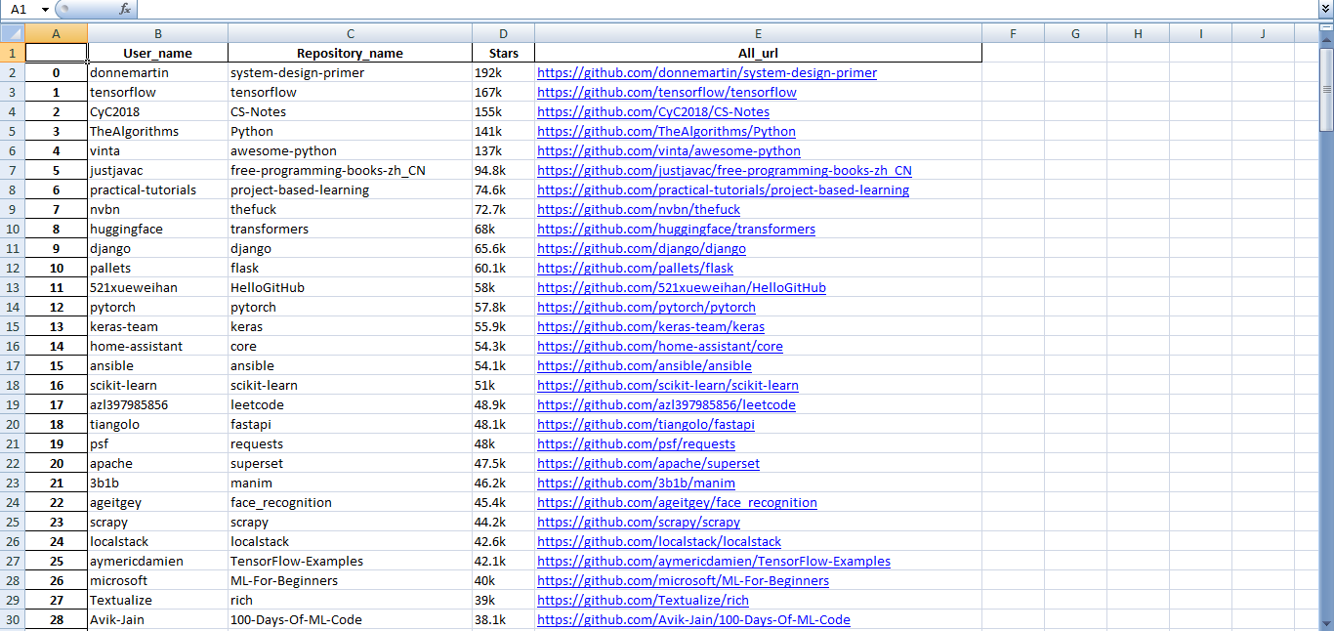
Output

Slide 17
Conclusion
The projects we developed during our training period were really helpful and helped us improve our skills and learn new language.
I have successfully completed 6 weeks industrial training in the start of 3rd year. I gained Industrial experience apart from regular academic activities. During this session of industrial training, I completed all tasks assigned to me and also planned and executed project assigned to me.

Slide 18
Thank you

