Slide 1

Mini weather station
Cse’299 (Junior Design)
Group -03
Faculty- Intisar tahmid nahin

Slide 2
Weather station
This is the first generation of Arduino based mini-weather station with Wi-Fi connection, which is able to post data publicly on the website that we have created.

Slide 3
Types of data:
1. Temperature (dht11 sensor)
2. Humidity (dht11 sensor)
3. Atmospheric pressure (bmp 180)
4. Air quality(mq135)
5. Rain(water sensor)

Slide 4
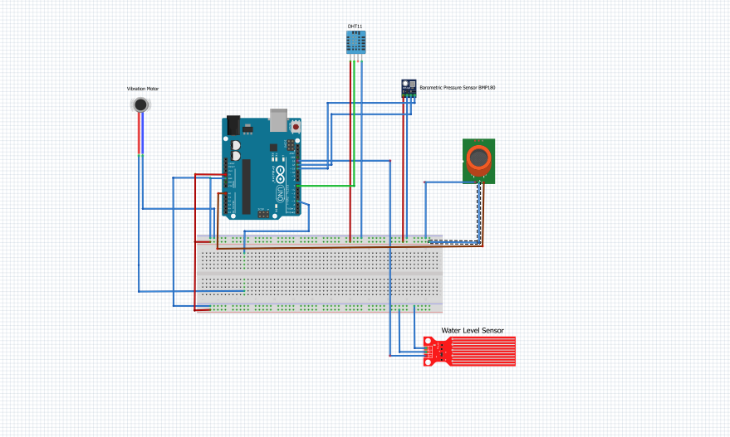

Slide 5
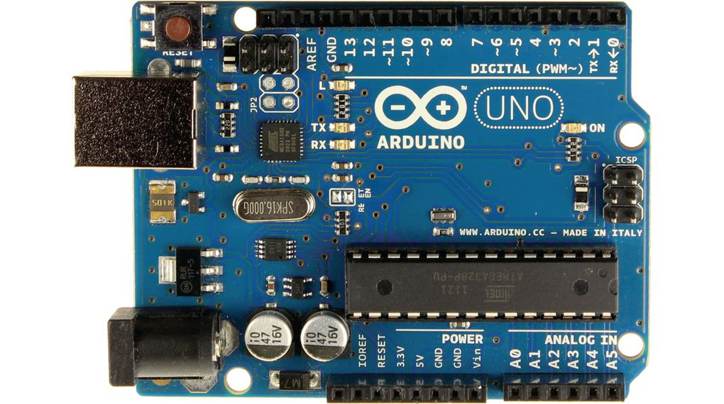
Arduino Uno
Arduino Uno is a microcontroller board based on the ATmega328P (datasheet). It has 14 digital input/output pins (of which 6 can be used as PWM outputs), 6 analog inputs, a 16 MHz quartz crystal, a USB connection, a power jack, an ICSP header and a reset button. It contains everything needed to support the microcontroller; simply connect it to a computer with a USB cable or power it with a AC-to-DC adapter or battery to get started

Slide 6
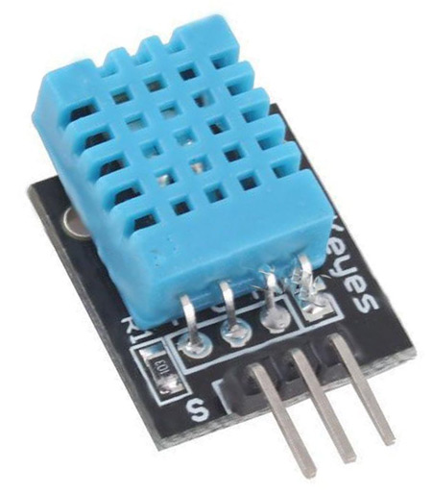
Temperature and humidity(dht11)
For measuring humidity we used the humidity sensing component which has two electrodes with moisture holding substrate between them. So as the humidity changes, the conductivity of the substrate changes or the resistance between these electrodes changes. This change in resistance is measured and processed by the IC which makes it ready to be read by a microcontroller.

Slide 7
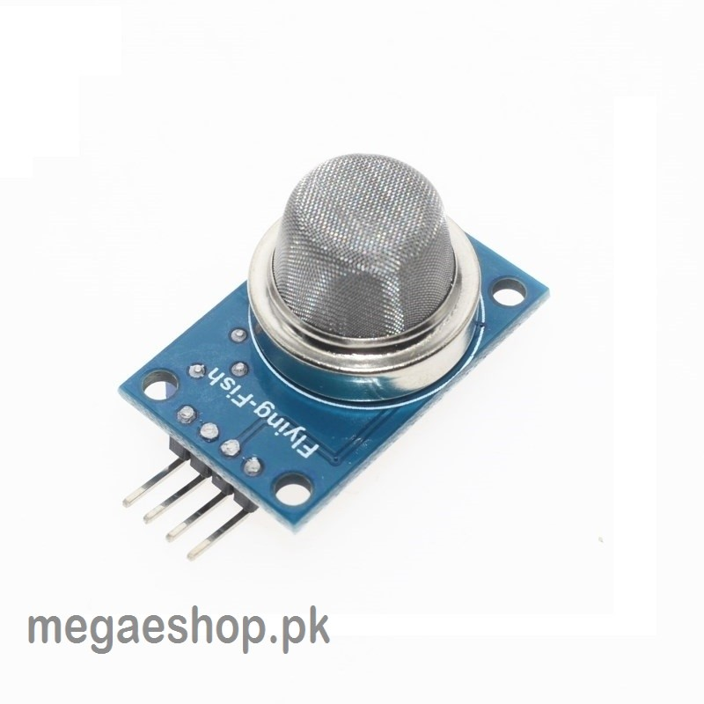
Air quality (mq135)
The gas sensor module consists of a steel exoskeleton under which a sensing element is housed. This sensing element is subjected to current through connecting leads. This current is known as heating current through it, the gases coming close to the sensing element get ionized and are absorbed by the sensing element. This changes the resistance of the sensing element which alters the value of the current going out of it.

Slide 8
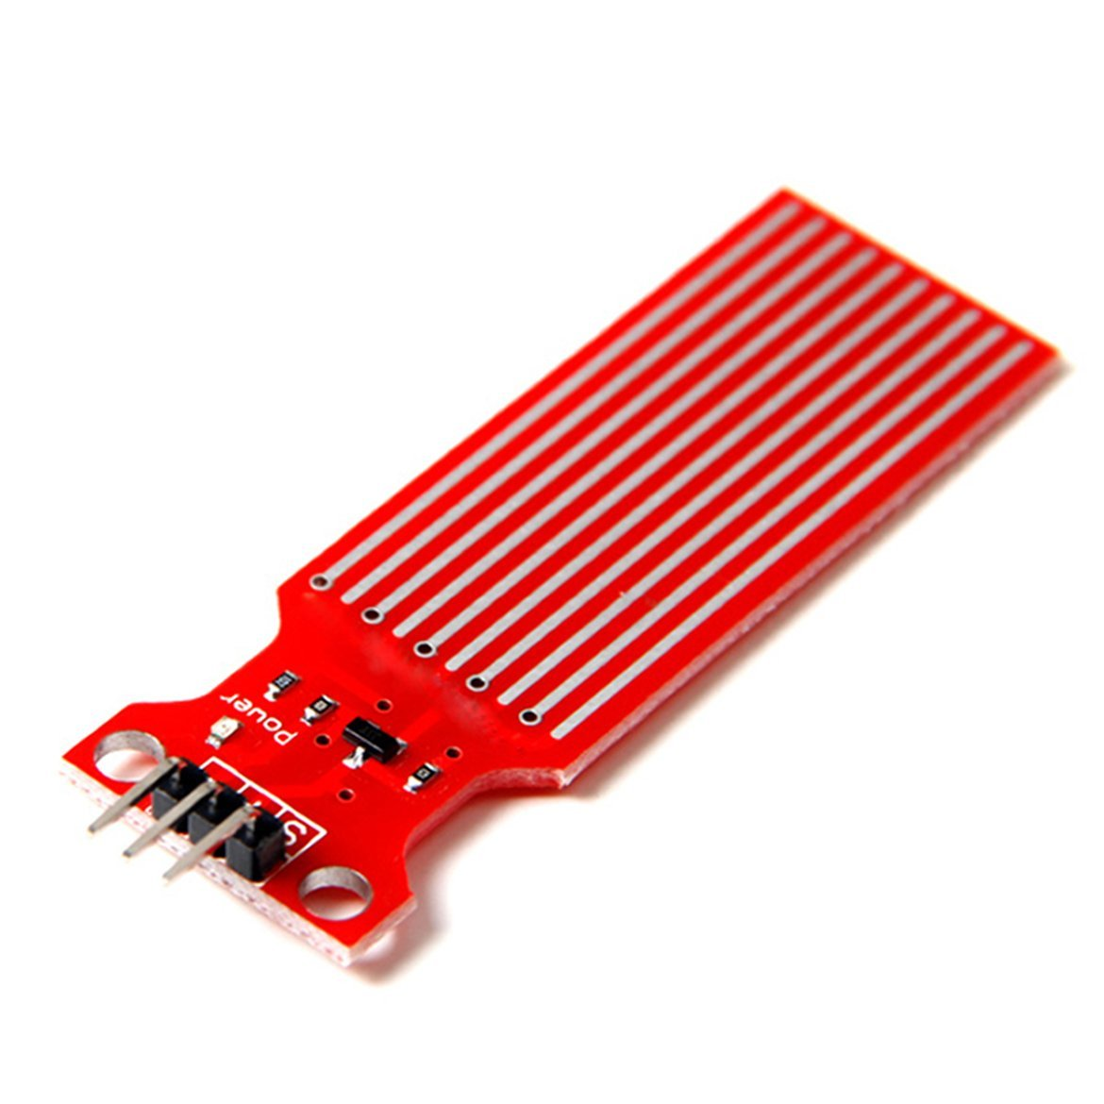
Water sensor:
Water sensor has 3 pins one is ground one is vcc and the other is analog data pin. It’s analog range is 480 to 705. we converted this raw number 00 to 40mm in order to calculate.

Slide 9
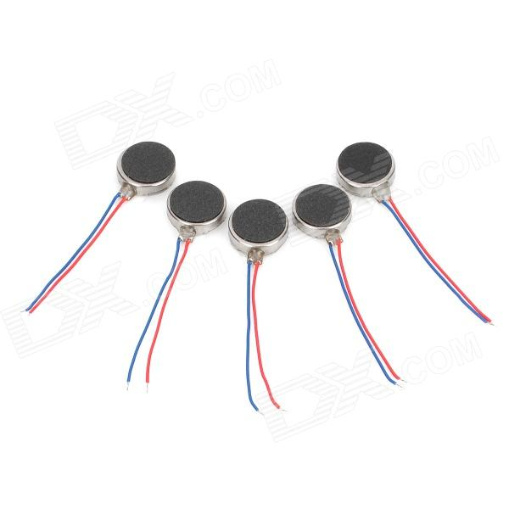
Coin vibration motor
At only 7 mm in diameter and 2.1 mm thick, Jinlong Machinery’s C0720B series is currently the smallest coin vibration motor on the market . Versions with foam pads and without adhesive are also available. It was designed for devices requiring vibration alerts or haptic feedback. Because it produces a relatively low vibrational force of 0.4 G, this motor is best suited for use in light weight devices placed directly against the user’s skin. The motor has an operating voltage range of 2.7 to 3.3 V_{DC}.

Slide 10
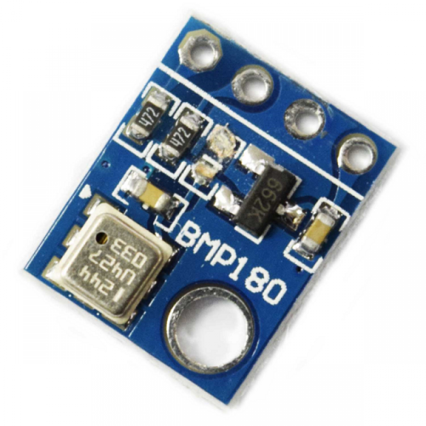
Pressure sensor (bmp 180)
The definition of pressure is a force "pressing" on an area. A common unit of pressure is pounds per square inch (psi). One pound, pressing on one square inch, equals one psi. The SI unit is newtons per square meter, which are called pascals (Pa).

Slide 11
Our aim:
Weather is the part and parcel in our day to day life. We all need the day to day update of the weather. This can be very beneficial for many who depend on weather information as part of their everyday lives like farmers, outdoorsy types and many weather enthusiasts . Our aim was simple , to make a mini weather station using the sensors at an affordable price .

Slide 12
The FAULTS!!
The sensors that were faulty are:
1. wifi router(Esp8266)
2.pressure sensor
3. coin vibration

Slide 13
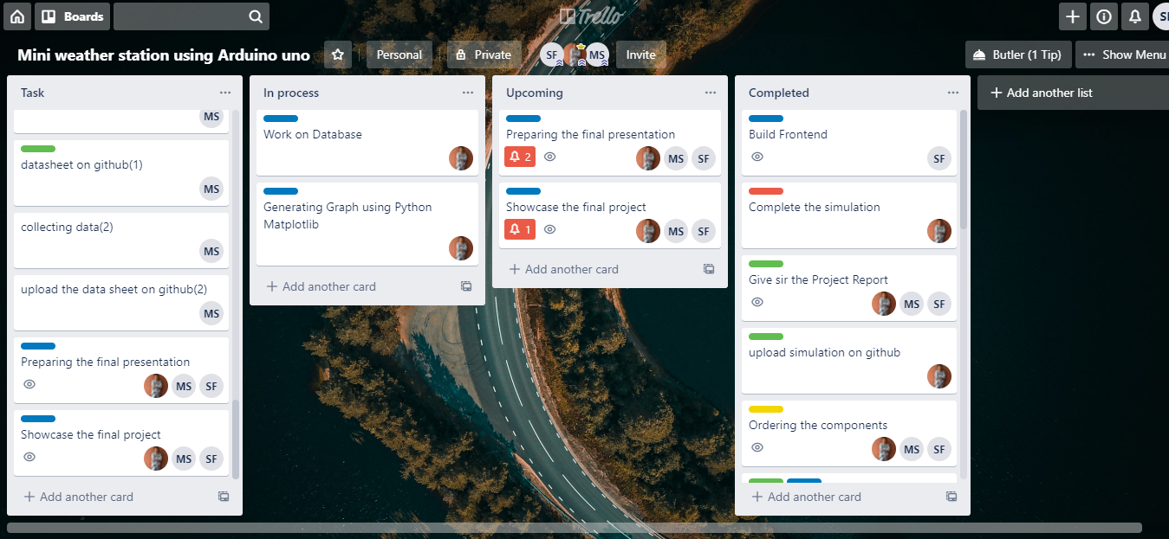
Trello board (updated on 21st December)

Slide 14
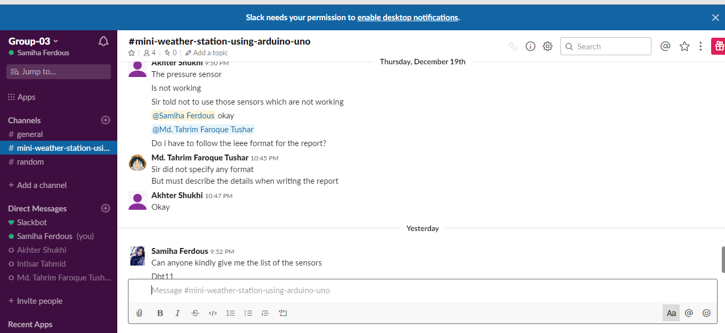
Slack (updated on 21st December)

Slide 15

Github (updated on 21st December)

Slide 16
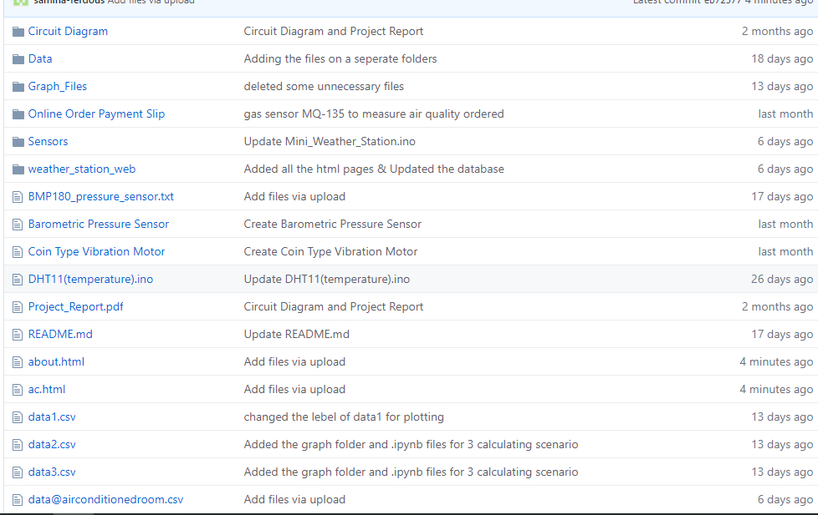
Github files(updated on 21st December)

Slide 17
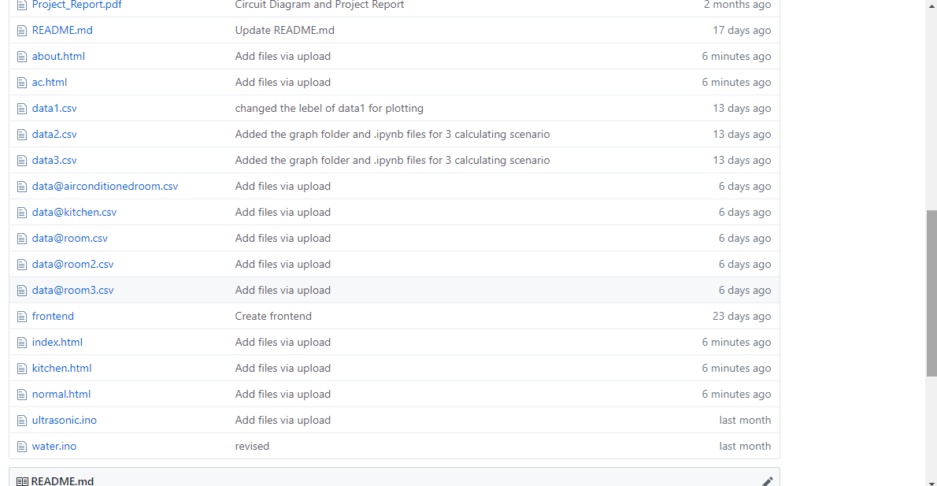
Github files (updated on 21st December)

Slide 18
Work distribution:
Integrating circuit | Tushar, Samiha, Momena
Code for dht11 and water sensor | Samiha
Code for coin type vibration and pressure sensor | Momena
Code for gas,mq135 and wifi module | Tushar
Collecting data | Momena
Frontend | Samiha
Backend and Database and Data Analysis | Tushar

Slide 19
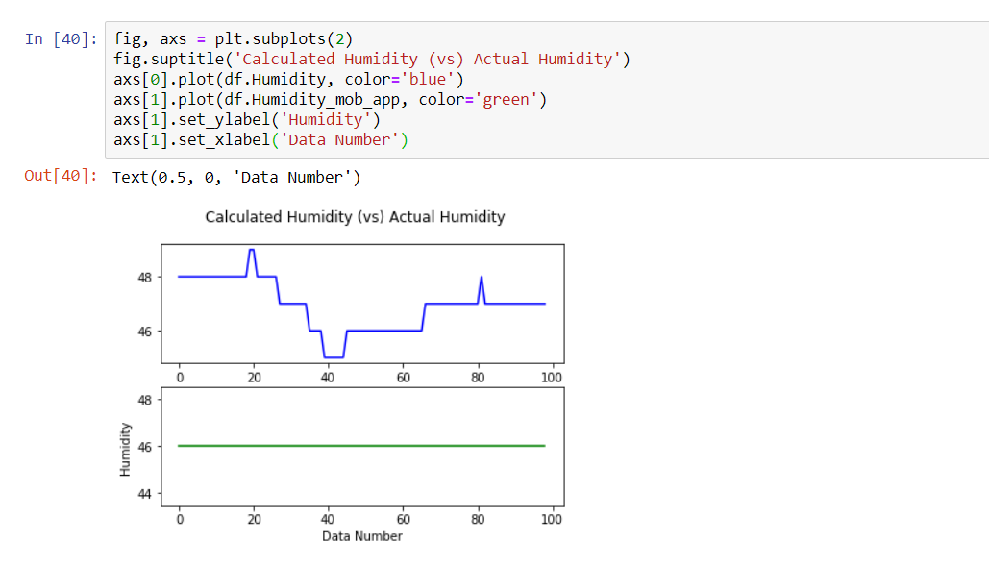
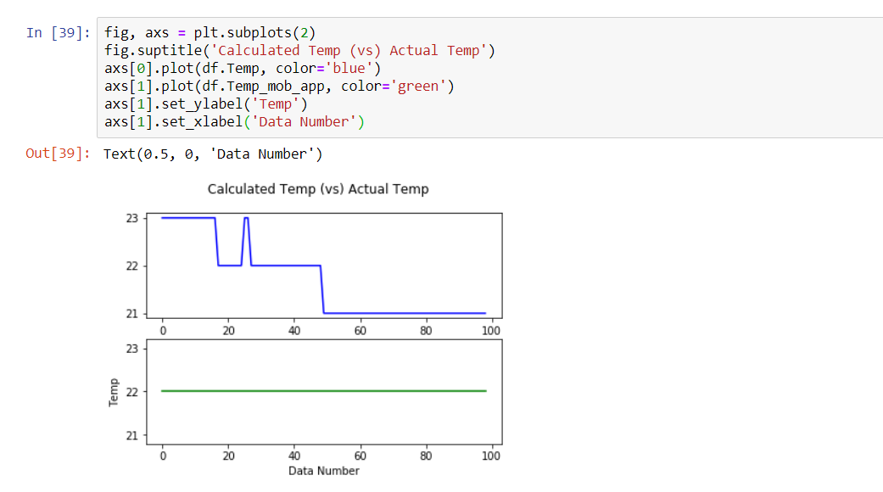
In air conditioned room:

Slide 20
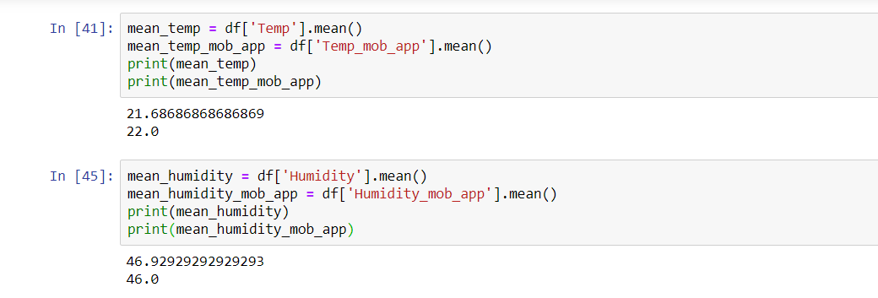
Air conditioned room (average)

Slide 21
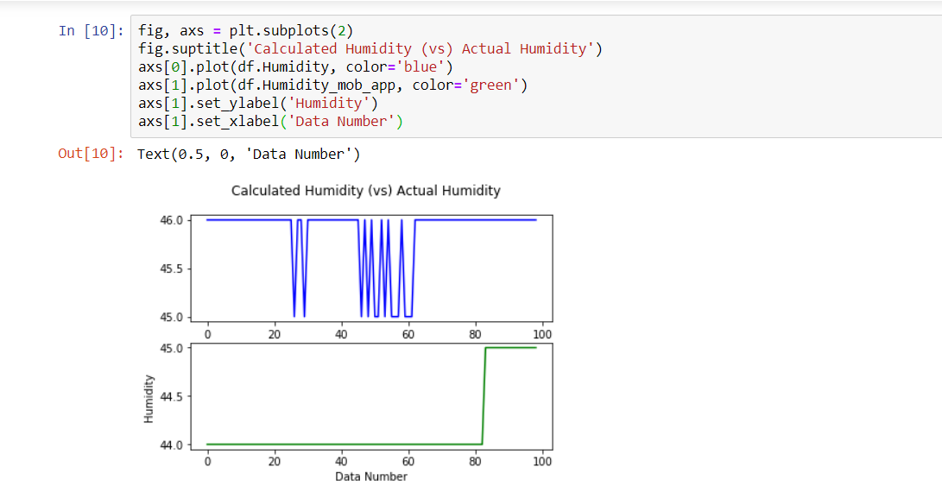
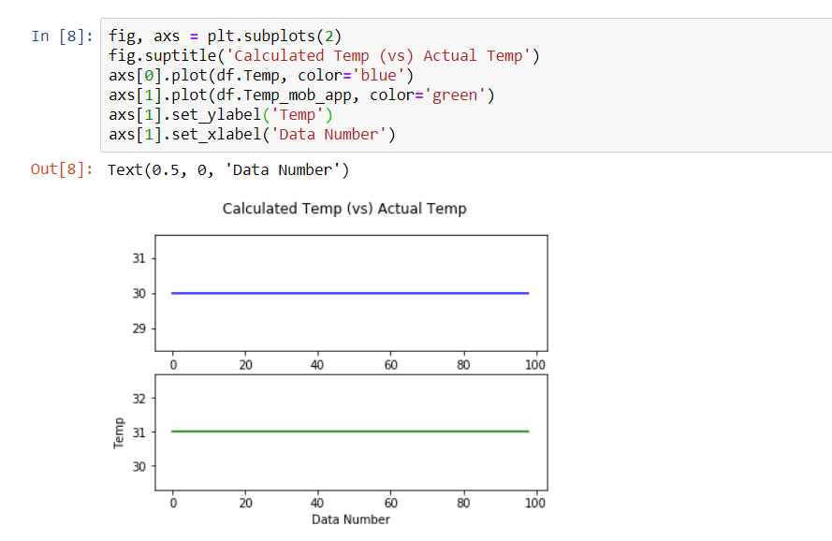
In normal room:

Slide 22
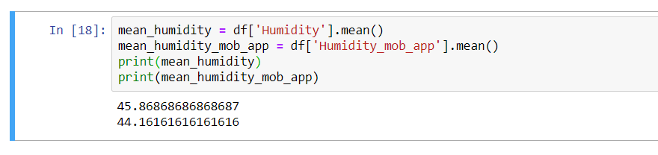
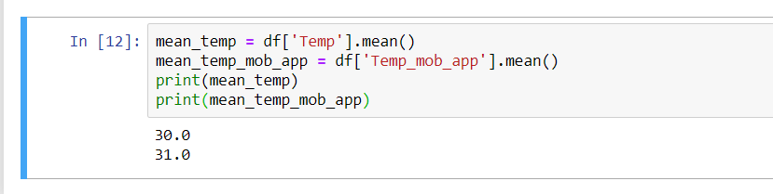
In normal room (average)

Slide 23
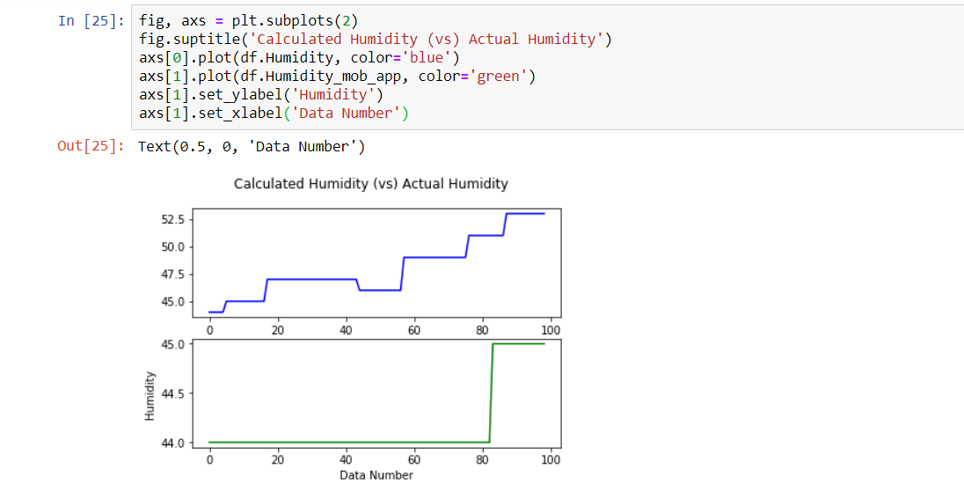
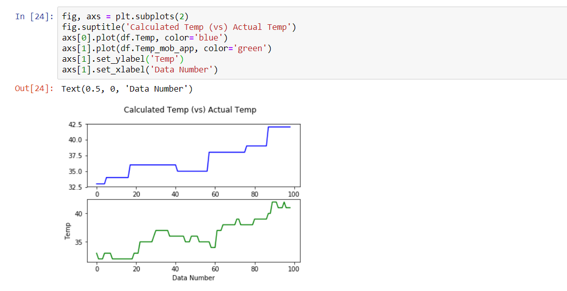
In kitchen :

Slide 24
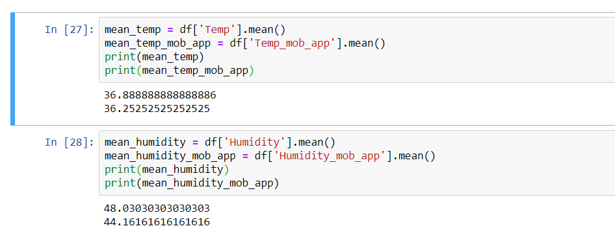
In kitchen (average):

Slide 25
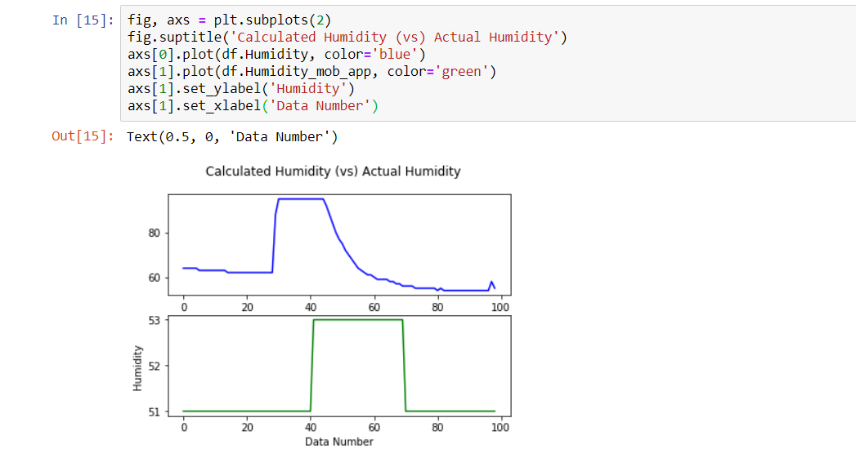
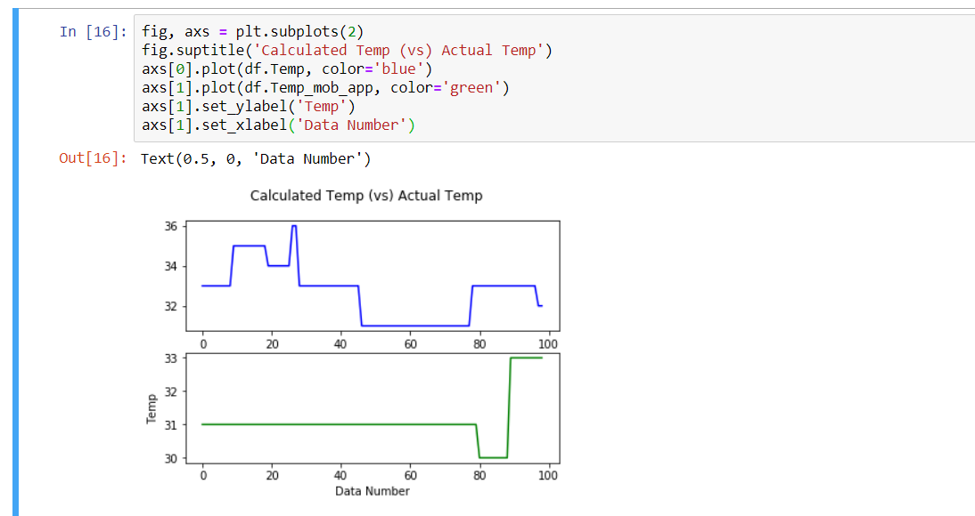
In coil room:

Slide 26
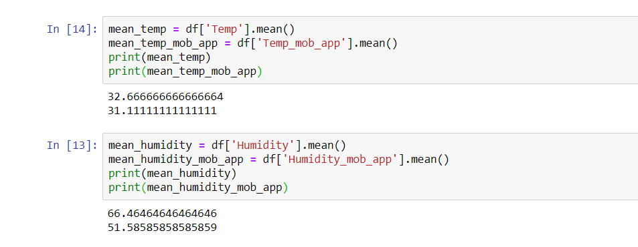
In coil room(average):

Slide 27
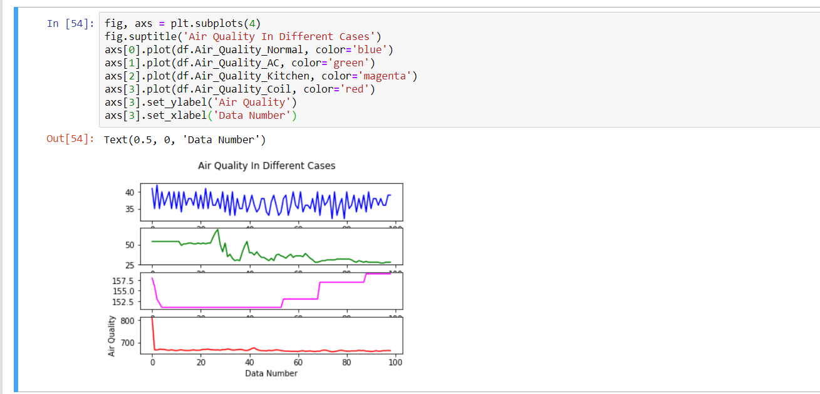
Air quality (in different cases):

Slide 28
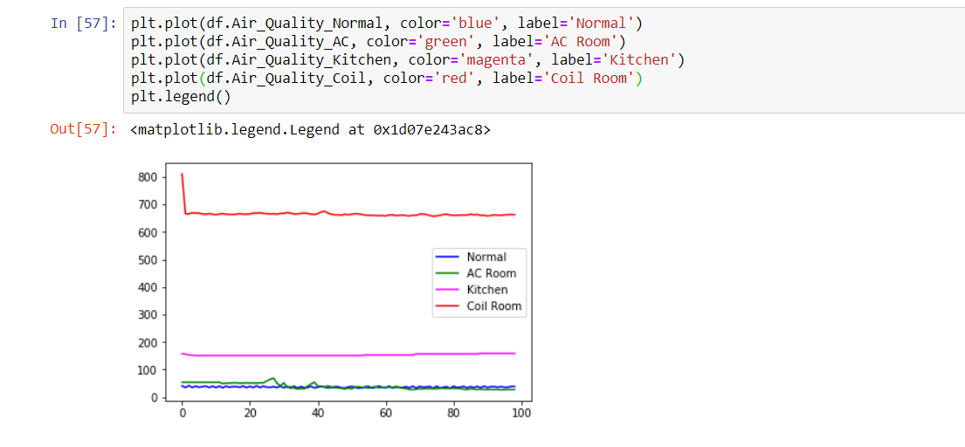
Air quality:

Slide 29
Thank you everyone
Samiha Ferdous (1620834042)
Tahrim Faroque Tushar(1621148642)
Momena Akhter Shukhi (1620763642)

